Slide 1
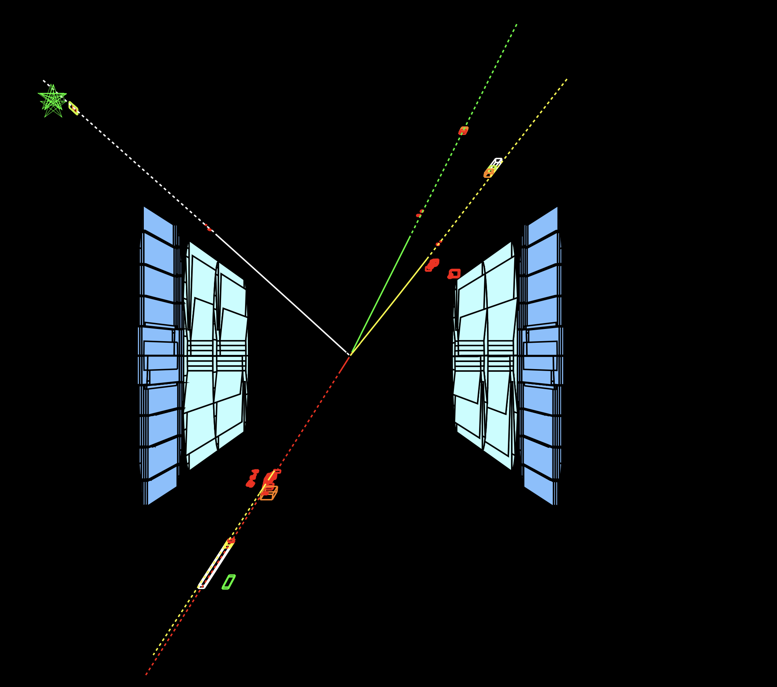
The Making of the
Standard Model
at LEP
Chiara Mariotti
YETI-2021 , 3 July 2021

Slide 2
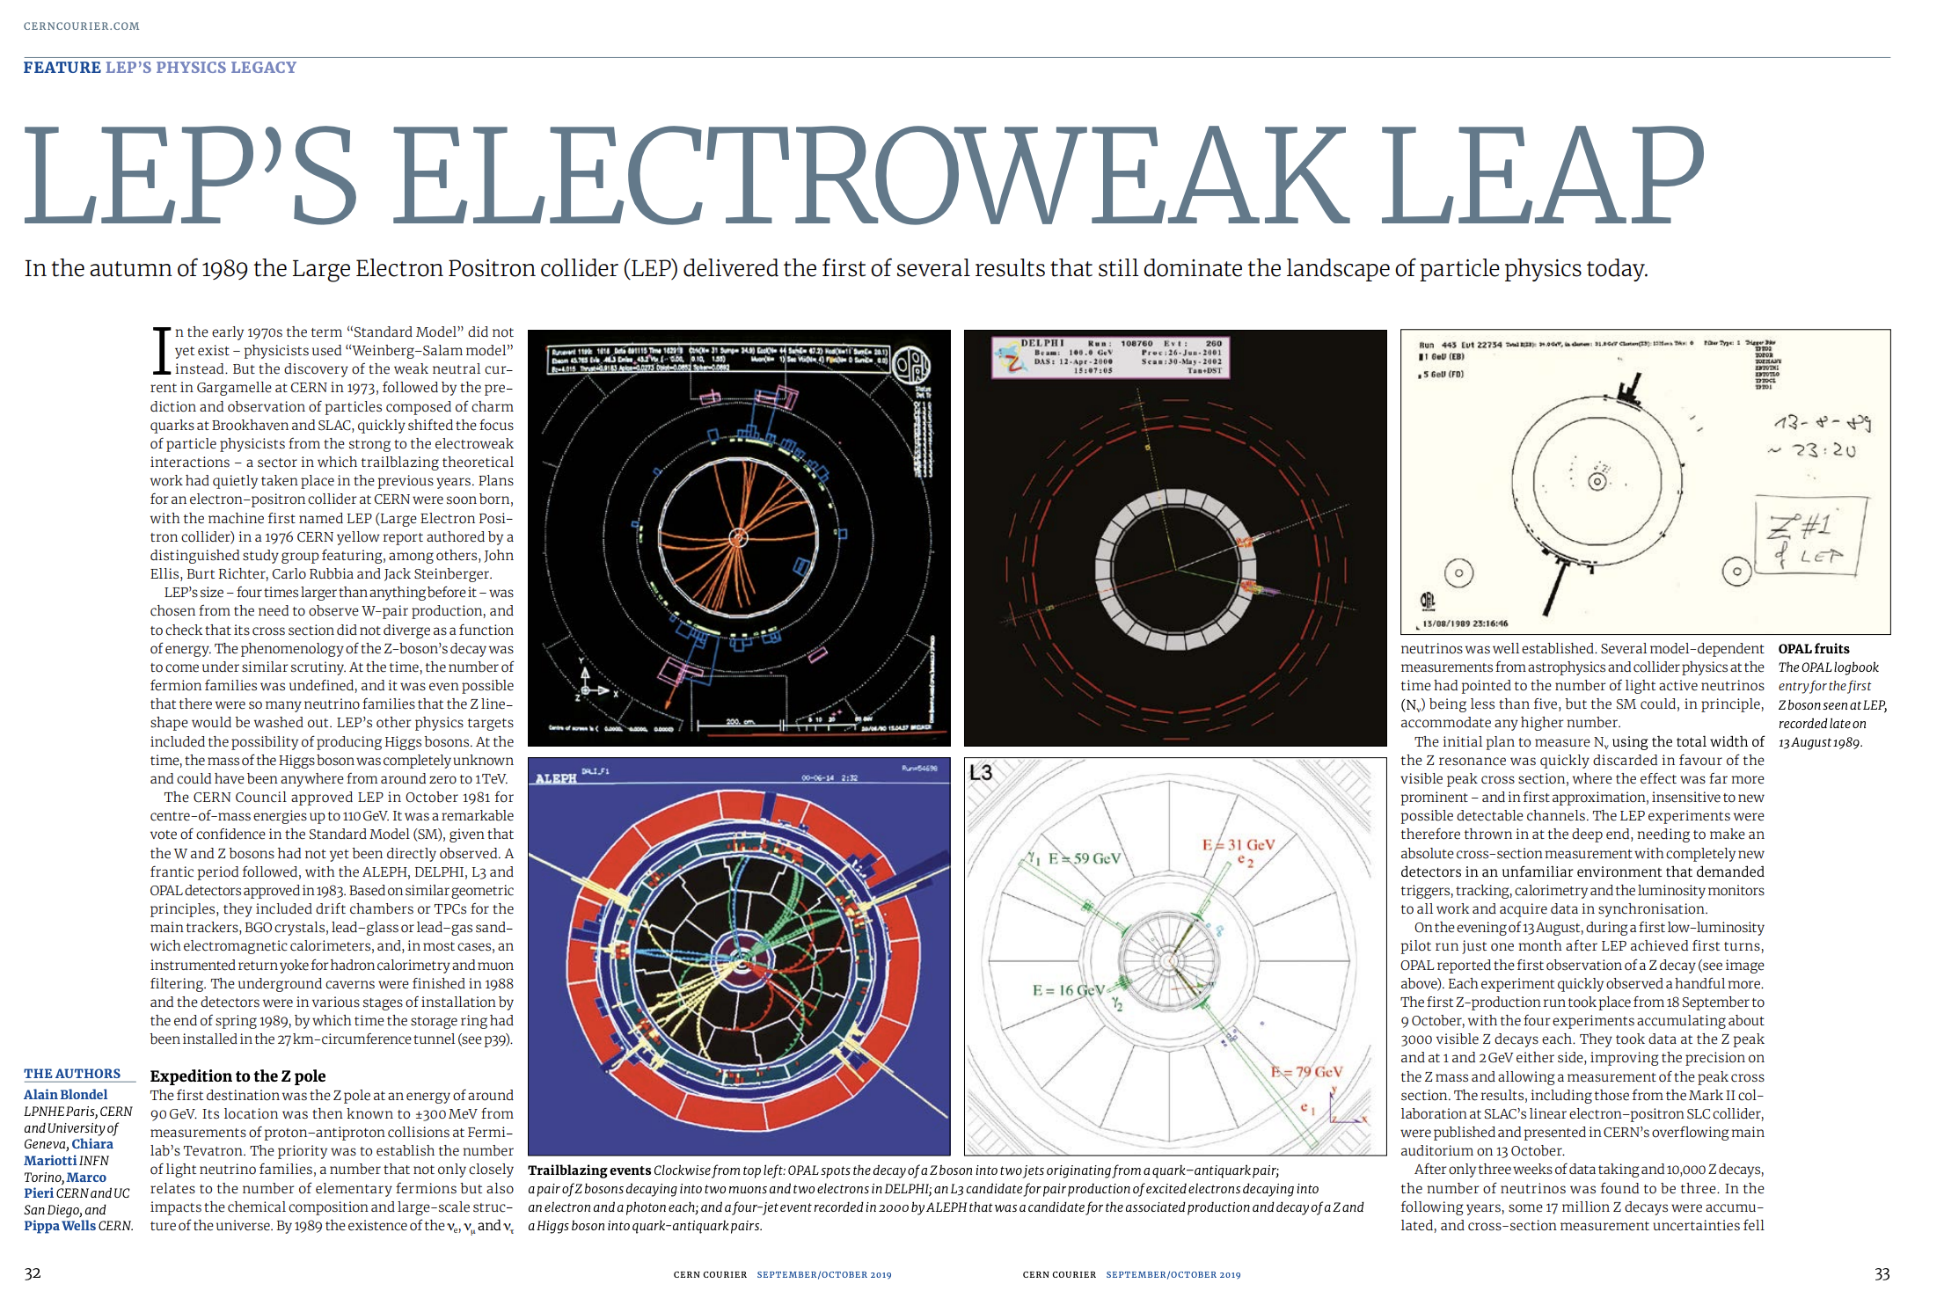
https://cds.cern.ch/record/2689203/files/CERNCourier2019SepOct-digitaledition.pdf

Slide 3
The making of the Standard Model
Introduction
Why LEP
The amazing machine
The results at LEP1
The results at LEP2
And then it was LHC

Slide 4
The SM: a long journey
54 Yang & Mills
61 Glashow
64 Brout, Englert, Higgs et al
67-68 Glashow , Weinberg and Salam
70 ‘t Hooft et Veltman
73 Gargamelle : discovery of the week neutral current
83: Ua1 & UA2: W and Z discovery
89-2000: LEP and HERA: the triumph of the SM
95: Tevatron: top quark discovery
2012: LHC: discovery of a Higgs like boson
Notes:
1954: Yang e Mills definiscono le teorie di Gauge per descrivere le interazioni tra particelle senza massa e i campi (di gauge). La teoria e’ rinormalizzabile (σ non va all’ ∞ per E → ∞ ).
• 1961 Glashow ipotizza che l’interazione elettromagnetica e quella debole siano lo stesso tipo di interazione, ma mediata da 2 propagatori a massa molto diversa.
• 1964 Higgs sviluppa il meccanismo di Higgs per cui da un bosone a M=0 e 2 particelle scalari si ottiene 1 bosone massivo e 1 scalare massivo.
• 1967-1968 Weinberg e Salam combinando le teorie di Yang e Mills, il meccanismo di Higgs e l’ipotesi di Glashow sviluppano la teoria del modello standard delle interazioni elettrodeboli.
• 1970 t’Hooft dimostra che la teoria e’ rinormalizzabile

Slide 5
Once upon a time… LEP
It is hard to remember how little we knew about the
ElectroWeak physics and QCD before LEP started!
LEP did a gigantic leap
as an example:
We did not know how many fermion families there were.
The top was not yet to be seen
The tau-neutrino was not yet observed
The Higgs was not yet discovered
All the quantities were known at the percent level or more →
« any » BSM was possible

Slide 6
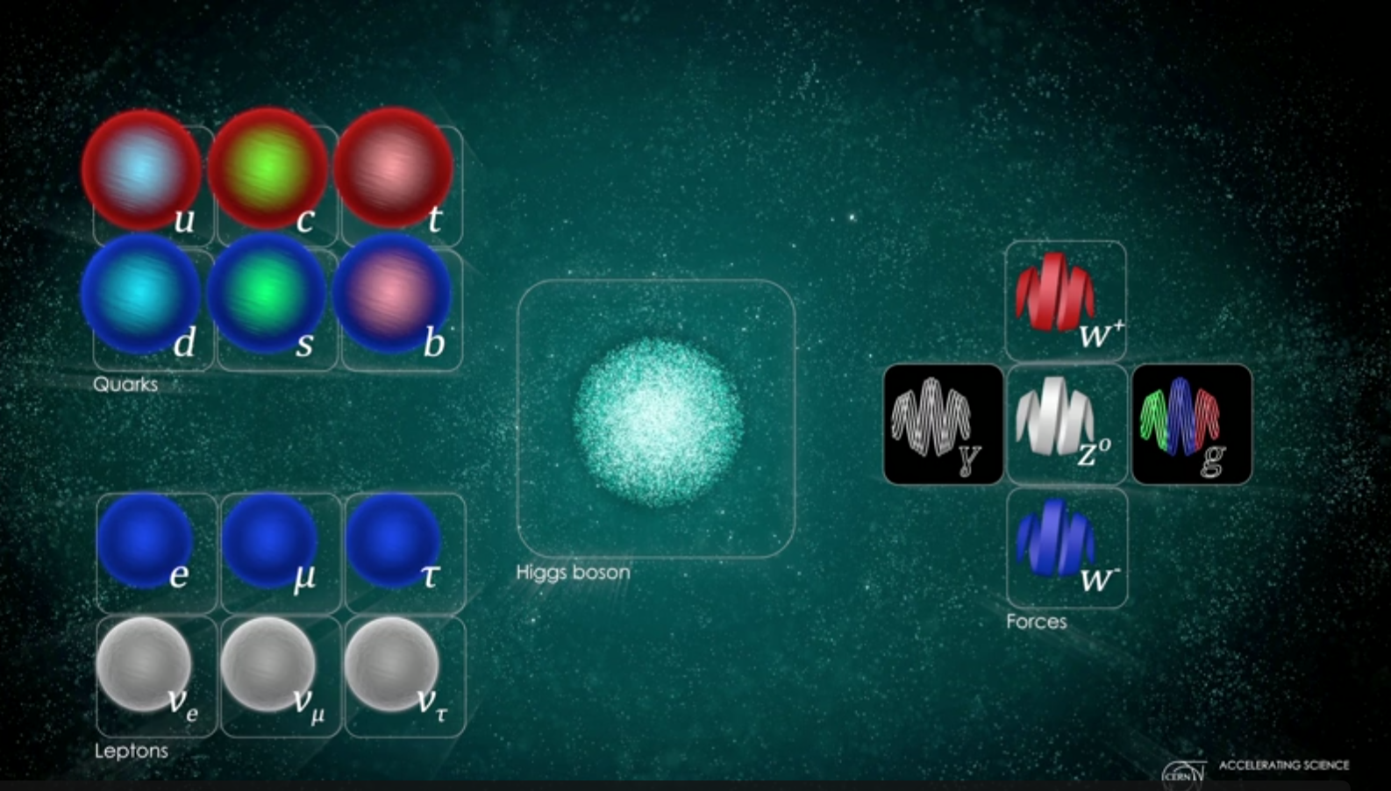
Once upon a time
Charm 1973
UA1/UA2 discovery - 1983
Beauty 1976

Slide 7

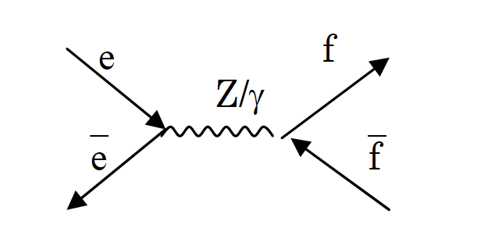
The origin of L.E.P.
After the discovery of the W and Z bosons in 1983 and the measurement of their mass at a few percent in the UA1 and UA2 experiments, the idea of accurately measuring the characteristics of the two bosons as a stringent test of the Standard Model became a "necessity".
LEP: Large Electron Positron collider
The best way to accurately study the characteristics of the W and Z gauge bosons is to produce them at an electron / positron collider.
Why L.E. / e + e-?
the simplicity of the initial state is transmitted to the final state:
e⁺
e⁻
f =e, mu, tau, quark
“Clean” interaction:
E=E(e⁺)+E(e⁻)

Slide 8
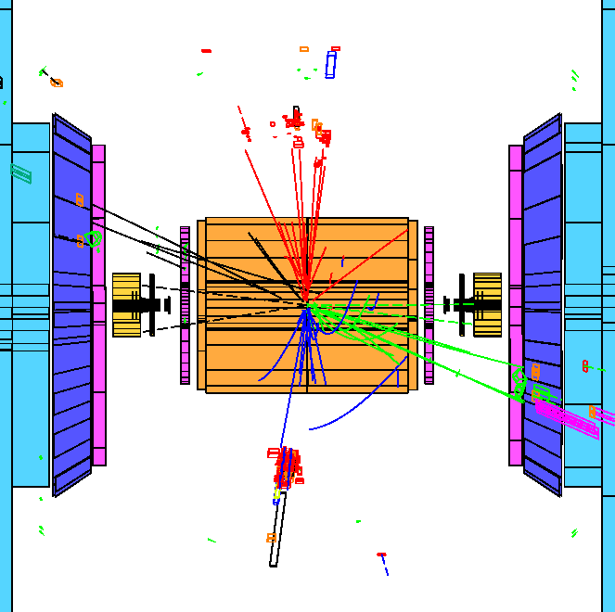
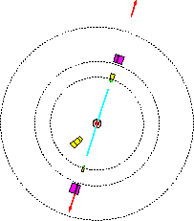
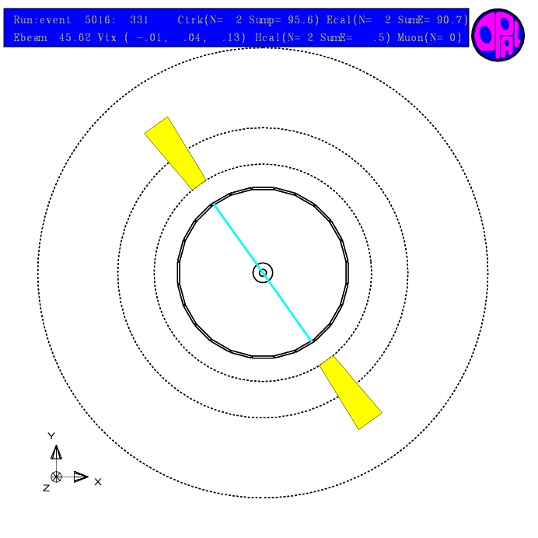
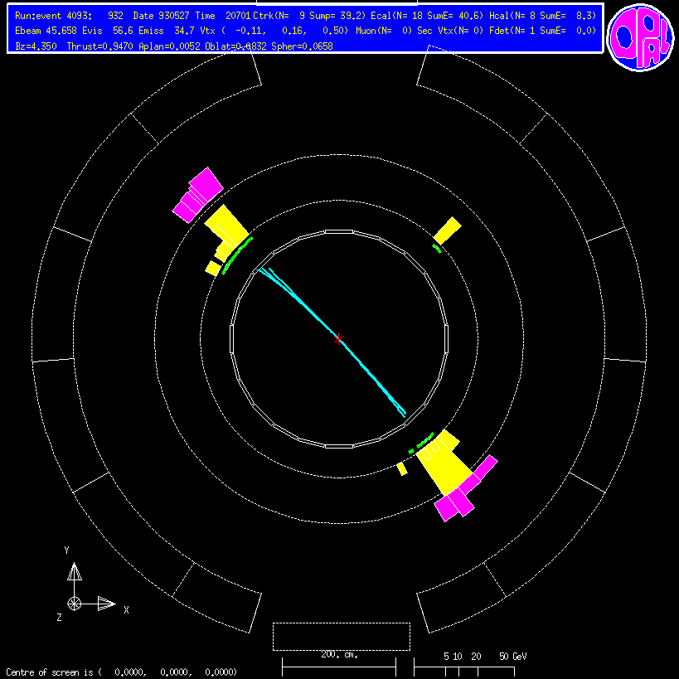
Simplicity in the initial state → simplicity in the final state

Slide 9
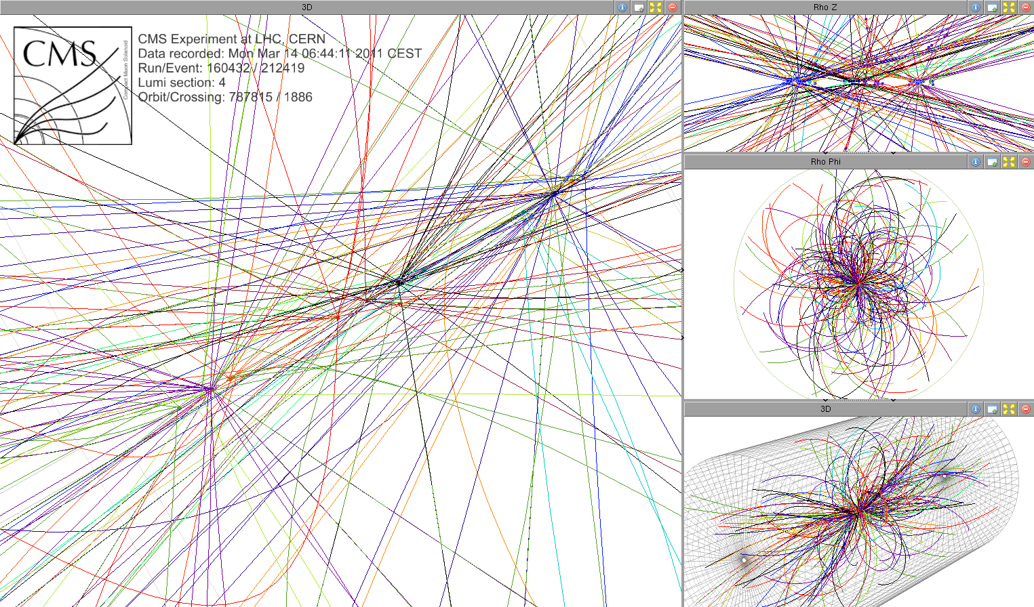
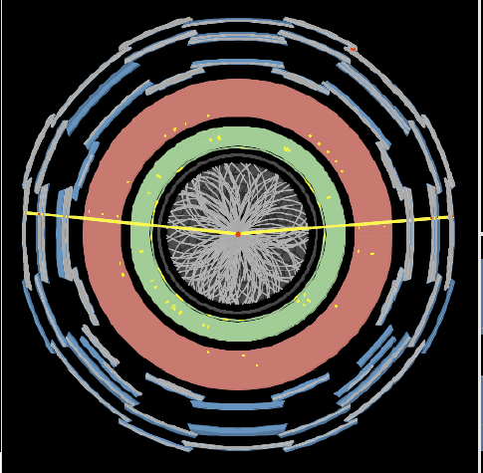
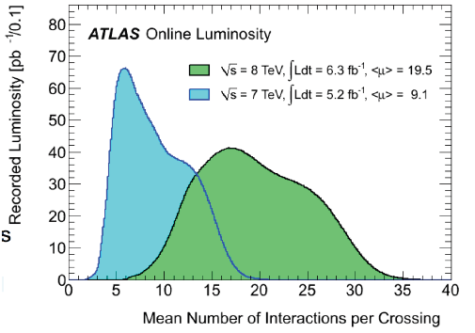
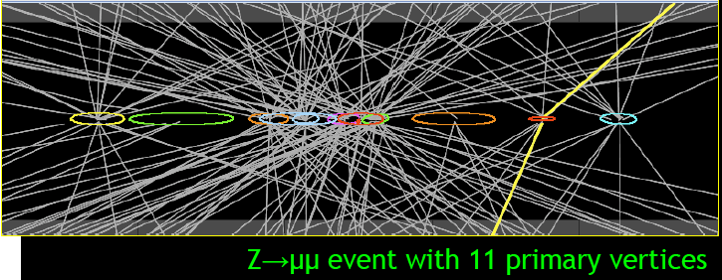
Z → μμ at LHC

Slide 10
L.E.P.
A new electron and positron accelerator was therefore proposed to accurately study the W and Z, determine the number of lepton families, search for the top….
→ accurately measure the parameters of the standard model:
LEP: Large Electron Positron collider
Why Large?
You want to go high energy:
~ 100 GeV (i.e. 50 GeV per beam) to produce the Z (LEP1)
~ 200 GeV (i.e. 100 GeV per beam) to produce 2 W (LEP2)
the radius of the ring must be very large, because electrons and positrons radiate energy if curved in a magnetic field (synchrotron radiation):
The power lost by synchrotron radiation goes as
the energy of the particle accelerated to the 4th power ~ E⁴
as the inverse of the machine radius squared ~ 1 / r².
p = 0.3⋅B ⋅R
LEP1 P~30 MeV
LEP2 P~2.5 GeV

Slide 11
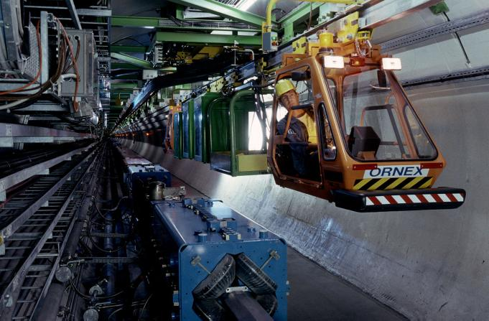
The LEP journey
Large Electron Positron collider
the 27 Km circumference RING, 100 meters below ground
1983: the beginning of the excavations: the biggest European Eng. work
august 1989: first interaction at E=91 GeV
1995 - 2000: E=130 – 209 GeV
Emilio Picasso director of LEP
11 years for construction
12 years of data taking
~350 x 4 physics papers

Slide 12
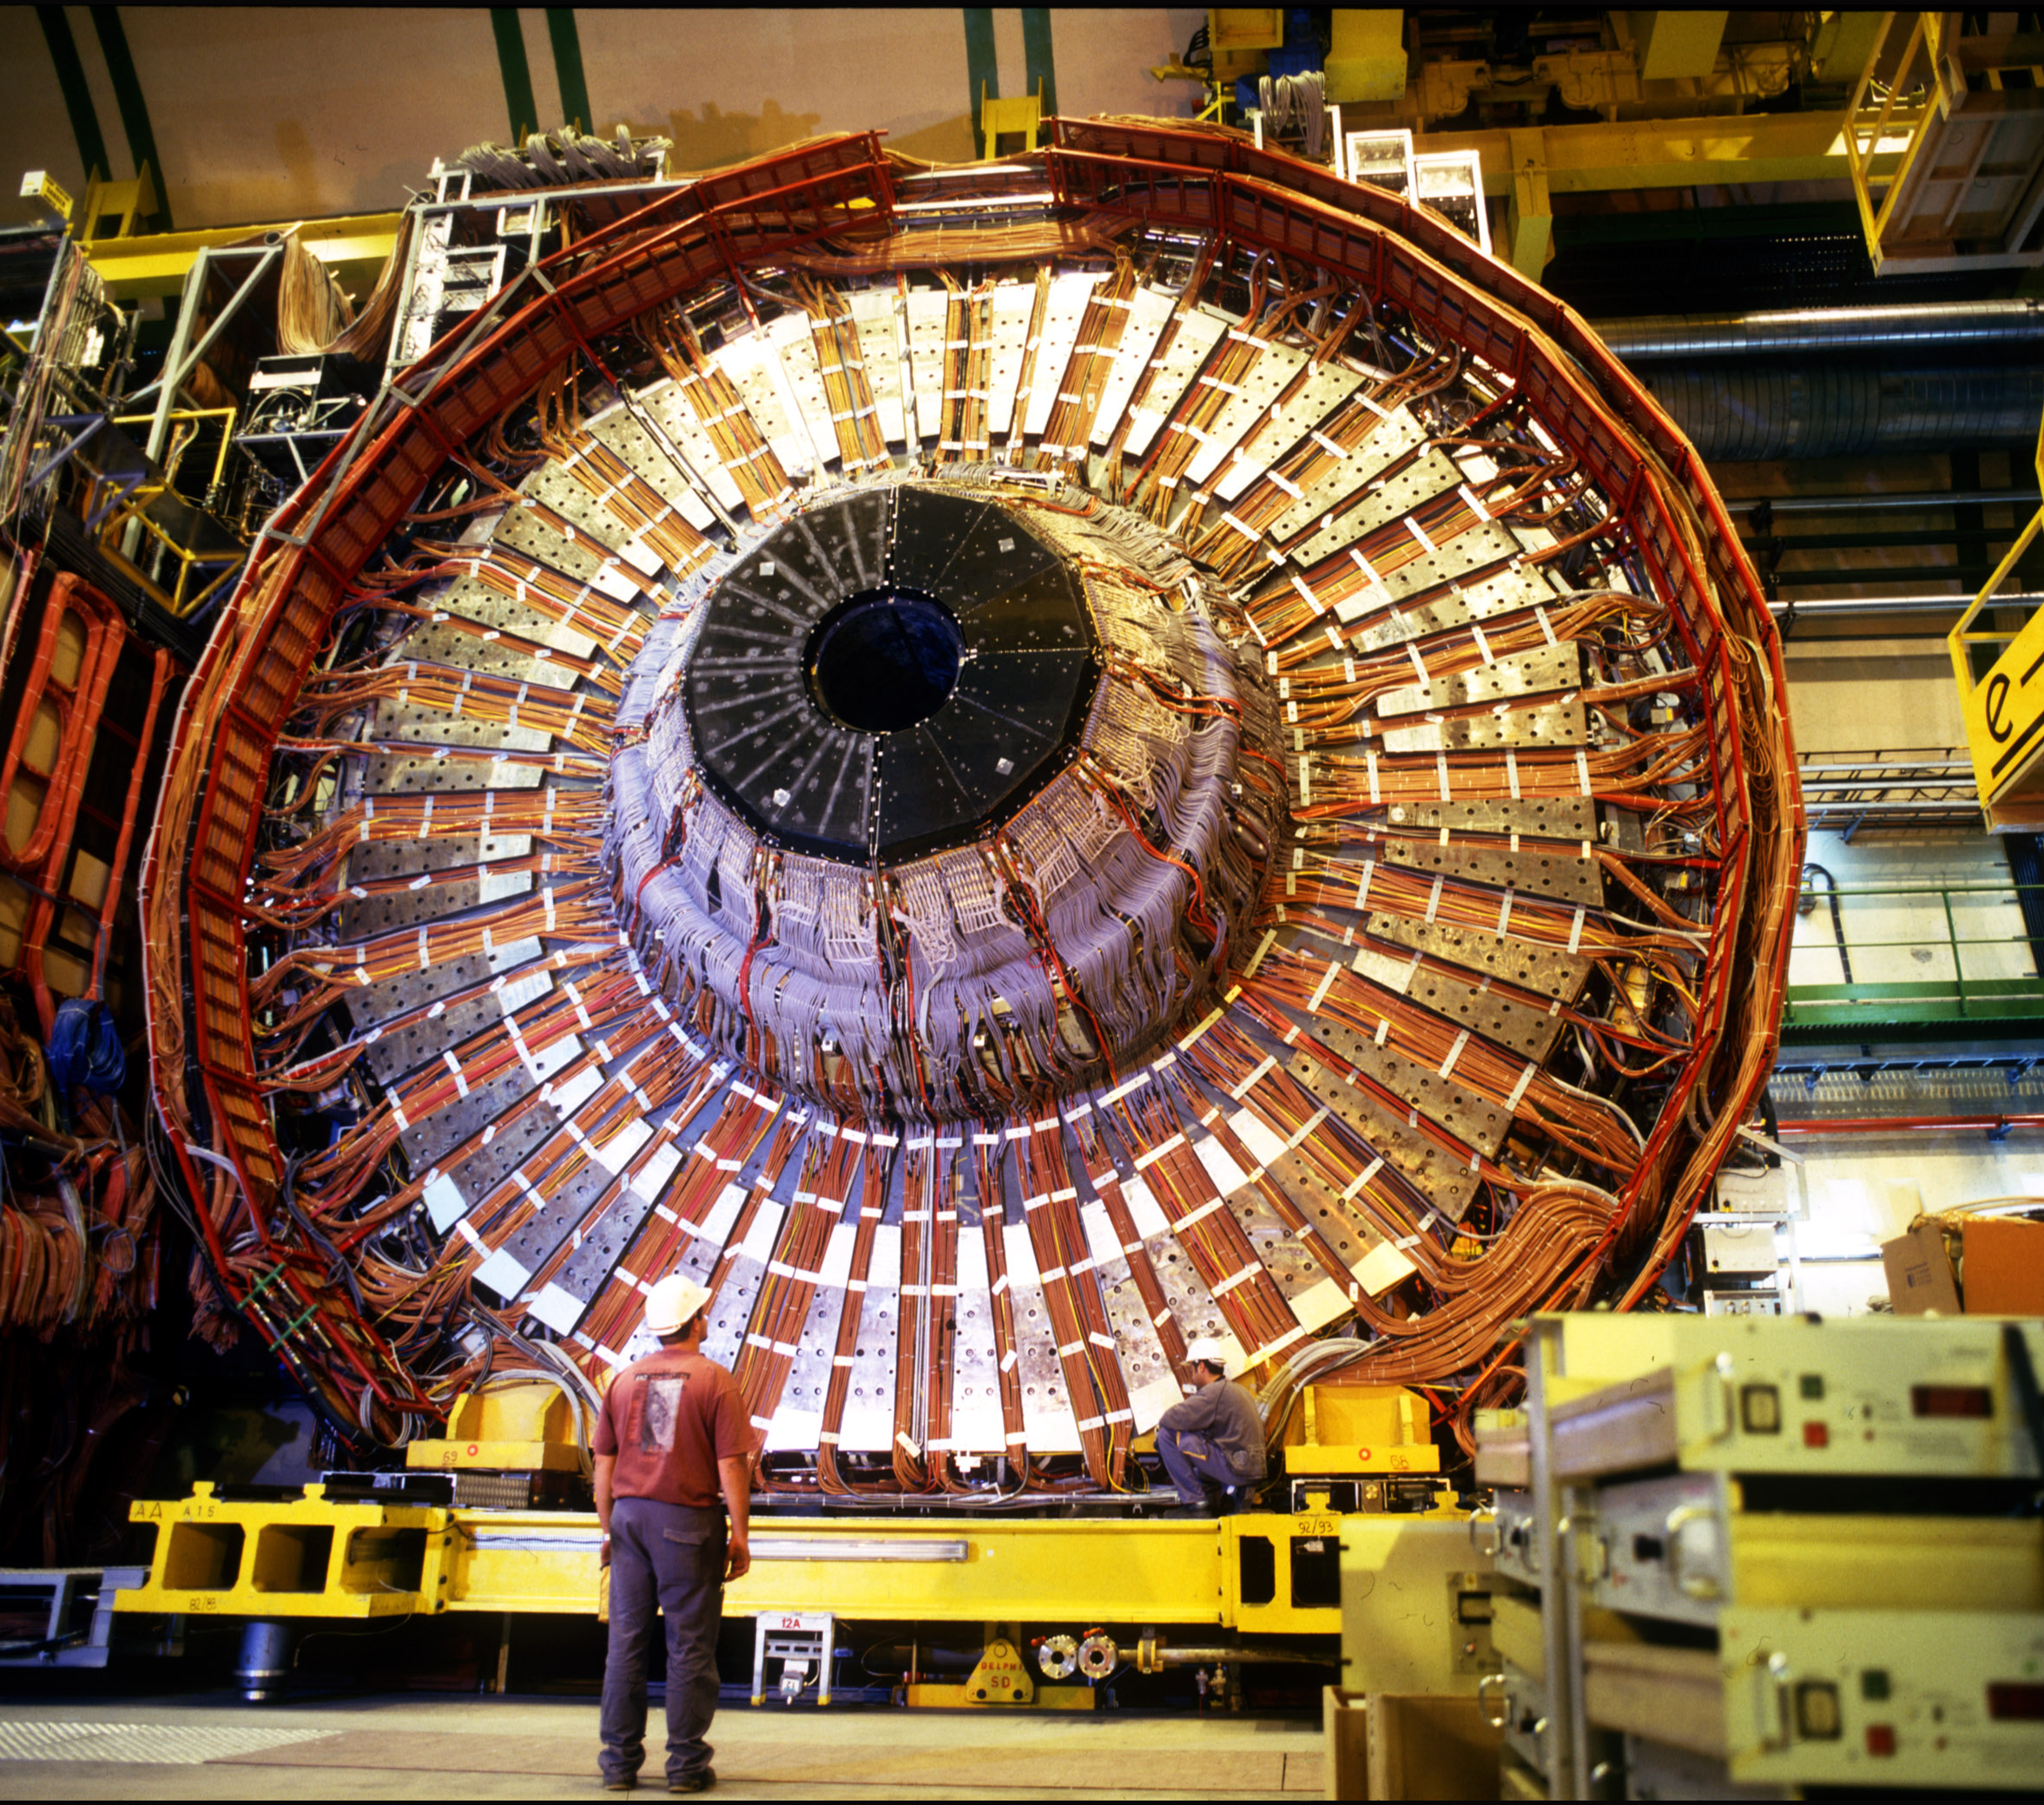
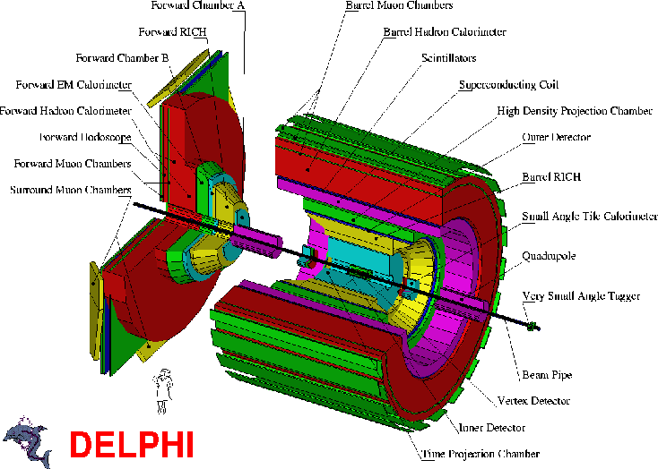
The LEP experiments
4 large experiments: ALEPH, DELPHI, L3 e OPAL
e⁺
e⁻
12

Slide 13
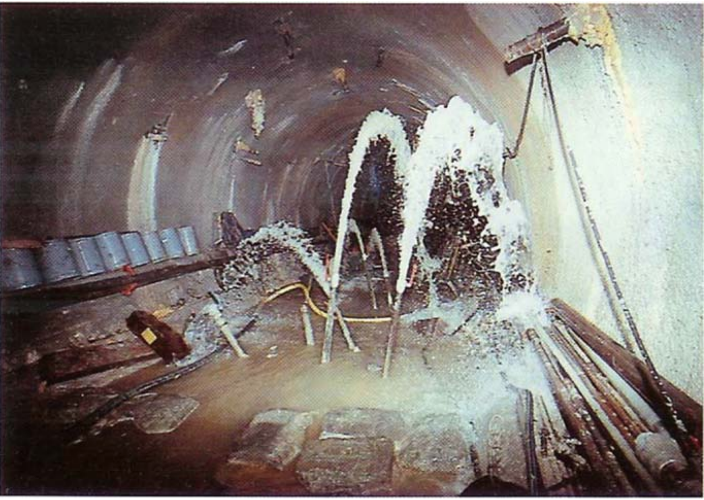
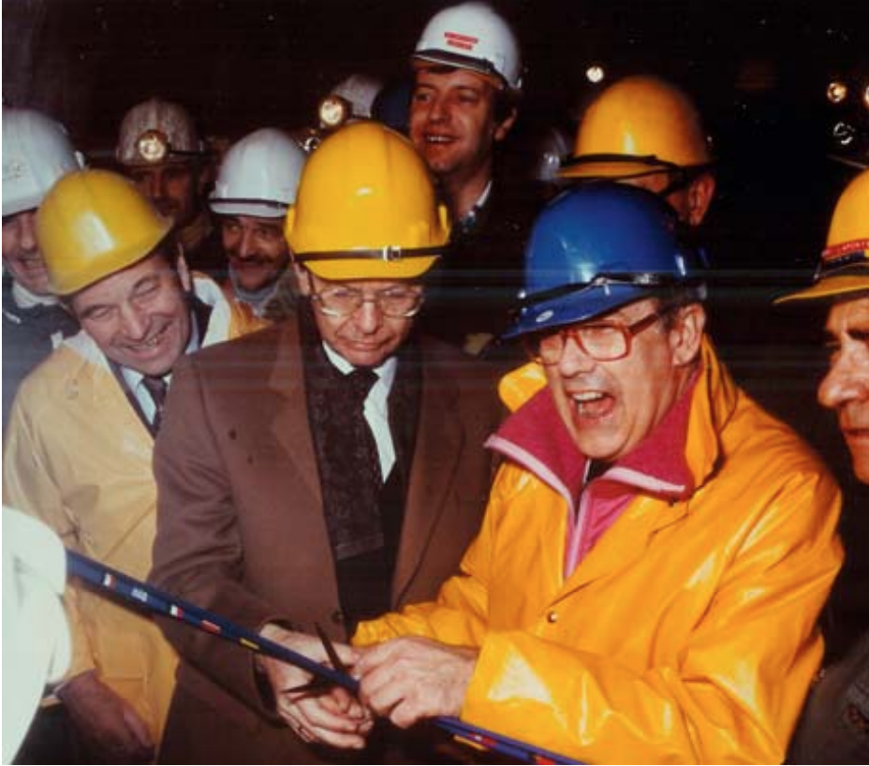
The digging of the LEP tunnel
« It took six months for the Jura water to be harnessed. However, there were no other
delays and LEP came into operation on July 14, 1989, with only six months delay
(on a 12 year planning) on the initials plans and with the great joy of Emilio »
from Ugo Amaldi talk in the memory of Emilio Picasso
« The last obstacle to complete the
tunnelling was to cut a blue ribbon. »
(Herwig Schopper and Emilio Picasso )

Slide 14
The Delphi superconducting magnet crossing the Jura

Slide 15
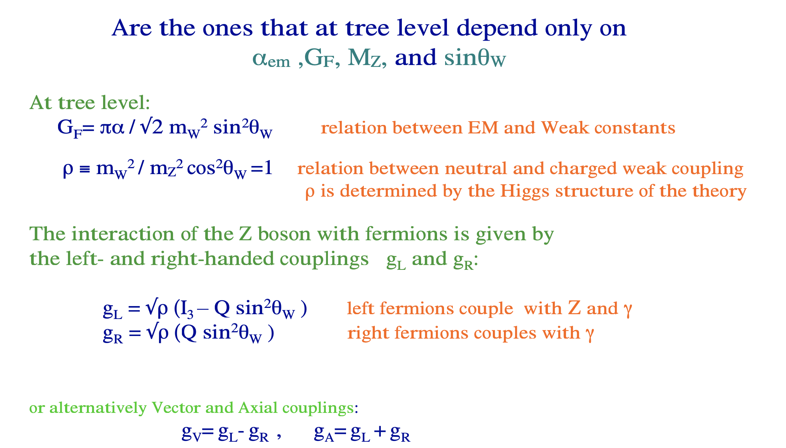

The Precision Observables
The Z boson couples with L and R leptons

Slide 16
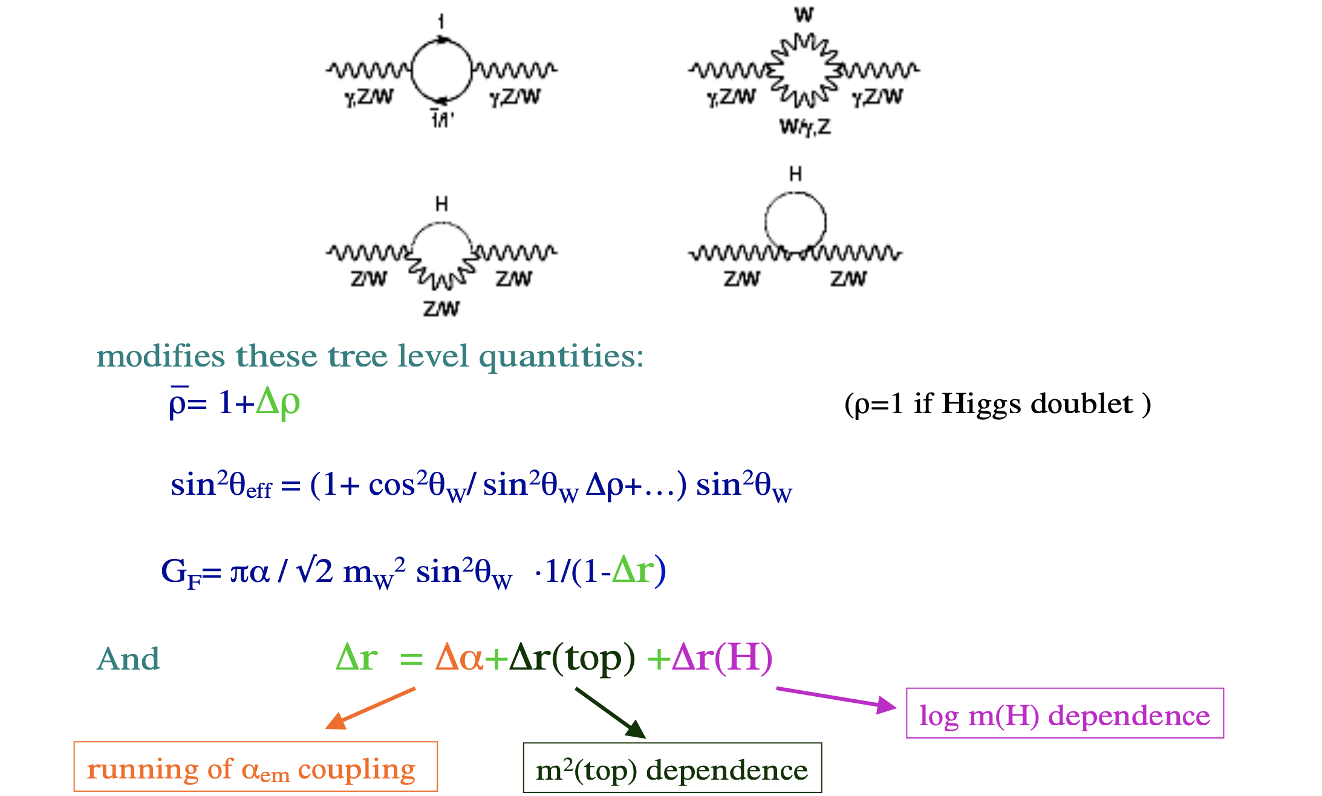
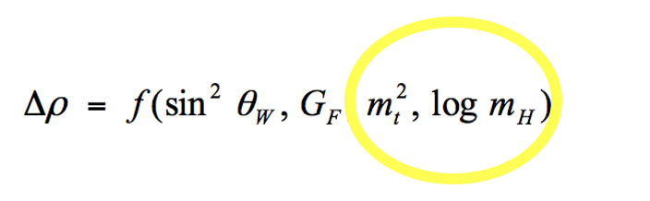
Radiative Corrections
By comparing the experimental measurements of the precision variables with the predictions of the SM, it is possible to indirectly determine the mass of the top, and of the Higgs.

Slide 17
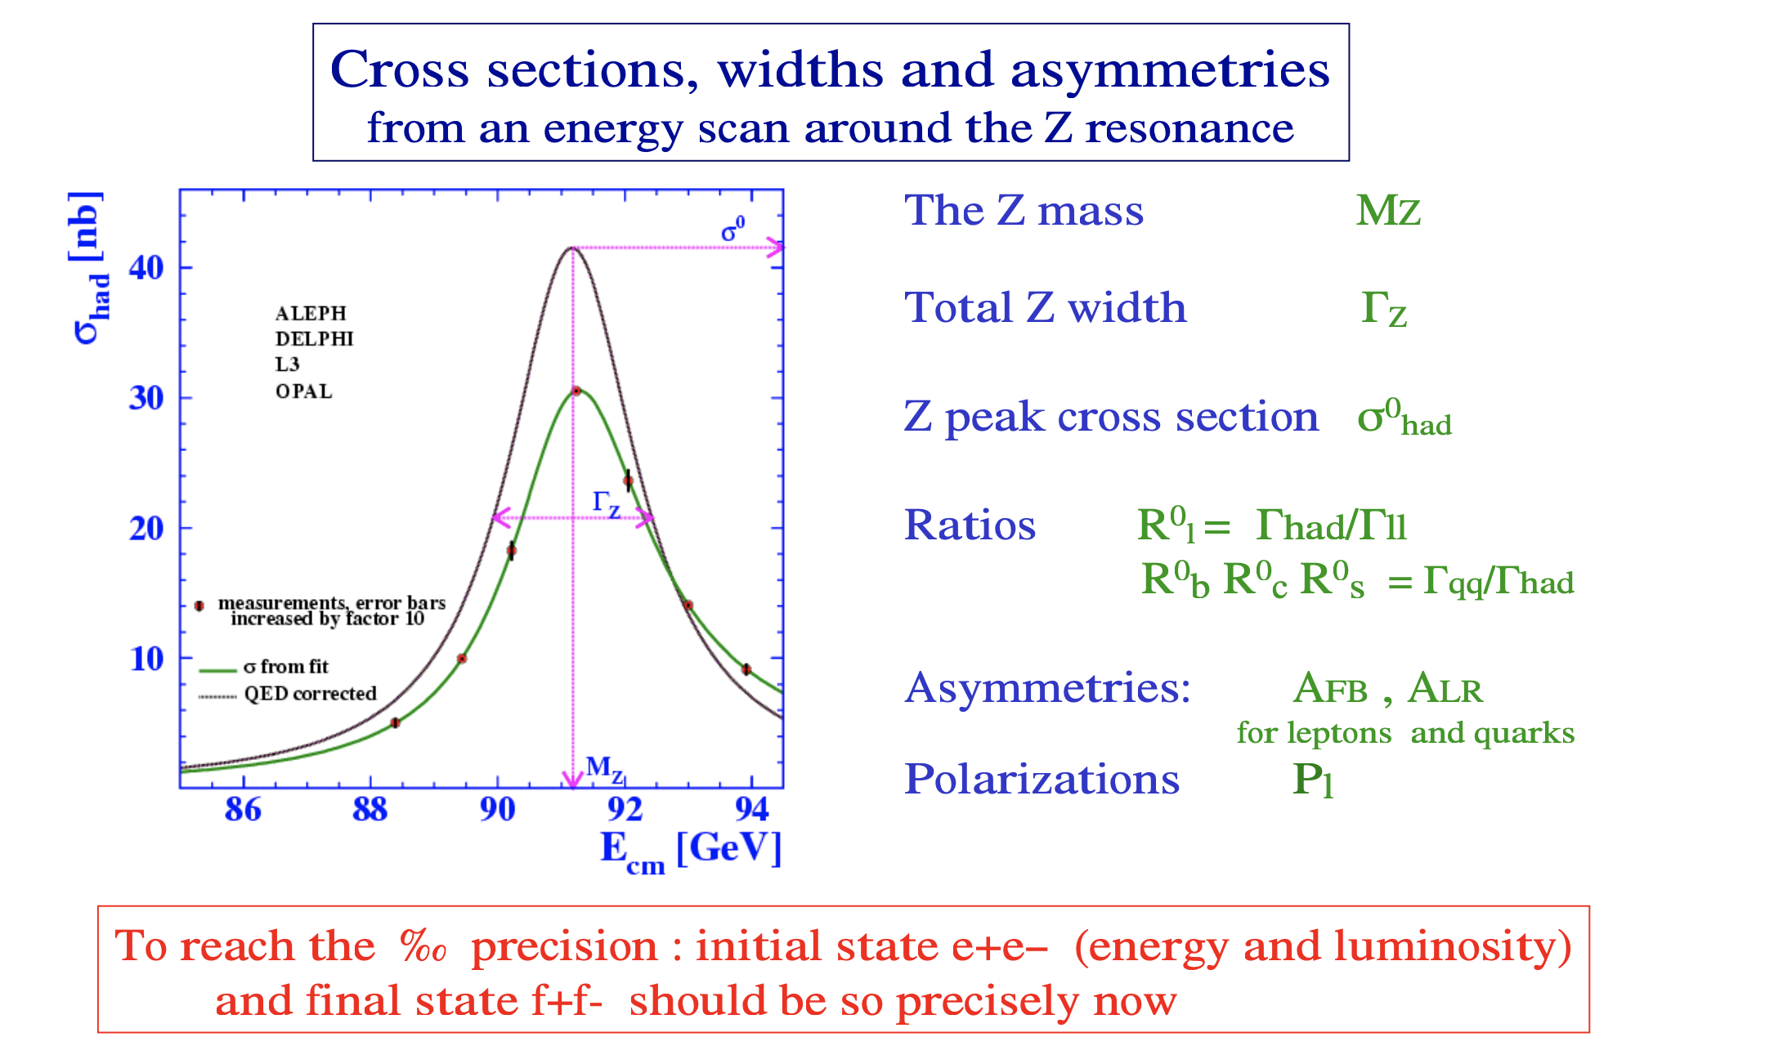
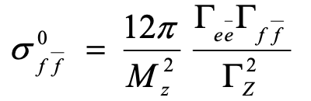
What we measure

Slide 18
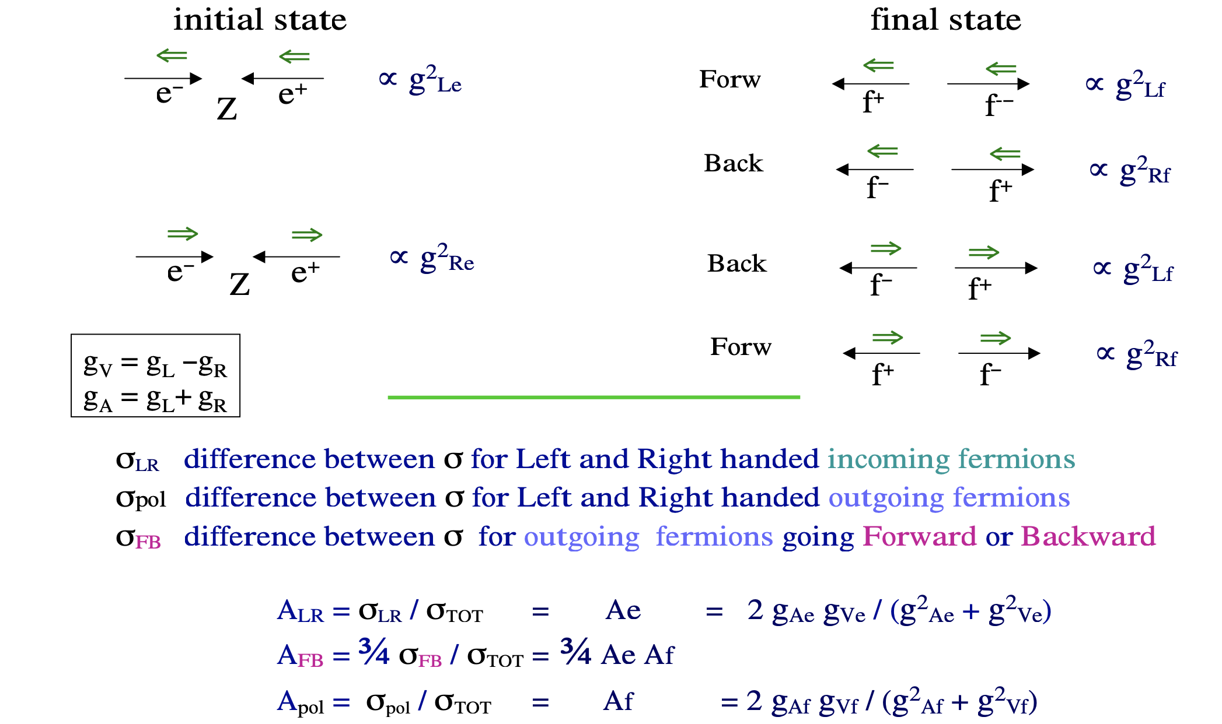
Measuring Asymmetries

Slide 19
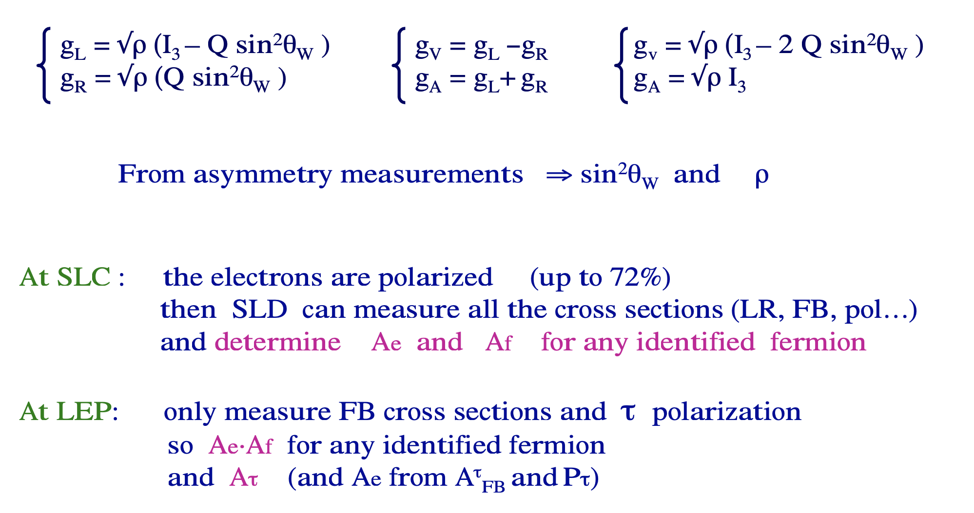
Measuring Asymmetries (2)

Slide 20
Line-shape
To determine the "line-shape" of the Z boson, cross sections are measured as a function of the center of mass energy and for selected final states:
= (N_{data} − N_{bck}) / ε × Luminosity vs E_{cm}
Experimentally it means:
count the events (N_{data}),
determine the efficiencies ε of the apparatus for the detection of such events
determine the background events (N_{bkg})
measure the Luminosity
measure the beam energy.
To achieve a fraction of per-mille precision on the parameters of the Z boson, it is necessary to reach this precision on both the initial state e + e- (Ecm and Luminosity) and final state f + f-.

Slide 21
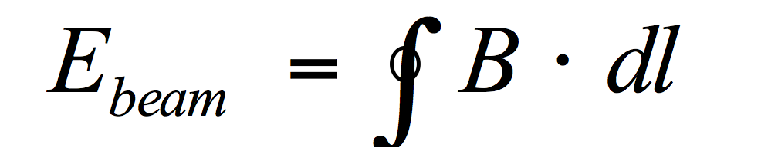

The beam energy measurement
The equation that determines the energy of the beams at a collider is
However, it is not trivial to measure the integral magnetic B field and the total path traveled by the particle L with accuracies of less than per-mille.
The method used to achieve these accuracies is that of "Resonant Depolarization".
This measurement takes place in special machine runs, i.e. at a given time t0.
What you really need is to know the energy of the beam during physics runs, i.e. at the time t1.
It is therefore necessary to correlate the measurement of the energy of the beam at the time t0 with that at the time t1.
To correlate E (t0) with E (t1) it is necessary to know how the integrated field B and the total path L = vary from t0 to t1.

Slide 22
Tidal effects
The figure shows how the beam energy varies during a whole day, due to the moon tides. In Geneva the ground level varies up to a maximum of 25 cm (i.e. a local change of the terrestrial radius of 4x10⁻⁸). The orbit of LEP is changed by less than 1 mm (the thickness of a hair!). Consequently the energy of the beam undergoes a variation of about 10 MeV.

Slide 23
How much did it rain?
Effects due to the water table on the Jura and the amount of water in the lake. The pressure variations due to changes in the mass of water either in the Jura or in the lake change the shape of the ring and therefore → variation of L
The figure shows how the water level of Lake Geneva affects the shape of the ring, i.e. the total path of the particles and therefore their energy. The measure was made possible thanks to the municipality of Geneva which, by maneuvering the dams, made it possible to increase and lower the water of the lake in a controlled manner

Slide 24
And some surprise !
The figure shows the energy trend as a function of the time of the day. This pattern was repeating regularly every day: increased energy during the evening and constant energy during the night. The measurements were made thanks to the NMR probes placed along the accelerator, i.e. the increase in energy was due to a variation in the magnetic field B of the machine.

Slide 25
The TGV
The explanation for this periodic variation of ~ 20 MeV comes from the France-Switzerland TGV train line: along the rails of the old section a fraction of the current does not return completely to the rails, but is dispersed into the ground. This current wanders in the ground until it meets the LEP tunnel, an excellent conductor, and then comes out of the tunnel when it goes into the "La Versoix" river. By measuring the voltage variations along the train line and along the LEP beam pipe and the variations of the NMR probes, it is possible to notice a perfect correlation with the passage of the TGV trains (In the night, i.e. between 00:00 and 04:00 : 00 no trains pass and a constant energy is measured.)

Slide 26
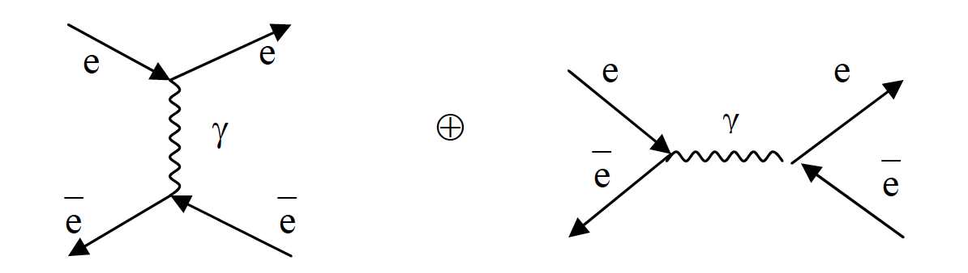
The luminosity
In theory, you can measure the luminosity from the parameters of the machine, in practice, the most accurate way to measure the luminosity of the beams is to use the relationship:
where a physical process is selected whose cross section is very well known theoretically. By measuring the number of events in the detector due to this physical process, the luminosity is consequently obtained.
The process, which is well known theoretically, is a QED process, namely Bhabha scattering:
Uncertainties of about 0.5 x 10⁻³ were reached on the luminosity.

Slide 27
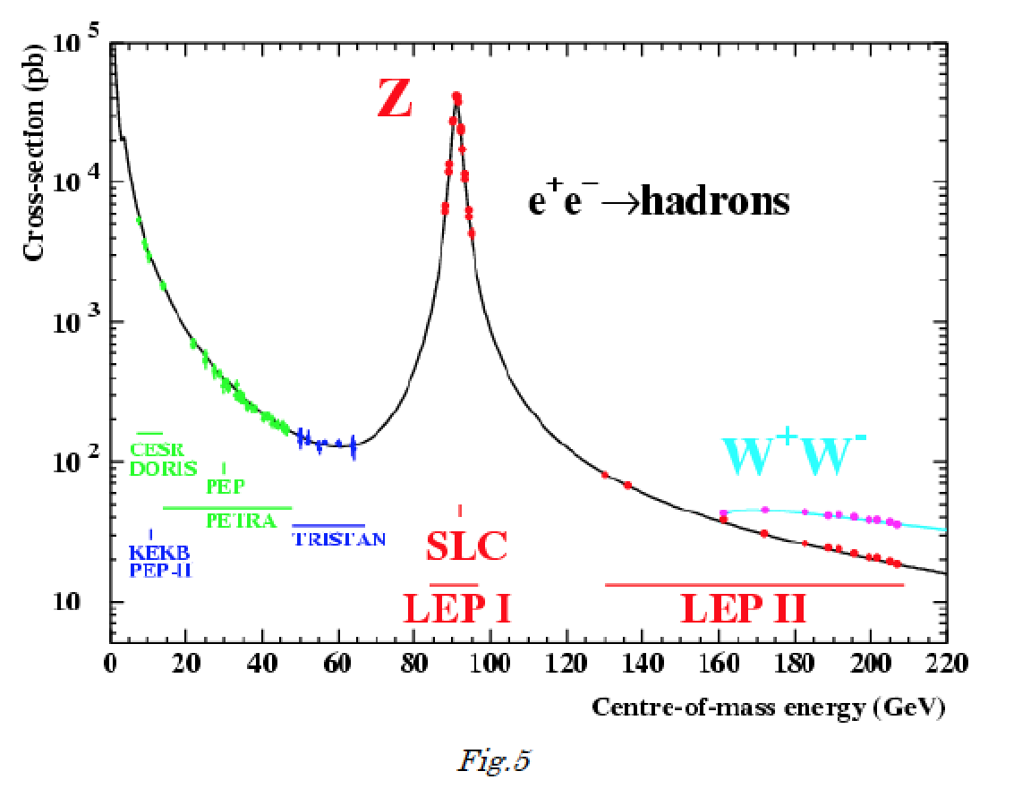


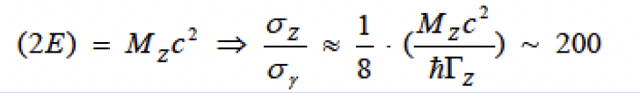

The background
At the Z exchange amont to 1% of the XS
At the Z

Slide 28
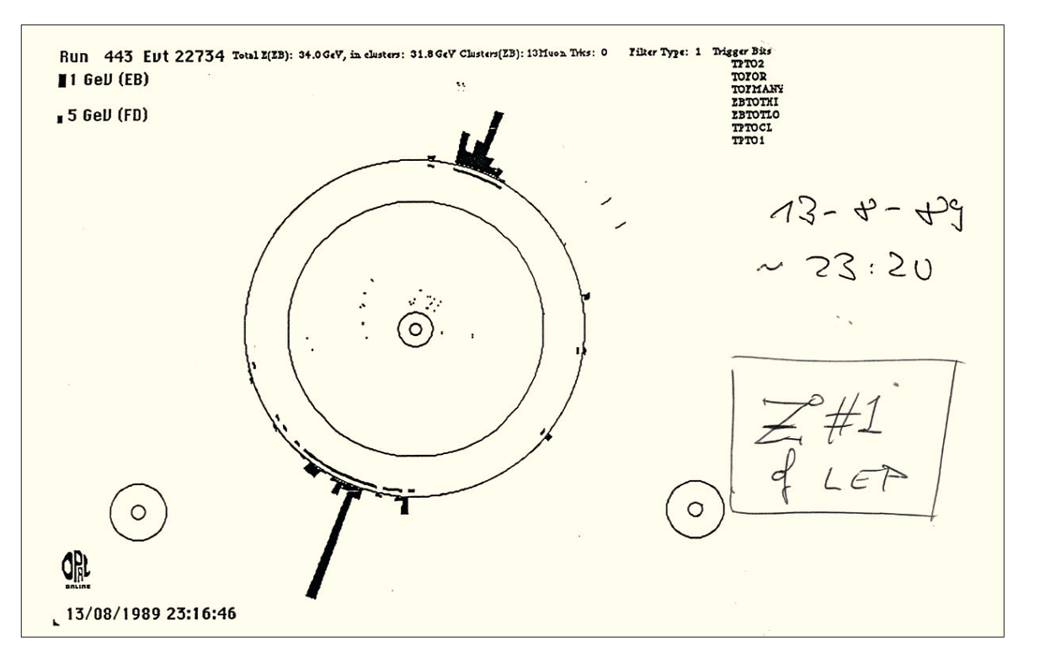
13/8/1989: the first Z event

Slide 29
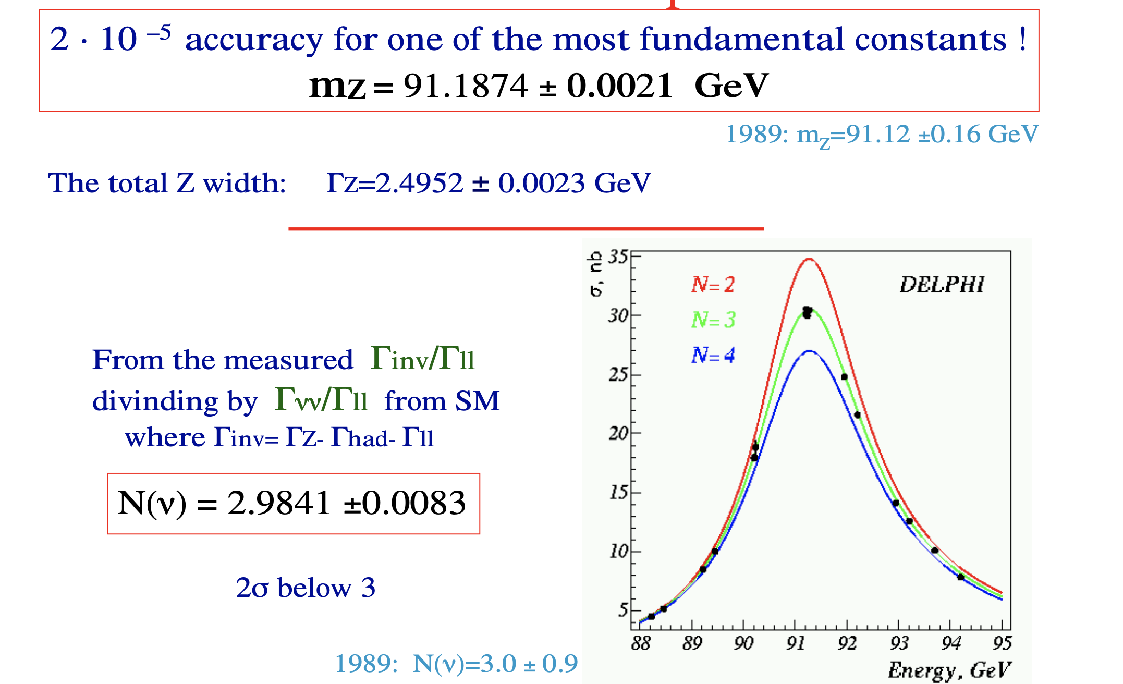
The Z line shape
The number of neutrinos is 3 → the number of lepton families in our universe is 3.
(the neutrino-tau was actually "seen" by DONUT at Fermilab in 2000)

Slide 30
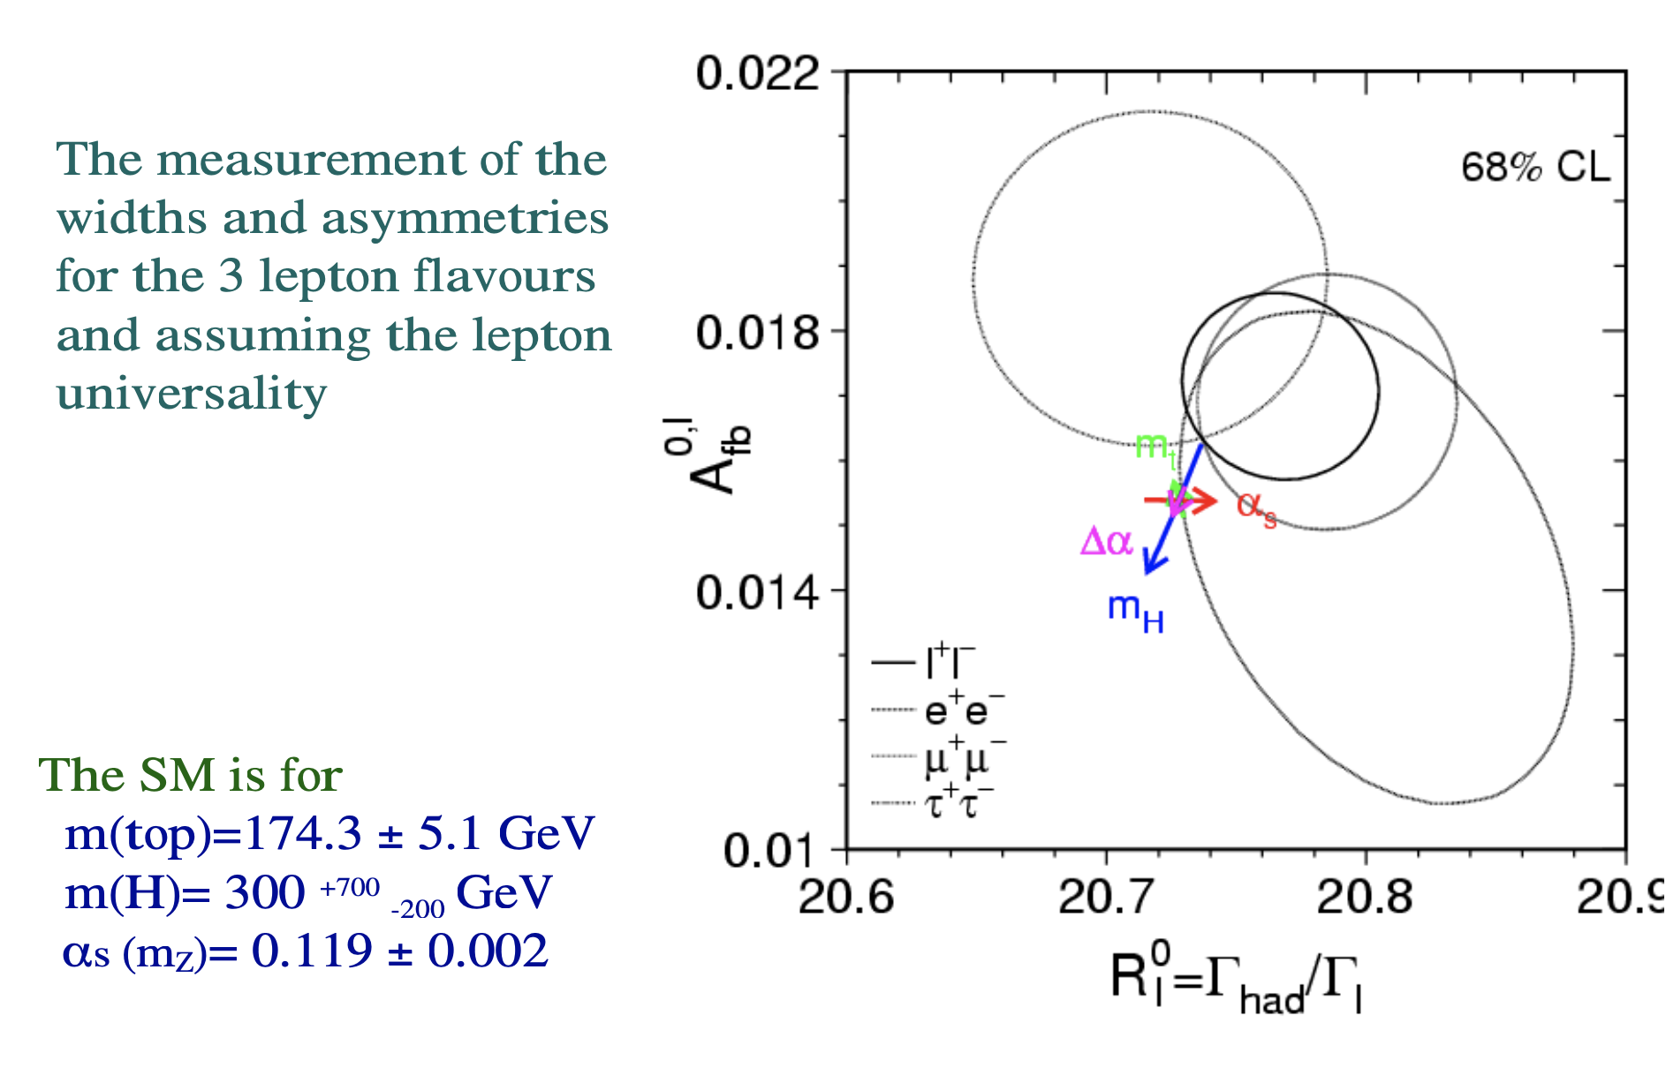
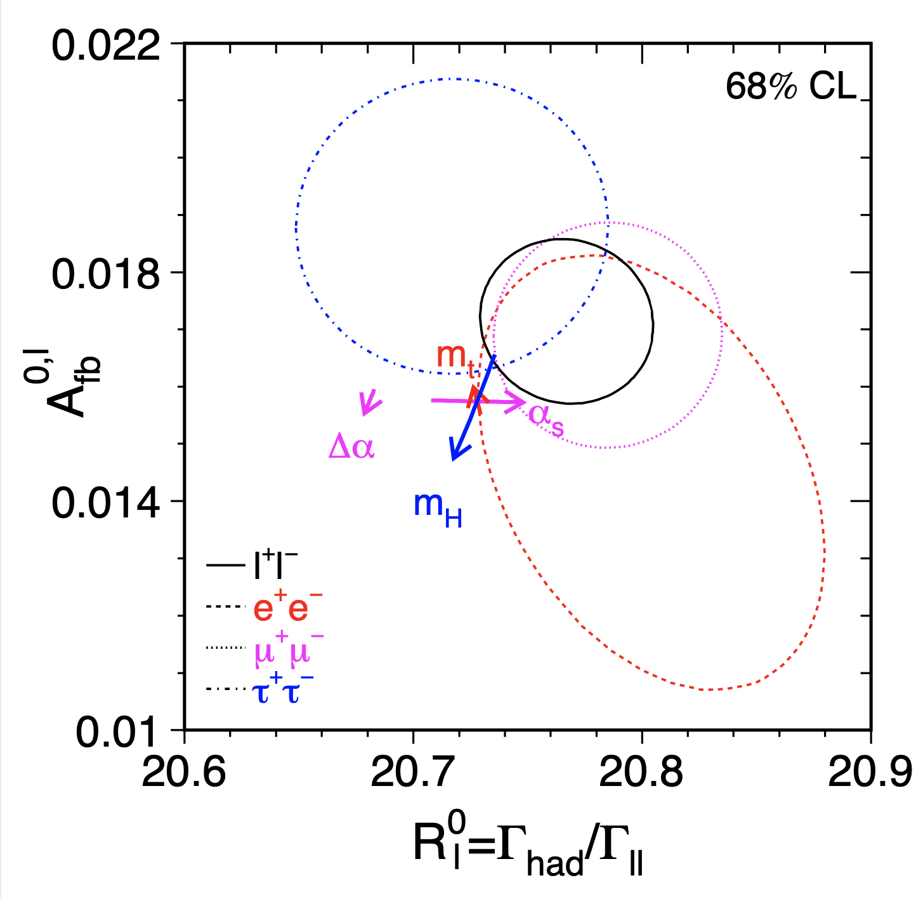
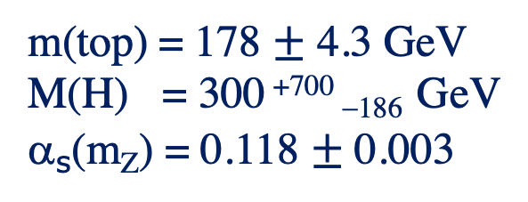
Lepton universality
m(top) = 178 $±$ 4.3 GeV
M(H) = 300 ⁺⁷⁰⁰ ₋₁₈₆ GeV
α_{s}(m_{Z}) = 0.118 $±$ 0.003

Slide 31
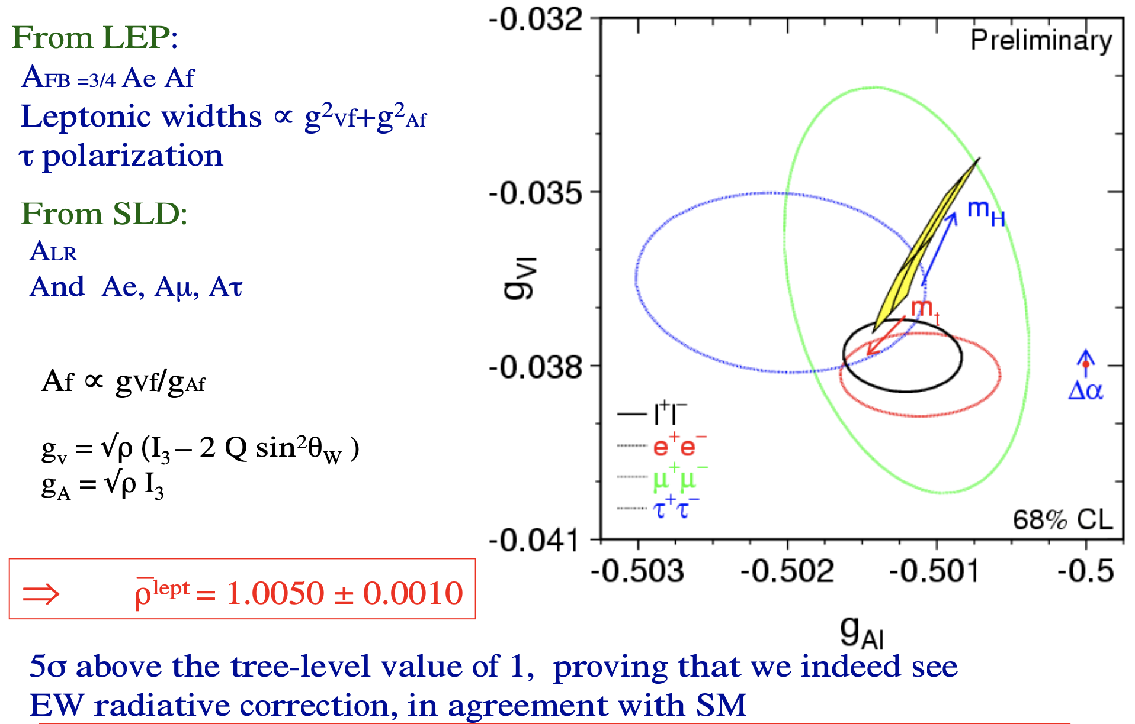
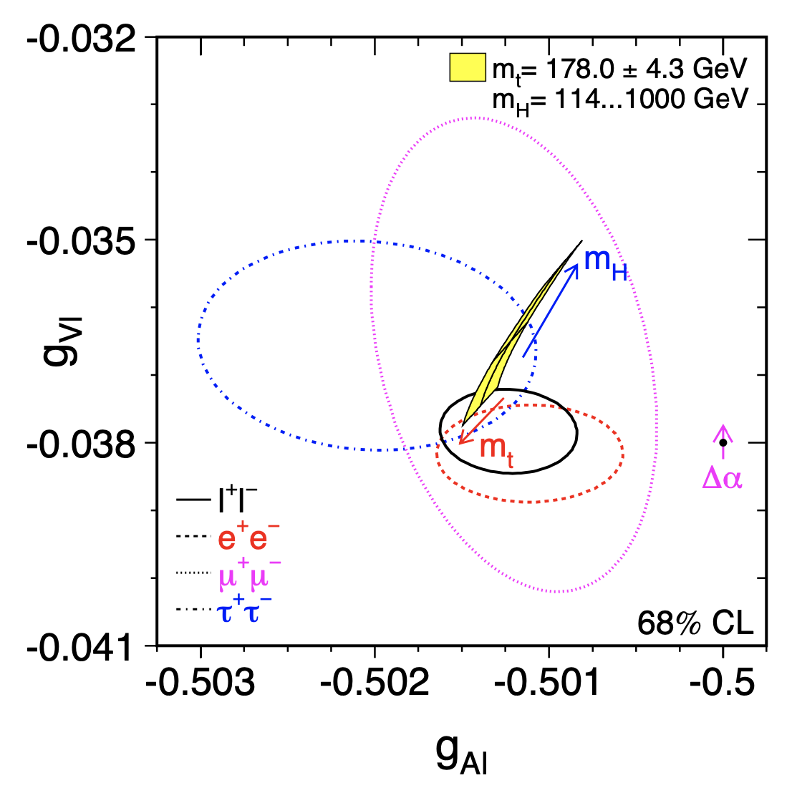
Z coupling to leptons

Slide 32
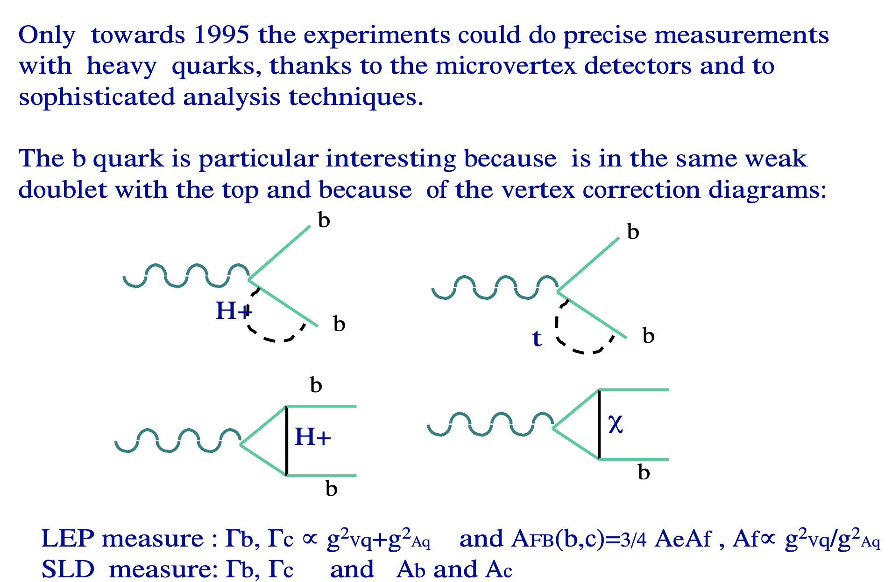
Heavy quarks

Slide 33
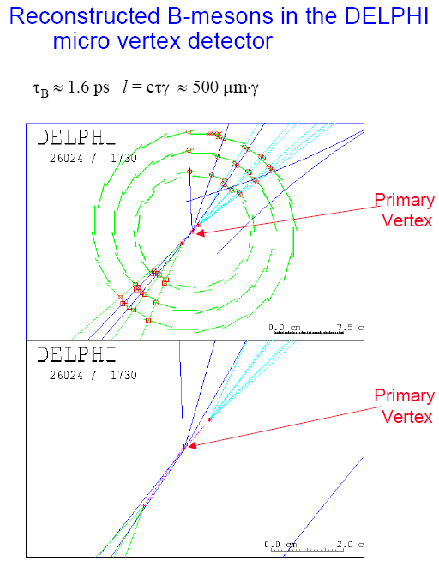
How to detect heavy quarks
τ_{B}≅ 1.564±0.014 ps,
m_{B}≅ 4.5 GeV.
x = γβcτ ~3.6 mm
n_{B}~5
p_{T}~m_{B}/2~2.2 GeV
Thus the detection of
1) a secondary vertex
of high mass and multiplicity
2) few tracks with high Impact Parameters:
IP~ cτ~ 460 µm

Slide 34

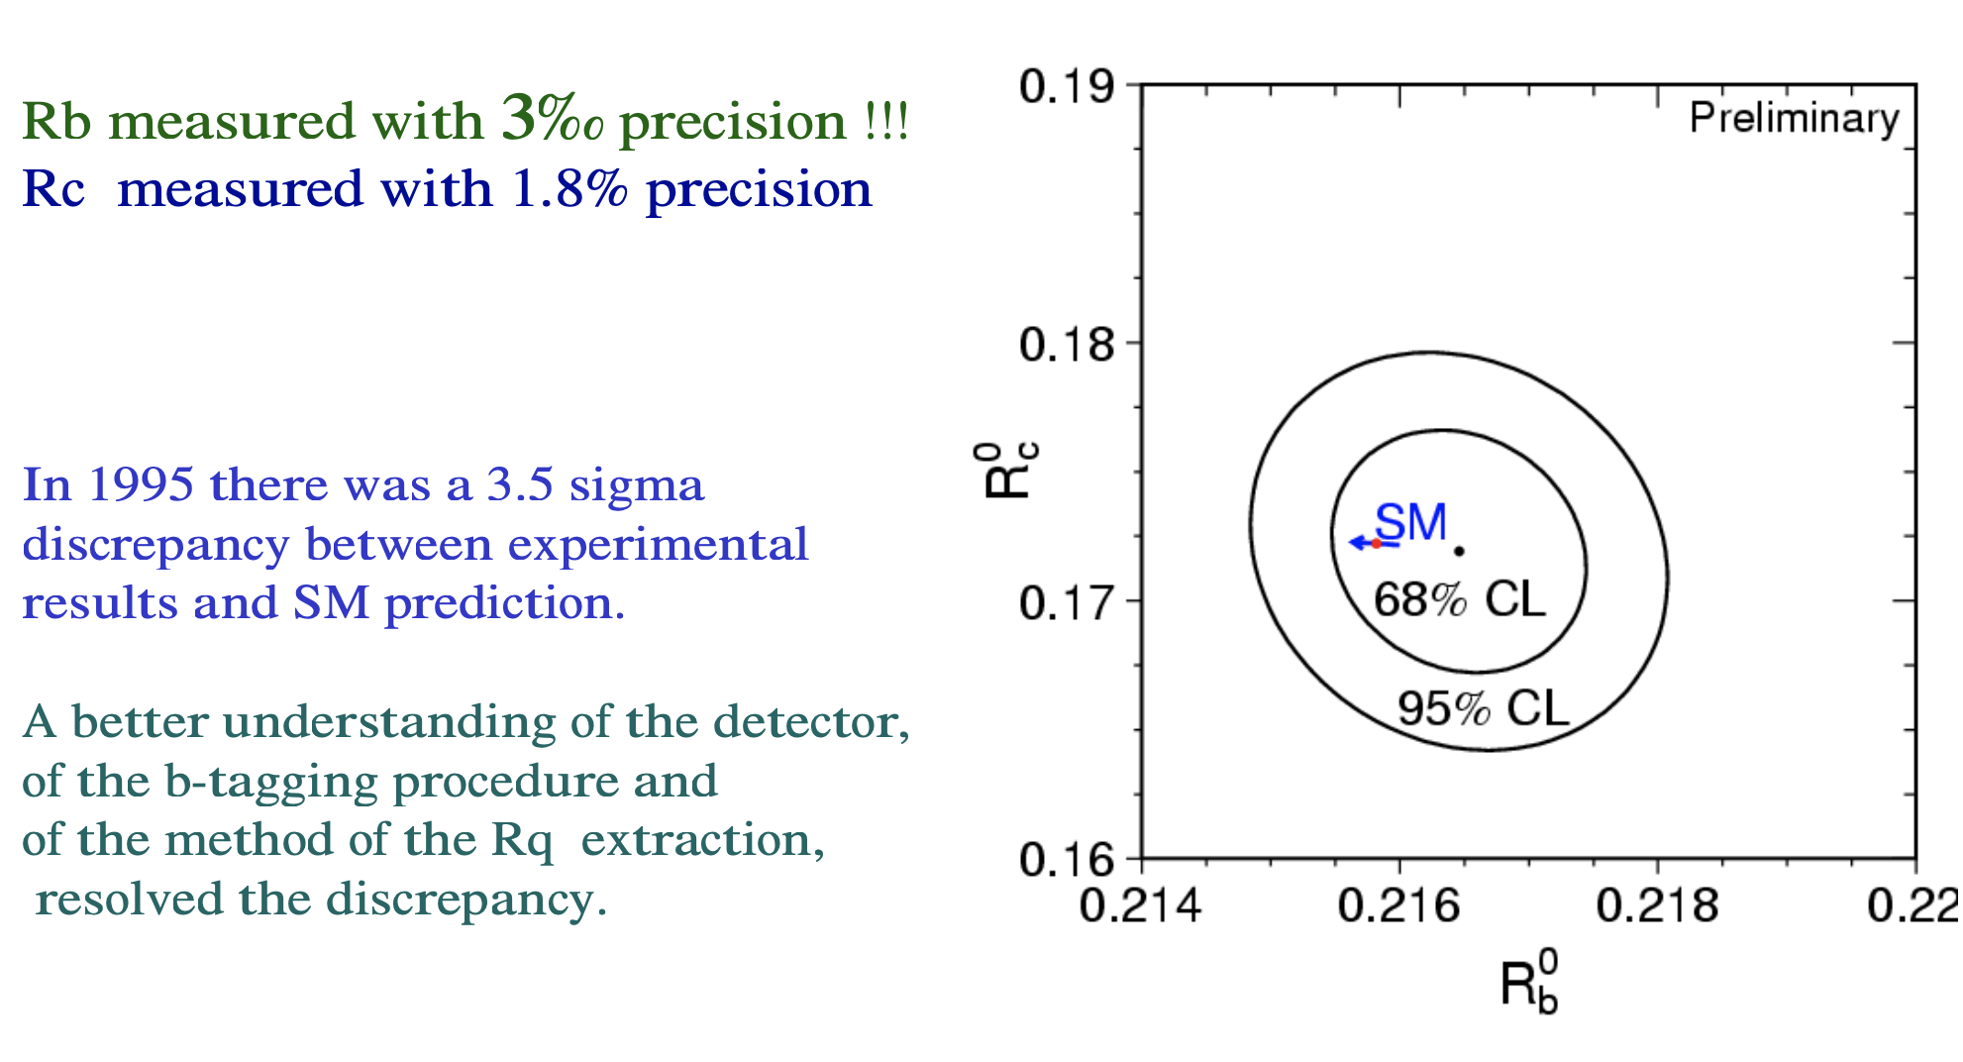
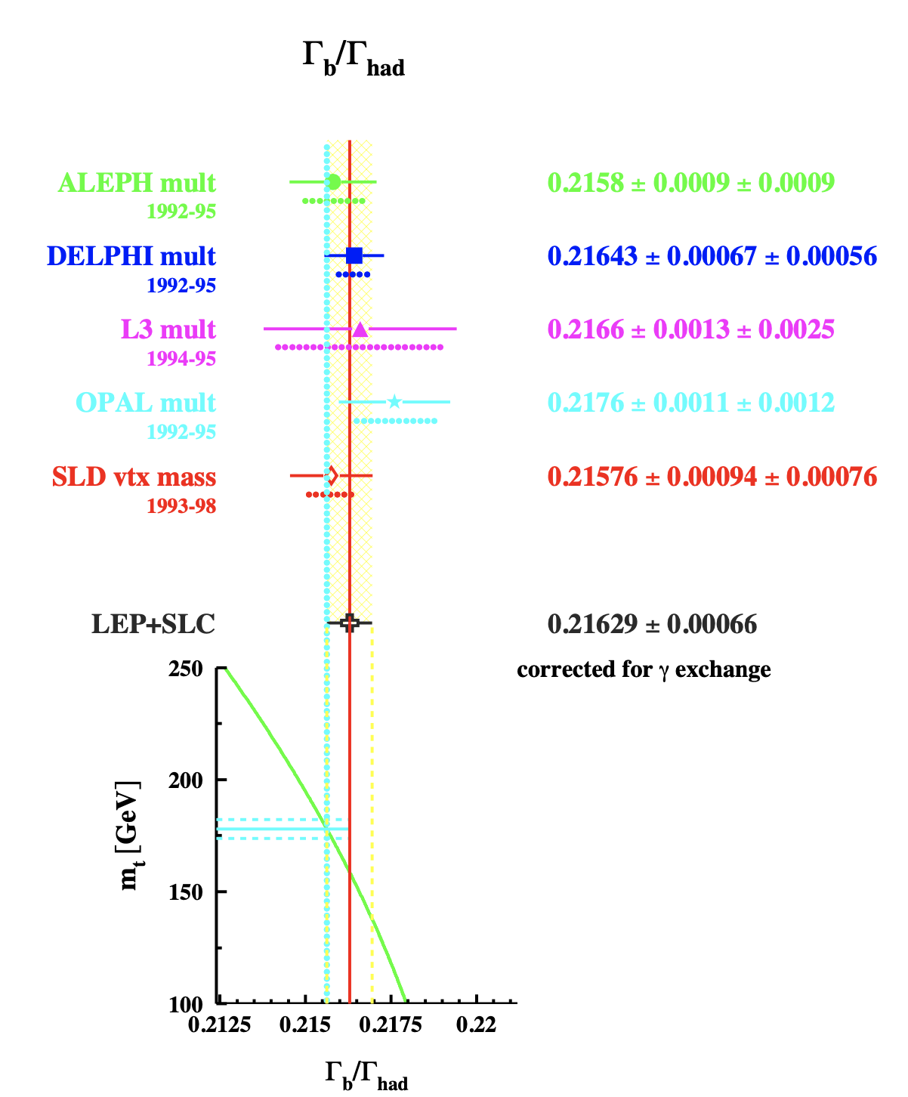
Rb and Rc as a test of the SM

Slide 35
Rb and Rc as a test of the SM

Slide 36
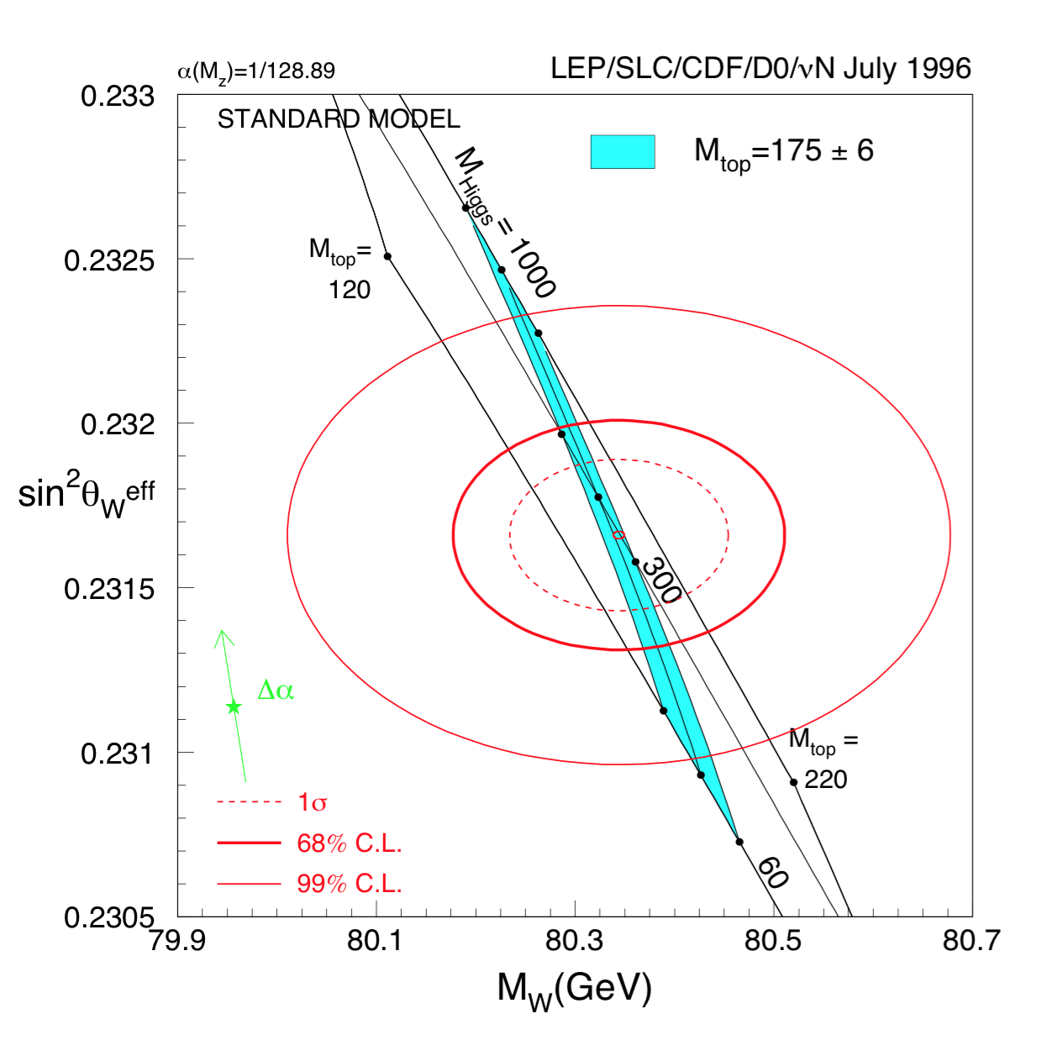
Top and Higgs in 1996

Slide 37
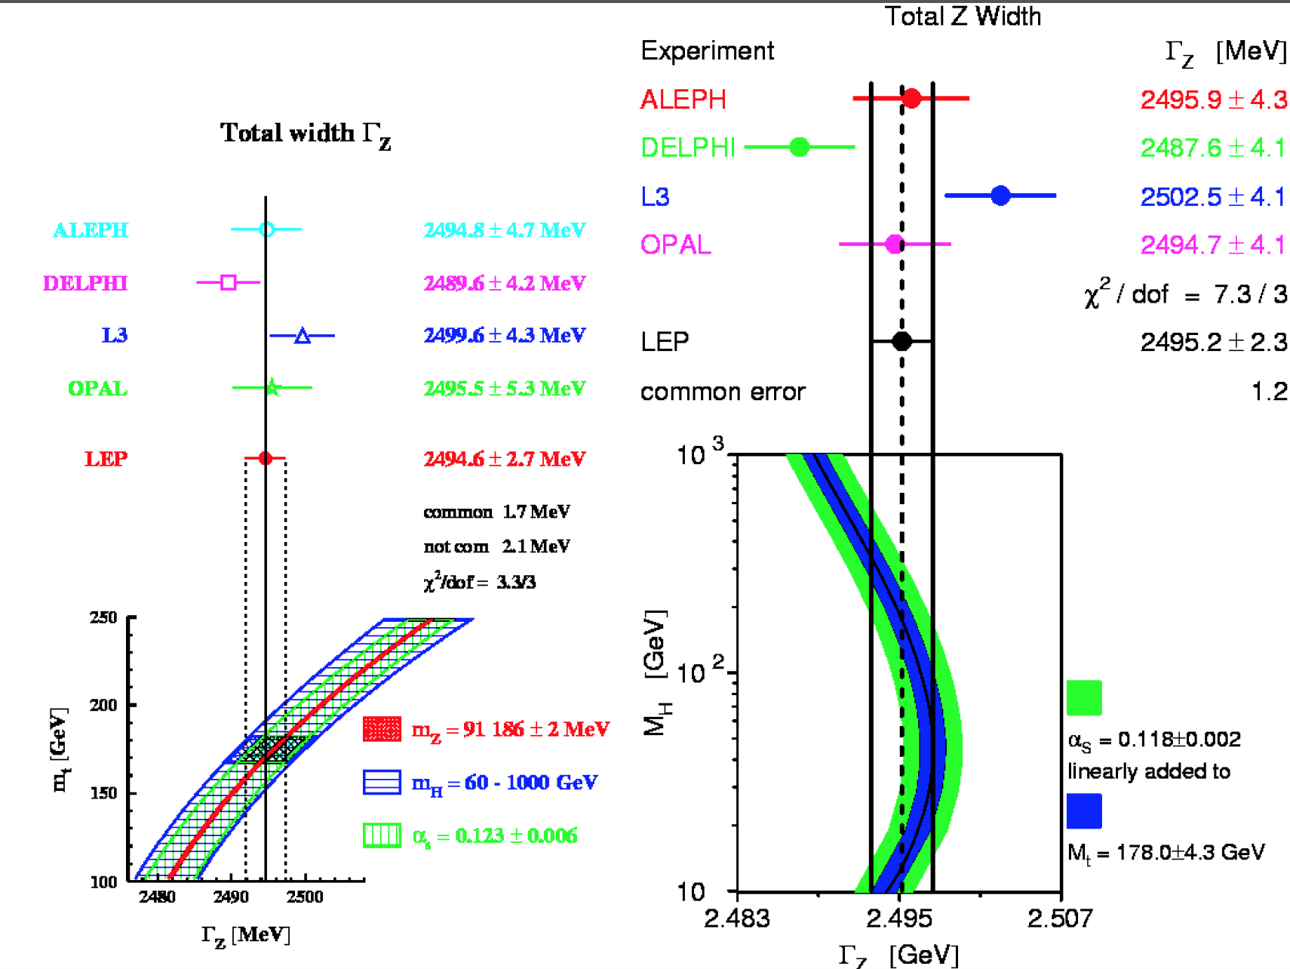

Slide 38
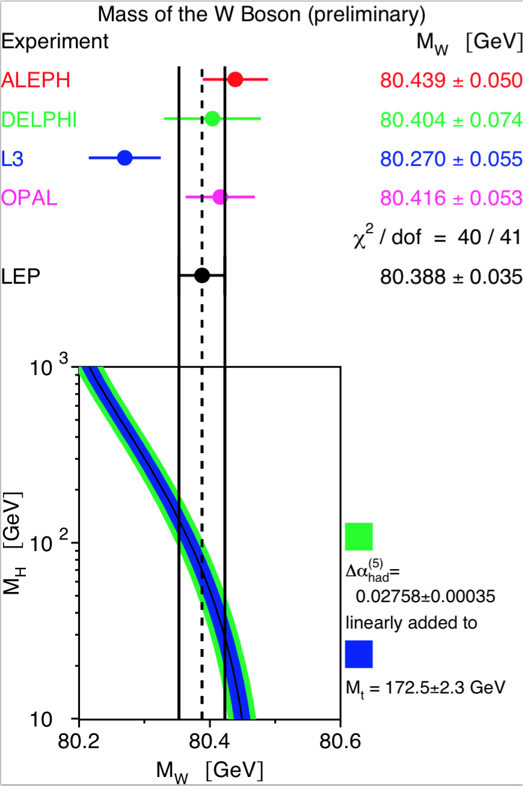
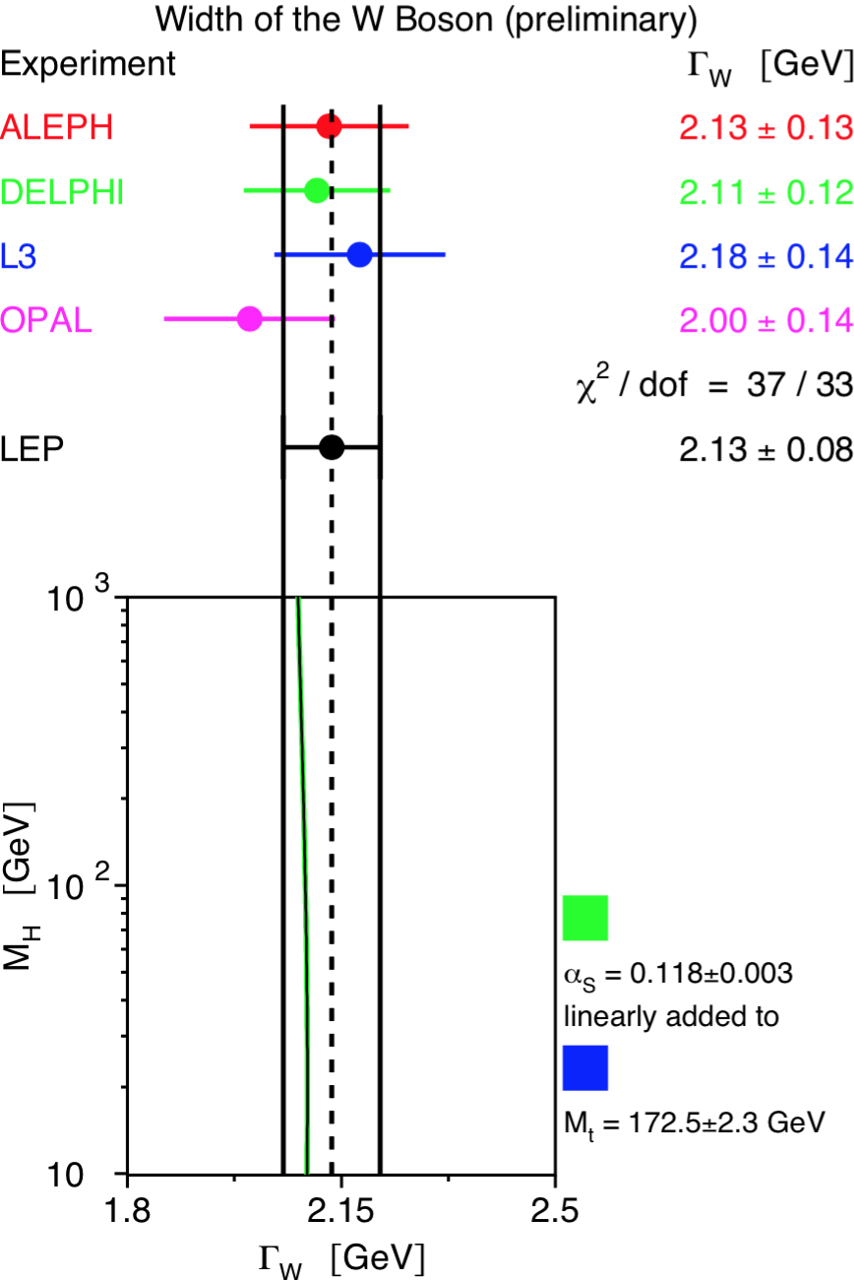
After the top discovery

Slide 39
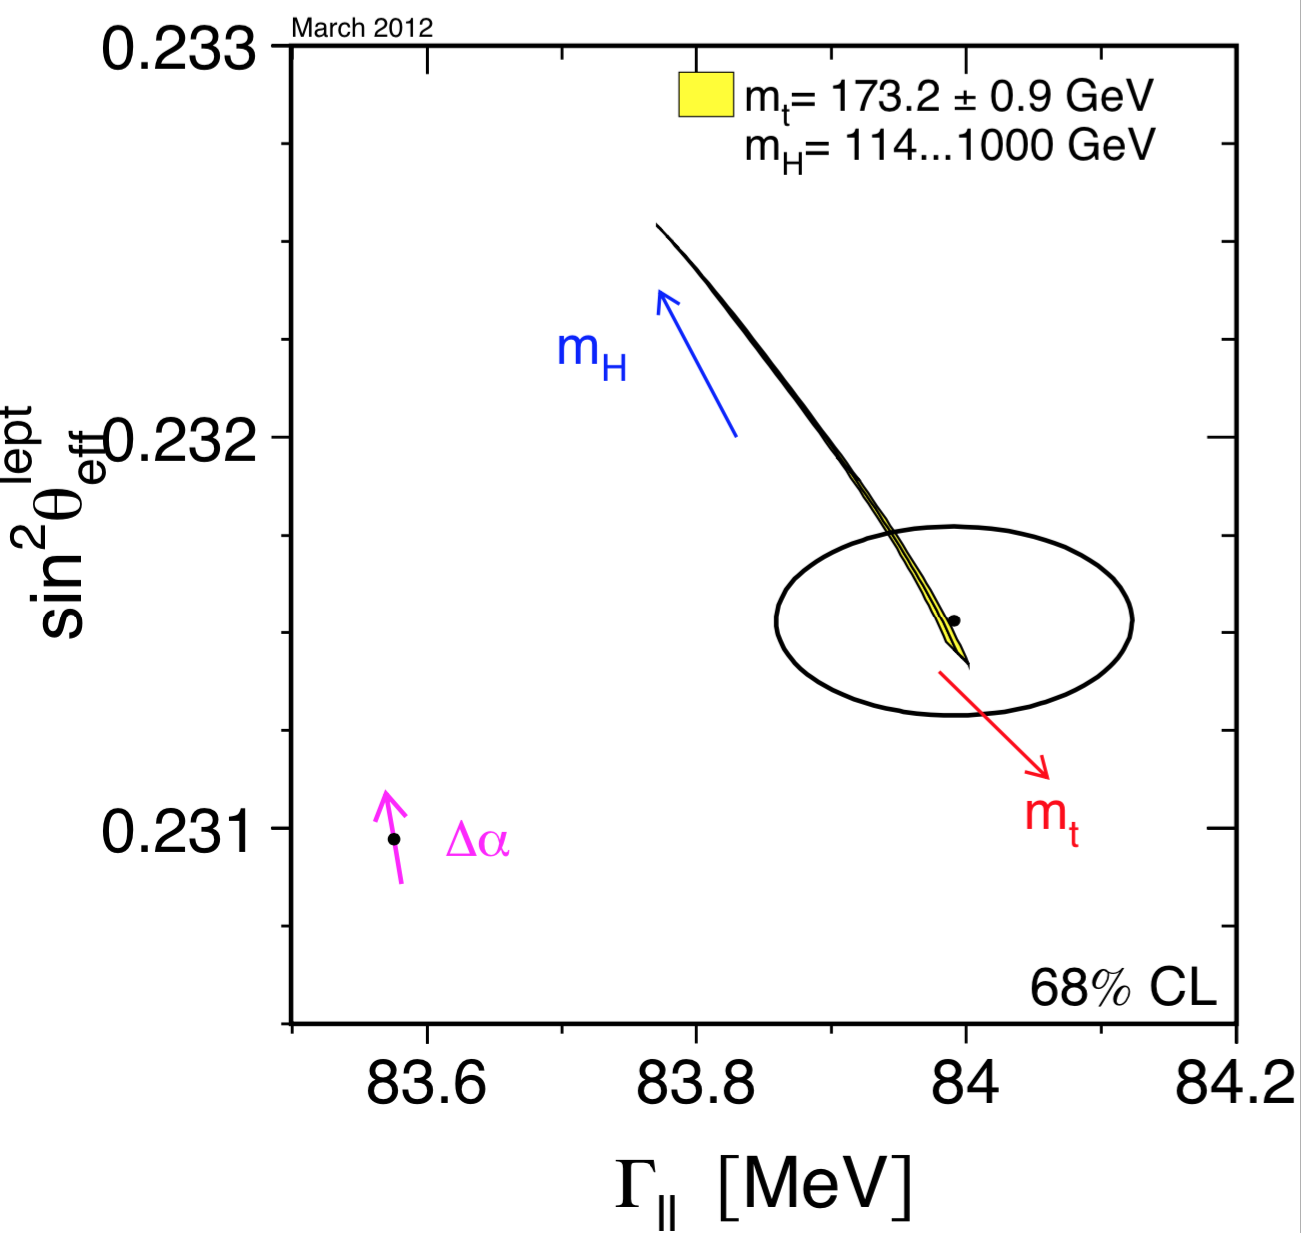
The end of LEP
The central value is in the center of the circle, the circle represents 68% of the confidence level. The experimental result can be compared with the predictions of the SM. In the figure the predictions of the SM are shown as vectors. First of all, the vector furthest to the left (in magenta) represents the value of the MS in the absence of electroweak radiation corrections, and the extension of the arrow represents how much this value could change as the electromagnetic coupling constant α_{em} varies. The other 3 vectors (blue, red and yellow) are the predictions of the MS taking into account the electroweak radiative corrections, and varying the not well known or unknown quantities, such as the mass of the top (m_{top} = 173.2+-0.9 GeV), the strong coupling constant (α_{s} = 0.118 +- 0.002) and the mass of the Higgs (mH = 300 + 700-186 GeV)

Slide 40
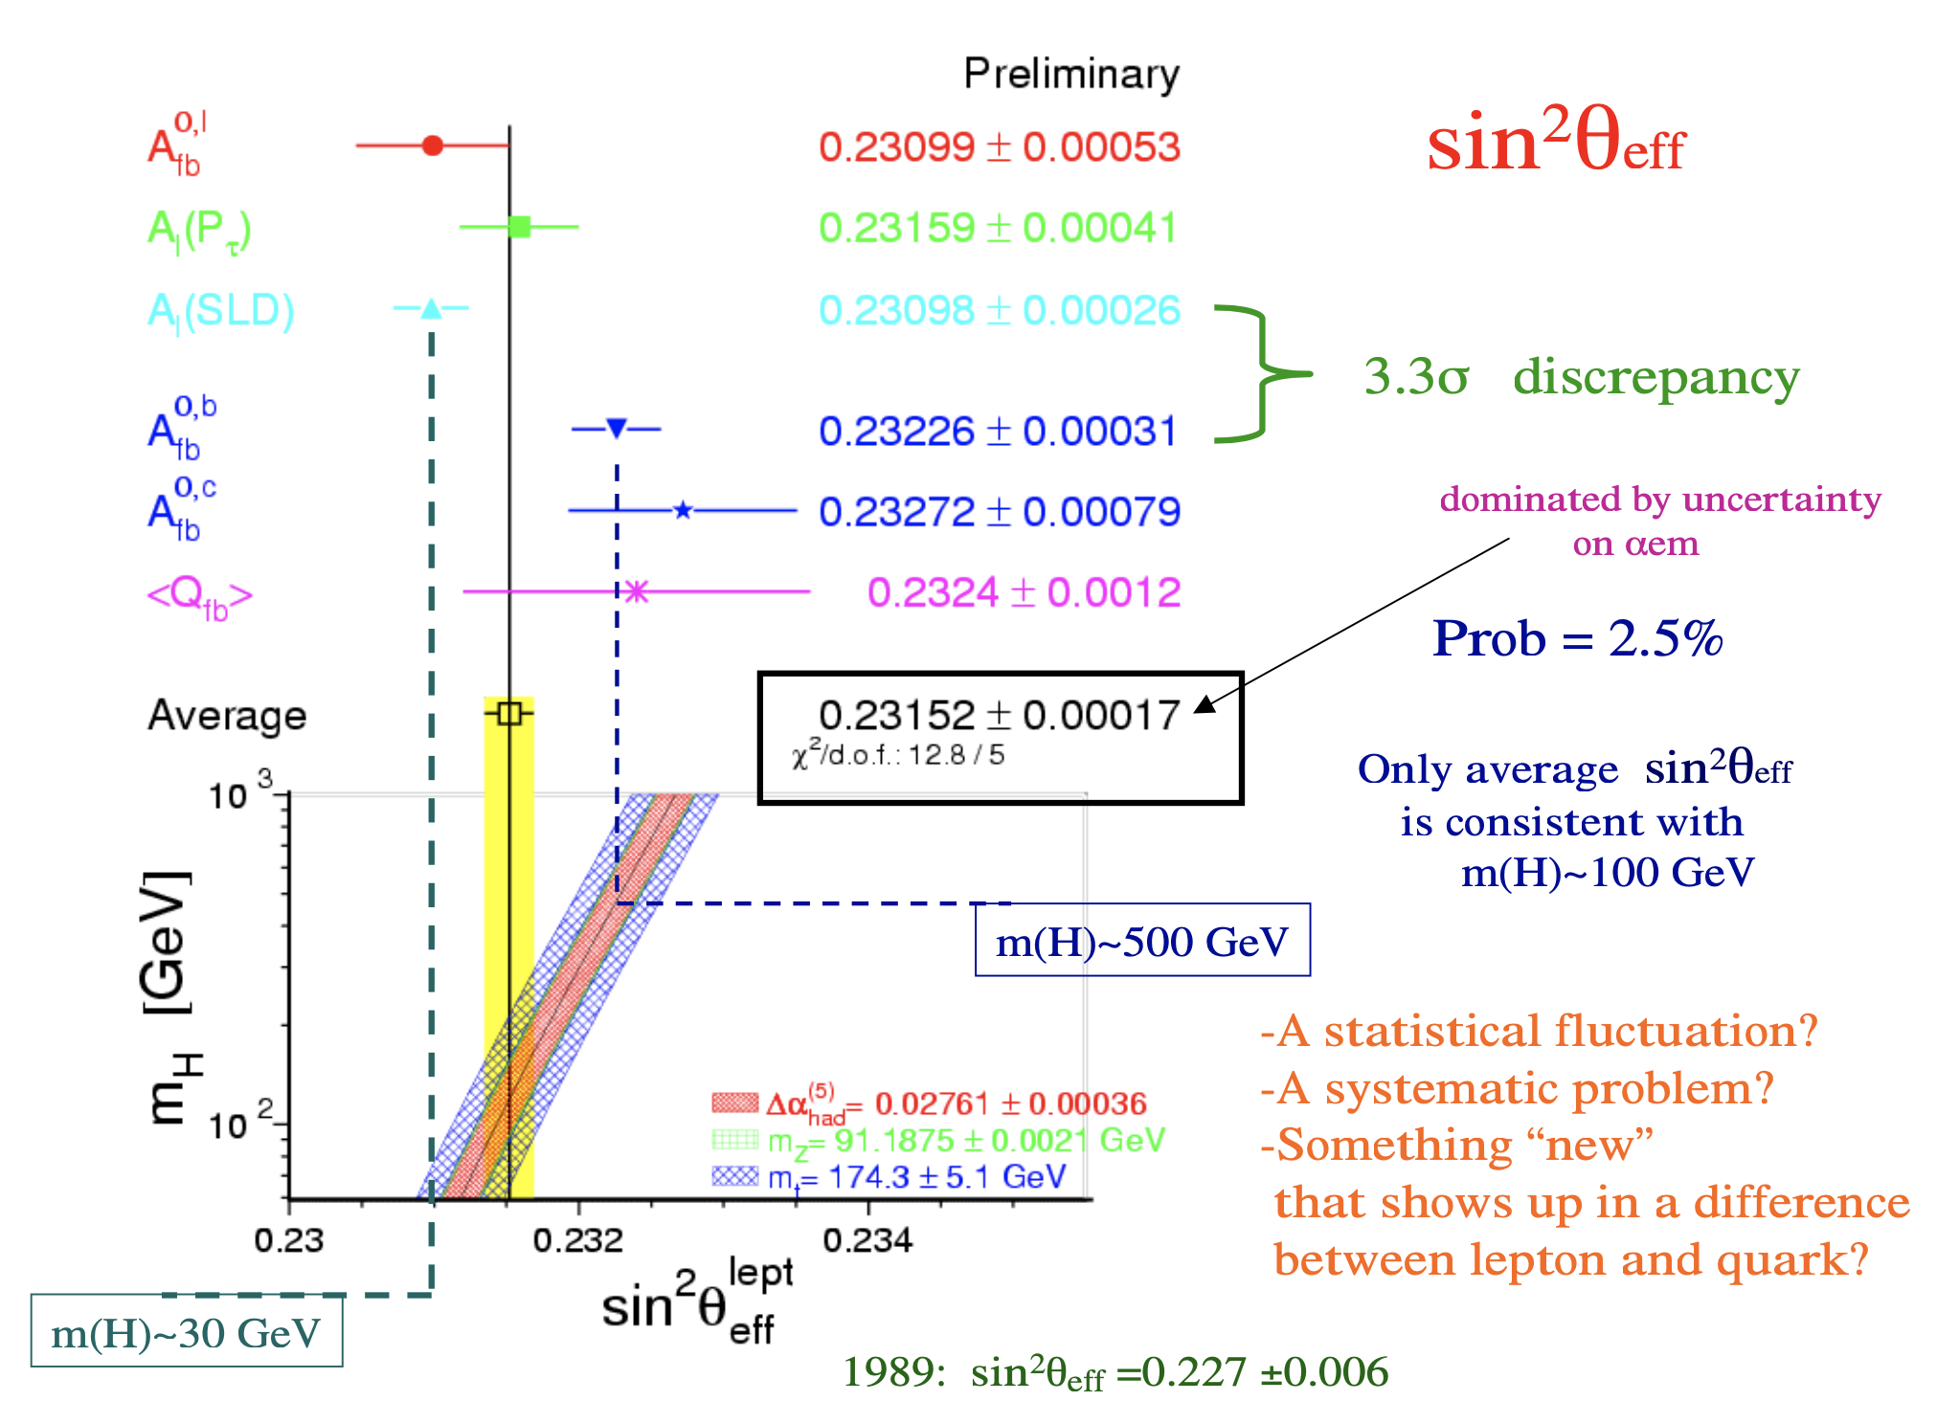

Slide 41
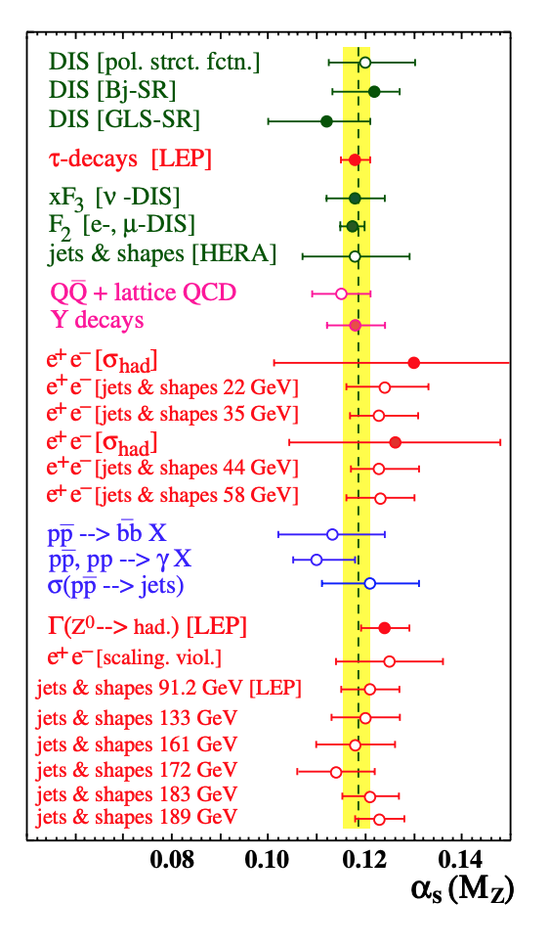
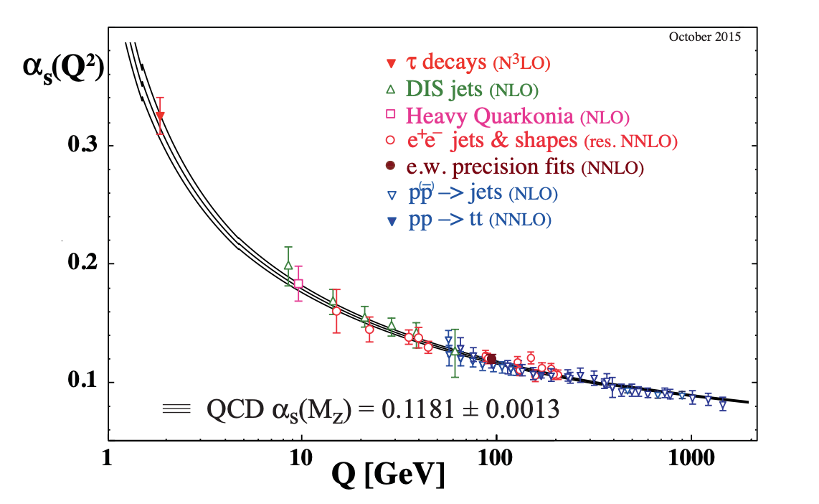
QCD measurements

Slide 42
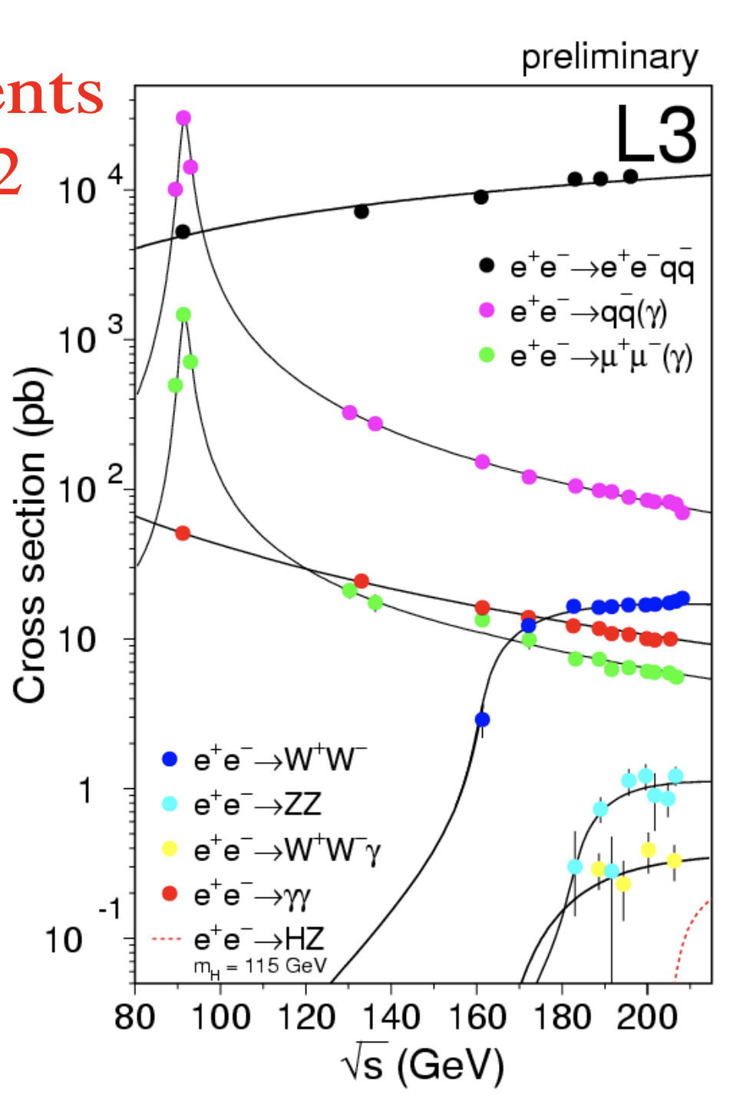
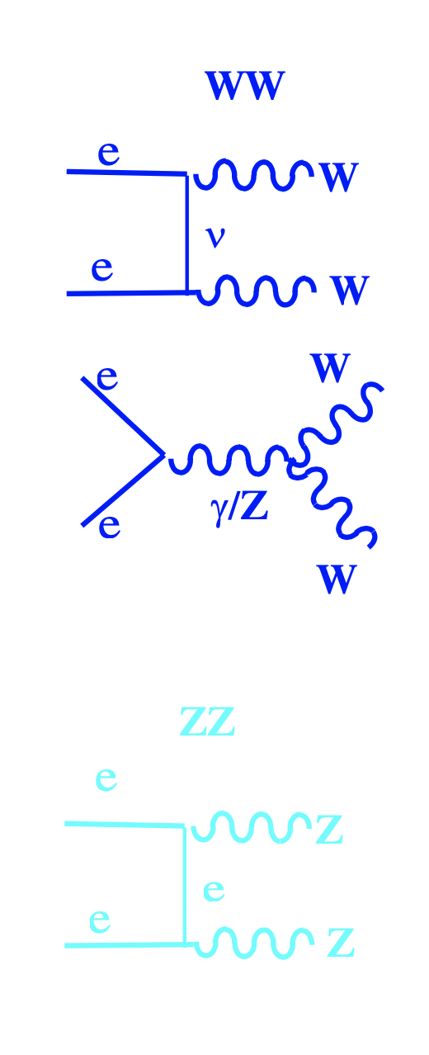
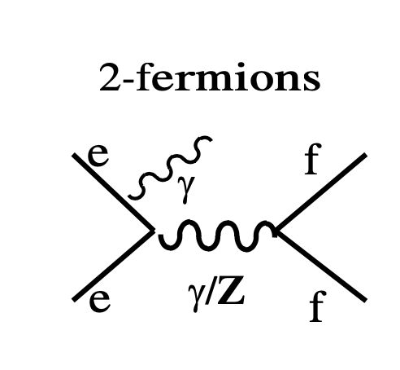
The measurement
at LEP2

Slide 43

2 fermion cross section and asymmetries

Slide 44

Triple and quartic gauge couplings
Many measurements, no deviations observed within the large uncertainties

Slide 45



WW
MANY

Slide 46


Slide 47



A lot of work went on
untill 2013
to reach an error of ~ 32 MeV
m_{W}= 80.375 ± 0.025(stat.) ± 0.022(syst.) GeV

Slide 48

9
8
9
14
7
Red: numbers from 2000
Black: final numbers, 2013

Slide 49

2
35
13 MeV
8

Slide 50

Electroweak at the end of LEP
Better than per-mille
Precisions on many quantities
α_{em} 3.1 x 10⁻⁴ 700ppm
M(Z) 2 x 10⁻⁵ 23ppm
G_{F} 8.6 x 10⁻⁶ 9 ppm
α_{s} 2.3 x 10⁻²

Slide 51


Higgs @ LEP: the ideal place.
The simplicity of the initial states is transmitted
to the final state
Higgs-strahlung
WW fusion
e⁺e⁻->Hνν
+
positive
interference
Dominant mode
m(H) ≤ √s-m(Z)
possibility to go beyond !
E_{cm}=206 GeV
Direct Searches:
LEP is the perfect machine to
search for the Higgs
IF m(Higgs) < E_{cm} – MZ
σ_{tot}(m_{H}=115) ~ 40 fb
LEP2 : 1995-2000, E_{cm} = 130 – 209 GeV
L > 2.5 fb⁻¹ @ E_{cm}> 187 GeV

Slide 52



LEP: the ideal place (2)
The simplicity of the initial states is transmitted
to the final state
4 jets
2 jets &
missing energy
60%
19%
2 jet &
2 lepton
6%
Or a τ
instead of the b

Slide 53

The combined limit on m_{H}
Exp Obs
ALEPH 113.5 111.5
DELPHI 113.3 114.1
L3 112.4 112.0
OPAL 112.7 112.7
4-jets 114.5 113.3
l+ν+τ 114.2 114.2
LEP 115.3 114.4
At LEP2 : 1995-2000, E_{cm} = 130 – 209 GeV
L > 2.5 fb⁻¹ @ E_{cm}> 187 GeV
Before LEP m_{H}>14 MeV,
After 1 year of LEP at the Z mass m_{H}>24 GeV

Slide 54



The events
The first 4 events maintain
the highest weight in the final analyses

Slide 55
One of the 3 Aleph events
4 b cand.
HZ hyp.
m_{H}=114.4 GeV/c²
NN = 0.997
jet b-tag:
Z
1 0.994
2 0.78
H
3 0.993
0.999
E_{LEP}=206.7
ZZ hyp.
m_{Z}=97 GeV
m_{Z}=94 GeV
A 22 GeV shower in SICAL that was giving Evis = 252 GeV
is rejected by a better algorithm : m_{H}= 112.8 −> m_{H}=114.4

Slide 56

The L3 event
With Ballestrero WPHACT …
Higgs events are not collinear !

Slide 57





Higgs discovery? from end of 2000 to the final results…
Nov 2000
Jul 2001
final
4.2 x 10⁻³
m_{H}>113.5
(115.3 expected)
~0.03 m_{H}>114.1
(115.4 expected)
~ 0.09 m_{H}>114.4
(115.3 expected)
Background Probabilities 1-CL_{b} (m_{H}=115)
Nov 2000 → July 2001 → final
LEPH: 0.00065 (to HWG) → 0.0015 → 0.0024
0.0011 (publ.)
DELPHI: 0.68 → 0.77 → 0.73
L3: 0.068 → 0.32 → 0.32
OPAL: 0.19 → 0.20 → 0.50
Changes: +10% L @ 206 final Ebeam
final detector calibrations
Aleph 2D correlation in Hqq
Delphi Hee optimized New MC for sig and bkg
L3 more MC
OPAL better bgk estim. New analyses, new mass rec.

Slide 58

LEP limit
LEP Expected to exclude: mH<115.3
Excluded: mH< 114.4 GeV
m(H)≤ 152 GeV/c²
at 95% CL
EW precision
measurements
m(H)= 94 GeV/c²
+29
-24

Slide 59

MARCH 2012

Slide 60

MARCH 2012

Slide 61
End of LEP
2000 last year of data taking at LEP
We insisted a lot to continue, but we failed.
1995 At the Research Board in June 95, Siemens proposed to produce
32 Superconducting RadioFrequency cavities for 32 MCH
(they were producing the SC for LEP2, and after that they would
have dismantled the production line)
With those cavities LEP could have reached Ecm=220 GeV
(thus m(Higgs) < E_{cm} – MZ ~ 129 ( + ΓZ ) )
The CERN management decided not to increase
the energy to more than 200 GeV
(we managed to reach 209 GeV ,
the last bits by « increasing » the radius of the collider!)
One historical sentence in the 2000 « battle » was:
Sam Ting: « At LEP every event is signal,
at LHC every event is background »
Notes:
chiusura di LEP : famosa citazione di Maiani ‘ Non possiamo estendere il run: vi rendete conto di cosa succederebbe per il programma LHC se per caso scopriamo l’Higgs ?’

Slide 62


The end of LEP → Toward LHC
2/2002
Dec 2000 LEP stops
and it is dismantled.
LHC starts engineering work
2009 first interactions
2010-2011-2012
LHC run at
7 TeV center-of-mass energy
2016-2018 LHC run at 13 TeV
2/2002

