Slide 1
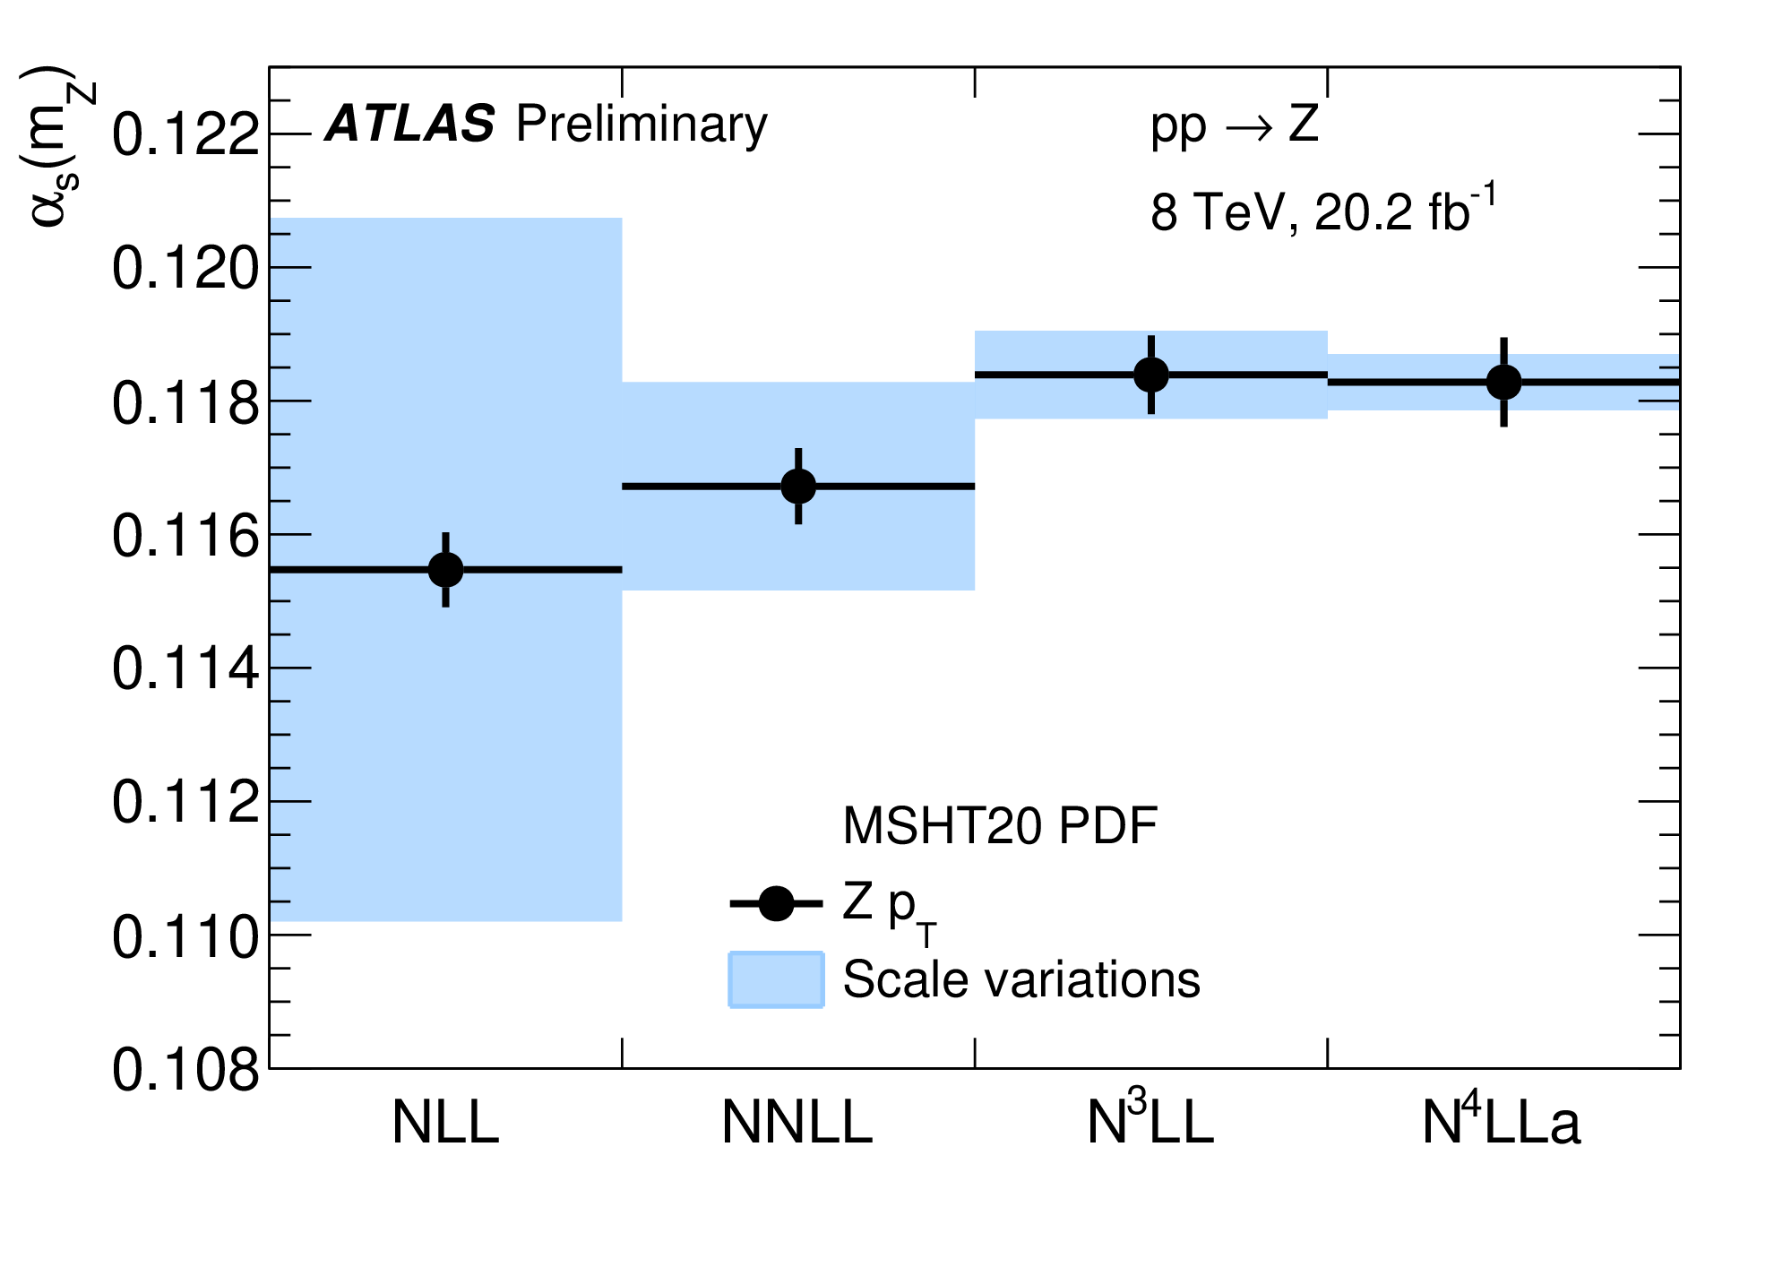

Advances in Resummed Calculations
Andrea
Banfi
QCD@LHC – 5 September 2023 – IPPP Durham

Slide 2
Outline
Resummed calculation have reached an astonishing accuracy. I will highlight some of the most impressive advances
Transverse momentum distributions
Hadronisation corrections
Non-global and super-leading logarithms
Not mentioned here, but worth considering
Heavy-quark masses
Power-suppressed corrections (see S. Jaskiewicz’s talk)
Collinear dynamics, track functions, etc (see W. Waalewijn’s talk)
This is a general overview: for technical details see Thomas Becher’s talk at PSR23

Slide 3
General considerations

Slide 4



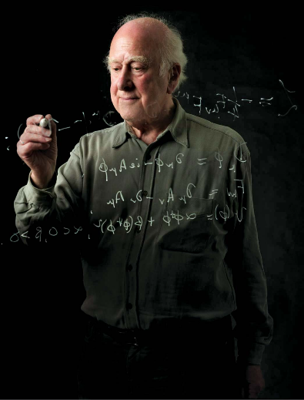

Two-scale problems
Resummation is all about taming two-scale problems, where an object characterised by a “hard scale” is accompanied by softer objects at a lower scale

Slide 5

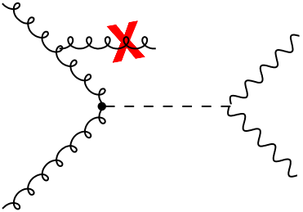
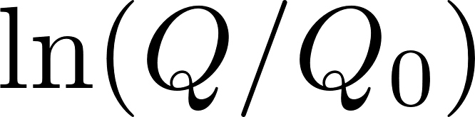
Two-scale problems
Example of two-scale problem: an object with a large invariant mass accompanied by jet with low transverse momenta
In QCD, large logarithms such as appear whenever the phase space for the emission of soft and/or collinear gluons is restricted

Slide 6
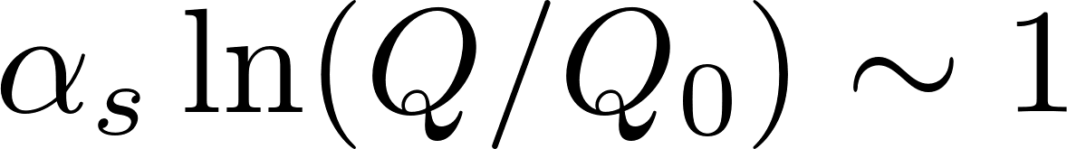
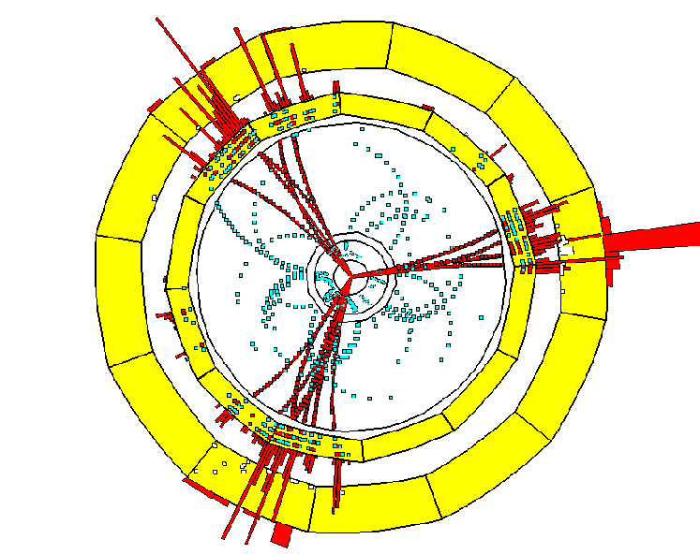
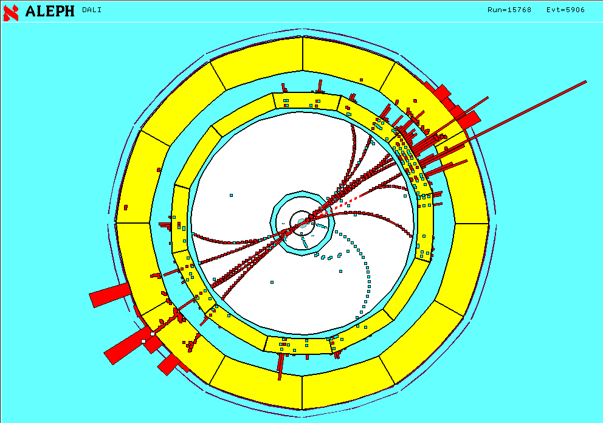
Where do we resum?
For jet observables, the bulk of events lies in the region
fixed order
resummation

Slide 7

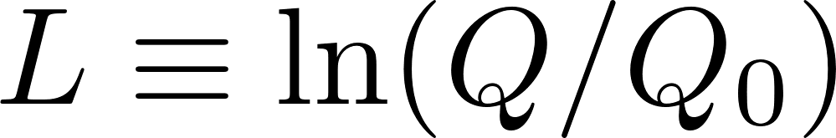
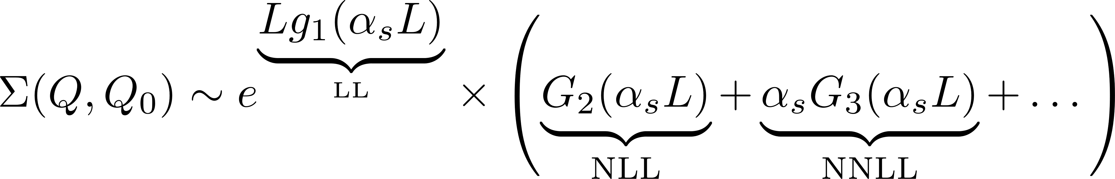
All-order resummation
All-order resummation of large logarithms reorganisation of the perturbative series in the region , with

Slide 8
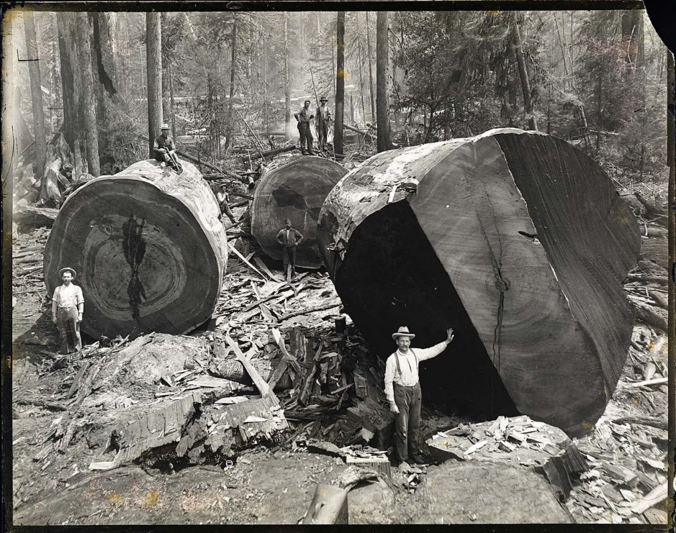
All-order resummation
All-order resummation of large logarithms reorganisation of the perturbative series in the region , with

Slide 9
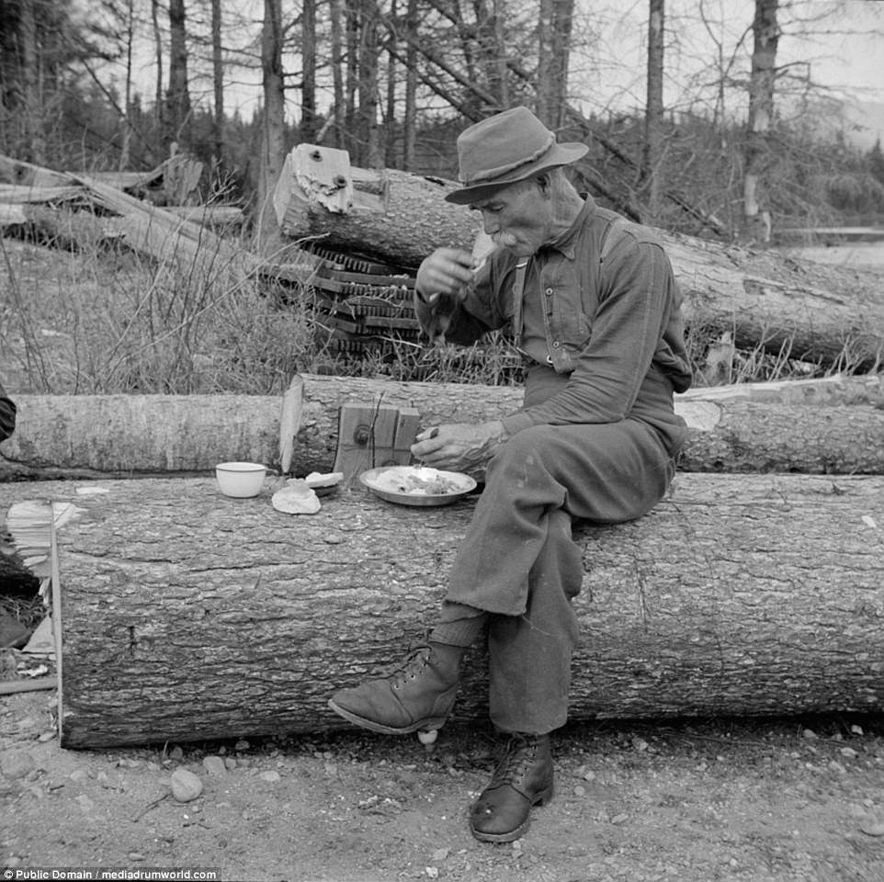
All-order resummation
All-order resummation of large logarithms reorganisation of the perturbative series in the region , with

Slide 10

All-order resummation
All-order resummation of large logarithms reorganisation of the perturbative series in the region , with

Slide 11

All-order resummation
All-order resummation of large logarithms reorganisation of the perturbative series in the region , with
This representation is independent of the formalism used for the resummation, so it can be used to compare different resummed predictions

Slide 12
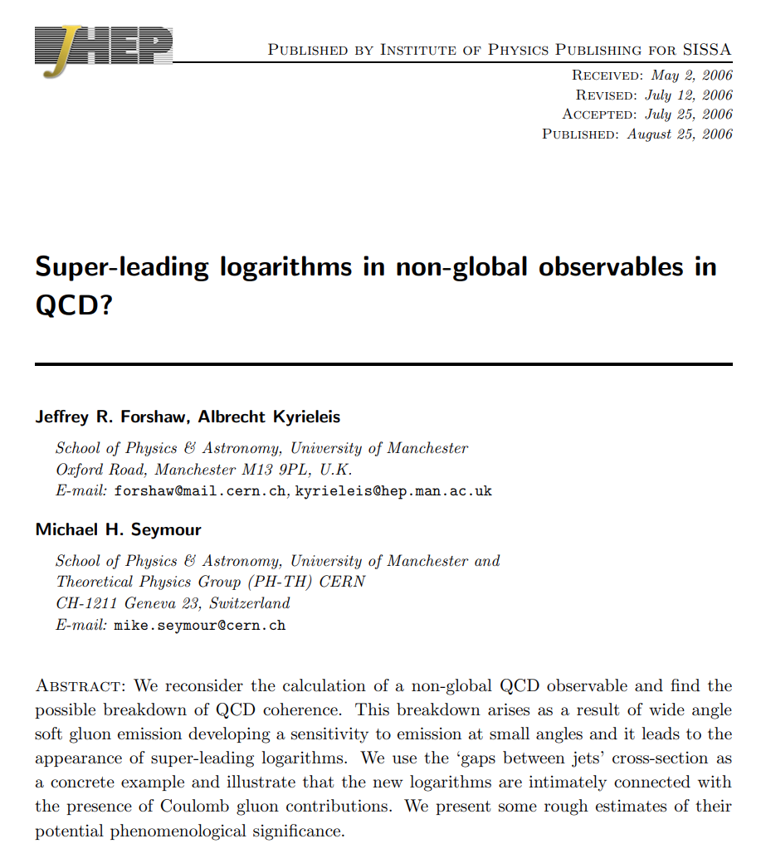
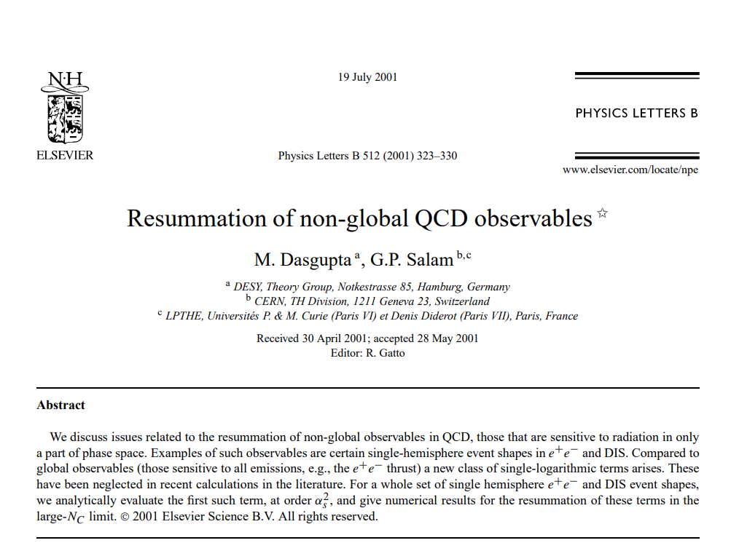
Important discoveries
Resummation is not only precision calculations. The probed all-order structure of QCD revealed unexpected features …
… and required new concepts, e.g.
Recursive Infrared and Collinear (rIRC) safety
Collinear anomaly
[AB Salam Zanderighi hep-ph/0407286]
[Becher Neubert 1007.4005]

Slide 13
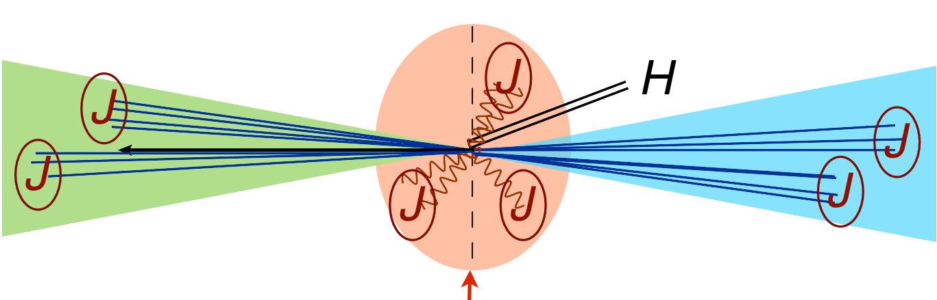

Soft-Collinear Effective Theory
Soft Collinear Effective Theory (SCET) exploits the strategy of region to extract the relevant integrals contributing to all-order resummations
Many observables enjoy factorisation theorems: the resummation consists in the convolution of hard, jet and soft functions, that can be computed independently
Anomalous dimensions of SCET operators and coefficient functions can be computed at very high accuracy using known loop techniques
Involved observable-dependent coefficients can be computed numerically with SoftSERVE (see also K. Brune’s talk)
[Bell Rahn Talbert 1812.08690, 2004.08396]

Slide 14
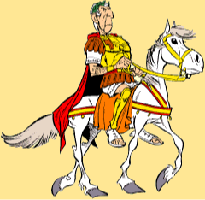
CAESAR vs ARES
It is possible to derive general formulae for the resummation of an arbitrary rIRC observable in an arbitrary process
[AB Salam Zanderighi hep-ph/0407286]
[AB McAslan Monni Zanderighi 1412.2126]
CAESAR performs automatically NLL resummations given only the observable definition in terms of momenta
Requires careful numerical extrapolations to be extended beyond NLL
ARES uses analytically determined soft and collinear limits of each observable
Currently NNLL, but can be in principle extended to an arbitrary logarithmic accuracy (see e.g. RadISH)
[Monni Re Torrielli 1604.02191]

Slide 15
Transverse momentum resummations

Slide 16
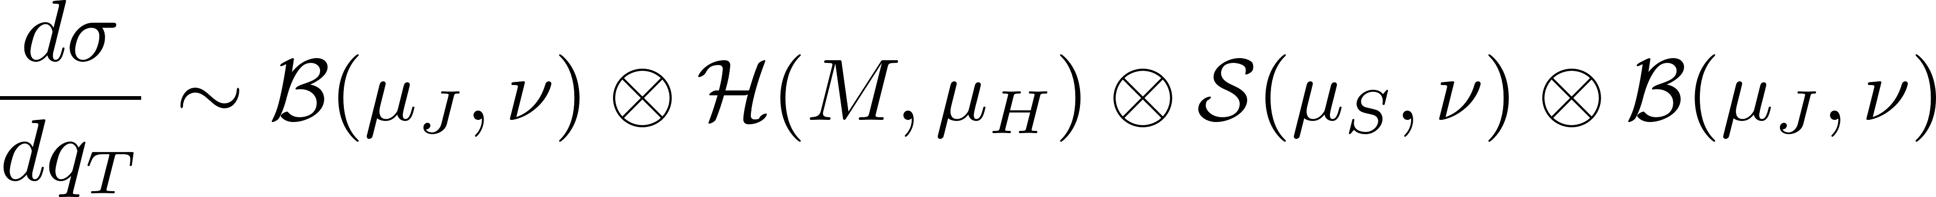
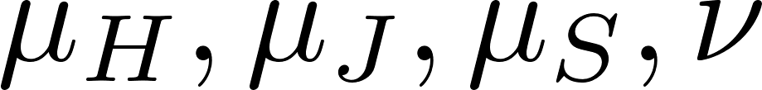
Transverse momentum distribution
The distribution in the transverse momentum of a colour singlet (e.g. Higgs, Z boson) is a fully inclusive observable and admits an all-order factorisation
[Collins Soper Sterman Nucl. Phys. B250 (1985) 199]
The independence of the distribution on the scales induces renormalisation group equations (RGEs) that can be solved at high accuracy
A similar all-order factorisation formula holds for the transverse momentum distribution of the leading jet (see J. Gaunt’s talk)
[Becher Neubert 1205.3806]

Slide 17
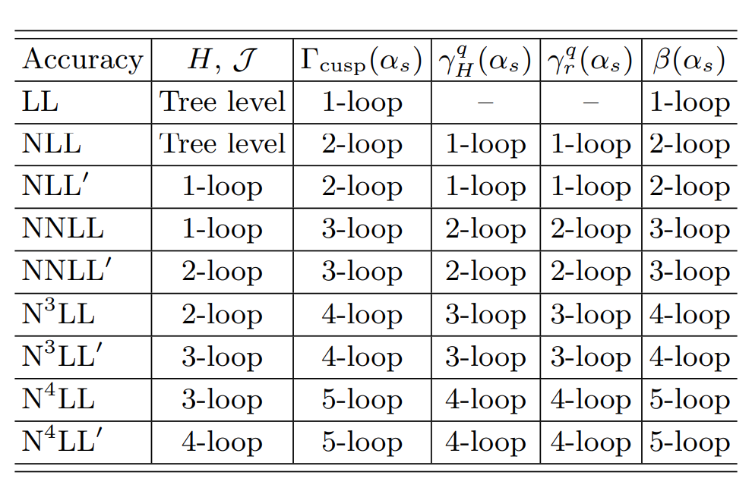
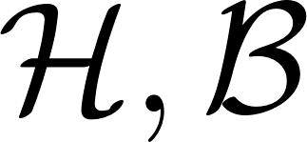
Transverse momentum distribution
Impressive progress in the calculation of anomalous dimension and coefficient functions allows resummation up to approximate N⁴LL accuracy

Slide 18




Transverse momentum distribution
Impressive progress in the calculation of anomalous dimension and coefficient functions allows resummation up to approximate N⁴LL accuracy
[Herzog Moch Ruijl Ueda, Vermaseren Vogt 1812.11818]
5-loop cusp estimated to have a very small effect

Slide 19

Transverse momentum distribution
Impressive progress in the calculation of anomalous dimension and coefficient functions allows resummation up to approximate N⁴LL accuracy
[Agarwala von Manteuffel Panzerb Schabinger 2102.09725]

Slide 20

Transverse momentum distribution
Impressive progress in the calculation of anomalous dimension and coefficient functions allows resummation up to approximate N⁴LL accuracy
Vladimirov’s conjecture
[Duhr Mistberger Vita 2205.02242]
[Vladimirov 1610.01404]
[Moult Zhu Zhu 2205.02249]

Slide 21

Transverse momentum distribution
Impressive progress in the calculation of anomalous dimension and coefficient functions allows resummation up to approximate N⁴LL accuracy
3-loop beam function
[Ebert Mistberger Vita 2205.02242]
4-loop hard function
[Lee von Manteuffel Schabinger Smirnov Smirnov 2202.04660]

Slide 22
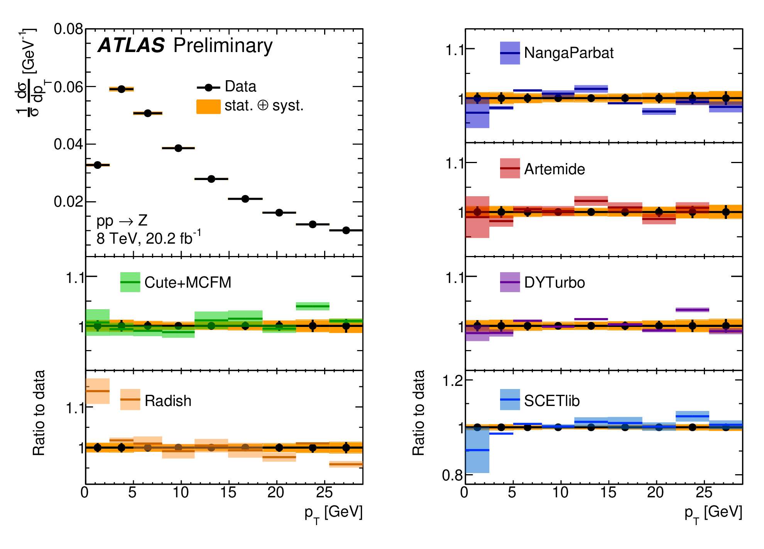
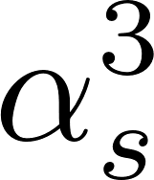
Comparison to LHC data
ATLAS-CONF-2023-013
All implementations except Artemide include results from MCFM

Slide 23
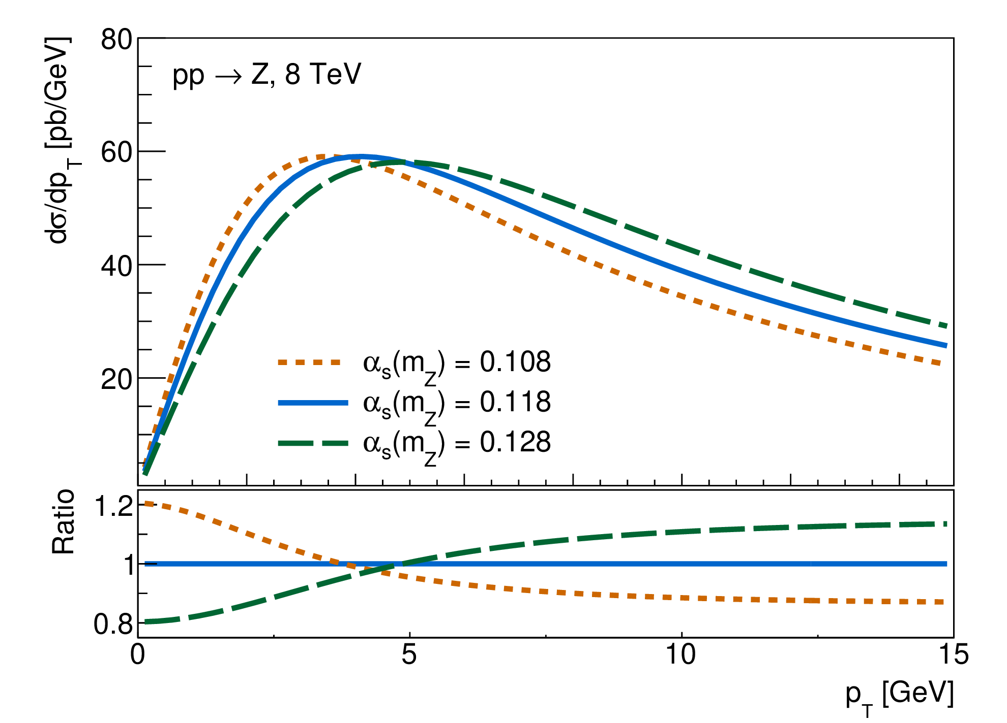
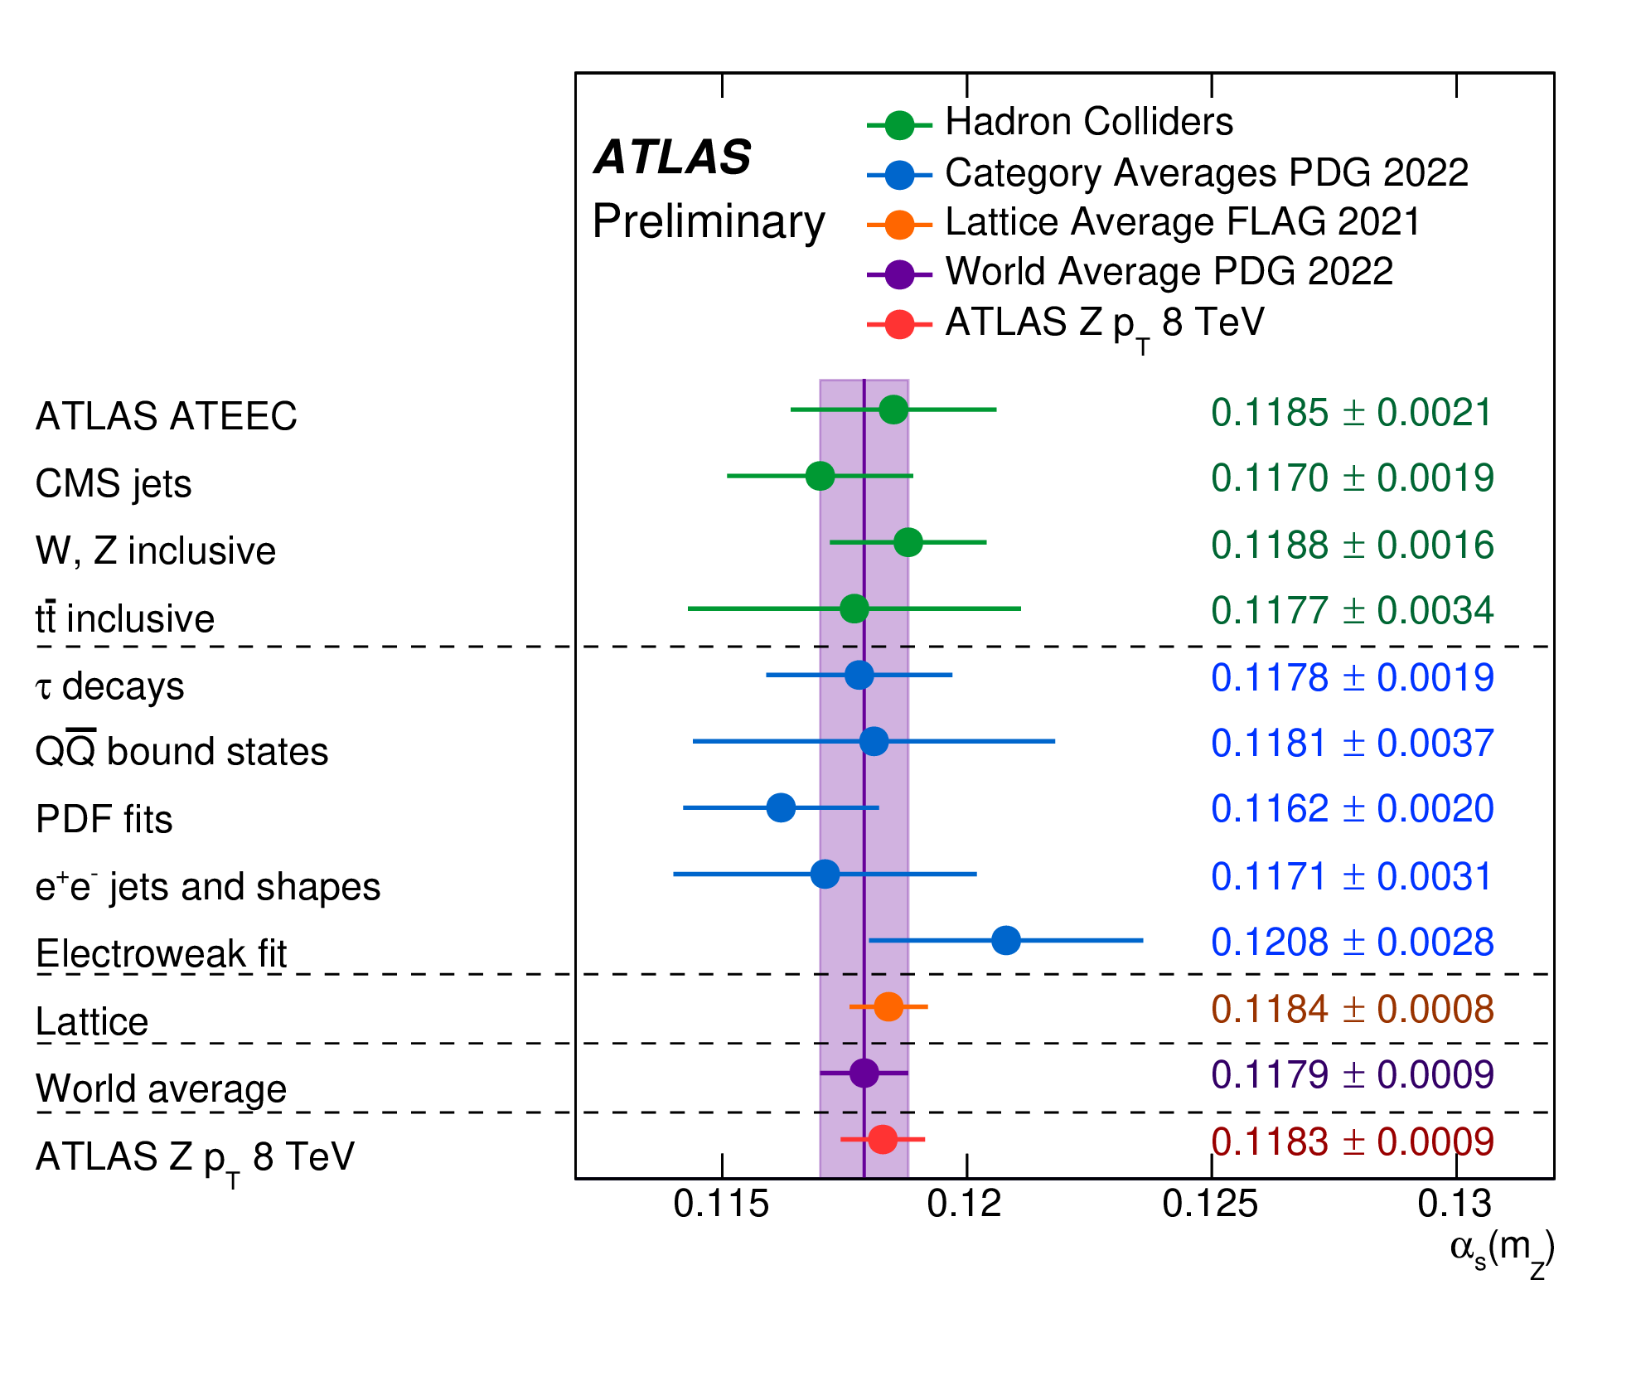

Measuring the strong coupling
Predictions obtained with DYturbo
Two-parameter non-perturbative model
[Camarda Cieri Ferrera 2303.12781]
ATLAS-CONF-2023-015
[Collins Rogers 1412.3820]
One of the most precise determinations of

Slide 24
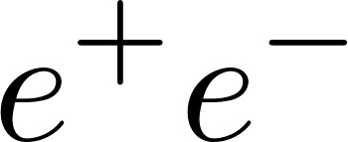
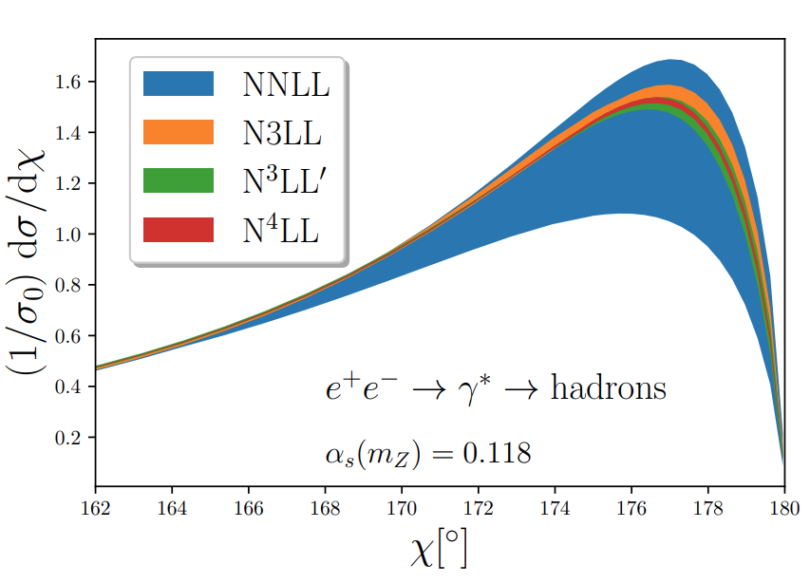
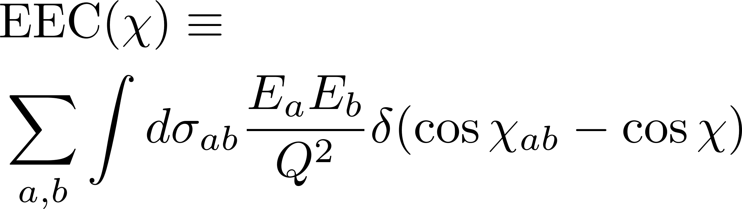
Energy-energy correlation
The new information on the rapidity anomalous dimension makes it possible to resum also the energy-energy correlation in at aN⁴LL accuracy
[Duhr Mistberger Vita 2205.02242]
The EEC is a particular example of energy-energy correlators (see K. Lee’s talk)
The EEC has large 1/Q hadronisation corrections: important at this accuracy
[Chen Moult Zhang Zhu 2004.11381]
[Dokshitzer Marchesini Webber hep-ph/9905339]
[Schindler Stewart Sun 2305.19311]

Slide 25

We don’t talk about
hadronisation

Slide 26
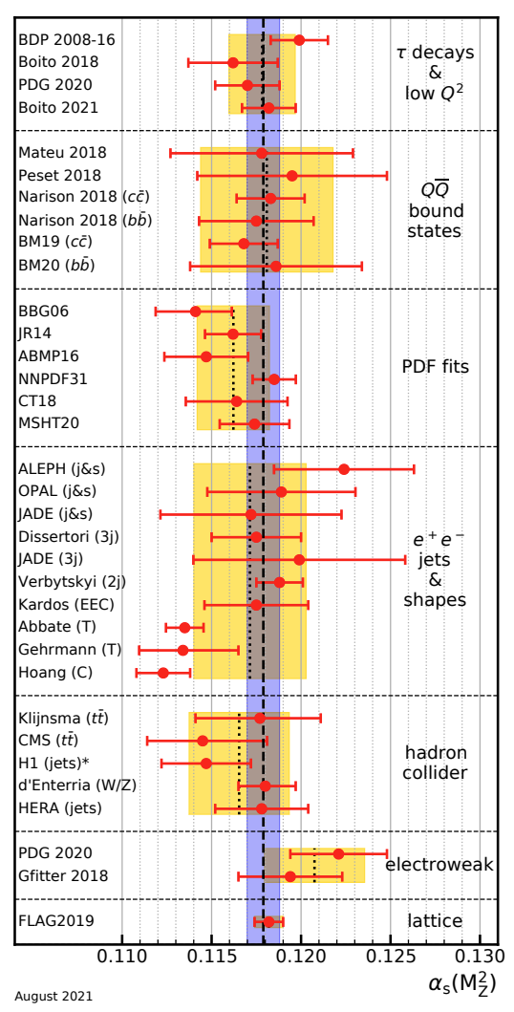
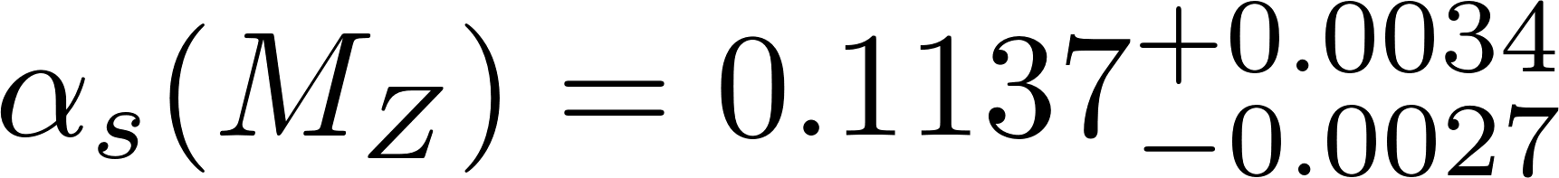
Strong coupling with jets
Jet observables constitute an important means of determination of the strong coupling
Increase in precision of PT QCD calculations resulted in massive decrease in theory uncertainties
The main difference between these predictions is the treatment of hadronisation corrections
Two-jet rate (NNLL+NNLO)
Thrust and C-parameter ((N)NNLL+NNLO)
[PDG 2022]

Slide 27
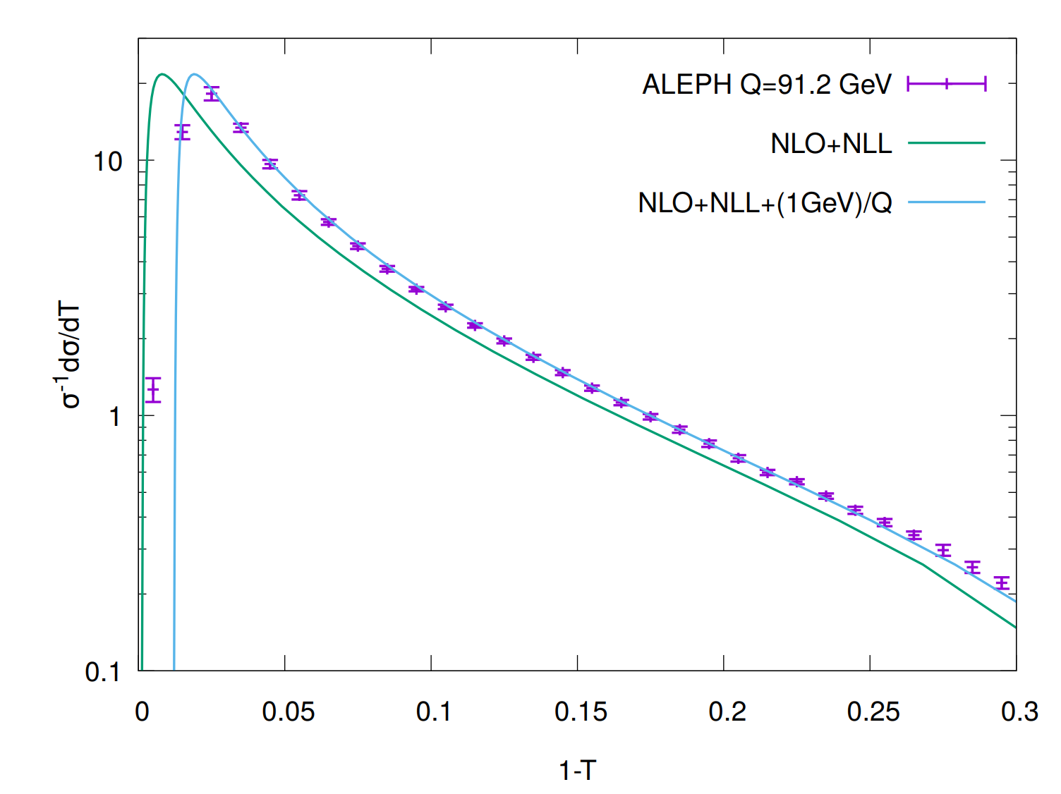
hadronisation effects
At the energies probed so far, perturbative prediction do not agree straightaway with data
Central hadrons with momenta ~1GeV give rise to a 1/Q suppressed shift of perturbative distributions of jet observables (~10% at LEP energies)
[Dokshitzer Webber hep-ph/9704298]

Slide 28
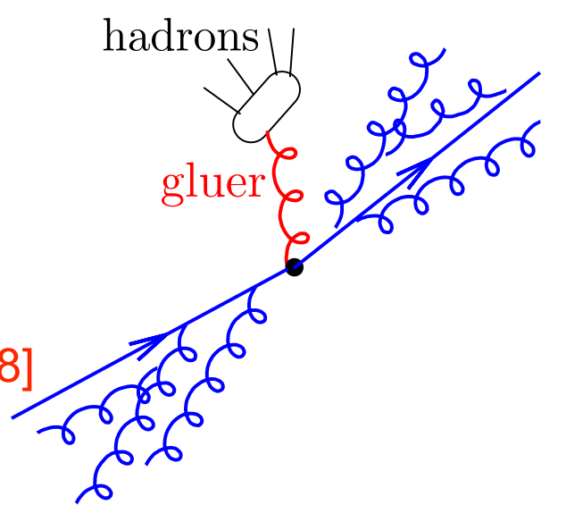


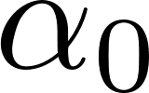
hadronisation effects
At the energies probed so far, perturbative prediction do not agree straightaway with data
ultra-soft
gluon
Central hadrons with momenta ~1GeV give rise to a 1/Q suppressed shift of perturbative distributions of jet observables (~10% at LEP energies)
Leading 1/Q hadronisation are modelled in terms of the emission of a single ultra-soft gluon simultaneous fit of and NP parameter
[Dokshitzer Webber hep-ph/9704298]

Slide 29
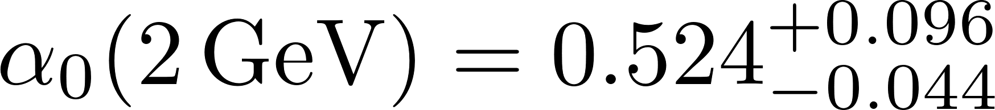

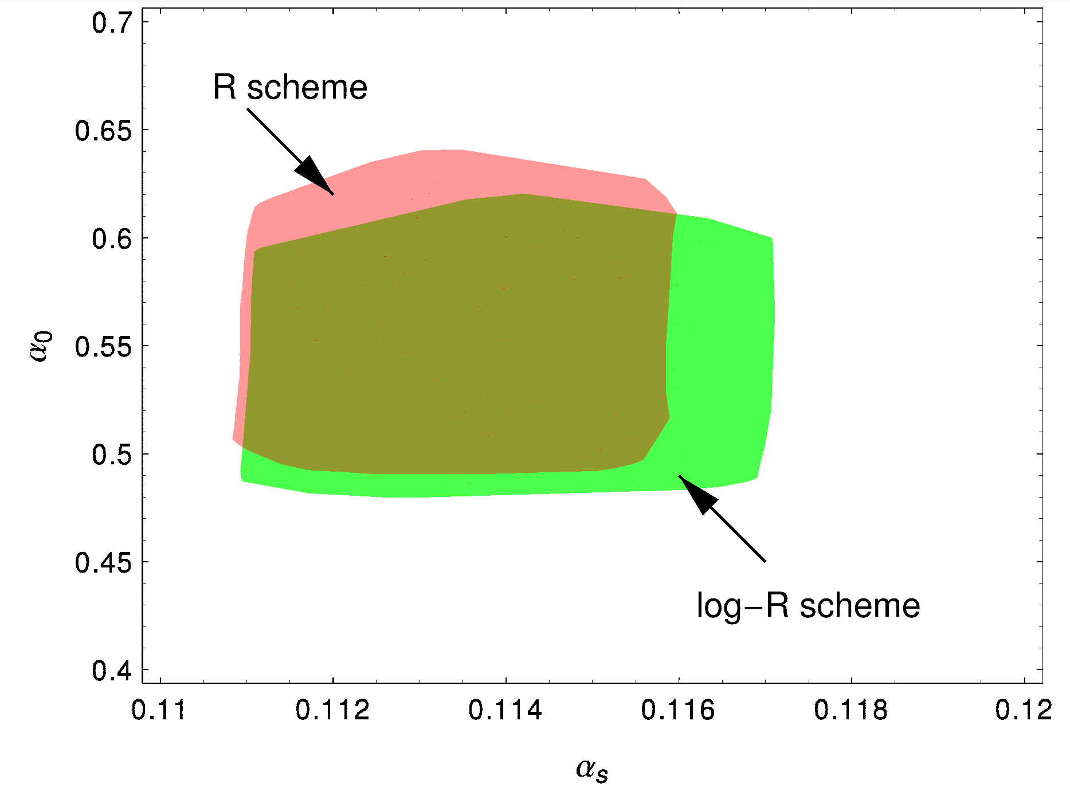
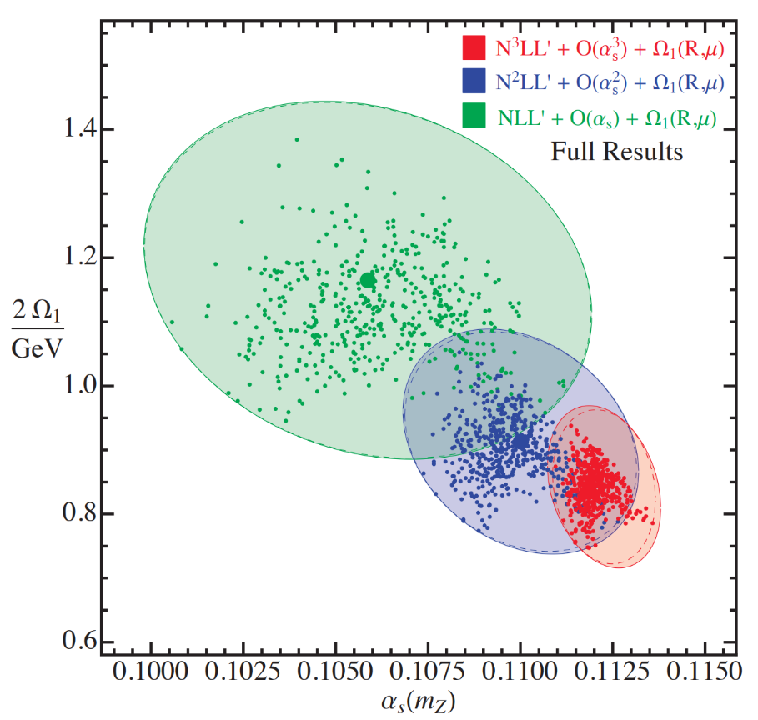
Simultaneous PT-NP fits
Most accurate determinations of with event shapes arise from simultaneous fits of 1/Q hadronization corrections
Thrust (NNLL+NNLO)
C-parameter (NNNLL+NNLO)
[Gehrmann Luisoni Monni 1210.6945]
[Hoang Kolodubrez Mateu Stewart 1501.04111]
Both fits assume that the shift in the fit range is the same as in the two-jet region, where 1-T an C are very small is this justified?

Slide 30
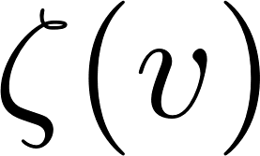
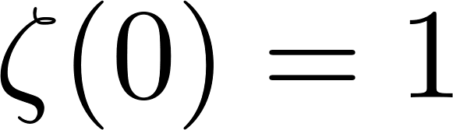
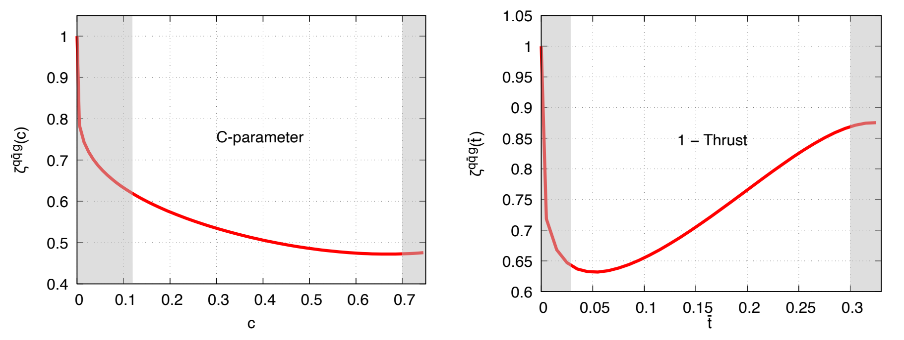
PT-NP interplay
The 1/Q shift depends on the observable’s value in the fit range extra 3-4% uncertainty in the determination of
It is possible to calculate analytically the deviation of the shift from the two-jet limit (see talk by P. Nason)
[Luisoni Monni Salam 2012.00622]
[Caola Ferrario-Ravasio Limatola Melnikov Nason Ozcelik 2204.02247]
fit range
fit range
New frontier for precision: calculation of the 1/Q shift in the three-jet region for all event shapes and jet resolution parameters

Slide 31
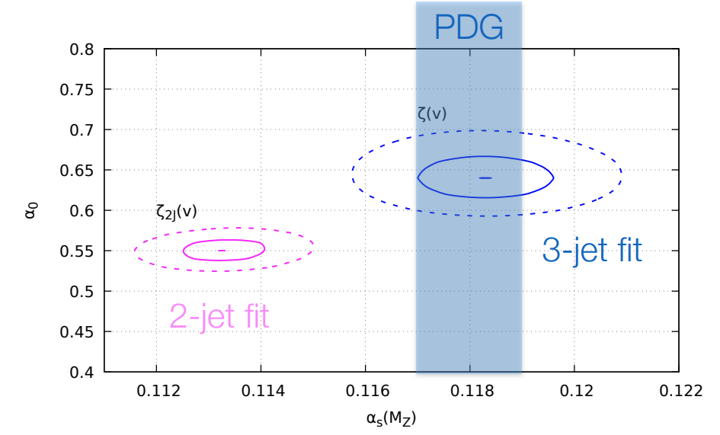
PT-NP interplay
The 1/Q shift can be computed in the three-jet region for most event shapes and for the three-jet resolution parameter
Using NP shifts in the three-jet region greatly improves the universality pattern of hadronisation corrections
[Nason Zanderighi 2301.03607]

Slide 32






PT-NP interplay
The 1/Q shift can be computed in the three-jet region for most event shapes and for the three-jet resolution parameter
Using NP shifts in the three-jet region greatly improves the universality pattern of hadronisation corrections
[Nason Zanderighi 2301.03607]
ultra-soft
gluon
This approach does not include resummation in the two-jet region, which is essential to describe event shapes (e.g. total jet broadening) where the shift is well defined only in the presence of multiple soft-collinear emissions
[Dokshitzer Marchesini Salam hep-ph/9812487]

Slide 33
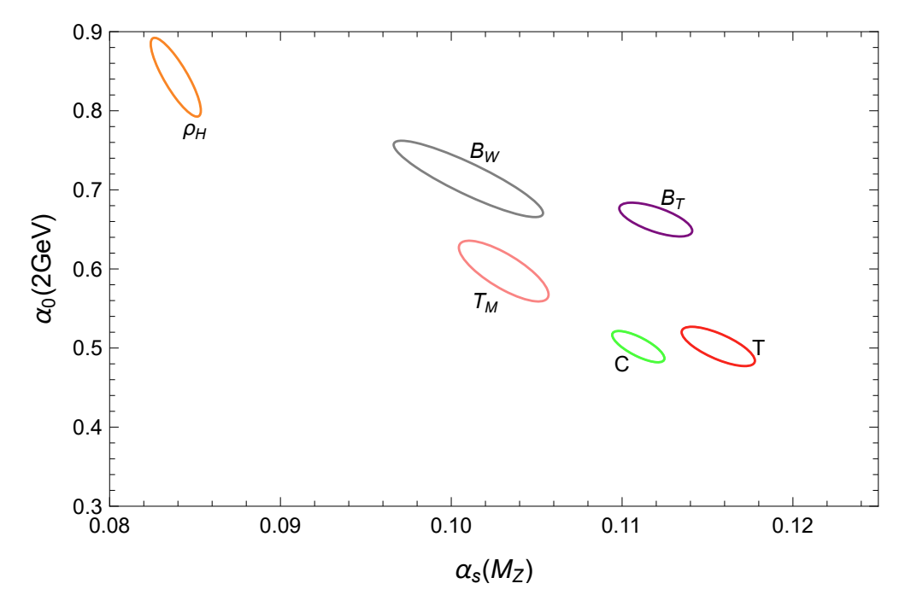
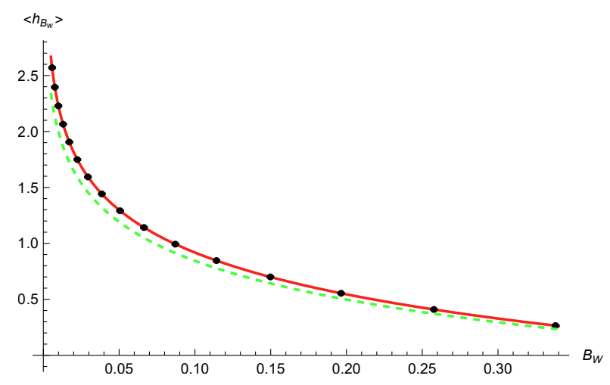
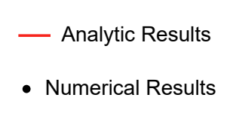
PT-NP interplay
With the ARES formalism, it is possible to compute the shift to an arbitrary event-shape variable in the two-jet limit in the presence of multiple soft and collinear emissions
[AB El-Menoufi Wood 2303.01534]
NEW
New results for the thrust major, which does not admit an analytic resummation
Frontier: merging of hadronisation corrections in the two- and three-jet regions

Slide 34
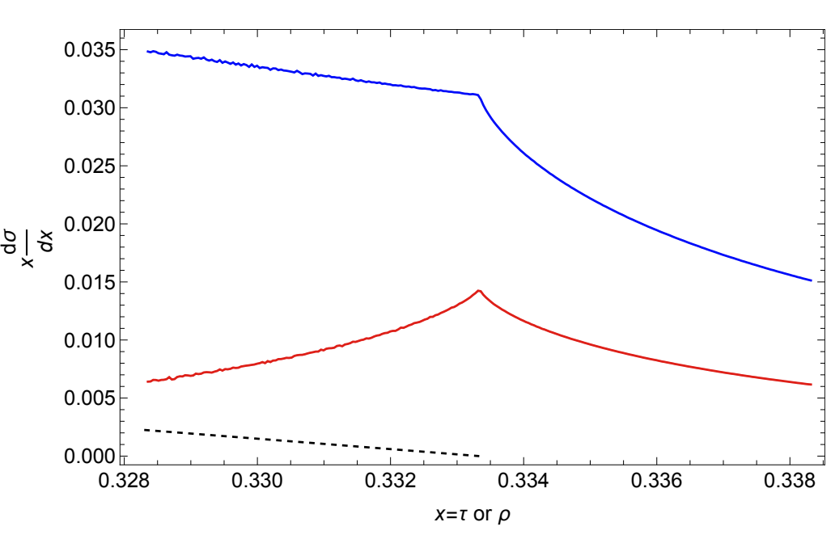
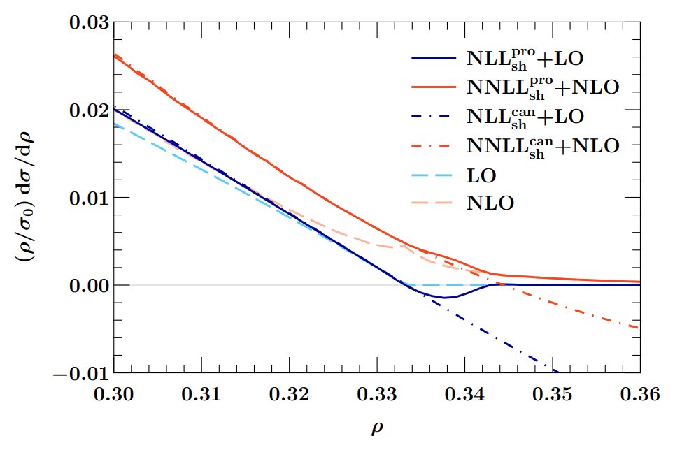
Sudakov shoulders
Pushing extractions of close to the three-jet end point requires taking into account logarithmically enhanced higher-order corrections
[Bhattacharya Schwartz Zhang 2205.05702]
NLO thrust
NLO heavy-jet mass
New: NNLL+NLO resummation of the heavy jet mass in the threshold region
Resummation is similar to that of the difference of two hemisphere masses or oblateness avenue for validation of the resummation strategy
[Bhattacharya Michel Schwartz Stewart Zhang 2306.08033]

Slide 35
Non-global observables

Slide 36
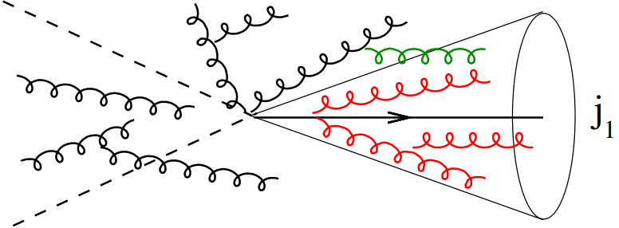
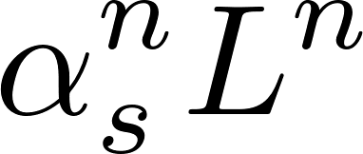
Non-global logarithms
Non-global logarithms arise whenever measurements are restricted to limited regions of phase space, e.g. single-jet mass distribution
They originate when softest emission in a correlated cascade of soft gluons enters the measurement region
[Dasgupta Salam hep-ph/0104277]
Non-global logarithms arise from soft emissions at large angles, hence leading logarithms are single logarithms
At LL accuracy, and in the large-N_{c} limit, they are resummed via the non-linear BMS equation
[AB Marchesini Smye hep-ph/0206076]

Slide 37
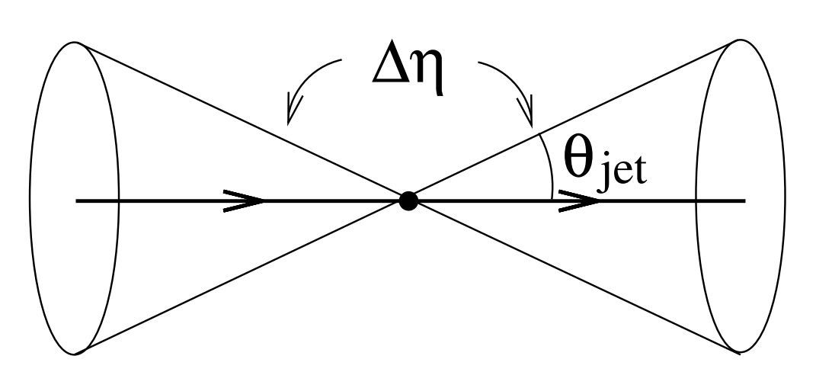
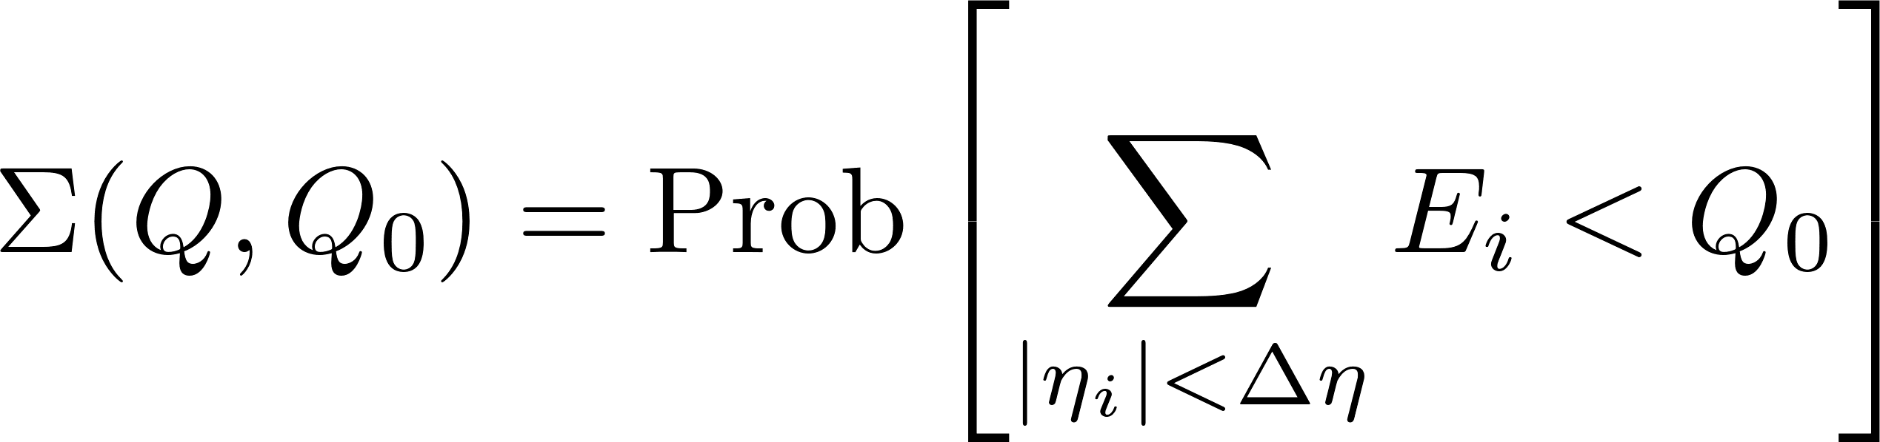
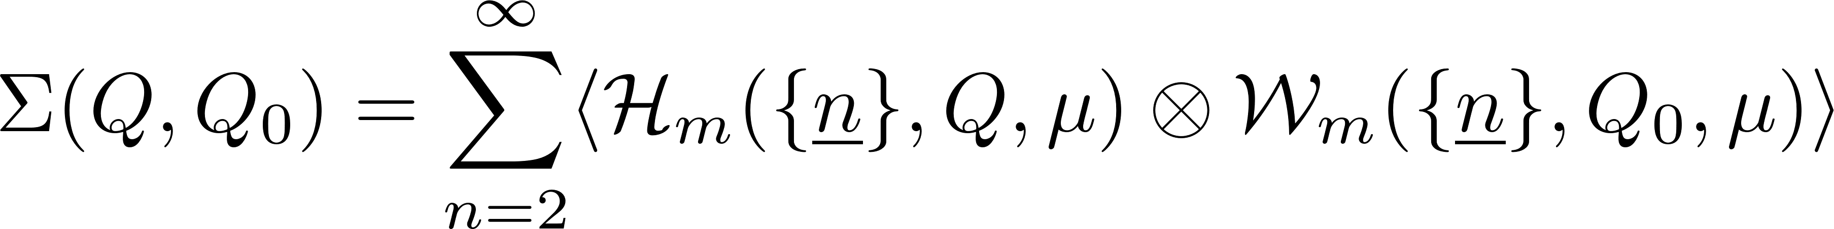
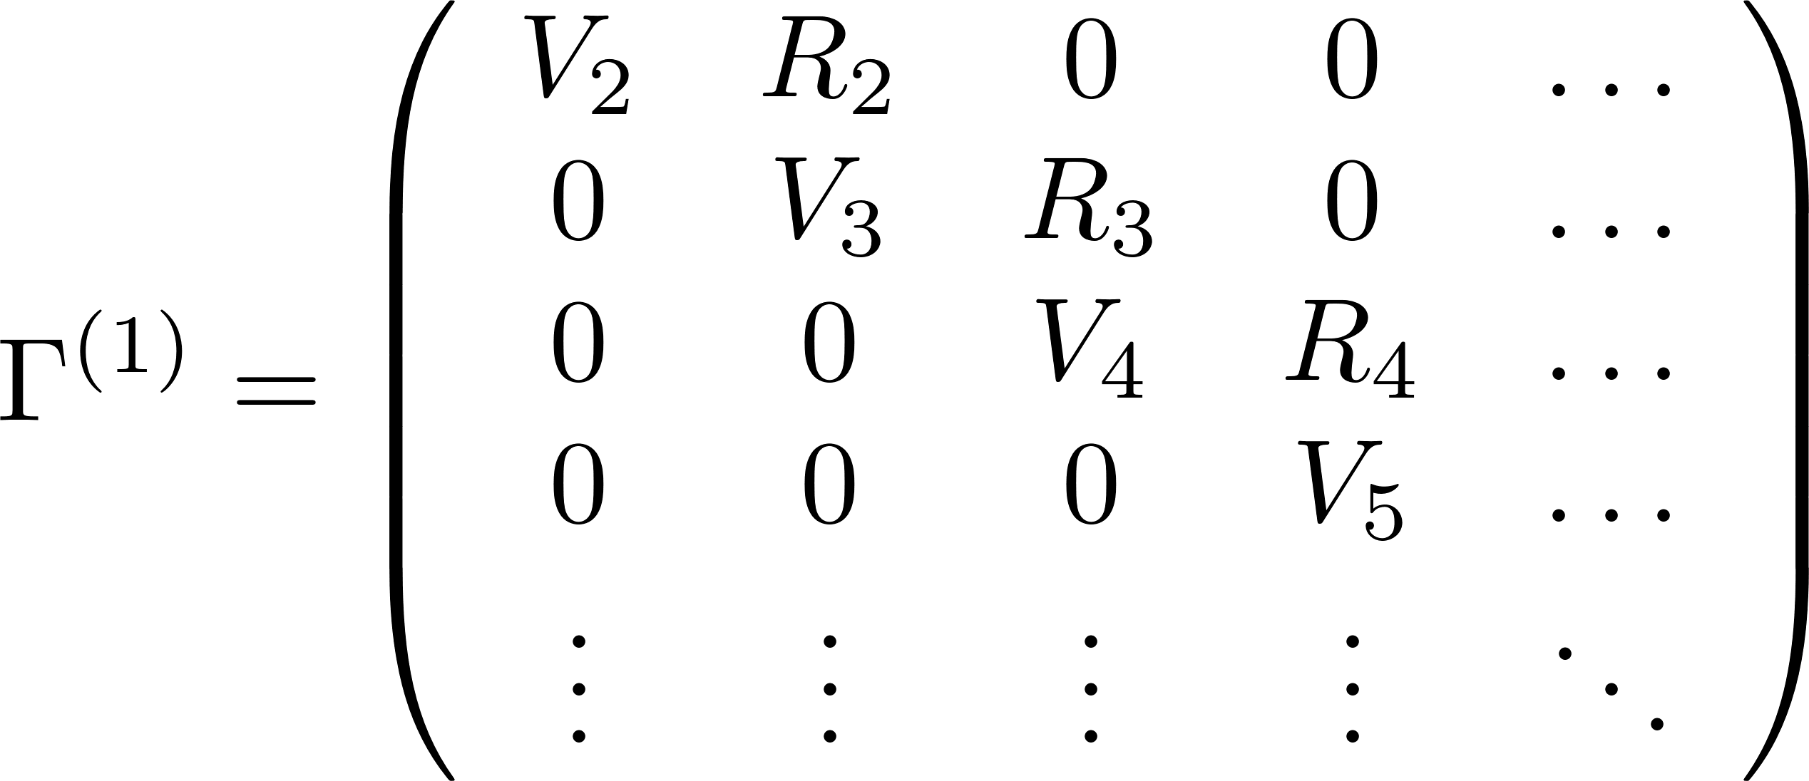
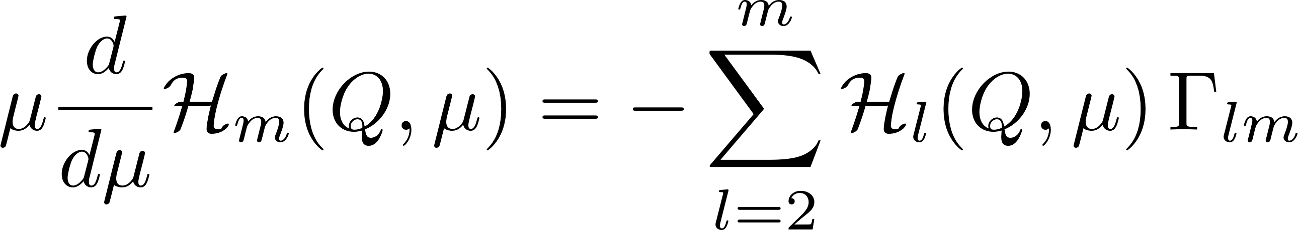
Leading non-global logarithms
Prototype observable: veto emissions inside a rapidity slice
In SCET, one can separate soft and hard modes
[Becher Neubert 1605.02737]
non-linear dynamics

Slide 38


Resummation of NL NGLs
It is possible to write a NL evolution equation for non-global logarithms and solve it numerically via a MC procedure
[AB Dreyer Monni 2104.06416 , 2111.02413]
[GNOLE https://github.com/non-global/gnole]

Slide 39

Resummation of NL NGLs
It is possible to write a NL evolution equation for non-global logarithms and solve it numerically via a MC procedure
[AB Dreyer Monni 2104.06416 , 2111.02413]
[GNOLE https://github.com/non-global/gnole]
A similar semi-numerical procedure has been employed in SCET to resum the rapidity-gap fraction in events with a Z boson
[Becher Rau Xu 2112.02108]
[Becher Schalch Xu 2307.02283]

Slide 40

Gap between jets
The prototype of non-global observable in hadron collisions is the cross section with a veto on soft emissions in a gap between the hard jets
gap
Beyond the large-N_{c} limit, the hard and soft functions are operators in the space of all possible colour states (e.g. singlet, octet, etc)

Slide 41






Evolution equation
Resummations of logarithms of the resolution can be performed by solving an RGE equation for the hard functions
[Becher Neubert Shao 2107.01212]
In the anomalous dimension one needs to keep additional contributions which cancel between real and virtual contributions in the case
+ hard collinear part
wide-angle
Glauber
collinear

Slide 42





Glauber gluons and coherence
New ingredient: the exchange of a Glauber gluon between the incoming partons
The insertion of two Glauber gluons destroys the coherence of QCD radiation
[Forshaw Kyrieleis Seymour hep-ph/0604094]

Slide 43

Super-leading logarithms
The insertion of two Glauber gluons accompanied by arbitrarily many soft and collinear gluons give rise to colour-suppressed double super-leading logarithms
The all-order resummation can be expressed in term of seven colour structures
[Becher Neubert Shao Stillger 2307.06359]

Slide 44



SLL in colour singlet production
SLL arise also in the production of a colour singlet (e.g. Z or Higgs boson), without jets (starting at 5-loops) or with an additional jet (starting at 4-loops)
[Becher Neubert Shao Stillger 2307.06359]

Slide 45



SLL in dijet production
SLL are much larger with at least two hard partons in the final state
[Becher Neubert Shao Stillger 2307.06359]

Slide 46
Concluding remarks
Resummed calculations have seen an impressive progress both in precision and in scope
Observable for which a factorisation theorem exist are taking advantage of the impressive progress in loop calculations N⁴LL!
Improved description of hadronization corrections in the three-jet region and resummation of endpoint logarithm new prospects for a better extraction of from jet observables
Resummation of non-global logarithms at NL accuracy and first resummation of super-leading logarithms resummation of an arbitrary observable at hadron colliders is now in sight

Slide 47
Concluding remarks
Resummed calculations have seen an impressive progress both in precision and in scope
Observable for which a factorisation theorem exist are taking advantage of the impressive progress in loop calculations N⁴LL!
Improved description of hadronization corrections in the three-jet region and resummation of endpoint logarithm new prospects for a better extraction of from jet observables
Resummation of non-global logarithms at NL accuracy and first resummation of super-leading logarithms resummation of an arbitrary observable at hadron colliders is now in sight
Thank you for your attention

Slide 48
Implementation of resummations

Slide 49
Resummed vs fixed-order
For resummations to have an impact on phenomenology, it is vital that predictions are available in the form of publicly available codes
The great majority of resummed predictions are in the form of in-house programs, typically observable specific
This is in contrast with fixed-order calculations, where a plethora of general tools is publicly available
  NLO calculations are fully automated and implemented in general frameworks
  NNLO calculations are publicly available for a variety of 2->2 processes
[MCFM https://mcfm.fnal.gov]
[MADGRAPH_aMC@NLO http://madgraph.phys.ucl.ac.be/]
[SHERPA https://sherpa-team.gitlab.io/]
[HELAC https://helac-phegas.web.cern.ch/]
[MATRIX https://matrix.hepforge.org/]
[NNLOJET https://nnlojet.hepforge.org/]
  It would be extremely useful to establish a common framework to implement resummed calculations

Slide 50




NLL resummations
NLL resummations for n hard emitting legs in any framework can be reduced to the CAESAR general formula
[AB Salam Zanderighi hep-ph/0407286]
When the colour correlators are numbers, NLL resummations can be implemented by just reweighting any tree-level event generator
For more than three-legs, is a matrix and has to be decomposed in a colour basis
[Baberuxki et al 1912.09396]
[SHERPA https://sherpa-team.gitlab.io/]

Slide 51


NNLL resummations
NNLL’ resummations have been interfaced to fixed-order programs in the case of the production of a colour singlet
[Campbell Ellis Neumann Seth 2301.11768]
[Kallweit Re Rottoli Wiesemann 2004.07720]
Reweighting of tree-level events, but with different strategies
  aMC@NLO-SCET and CuTe-MCFM: beam functions as new LHAPDF tabs
  MCFM-RE: NNLL corrections of collinear origin as new NLO integrated counterterms
  MATRIX+RadISH: tree-level matrix elements used as initial condition for the RadISH MC resummation
[CuTe-MCFM https://mcfm.fnal.gov/cute-mcfm.html]
[MCFM-RE https://github.com/lcarpino/MCFM-RE]
[MATRIX+RadISH https://matrix.hepforge.org/matrix+radish.html]

Slide 52




Resummation mode
As a basis for discussion, let’s start from the CAESAR NLL formula and see how it can be upgraded to NNLL (and beyond)
If Sudakov form factor is a function of Casimirs only it can be accounted for by a simple reweighting factor
Jet functions involve convolutions with tree-level matrix element squared modified integrated counterterms
For gluons, additional spin-dependent jet-function in near-to-planar kinematics need spin decomposition of amplitudes
For more than three emitters, soft functions and their anomalous dimensions involve colour matrices need colour decomposition of Born matrix elements
[HELAC https://helac-phegas.web.cern.ch/]
[SHERPA https://sherpa-team.gitlab.io/]
[DEDUCTOR https://pages.uoregon.edu/soper/deductor/]

