Slide 1


Muon Collider and nuSTORM
Xianguo LU / 卢显国
University of Warwick
On behalf of the nuSTORM Collaboration
PPAP community meeting
Manchester, 22 Sept. 2022
Notes:
hello
welcome to talk
thank invitation
talk about

Slide 2
Latest mission statement
PPAP IF Preliminary Activity Submission Wave 3 (Sept, 2022)
  Neutrinos from Stored Muons, nuSTORM, will serve a first-rank neutrino-physics programme, provide the ideal muon-collider test bed, and prove novel particle-accelerator techniques.
  The principal objectives of the 3-year Preliminary Activity (PA) are:
    The completion of the detailed conceptual design for nuSTORM located at CERN, including the design of the detector suite that maximises its physics potential; and
    The detailed conceptual design of the 6D cooling experiment.
    The designs will be presented in definitive Conceptual Design Reports (CDRs). The CDRs will be submitted to the next update of the European Strategy for Particle Physics (ESPP) to make the case for nuSTORM and the 6D-ionization-cooling demonstrator to enter the pre-construction phase.

Slide 3
Recent Community Feedback
2020 update to the European Strategy for Particle Physics (ESPP)
  highlighted the consideration of a European infrastructure for precision measurements of neutrino scattering cross sections and muon beam R&D as a High Priority Initiative.
Accelerator R&D Roadmap prepared by the European Laboratory Directors Group
  highlighted the need to complete the design of 6D muon-cooling demonstrator before the next ESPP update and noted synergy with nuSTORM
PPAP 2021 roadmap
  “The UK should maintain its recognized expertise in Muon Collider studies concentrating on medium-term projects focused on feasibility demonstration exploring synergies with neutrino physics such as nuSTORM”
  “To extract the most physics out of the long-baseline neutrino experiments the UK should build on its existing expertise to pursue a complementary programme of precision measurements of neutrino interaction cross-sections and neutrino fluxes.”
nuSTORM and the international Muon Collider (IMC) are now being reviewed in the US Snowmass2021 summer study.
  expected to conclude that development of the IMC is important for the US particle physics programme and to recommend principal risk mitigation R&D be carried out by 2035.
The IMC programme has successfully attracted European Horizon Europe funding (muCol project, 2022-INFRA-DEV-01-01), scoring 14.5/15.
September 2022: Invited for PPAP Preliminary Activity Submission, not endorsed by STFC.

Slide 4
CERN
Horn and bubble chamber
First neutrino beam
IHEP
SKAT, JINR
CERN
Gargamelle, Aachen/Padova, CDHS,
CHARM, BEBC, CCFR, NOMAD, CHORUS
FNAL
MINOS, MINOS+, NOvA
Global neutrino
progamme
Hyper-K
LBNF/DUNE
CERN Neutrino Platform
CERN
OPERA, ICARUS
BNL
first neutrino
“beam”
BNL/FNAL
CITF, HPWF, 7’ BC, 15’ BC, E605,
E613, E734, E776, NuTEV
KEK/J-PARC
K2K, T2K
CERN
Horn #2 & Gargamelle
1950
1960
1970
1980
1990
2000
2010
2020
2030
ν_{μ}
discovery
Development of
E/w SM, QPM, QCD
Development of
Standard Neutrino
Model
ν_{e}/ν_{μ}
universality
Neutral
Current
discovery
Discovery of
CP-invariance violation?
Innovation in detectors to provide:
— High-precision
— Large data sets
— Control of systematics
Innovation in accelerators to go beyond

Slide 5
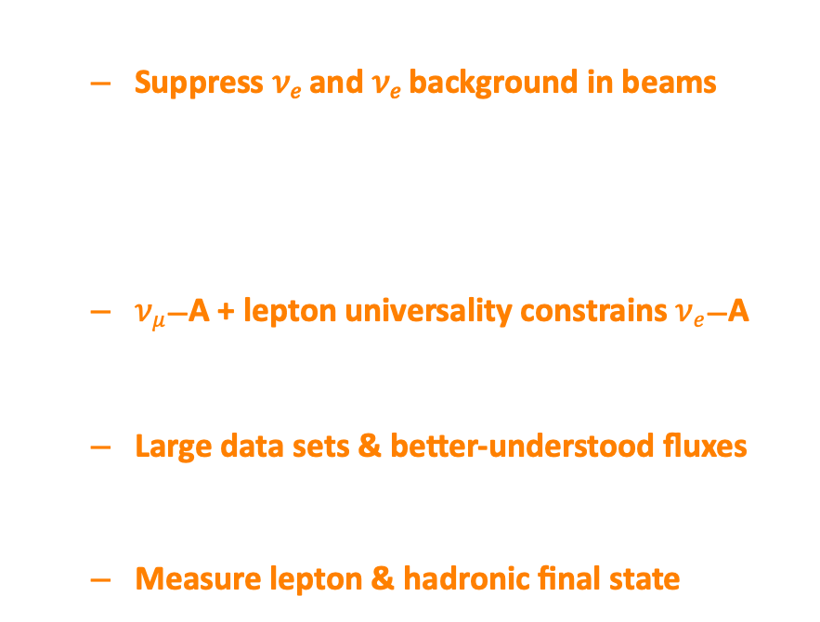
𝝂_{𝒆}/𝝂̅_{𝒆} interactions for oscillations
𝛿_{CP} requires 𝜈_{𝑒} and 𝜈_{𝑒} appearance
  Suppress 𝜈_{𝑒} and 𝜈_{𝑒} background in beams
Need $νe$/$\overline{ν}e$ interaction data
At 1st order precision:
  $νμ$—A + lepton universality constrains $νe$—A
𝛿_{CP} requires requires 2nd order precision!
  Large data sets & better-understood fluxes
High-specification detector:
  Measure lepton & hadronic final state

Slide 6
Neutrinos from stored muons
Scientific objectives:
  %-level ( ν_{e}N ) cross sections
    Multi differential / E_{ν} scan
  BSM searches
    E.g. steriles beyond FNAL SBN
  Muon collider demonstrator
Precise neutrino flux:
  Normalisation: < 1%
  Energy (and flavour) precise
π ⇢ μ injection pass:
  “Flash” of muon neutrinos
(—)

Slide 7
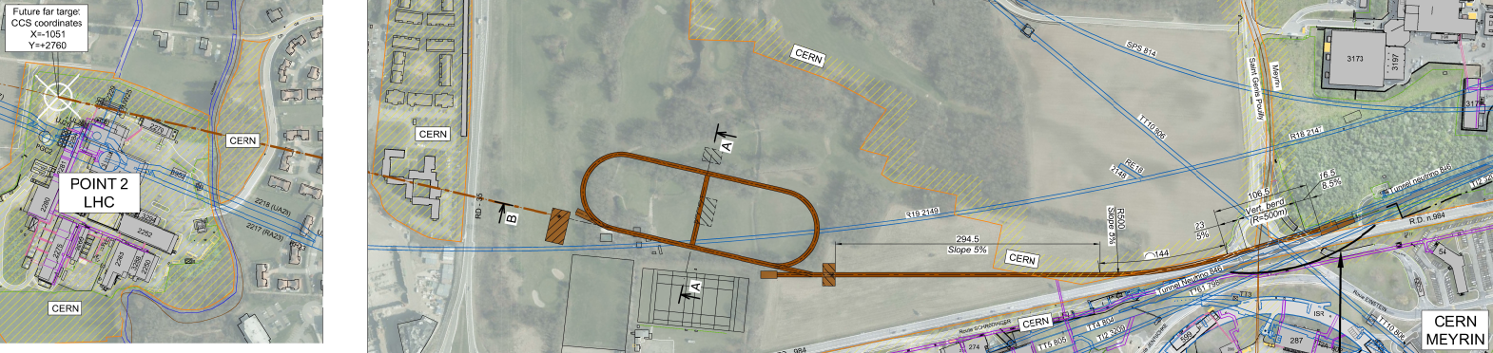
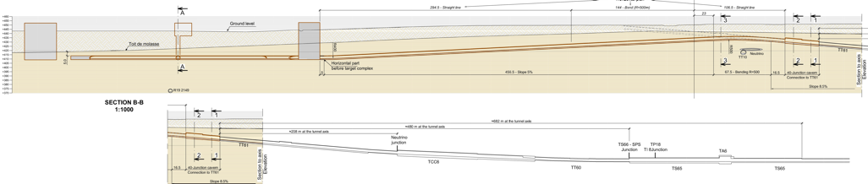
Overview
CERN-PBC-REPORT-2019-003
DOI:10.17181/CERN.FQTB.O8QN
Extraction from SPS through existing tunnel
Siting of storage ring:
  Allows measurements to be made ‘on or off axis’
  Preserves sterile-neutrino search option

Slide 8
End-to-end simulation for (re)optimisation
P. Kyberd et al
“nuSIM” under development to:
  Simulate facility “from target to detector”:
    Pragmatic approach:
      Fast simulation, parametric approach
      Full tracking using G4 based code; “BDSIM”
Neutrino energy scan:
  “Pion flash” in first pass
  Subsequently neutrinos from muon decay
    Spectrum determined by accelerator tune
    Normalization uncertainty < 1%

Slide 9
nuSTORM@CERN: flux estimation
T. Alves, M. Pfaff
Area normalised
Area normalised
μ
μ
Oscillation-relevant energy regime
  Hyper-K: 0.6 GeV
  DUNE. : 2.4 GeV
Set by stored-muon momentum
Accelerator "tune" gives fine control
  E.g. optimise flux shape (or spread) by adjusting the ring acceptance
Unique opportunity:
  𝐸_{𝜈}-scan measurements
  Monoenergetic flux (ν_{e}!!) emulated by flux combination
    Like PRISM, but with more degree of freedom in component shaping

Slide 10
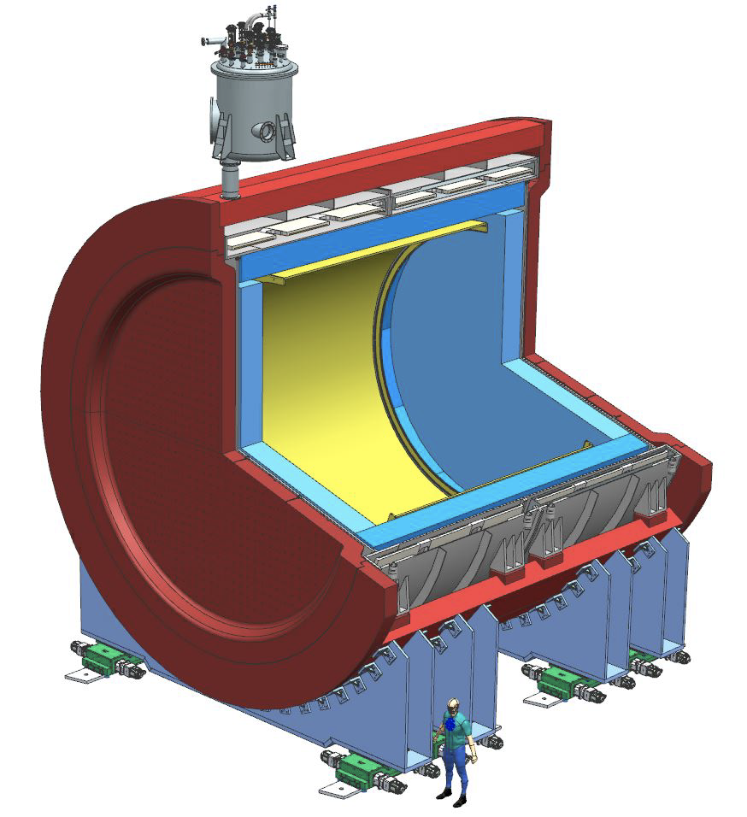
nuSTORM@CERN: working towards a detector concept
DUNE, instruments 5, 31 (2021)
nuSIM ready to allow performance evaluation:
  Require “highly capable” detector:
    Scattered lepton
    Inclusive and exclusive final states
Initial study use DUNE ND-GAr:
  TPC reference design
    10-bar argon-based gas TPC
    Large gas volume
    Surrounded by calorimeter
  4𝝅 acceptance, very low threshold
  B-field provides sign selection
  e/μ id; final state reconstruction

Slide 11

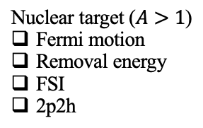
nuSTORM@CERN: first analysis concept
Our collider neighbors have been using something similar since a long time ago
Transverse Kinematic Imbalance (TKI)
[…]
[…]
TKI
Multi-dimensional observation
Momentum (magnitude)
Angle
Asymmetry
Stationary free nucleon target
Nuclear target ($A>1$)
Fermi motion
Removal energy
FSI
2p2h
Community efforts:
T2K, MINERvA (analysis coordinator in the UK), MicroBooNE, SBND, …
Notes:
since a long time ago
*They even have written a wiki page for it!
* One big difference is that, TKI is multi-dimensional and we will discuss all these observations in the following

Slide 12
nuSTORM@CERN: 𝑬_{𝝂}-scan measurements
High-pressure gas TPC acceptance
T. Alves
M. Pfaff
X. Lu
Start of study of energy dependence of various exclusive measurements:
  To provide precise constraints on nuclear effects and their energy evolution
Cross-section estimation using (preliminary) nuSTORM flux
Energy evolution “tunable” to optimise sensitivity of measurement
Start of study of energy dependence of various exclusive measurements:
  To provide precise constraints on nuclear effects and their evolution

Slide 13
Conclusions
nuSTORM will be a unique facility (perfect synergy with accelerator neutrino community):
  %-level electron and muon neutrino cross-sections
    Neutrino energy scan; spectrum at each point precisely known
    Monoenergetic flux (ν_{e}!!) emulated by flux combinations with flexible component shaping
  Exquisitely sensitive BSM & sterile neutrino searches
  Serve as muon accelerator test bed
Feasibility of executing nuSTORM at CERN:
  Established through Physics Beyond Colliders study
nuSTORM: a step towards the muon collider:
  Proof-of-principle of high brightness stored muons beams
5-year goal: prepare robust case and “pre-CDR” for nuSTORM

Slide 15
nuSTORM on the route to the Muon Collider
Accelerator key systems/technology issues:
  High power, pulsed proton beam
  Pion production target and capture:
    Target, high-field solenoid capture
  6D ionization cooling to achieve luminosity goals:
    High-field solenoids, compact lattice
    High-gradient RF in magnetic field
  Rapid acceleration:
    RCS or FFA
  Collider ring:
    Combined function magnets
    Beam protection
    Strong focusing at IP and maintenance of short bunch length
In a facility that delivers neutrino physics
← nuSTORM
← nuSTORM
← nuSTORM
← nuSTORM
← nuSTORM

Slide 16
nuSTORM for νN scattering @ CERN — parameters
CERN-PBC-REPORT-2019-003
DOI:10.17181/CERN.FQTB.O8QN

Slide 17
Under discussion!
ENUBET
6D cooling
test facility
nuSTORM
Under study

