Slide 1
Boulby and Underground Physics/Dark Matter
Can we prepare for a UK particle physics community future where large-scale UG experiments are hosted in the UK?
  Strategic review of Particle Physics Recommendation 88: “The current funding silo for Particle Astrophysics should end and those projects defined as being predominantly particle-physics related should be evaluated and funded within the particle-physics structures.”
  How will UG projects not hosted in the UK find equity?
How can we help build an ecosystem of small and mid-sized experiments to utilize Boulby in the next decade and to fill out an expanded lab?
  Indeed, as so much of particle physics centers around large experiments/collaborations and long timelines, can we benefit from more small and nimble projects?
What should we do to enhance public and government understanding of and excitement for dark matter and particle physics? (examples from next slide)

Slide 2
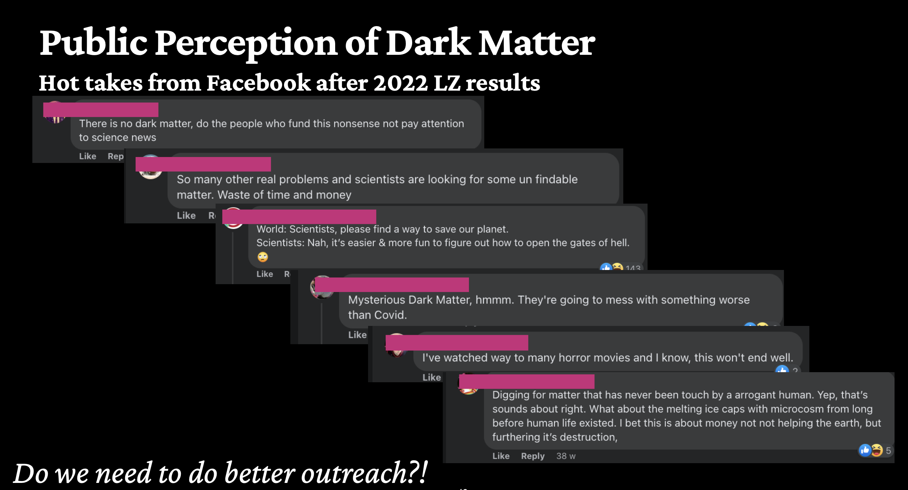
From S. Shaw’s IOP talk

