Slide 1
Unitarity triangles and the lattice
Amarjit Soni
BNL-HET
Lattice 2024, Liverpool; 8/1/2024

Slide 2
Outline
In naturalness we trust
Early history: The crucial role of BK
Current tensions in B-UT
A moral (esp.for the lattice) from epsilon’
Progress in eps’ and implications for the UTs
Importance of K-UT
Constraining the gold-plated mode KL => pi0 nu nu
Taming K0 => pi0 l+ l-
Summary

Slide 3
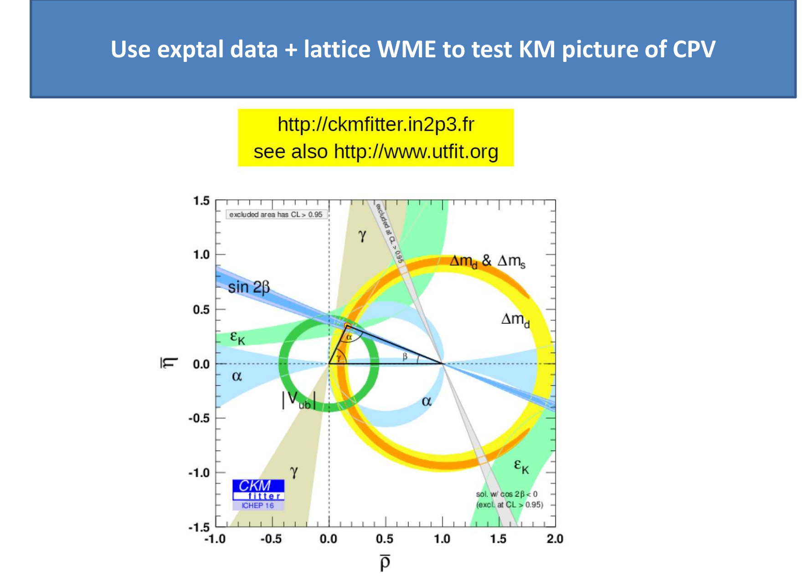

Slide 4
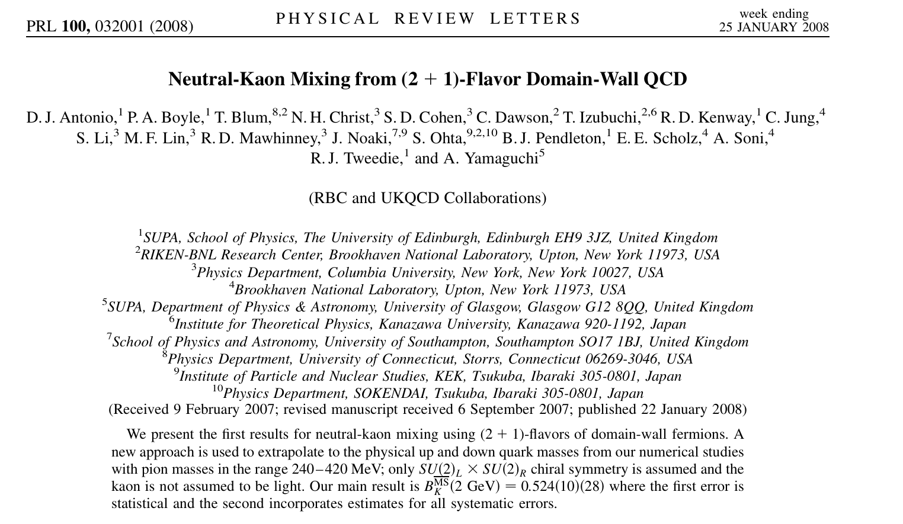


Slide 5





Current tensions in Vxb due inc vs exclusive
Vub | Vcb
Inc. (4.511 +-0.45)X10^-3 | (42.2 +- 0.8)X10^-3
Exc (3.4 +- 0.4)X10^-3 | (39.4 +- 0.8)X10^-3

Slide 6





Current tensions in Vxb due inc vs exclusive
Very many sources of errors: As an example of pretty nasty one is exptal…Vub inclusive ..This just means they don’t see a charm hadron…
For inc continuum pheno uses approx. symmetery
For the lattice (exc) things seem in better control
But excited state(s) should be an important concern
Should use modern sophiscated lattice methodology like GEVP to (re)confirm (excited) states have been properly identified and error estimates are truly robust.
See, e.g, CK etal (RBC-UKQCD) eps’ 2015 vs 2020
Luscher+Wolfe, NPB’90; Sommer et al JHEP’09; JHEP’12

Slide 7
Reminder
Motivation: It is exceedingly important to determine UTs as precisely as possible….
Briefly recall special role of lattice BK in confirmation of KM theory of CPV
Progress in lattice eps’….implications for both UTs though crucial for KUT
More on K UT

Slide 8
Main points for 40+years on lattice eps’, Delta I=1/2 rule….effort
Calculational framework for K=> pi pi & eps’
Obstacles aglore and major break-throughs
Lattice chiral symmetry even for a finite non-vanishing lattice spacing! : DWQ
Direct K=> pi pi w/o ChPT using finite vol correlation functions
Non-perurbative renormalization
1st [prot-type] demonstration….~2015
Difficulty therein : strong I=0 pi pi phase
1st complete result with GPBC, 2020
2nd independent method (PBC) developed, 2023
Lattice applications to K and B-UTs

Slide 9
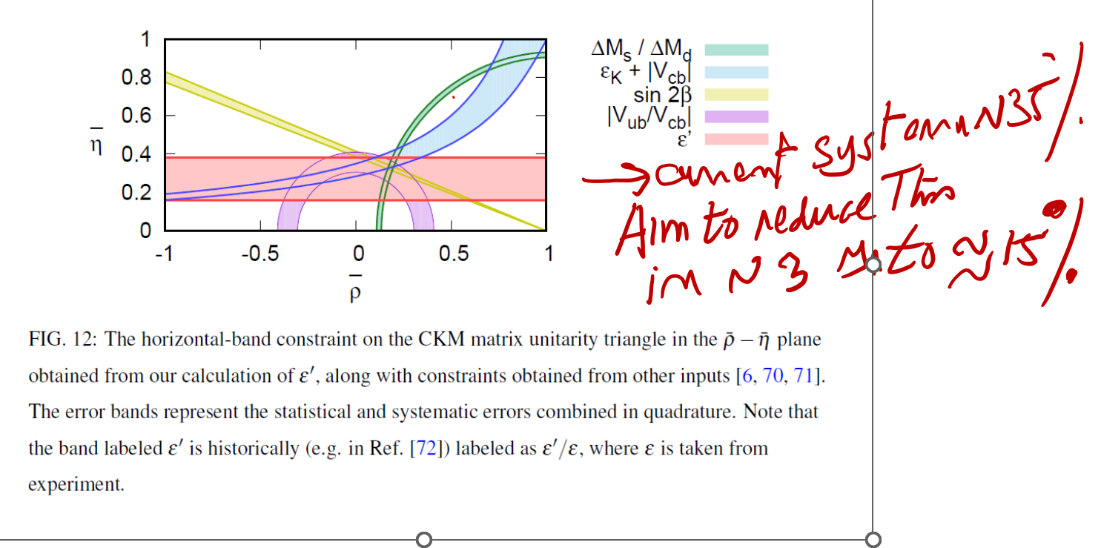
PRD’20 C.Kelly et al

Slide 10
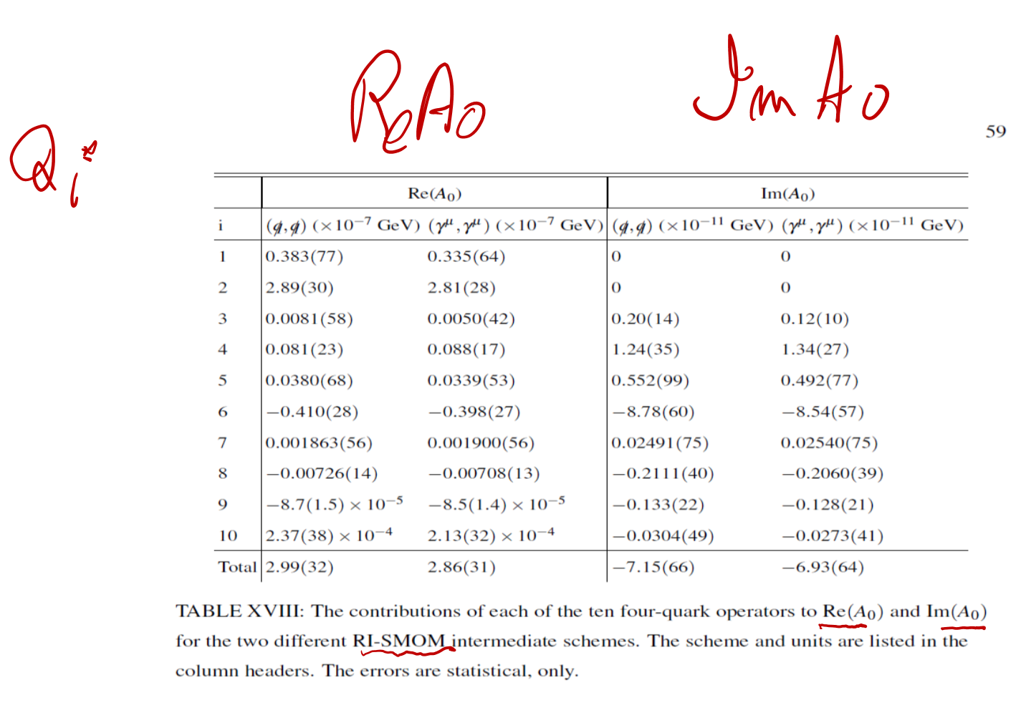








Slide 11
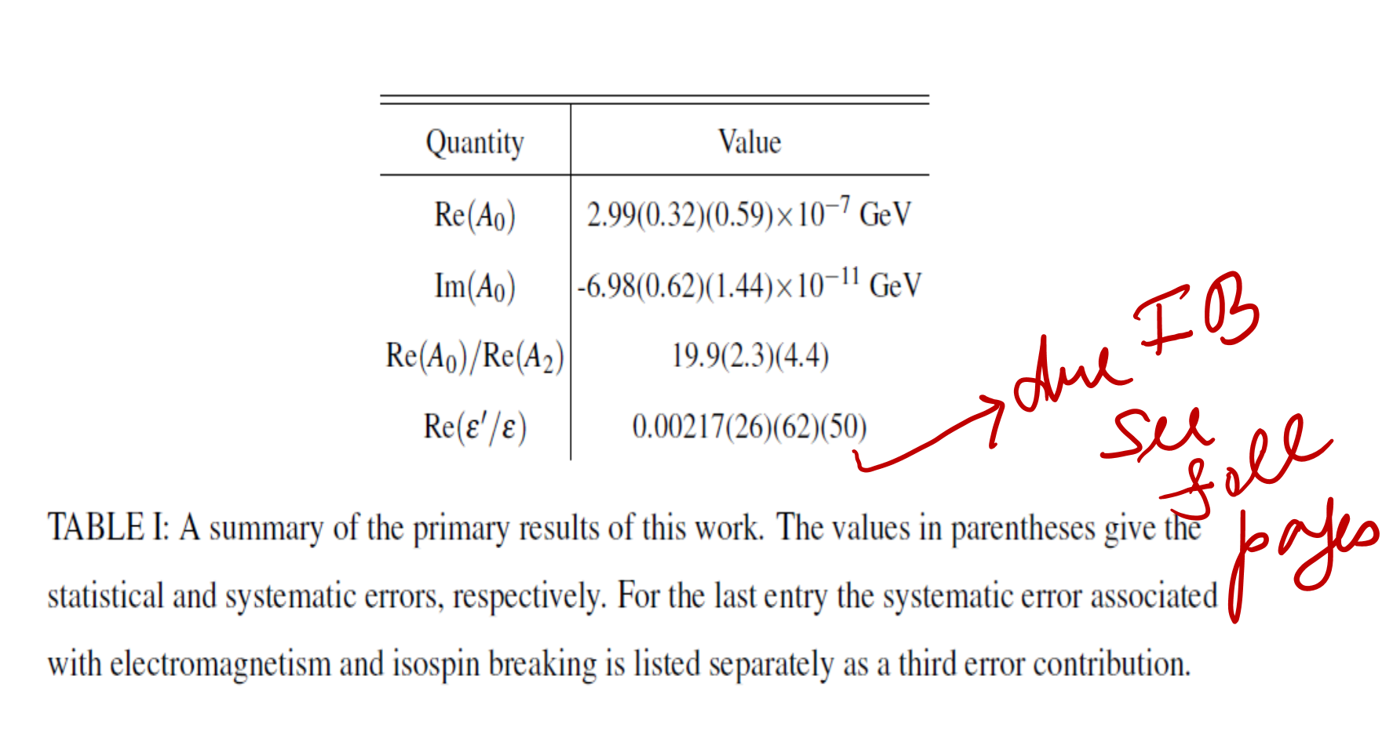


Slide 12



Motivations for independent calculation of eps’ with PBC
For the first time RBC-UKQCD calculated eps’ from 1st principles with a modest accuracy of ~35%. Because of naturalness reasoning, continuing to search for a BSM-CP odd phase with eps’ is important and therefore continuing to calculate eps’ with better accuracy is highly desirable.
With GPBC configs have to be specially created making it very expensive to use multiple lattice spacings for taking a continuum limit.
With PBC no need for special configs and in fact two different lattice spacings with ~physical pions already exist, so taking the continuum limit seems a lot more viable
Given the importance of the result on eps’ and the complexity of the calculation, an independent calculation of K=> 2 pion and epsilon’ with possibly using PBC seems highly desirable
With GPBC a lattice calculation of corrections on eps’ due to EM+isospin appears very difficult, with PBC this may be less problematic
Driving force behind current RBC/UKQCD-PBC effort is Masaaki Tomii
See Masaaki talk on Fri
Luscher+Wolff, NPB’90; Sommer et al JHEP’09; Sommer et al JHEP’12

Slide 13

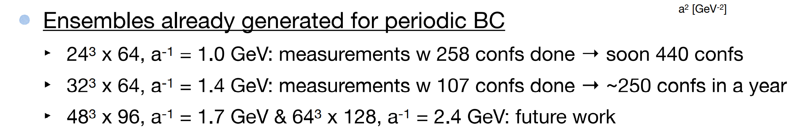

Slide 14
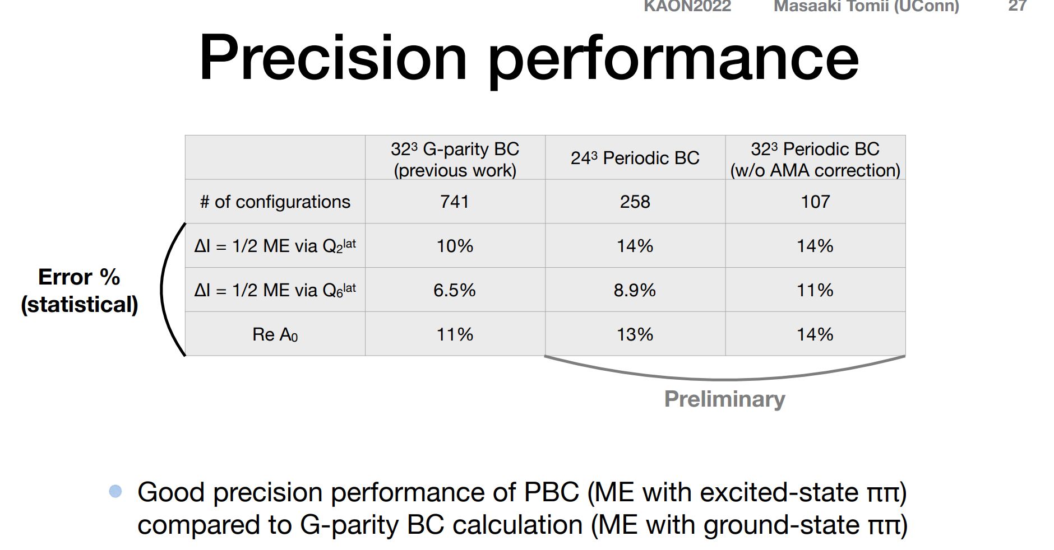




Slide 15
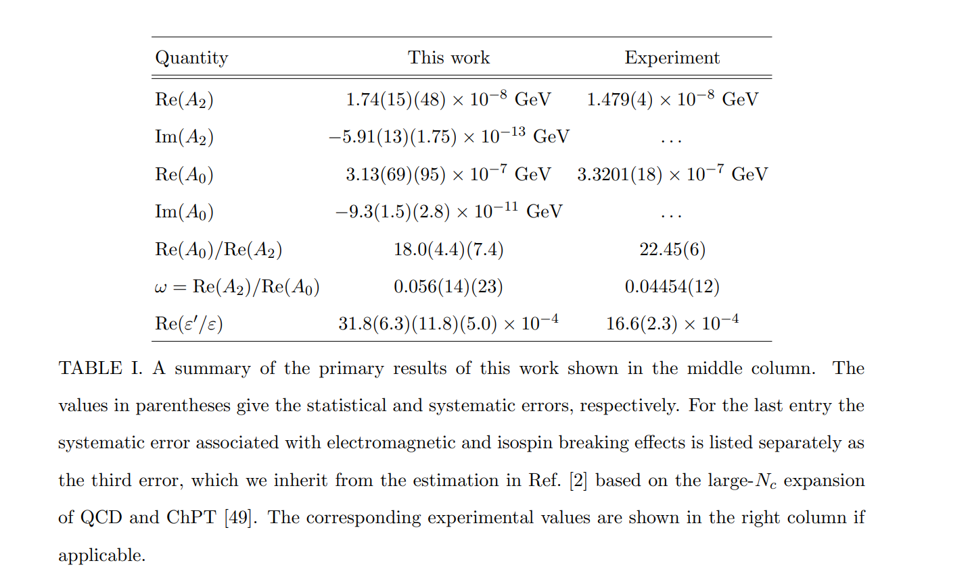


Slide 16
K-UT..many reasons to go for it e.g. Long-standing issues inclusivE versus Exclusive Tension in Vxb

Slide 17
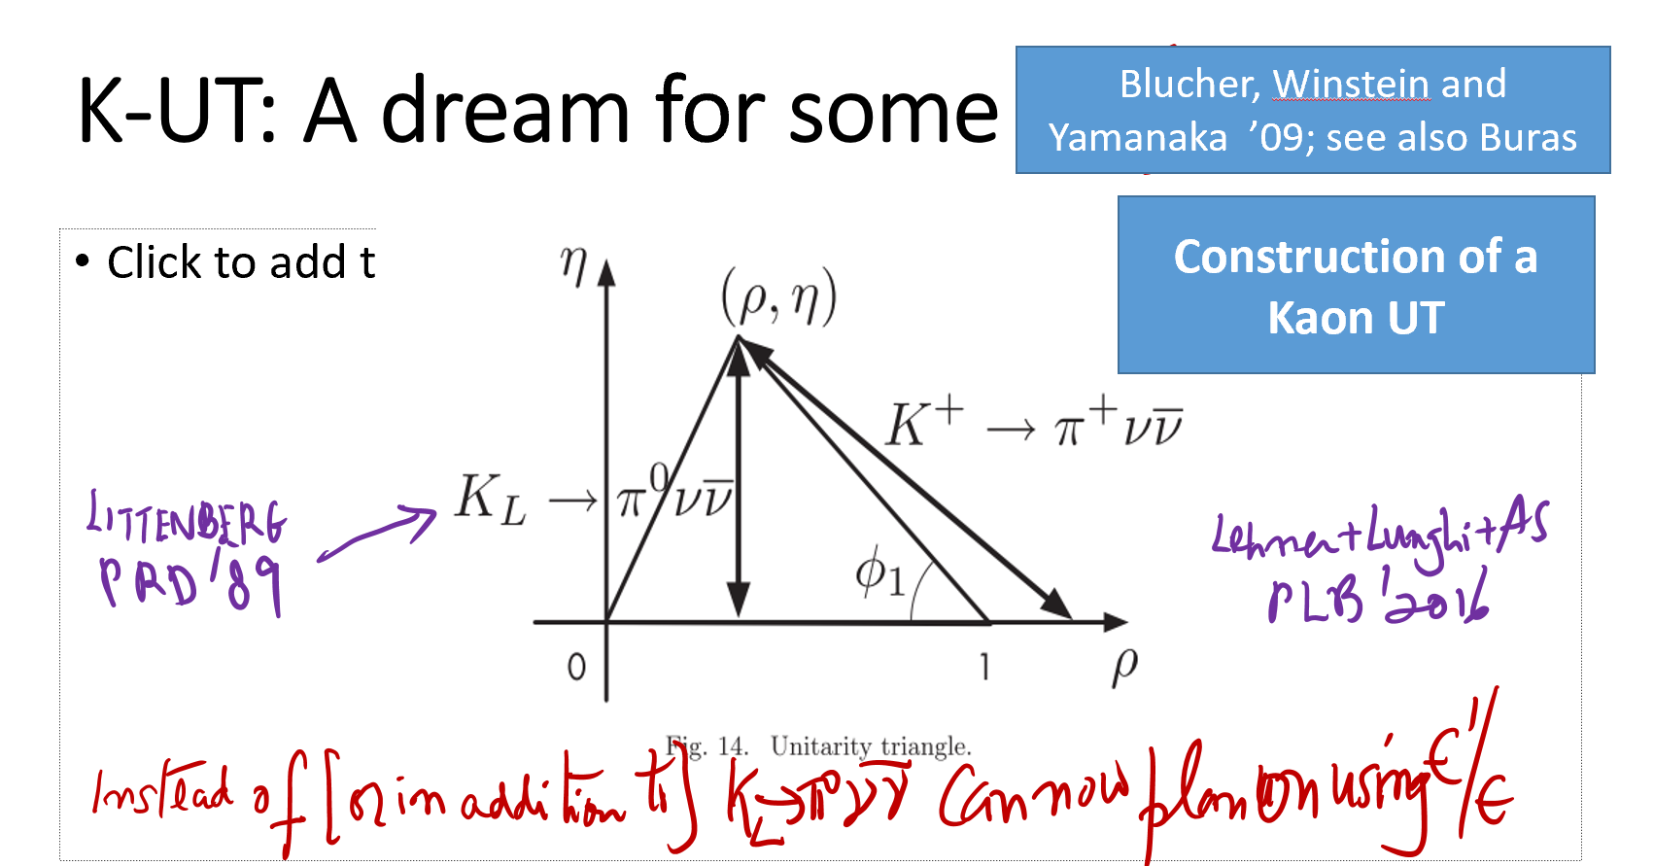
Also constrain KL=>pi0 nu nu via K0=>pi0 mu+mu- (c AS in Lat23)

Slide 18















BUT EXPERIMENTALLY extremely challenging
“NOTHING TO NOTHING”

Slide 19
















Slide 20
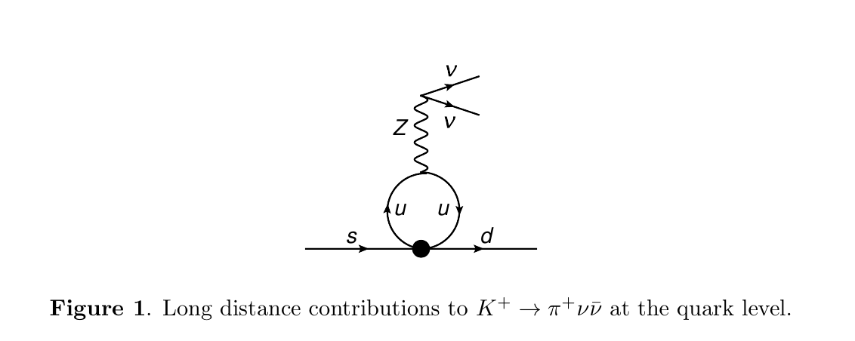

Slide 21
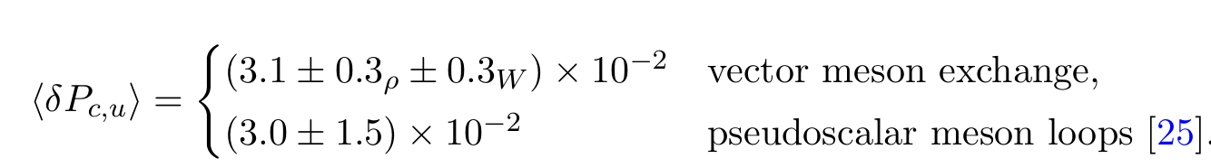






One result from paper with E. Lunghi
VMD: Gounaris+Sakurai; Lee+Zumino

Slide 22
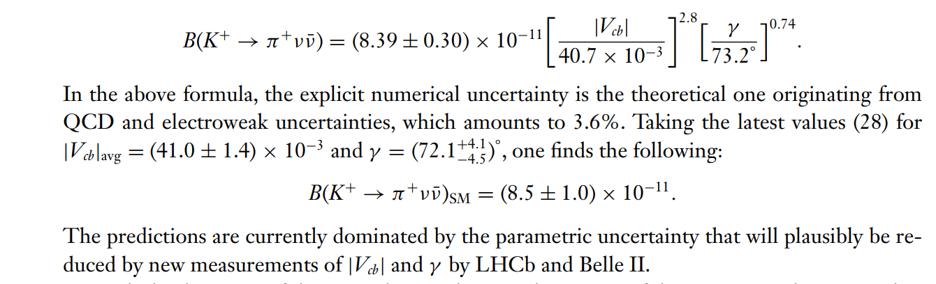
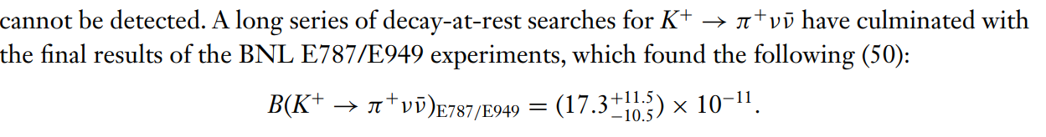
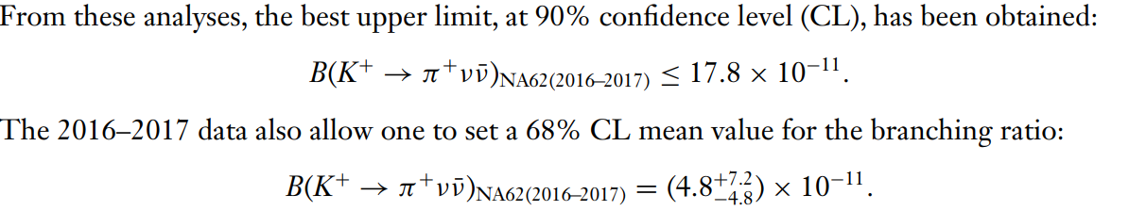
CECCUCCI Rev.

Slide 23
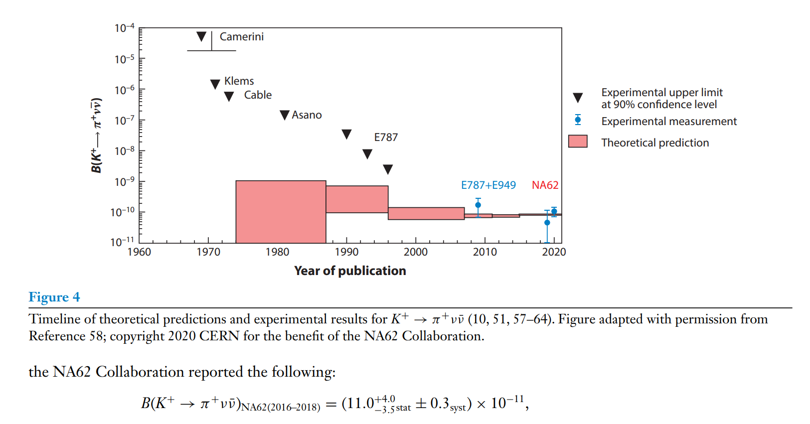


CECCUCCI Rev.

Slide 24
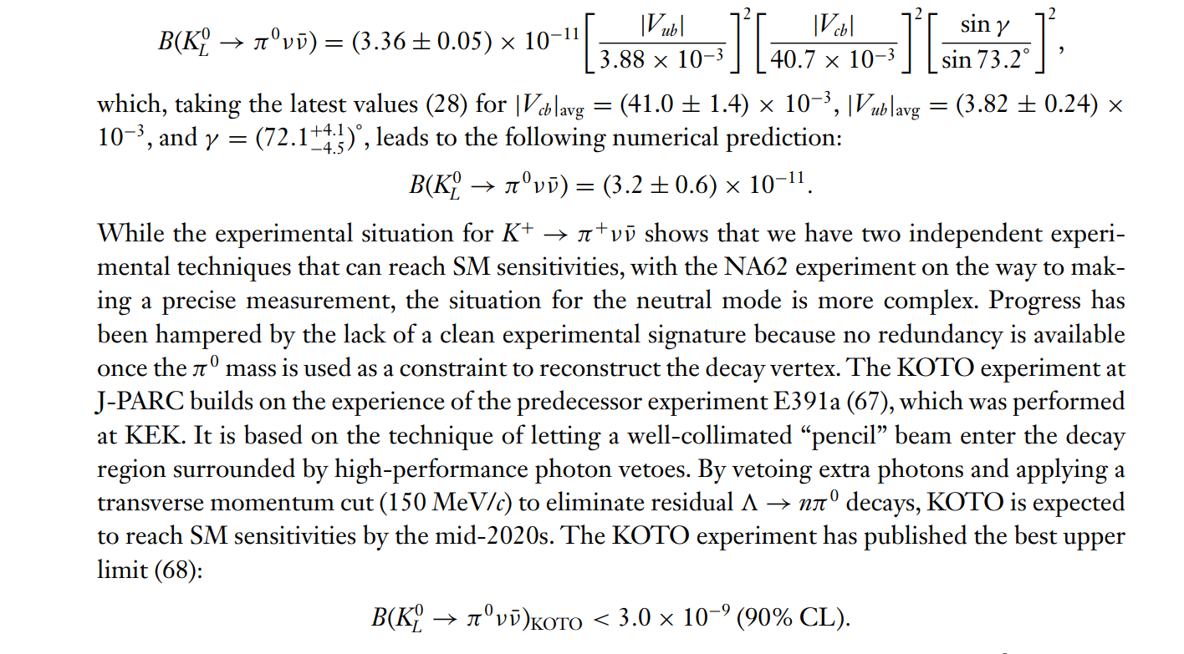



CECCUCCI Rev.

Slide 25

K0=>pi0 mu+ mu-
LHCb: Ks
JPARC:KL
Pheno: Isidori et al…;D’Ambrosio et al;Schact + AS (WIP)
Lattice: RBC+UKQCD many papers on
closely related rare K-decays
To have meaningful impact accuracy in
LQCD needs to improve significantly

Slide 26



















Theoretical Challenge: one vs two photons
A precise answer for one photon will go a long way

Slide 27
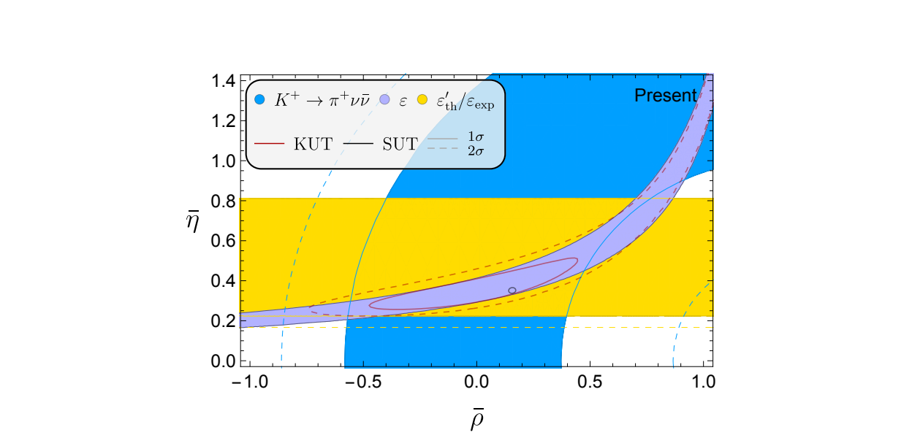

Slide 28
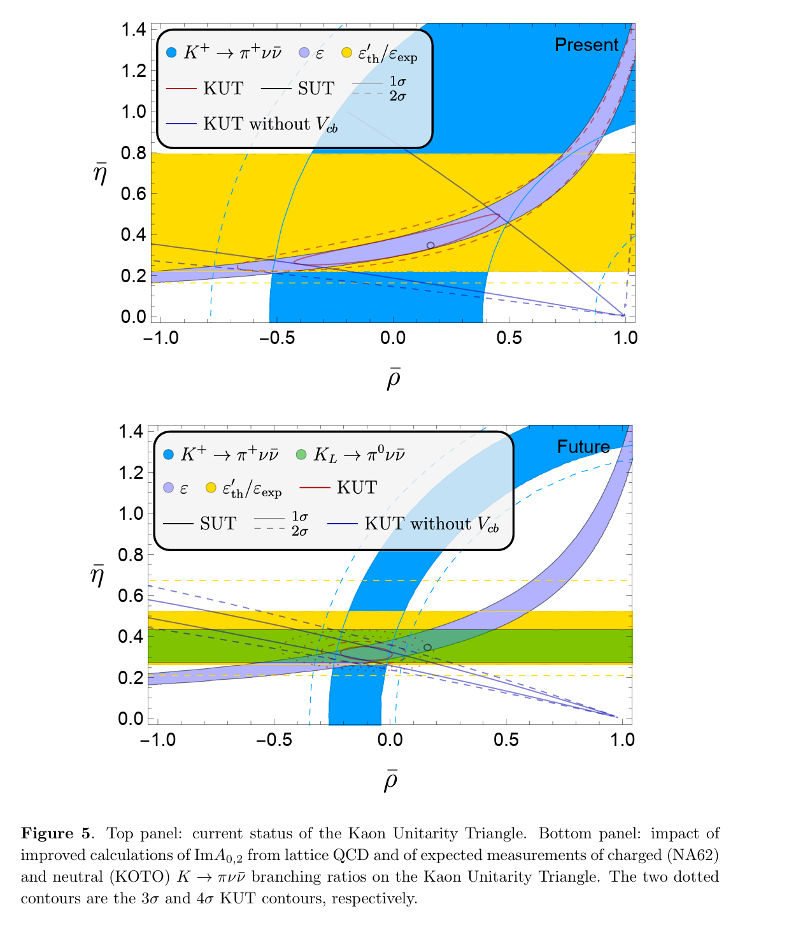

Slide 29
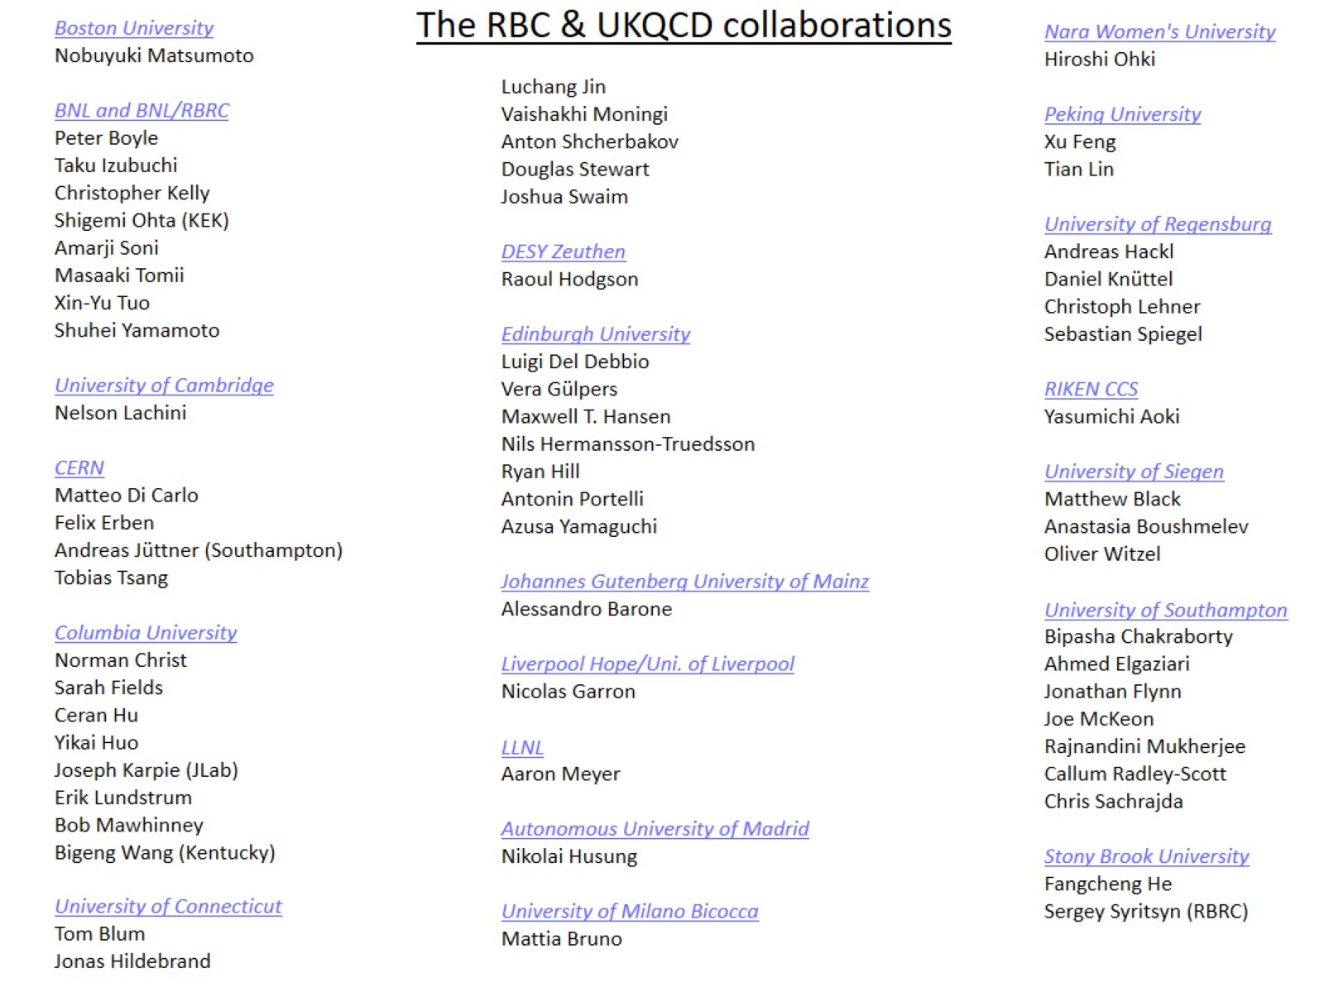
\

Slide 31
In naturalness we trust

Slide 32
Summary + Outlook
Tension in Vxb due to incl vs exclu diff of 2 -2.5 sigma …suggest that errors due to excited states should be carefully studied.
New estimate of LD u-loop to K+=> pi+ nu nu
Showed how using eps’ + eps + Br (K+ => pi+ nu nu) can construct the K-UT
Also K0=>pi0 mu+ mu- input from LHCb, JPARC, pheno and lattice should provide important constraints for the gold plated KL=>pi0 nu nu mode being pursued by the KOTO expt @ JPARC
It is exceedingly important to determine/constrain UTs as precisely as possible as it is highly unlikely that at the end of the day it’d be just a triangle

Slide 33
EXTRA’s

Slide 34
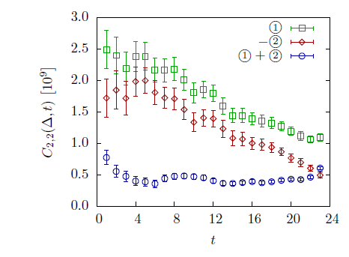
Dissecting (the much easier) ΔI=3/2 [I=2 ππ] Amp on the lattice: 2 contributing topologies only
Simplest basic step is
Significantly different
from phenomenological
Expectations!

Slide 35
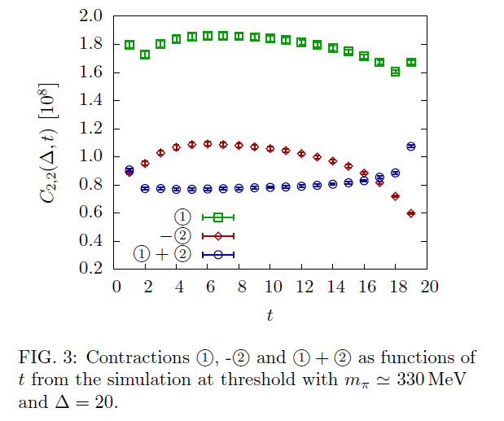

Slide 36
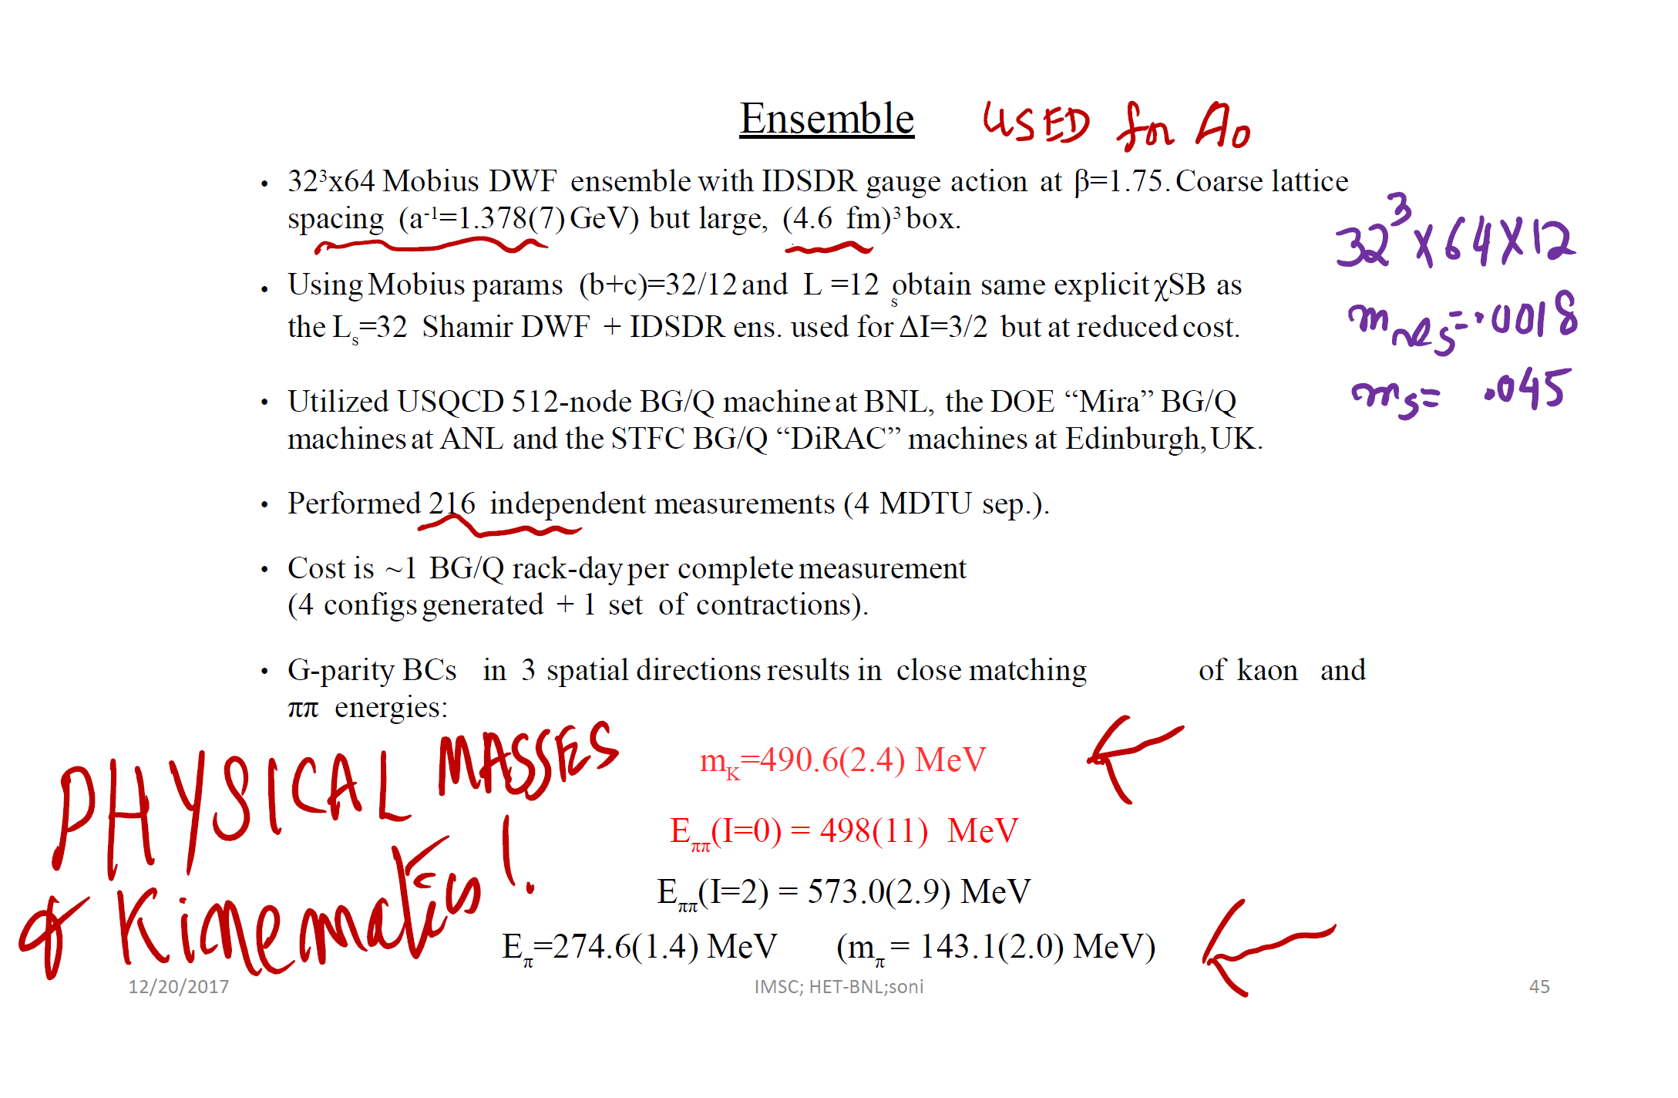

Slide 37
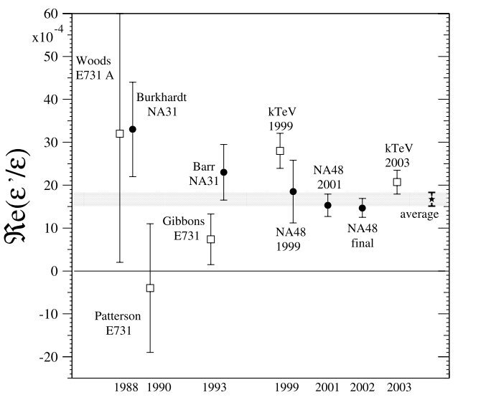
A monumental experimental achievement!

Slide 38
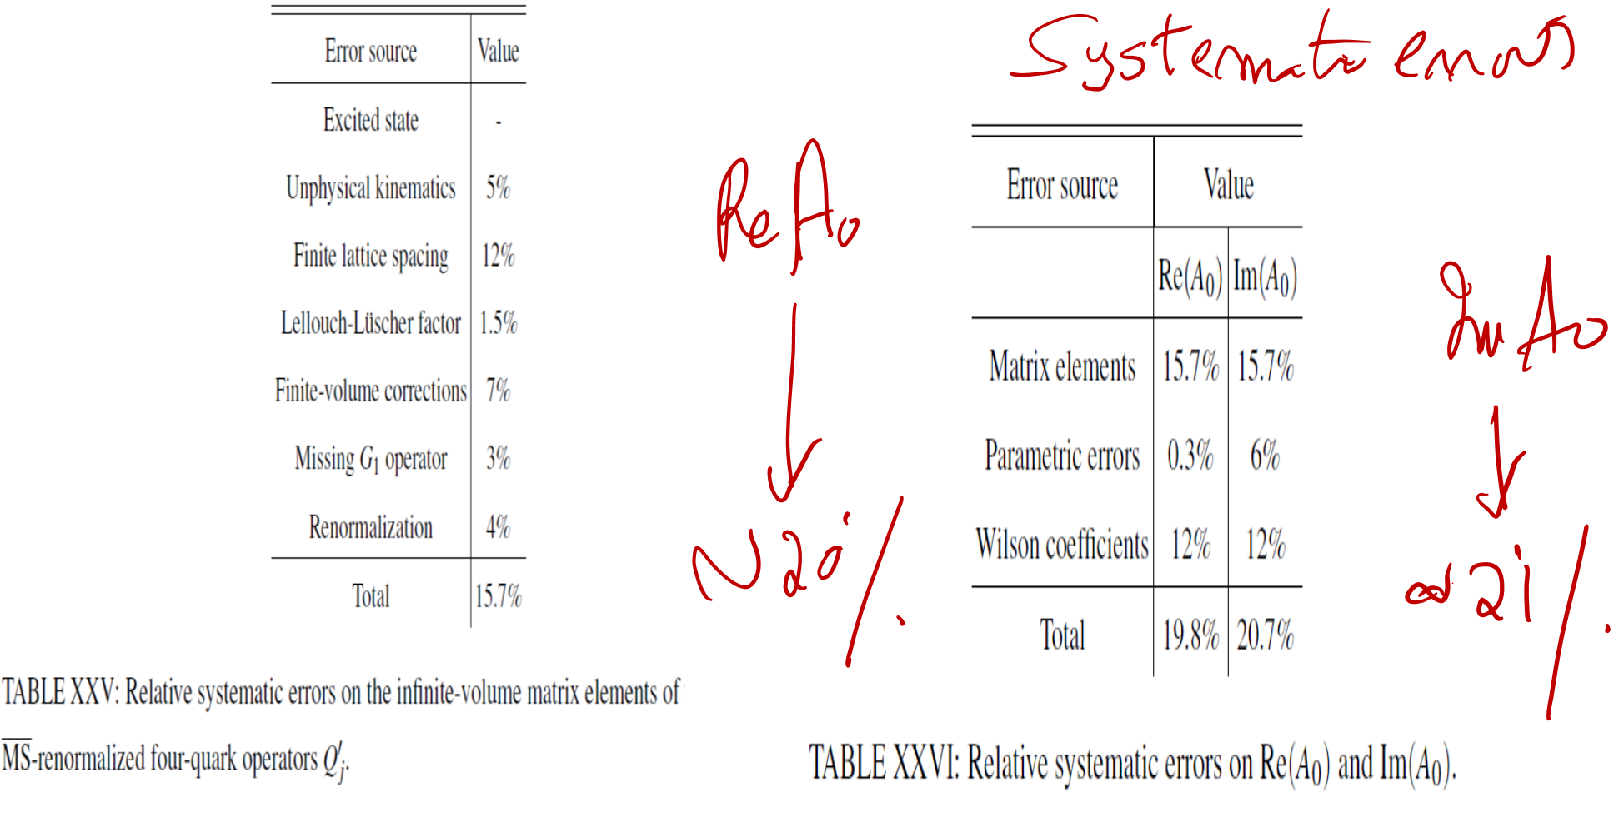

Slide 39
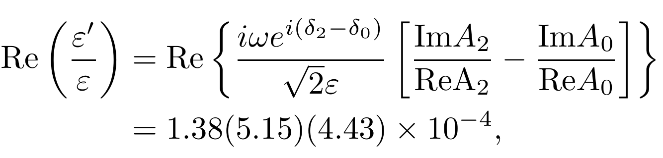
Results for ε'
●
Using Re(A ) and Re(A ) from experiment
and
our
lattice
values
for
0
Im(A2)
2
Im(A0)
and
and
the
phase
shifts,
LARGE CANCELLATION!!
RBC-UKQCD PRL’15
EDITOR’S CHOICE
= (this work)
(experiment)
Bearing in mind the largish errors in this first calculation, we interpret that our result are consistent with experiment at ~2σ level
●
Find discrepancy between lattice and experiment
at the
2.1σ level.
Computed ReA2 excellent agreement w
Computed ReA0 good agreement with expt
Offered an “explanation” of the Delta I=1/2
enhancement

Slide 40

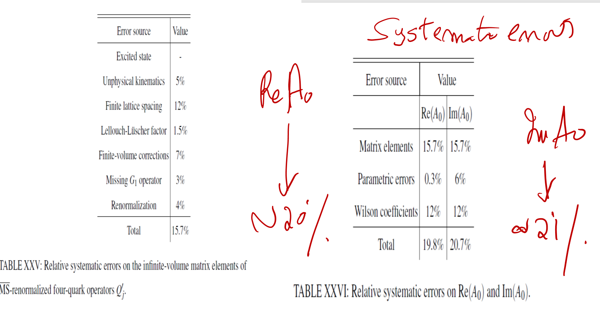

Slide 41
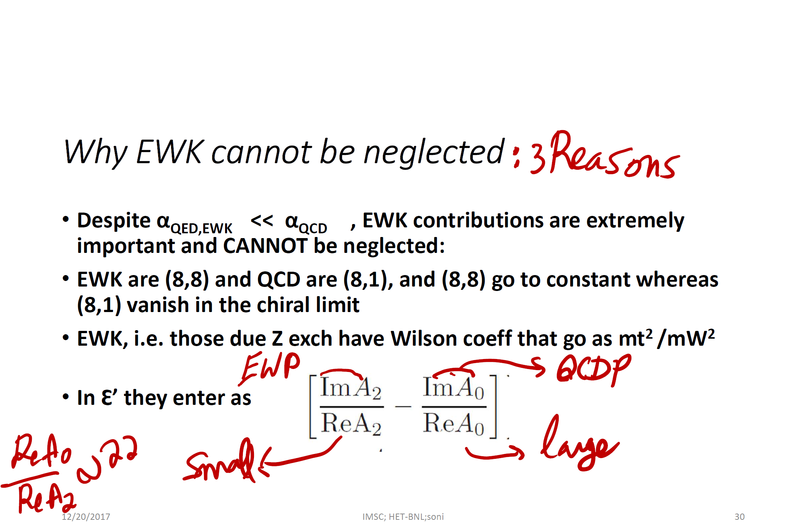

Slide 42
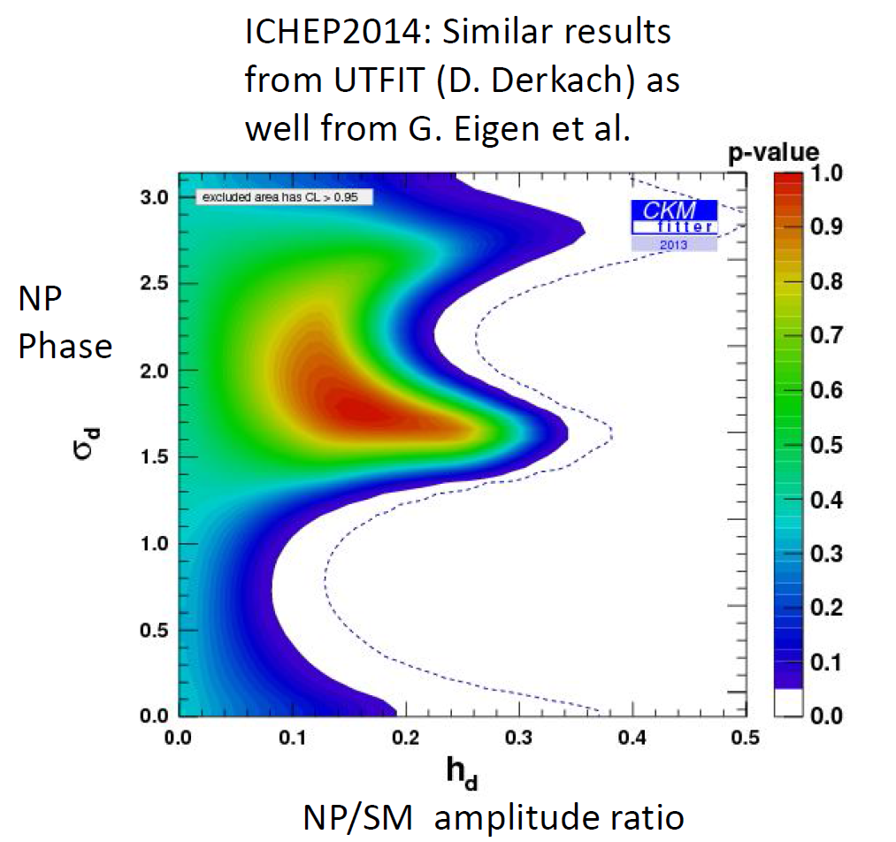
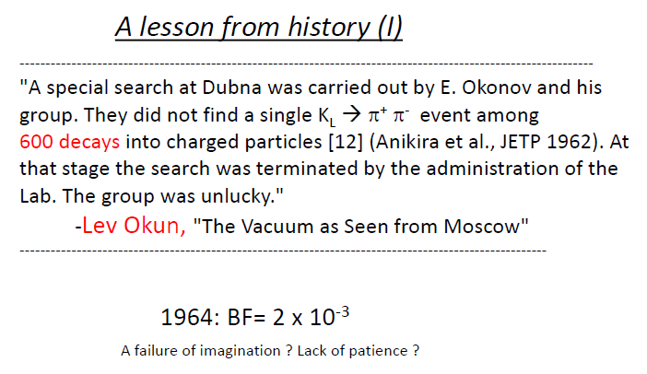
Current O(few%) tests are far away from O(0.1%) asymmetry in KL=>pi pi
Had KL=>pi pi been abandoned, history of Particle Physics would have been significantly different!

Slide 43
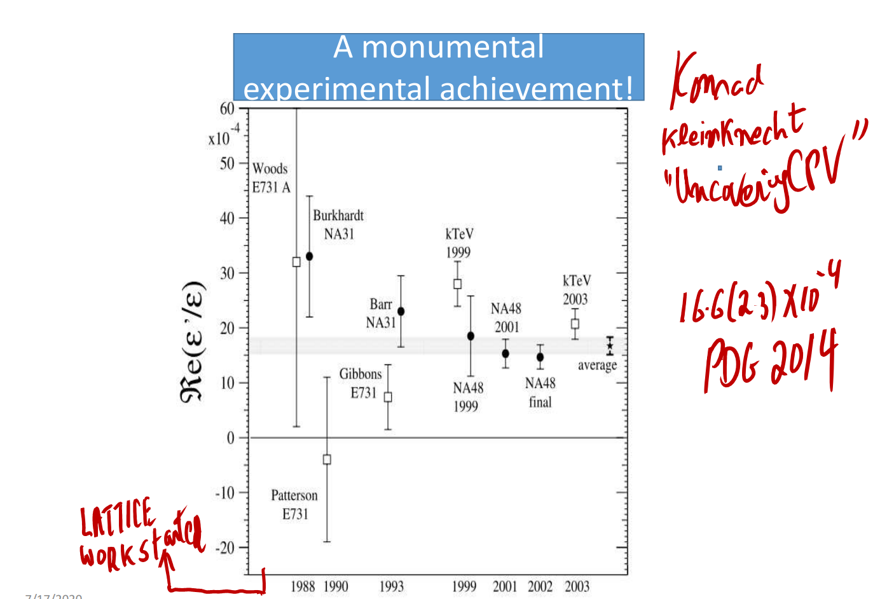

Slide 44
Xtras

Slide 45
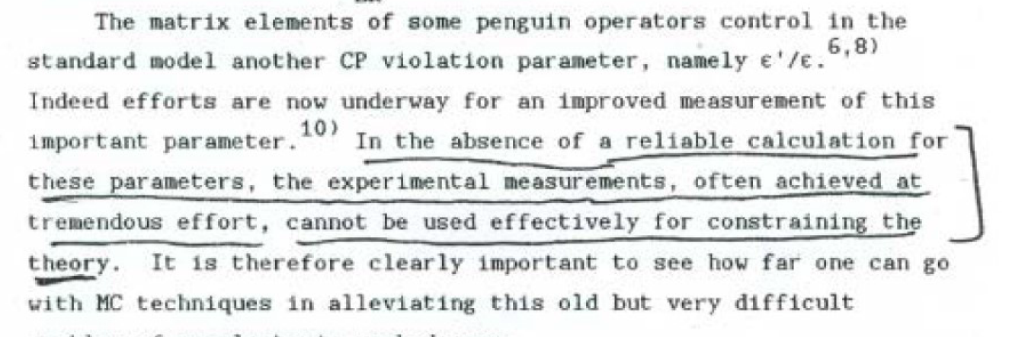
With C. Bernard
[UCLA]

Slide 46
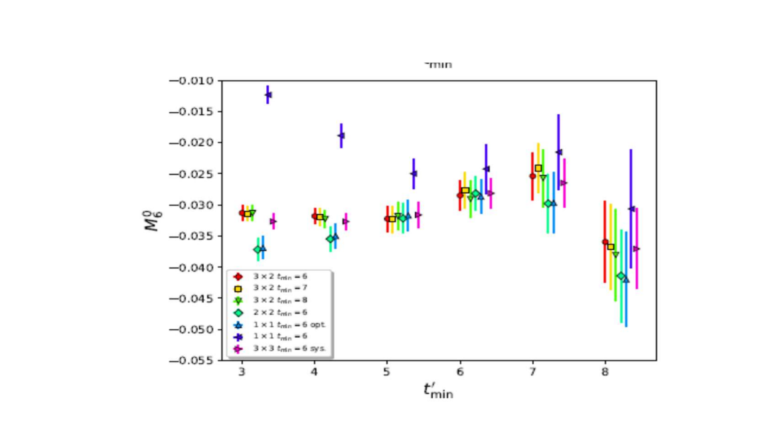

Slide 47
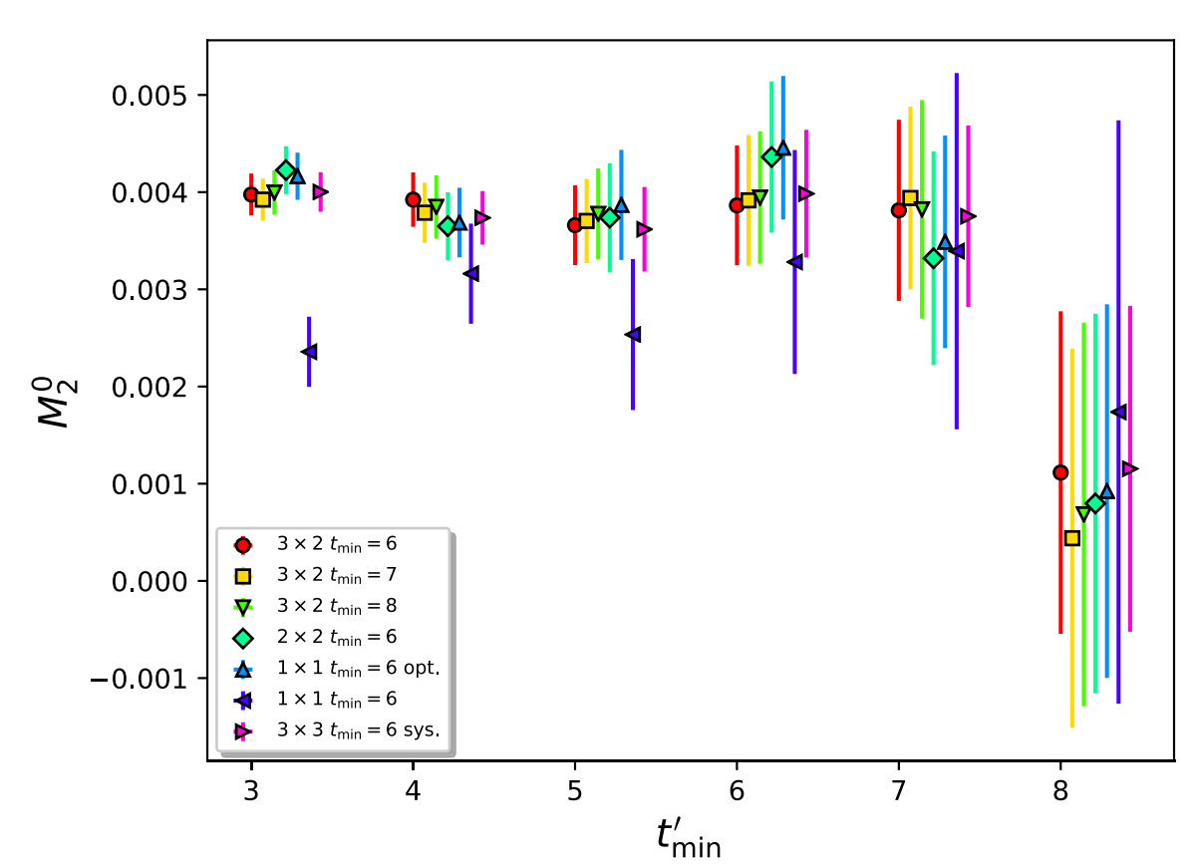

Slide 48
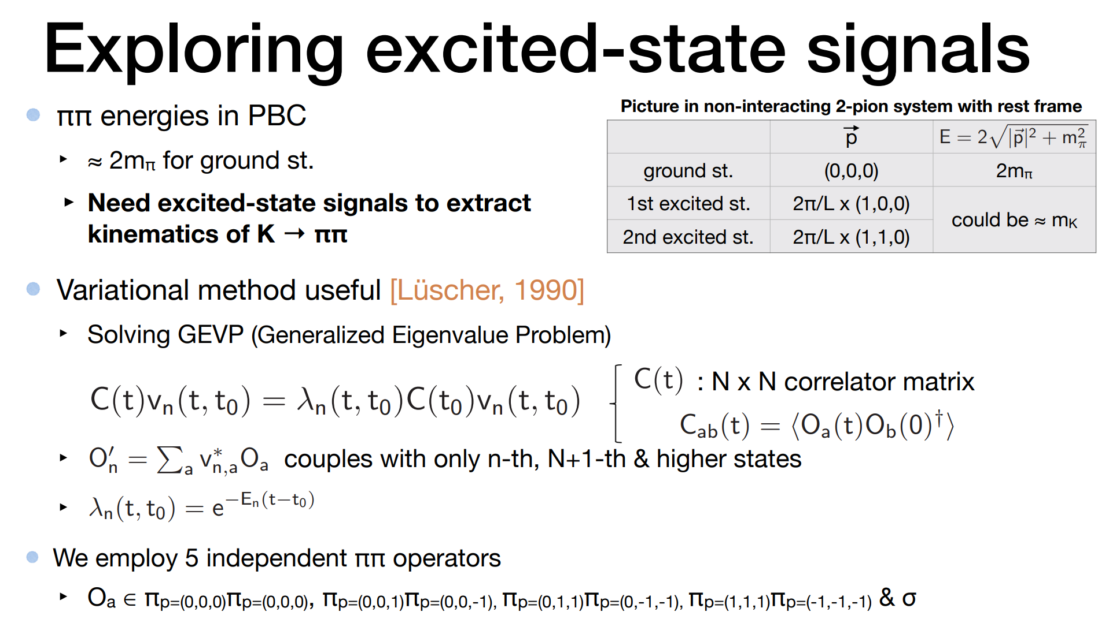

Slide 49
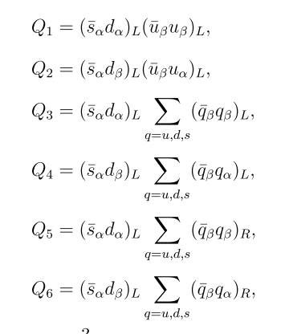
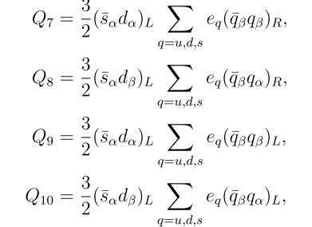

Slide 50
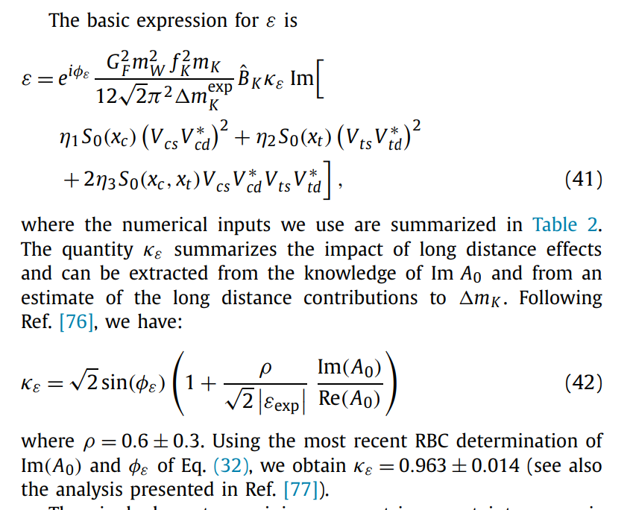
Indirect CP violation in KL=>3 pi

Slide 51
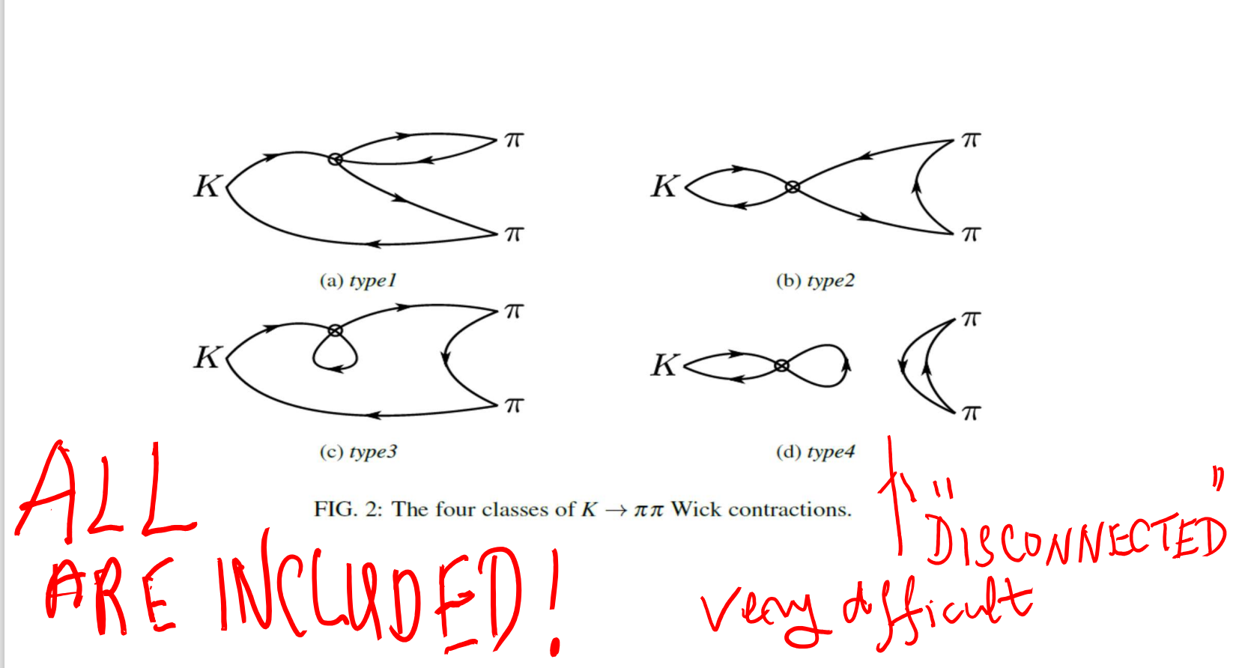

Slide 52
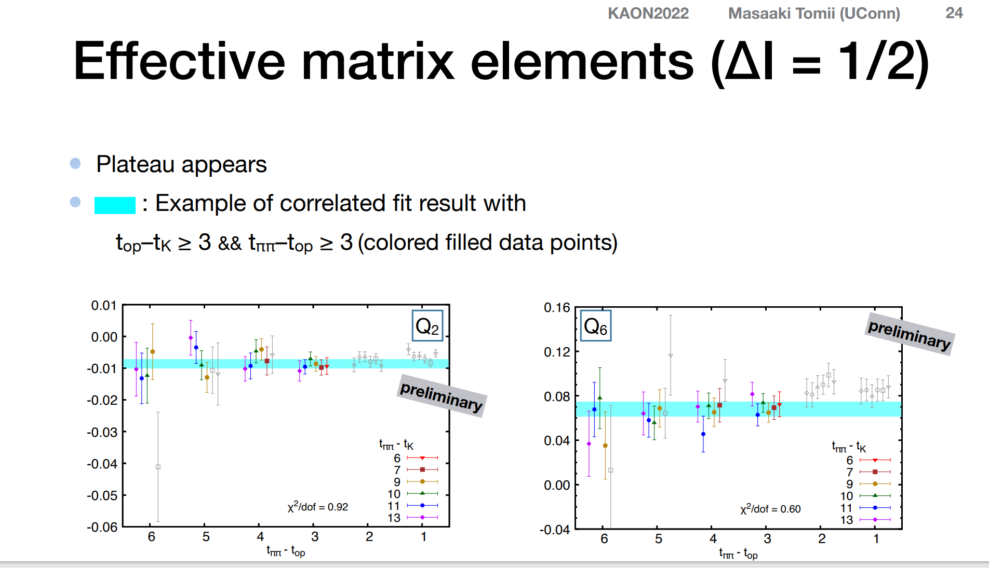

Slide 53
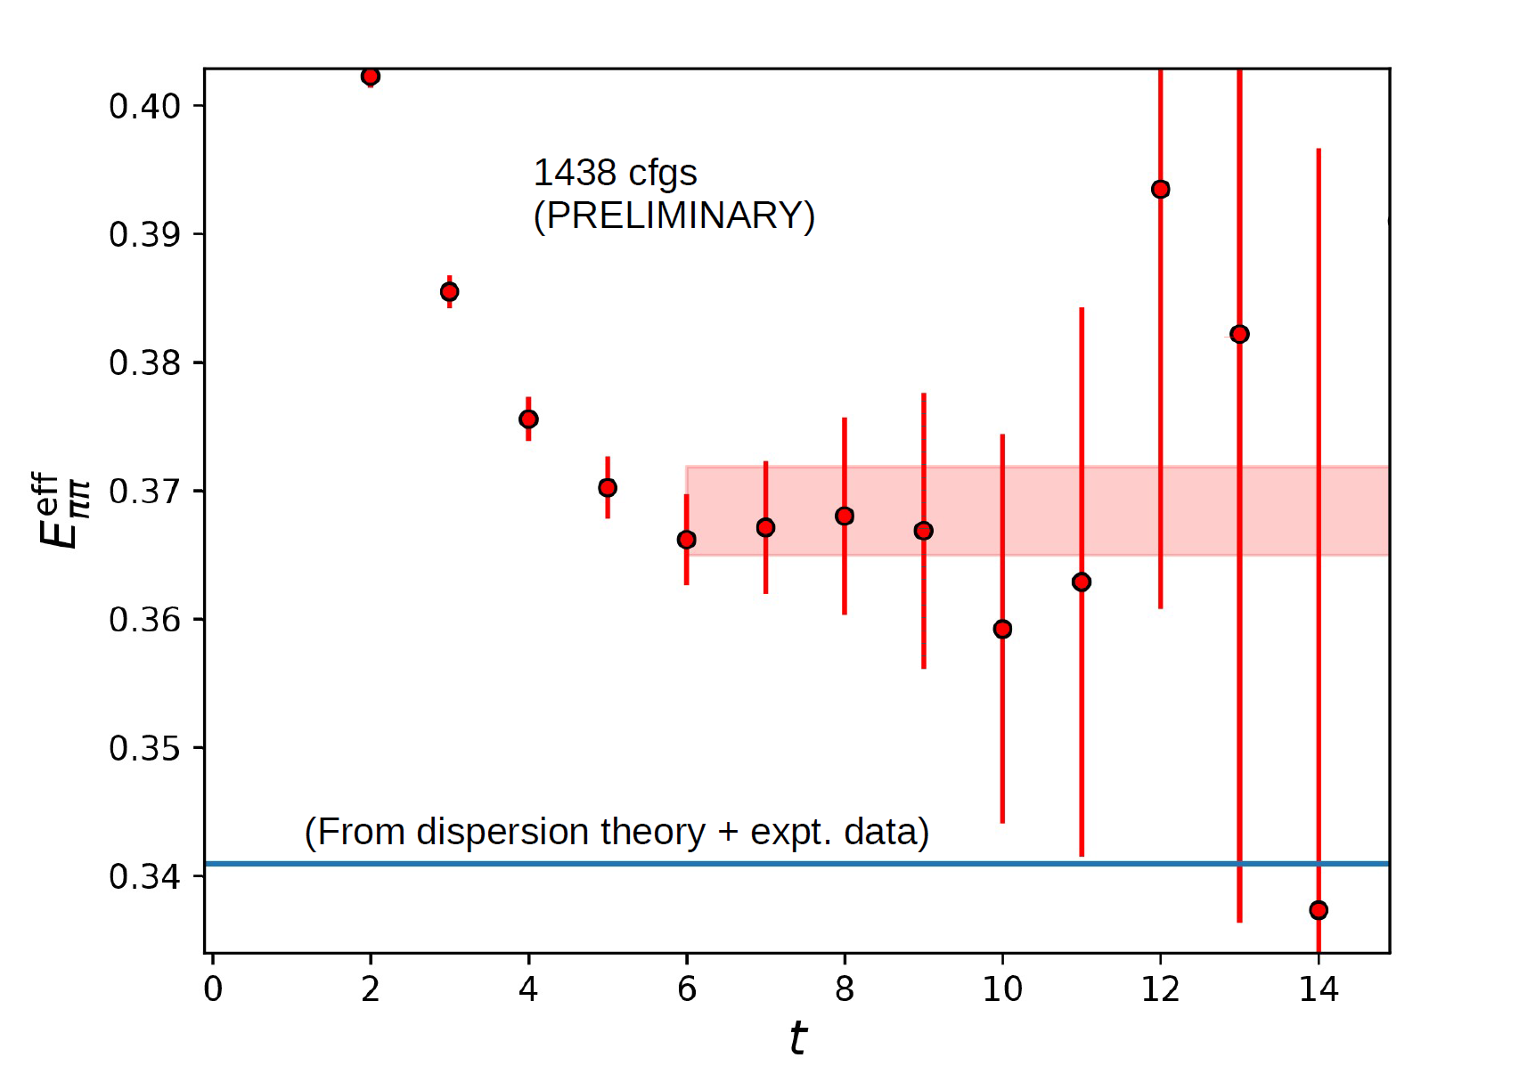

Slide 54
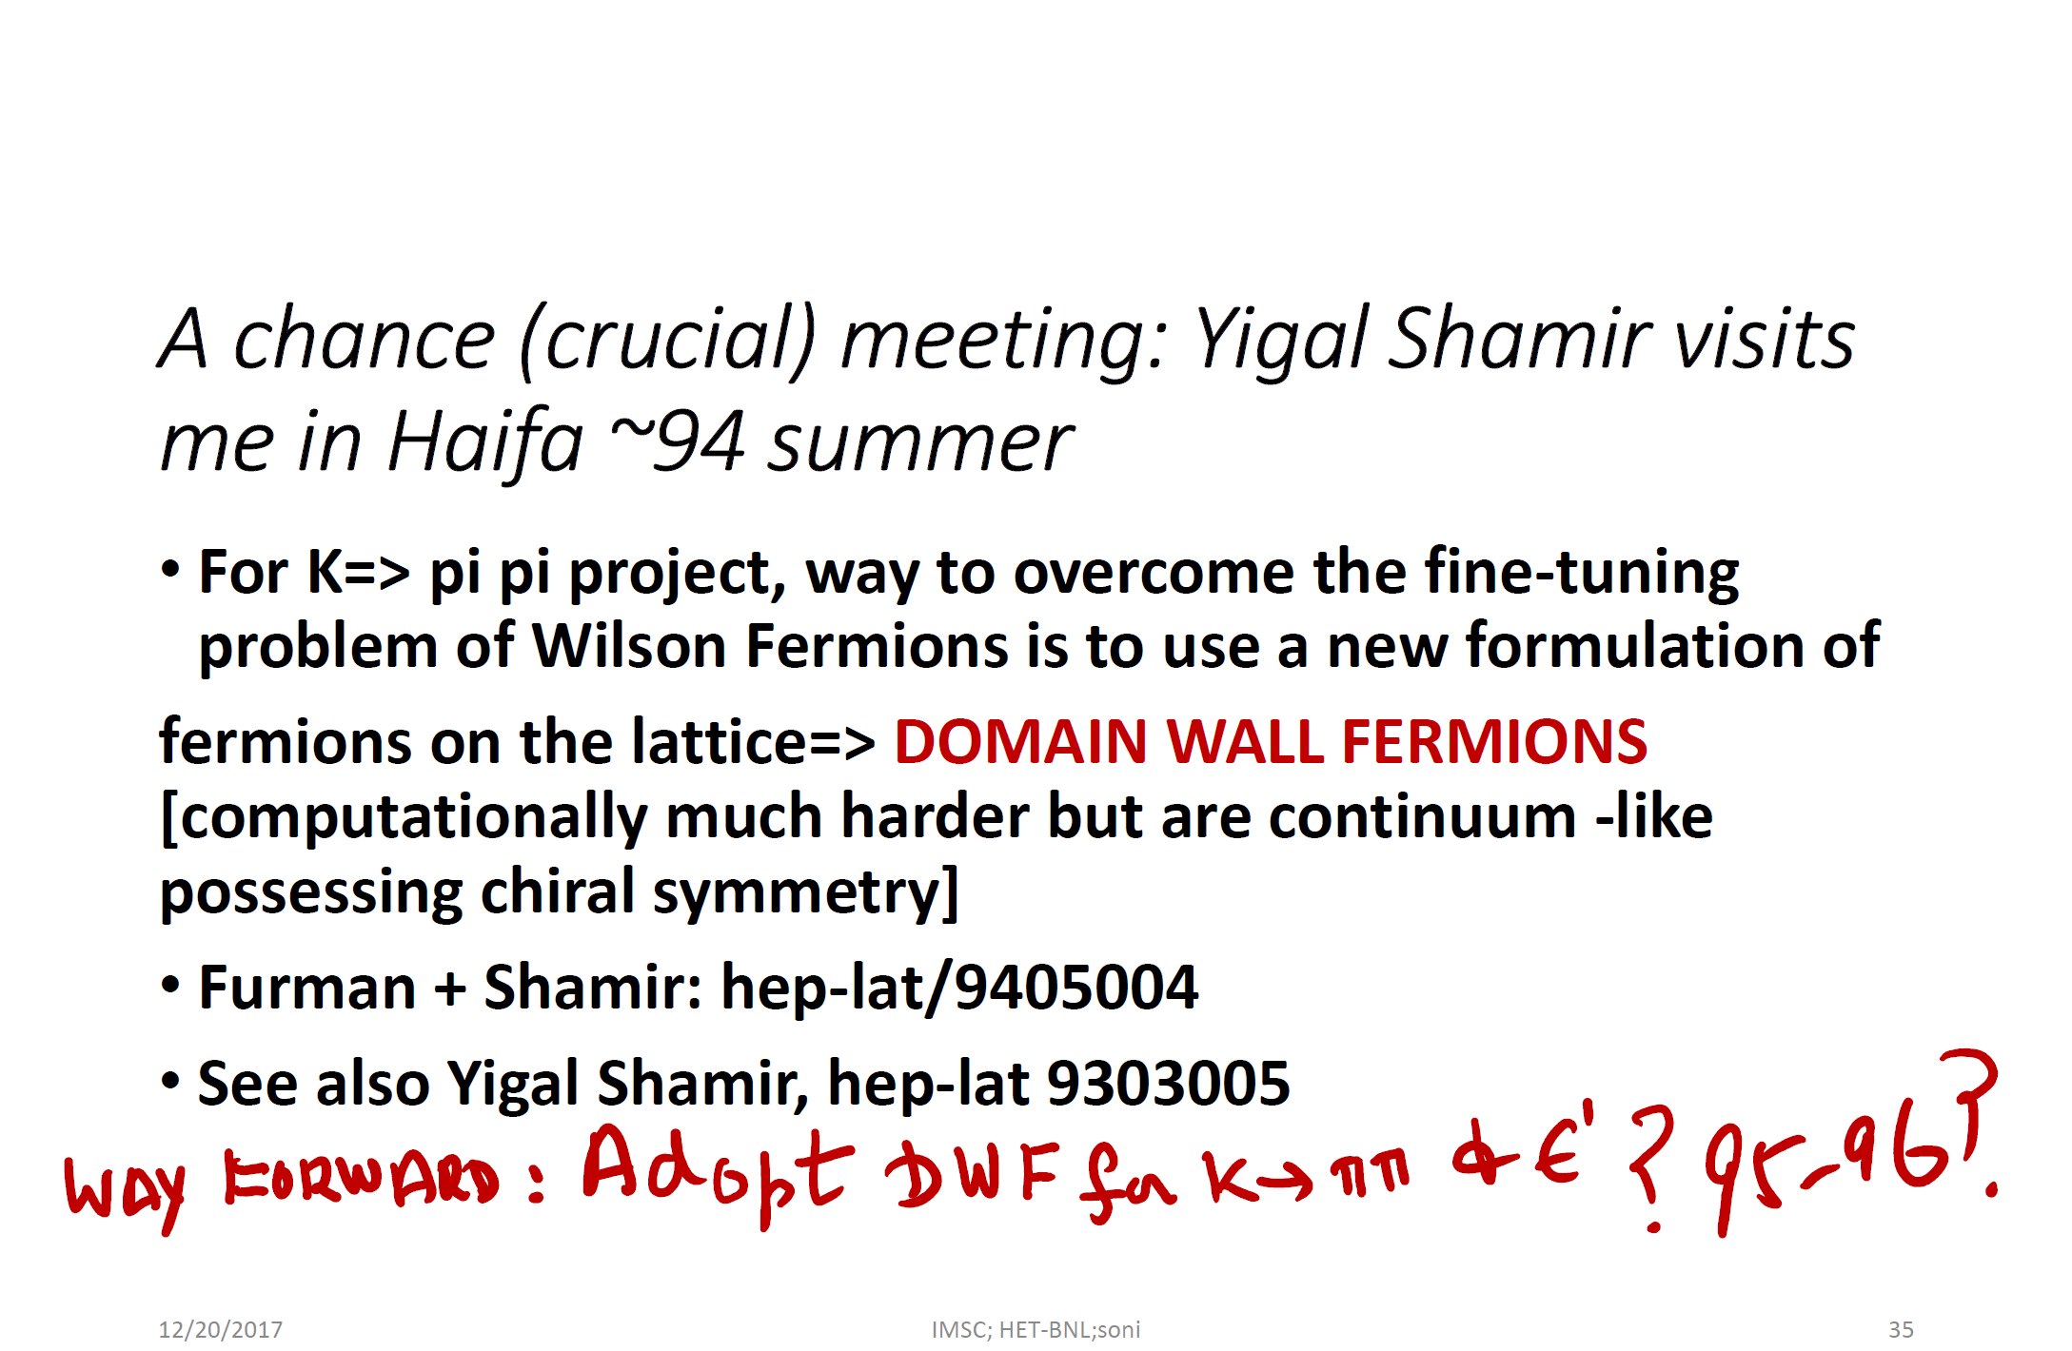

Slide 55
As a result, the large accidental cancellations significantly enhances sensitivity of ε’ to NP

Slide 56
More demands on the calculation
~ The 1995 discovery of the huge top mass accentuated the cancellation of I=0 and I=2 contributions to ε’ significantly, putting additional demands on the calculation but also enhancing the potential for discovery of new physics

Slide 57
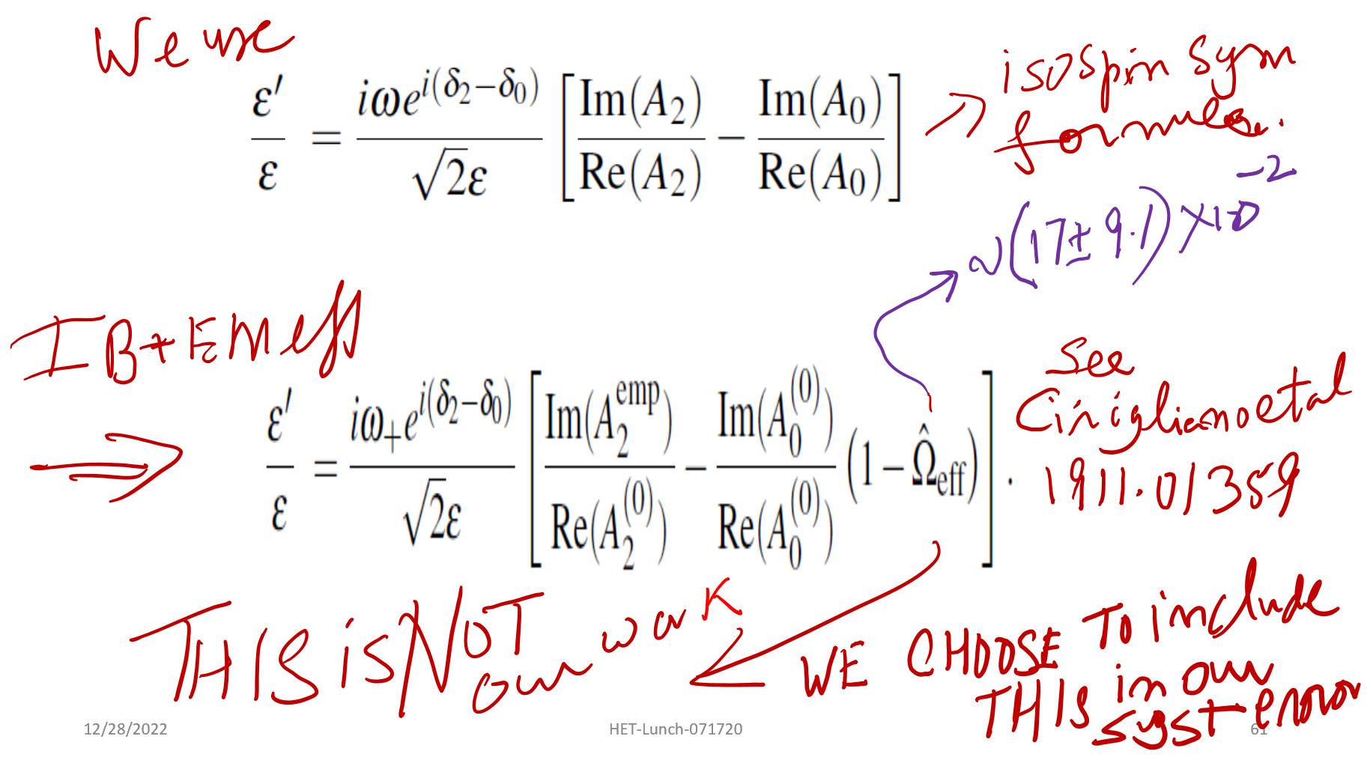

Slide 58
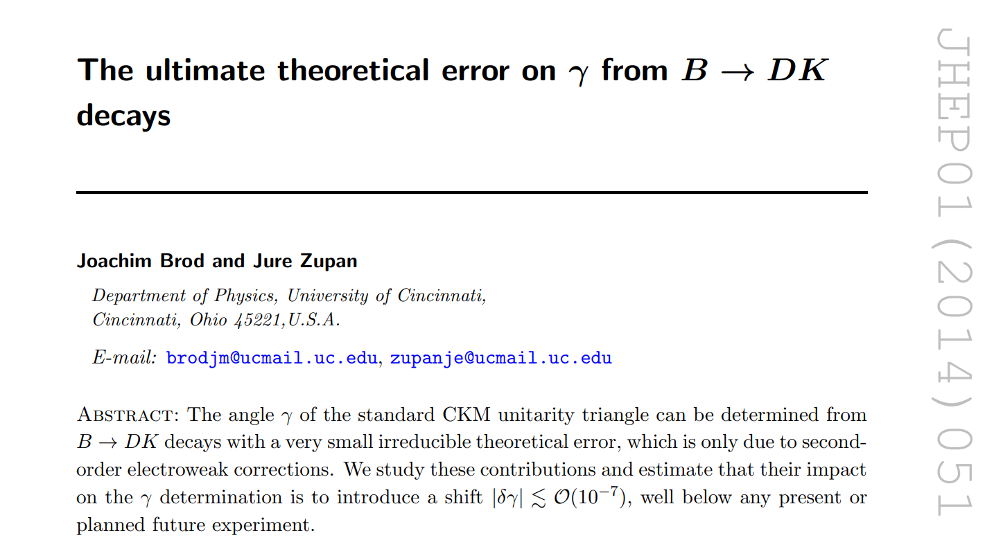



Slide 59

A difficulty: strong phases
The continuum and our lattice determinations of strong phase
difference differs at the ~2σ level:

Slide 60
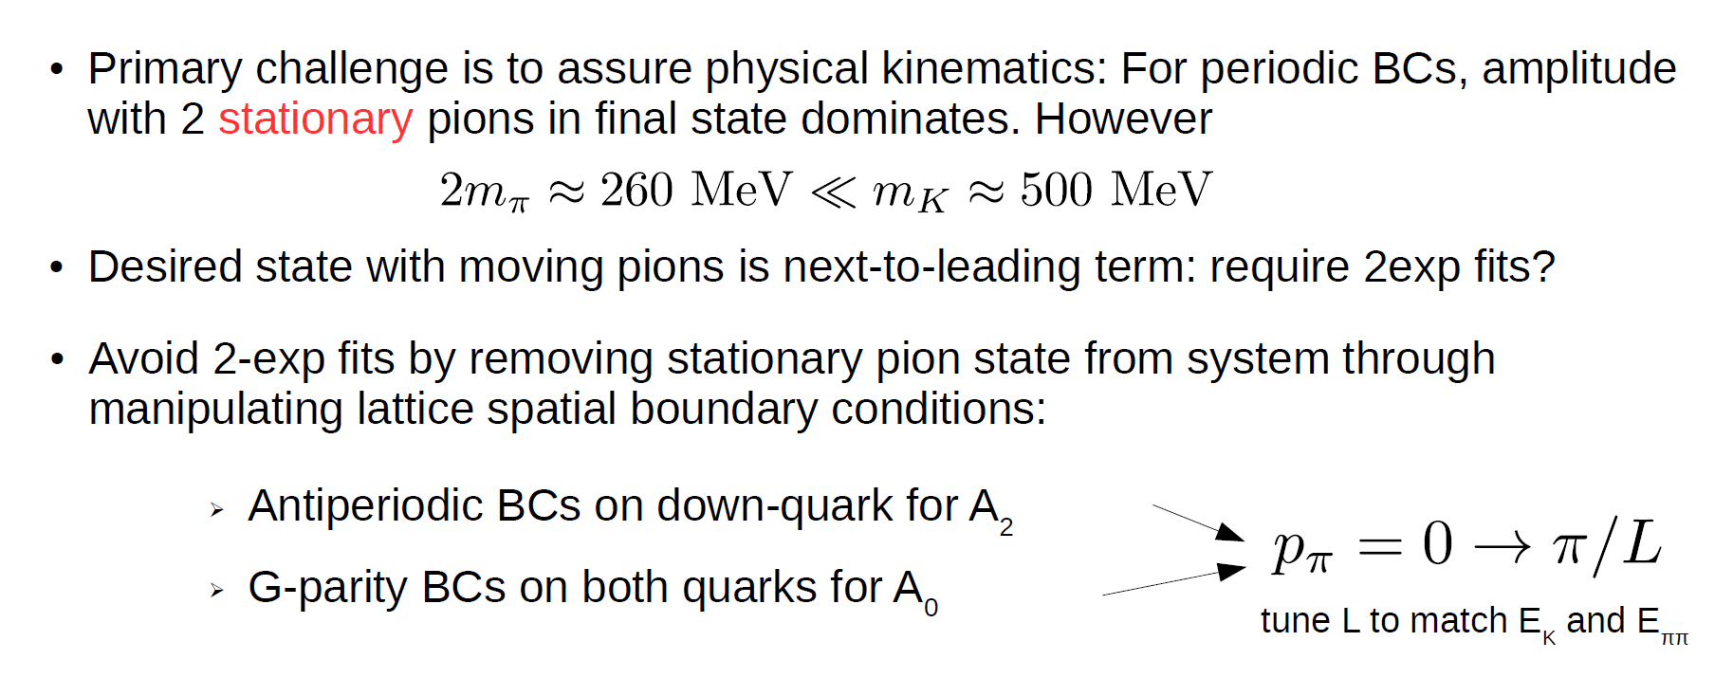
Challenges of physical K=>pi pi kinematics on the lattice

Slide 61
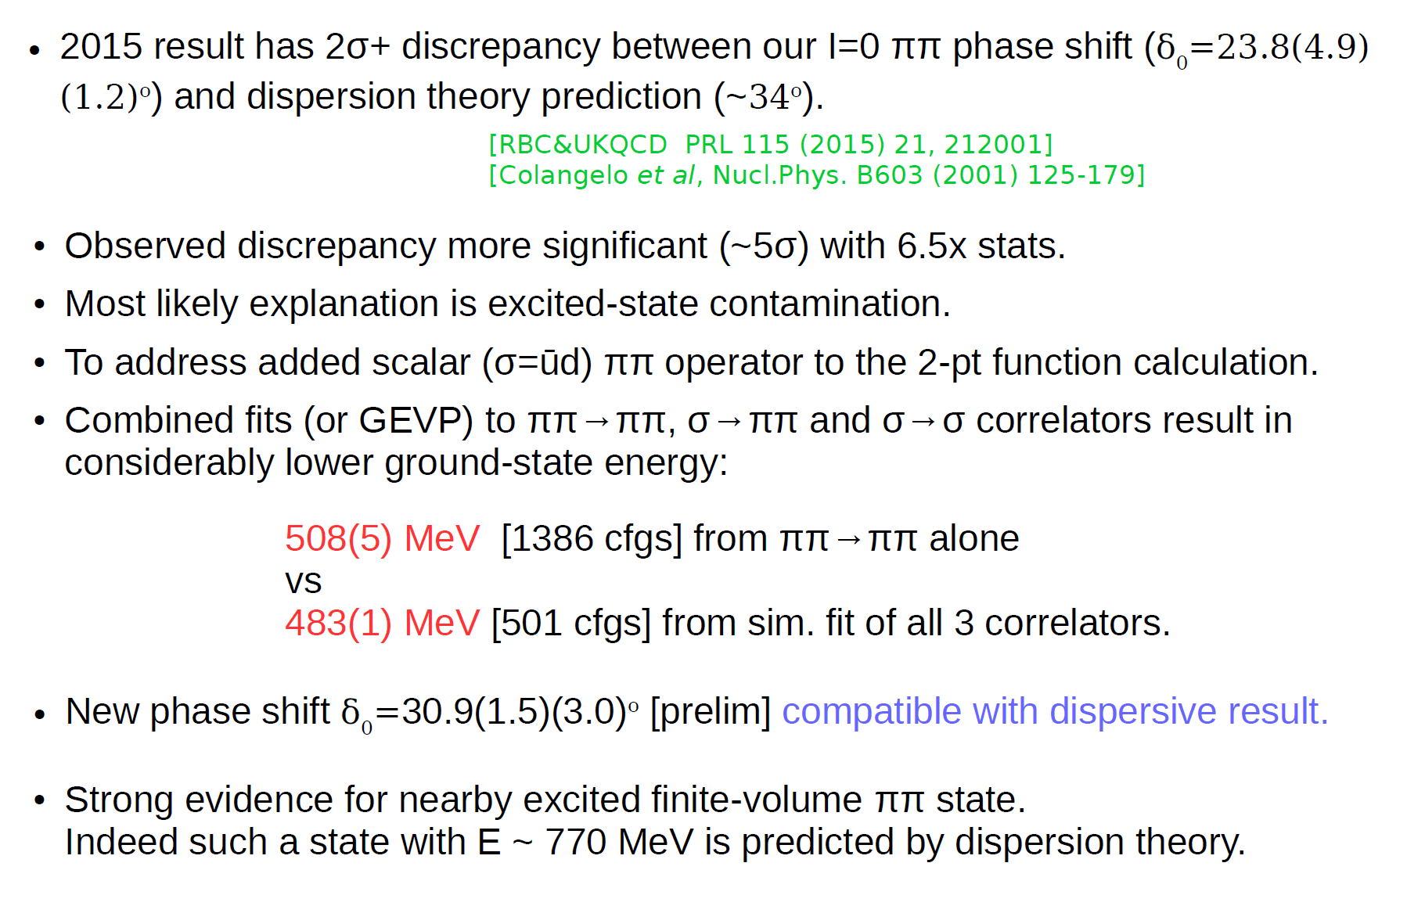
Resolving the [I=0] Energy & phase shift in the pi pi channel

Slide 62
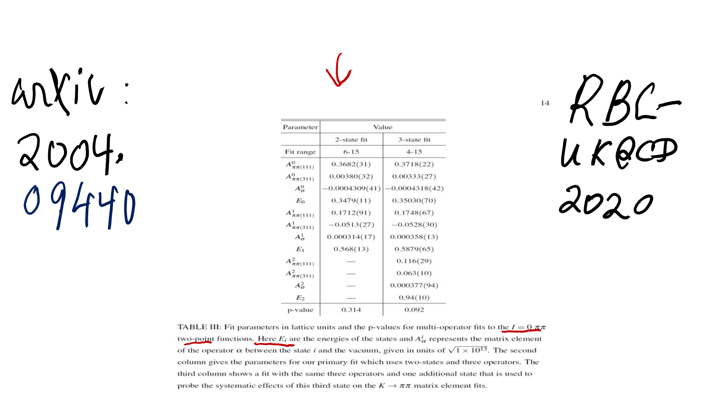

Slide 63
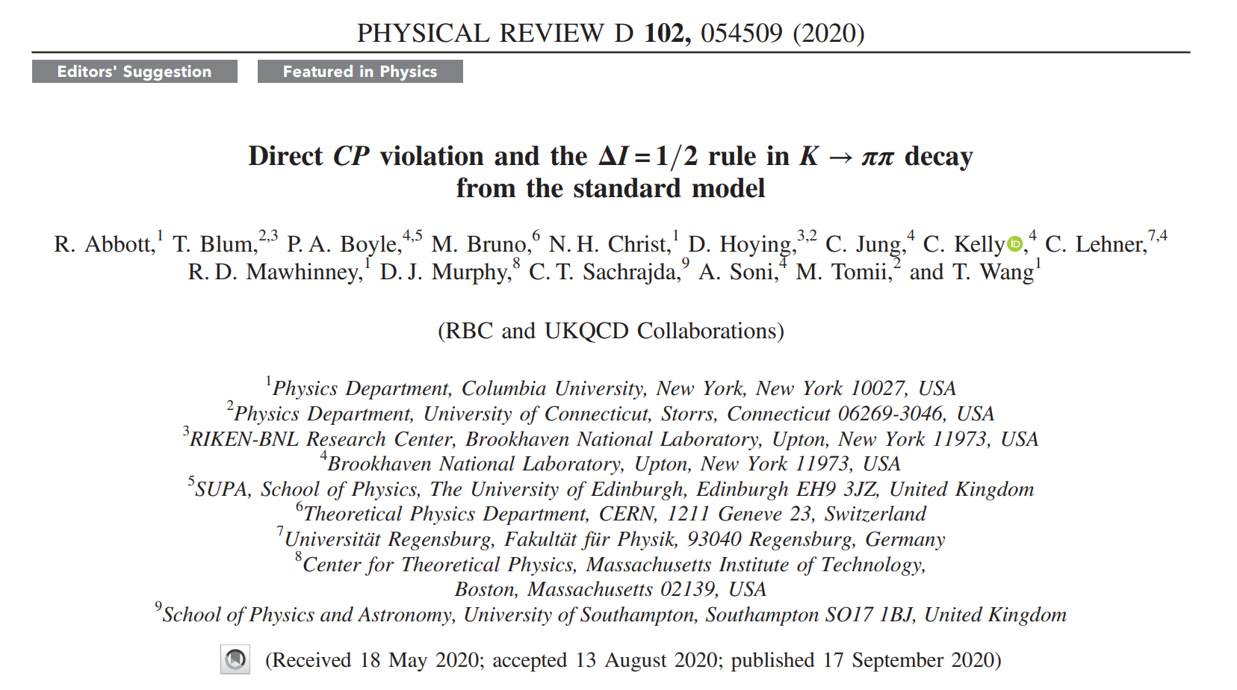

Slide 64
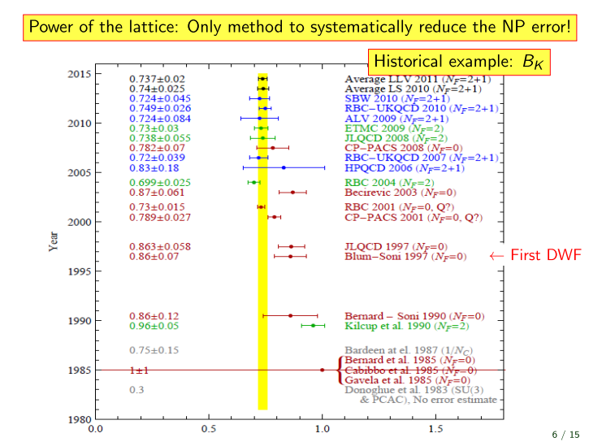

Slide 65
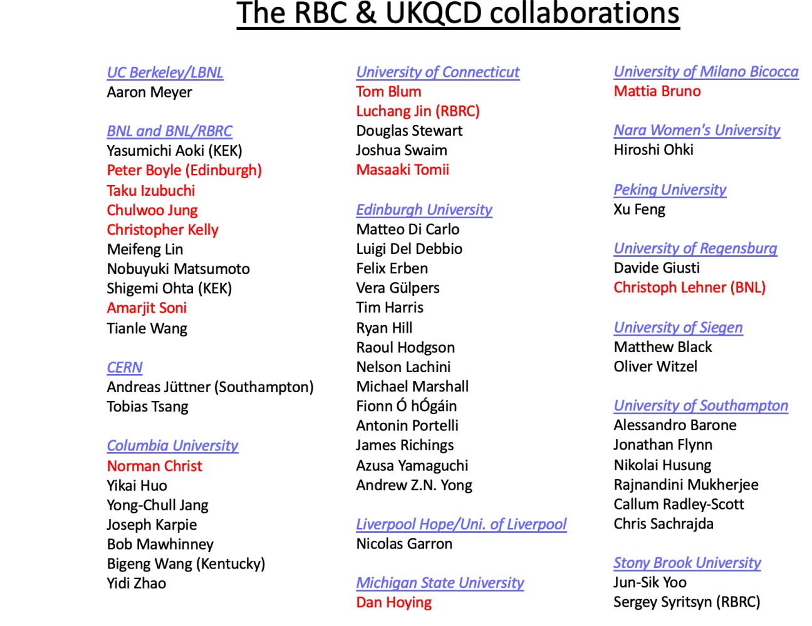

Slide 66
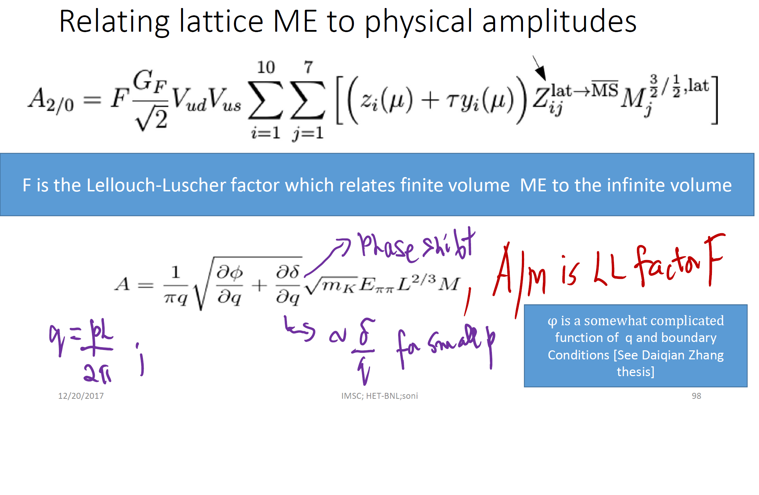

Slide 67
Main: (Old) and new points
In naturalness we trust
Early history: The crucial role of BK
Current tensions in B-UT
A moral (for the lattice) from epsilon’
Importance of K-UT
eps’: Periodic Boundary Condition appear promising
[with RBC-UKQCD]
Improving LD contribution to K+ => pi+ nu nu [with Enrico Lunghi]
K0=> pi0 l+ l-: should help significantly in constraining the extremely challenging gold plated mode: KL => pi0 nu nu. [with Stefan Schacht]
Summary

