Slide 1

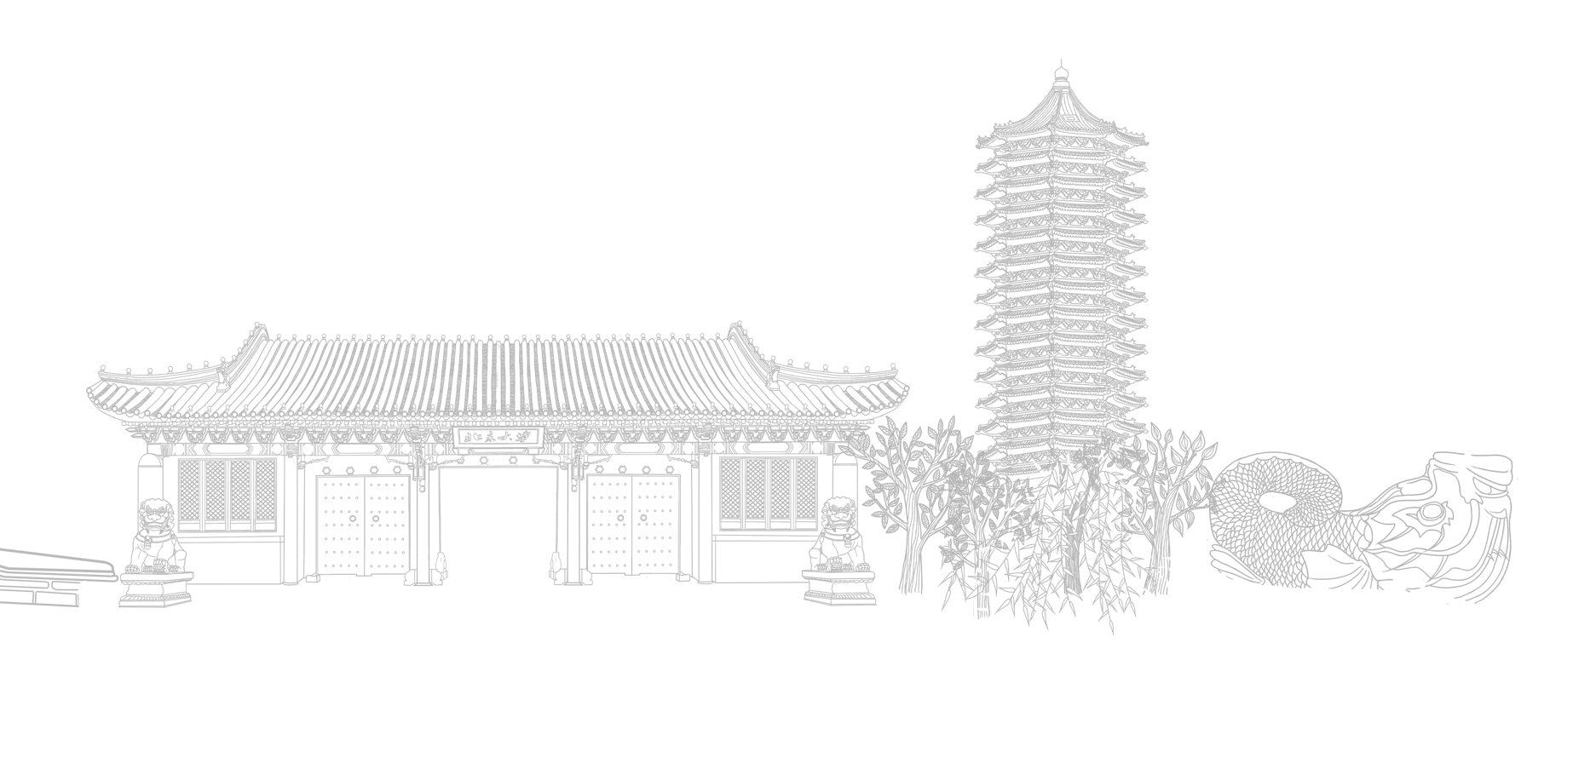

Lattice QCD calculation of
$π^{0}$-pole’s contribution to HLbL
Speaker: Tian Lin
Peking University
On behalf of the RBC&UKQCD collaborations
July, 2024
Lattice2024, Liverpool, UK

Slide 2
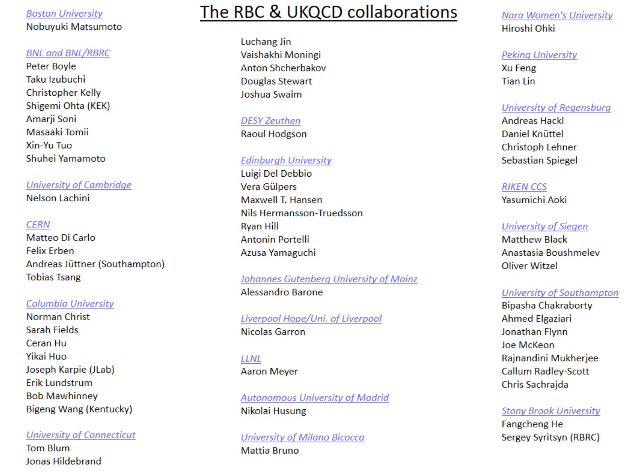

Slide 3

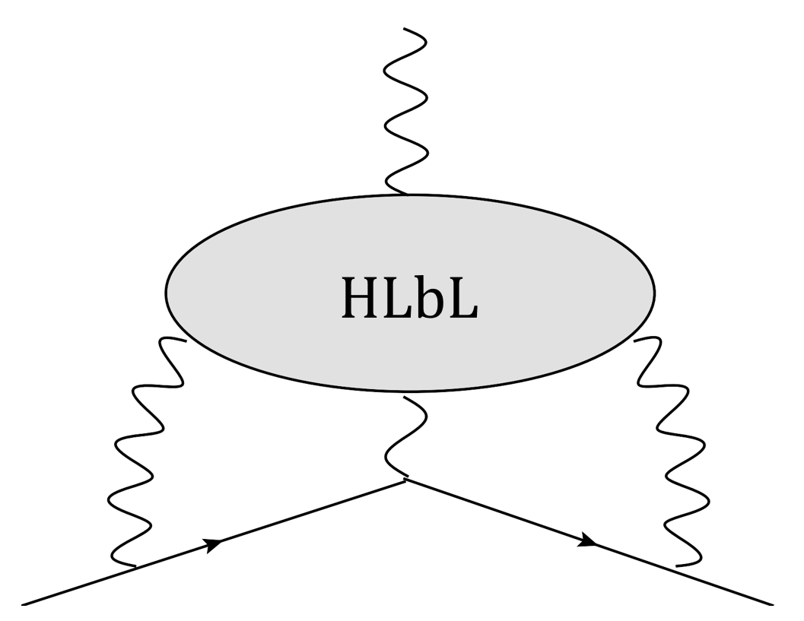
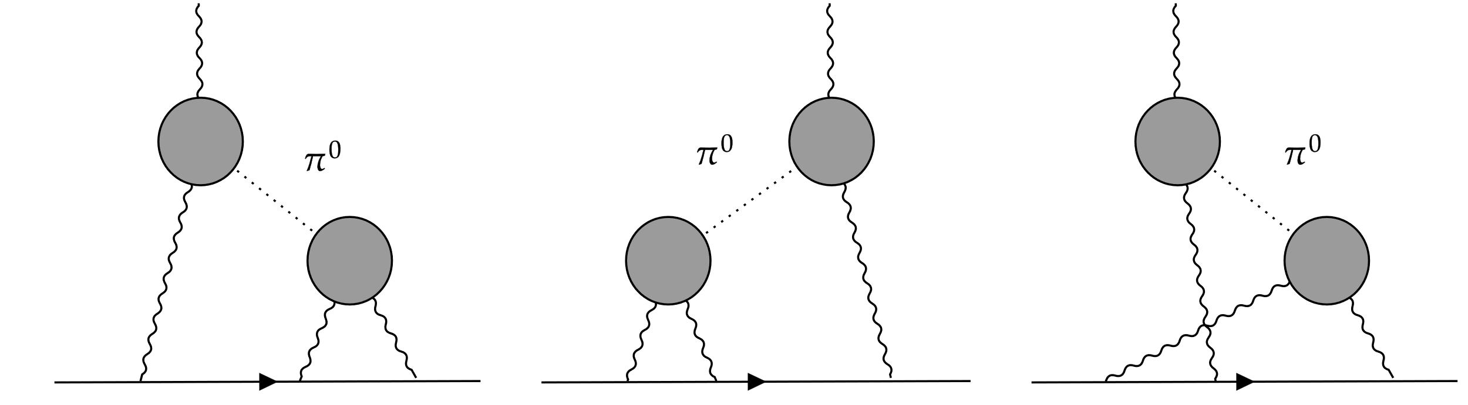
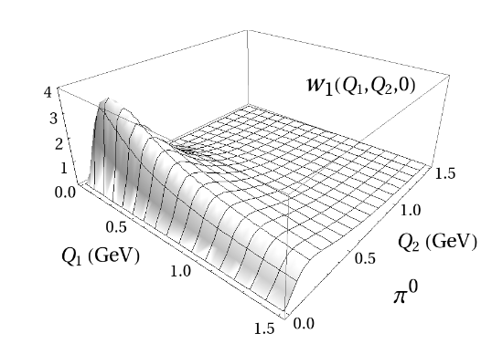
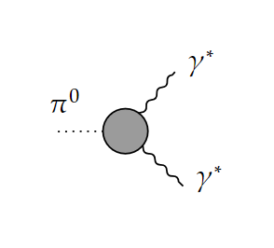

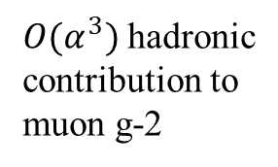
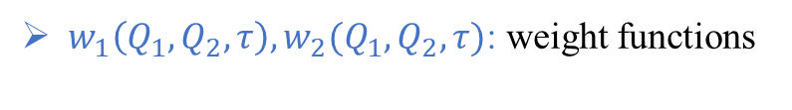

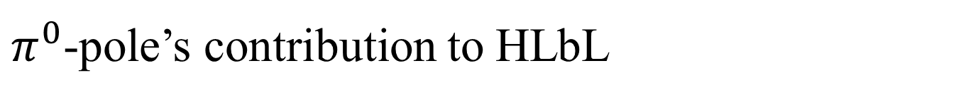
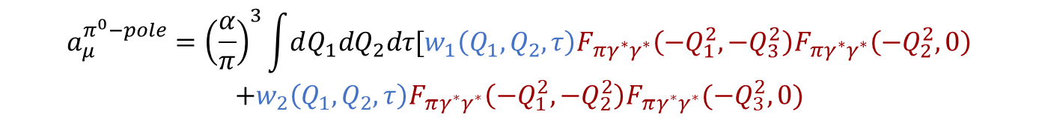
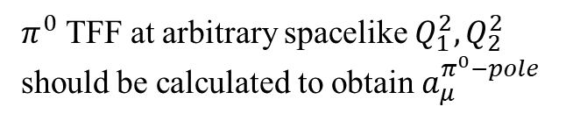
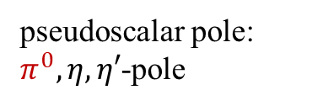

$π^{0}$-pole’s contribution to HLbL
$O(α^{3})$ hadronic
contribution to
muon g-2
$main$ contribution
pseudoscalar pole: $π^{0},η,η′$-pole
$$a_{μ}^{π^{0}−pole}={\left(\frac{α}{π}\right)}^{3}\int{dQ_{1}dQ_{2}dτ[w_{1}\left(Q_{1},Q_{2},τ\right)F_{πγ^{∗}γ^{∗}}\left(−Q_{1}^{2},−Q_{3}^{2}\right)F_{πγ^{∗}γ^{∗}}\left(−Q_{2}^{2},0\right)}$$
$$+w_{2}\left(Q_{1},Q_{2},τ\right)F_{πγ^{∗}γ^{∗}}\left(−Q_{1}^{2},−Q_{2}^{2}\right)F_{πγ^{∗}γ^{∗}}(−Q_{3}^{2},0)$$
$w_{1}\left(Q_{1},Q_{2},τ\right),w_{2}(Q_{1},Q_{2},τ)$: weight functions
$F_{πγ^{∗}γ^{∗}}\left(−Q_{1}^{2},−Q_{2}^{2}\right):π^{0}$ transition form factor
$π^{0}$ TFF at arbitrary spacelike $Q_{1}^{2},Q_{2}^{2}$ should be calculated to obtain $a_{μ}^{π^{0}−pole}$
(P. Masjuan et al.2017)
peaks at $Q^{2}∼m_{π}^{2}$

Slide 4

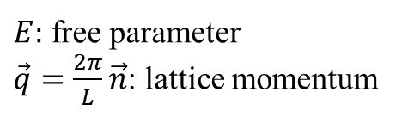
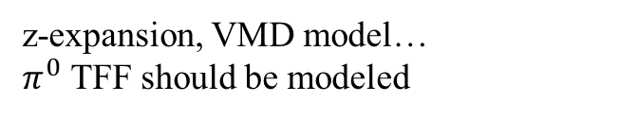
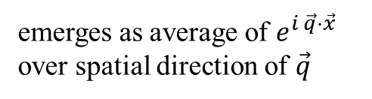


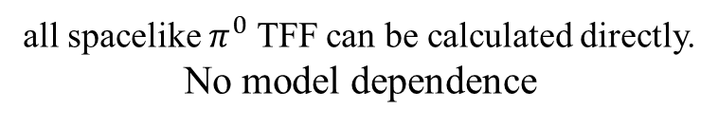
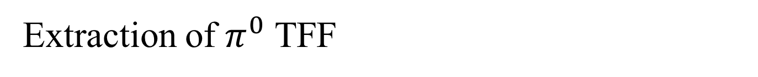

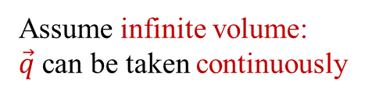
Extraction of $π^{0}$ TFF
Lattice input$: ℋ_{μν}(x)$
spacelike $π^{0}$ TFF
$$i∫d^{4}xe^{−iQ_{1}⋅x}\left\langle Ω\left|T\left\{J_{μ}\left(x\right)J_{ν}\left(0\right)\right\}\right|π^{0}\left(P\right)\right\rangle ≡ε_{μναβ}q_{1}^{α}q_{2}^{β}ℱ_{π^{0}γ^{∗}γ^{∗}}(−Q_{1}^{2},−Q_{2}^{2})$$
$Q_{1}=\left(iE,\vec{q} \right)$
$E:$ free parameter
$\vec{q}=\frac{2π}{L}\vec{n}$: lattice momentum
not all spacelike $π^{0}$ TFF can be calculated directly!
Traditional method：
z-expansion, VMD model…
$π^{0}$ TFF should be modeled
Infinite volume method:
Assume infinite volume:
$\vec{q}$ can be taken continuously
all spacelike $π^{0}$ TFF can be calculated directly.
No model dependence
$$ℱ_{π^{0}γ^{∗}γ^{∗}}\left(−Q_{1}^{2},−Q_{2}^{2}\right)=\frac{1}{2m_{π}}\int{dt }\int{d^{3}x}e^{Et}\frac{{ j}_{1}\left(\left|\vec{q}\right|\left|\vec{x}\right|\right)}{\left|\vec{q}\right|\left|\vec{x}\right|} {ε^{μνα0}x_{α}ℋ}_{μν}\left(x\right)$$
(Christ et al. 2022)
(Meng et al. 2023)
emerges as average of $e^{i \vec{q}⋅\vec{x}}$ over spatial direction of $\vec{q}$

Slide 5
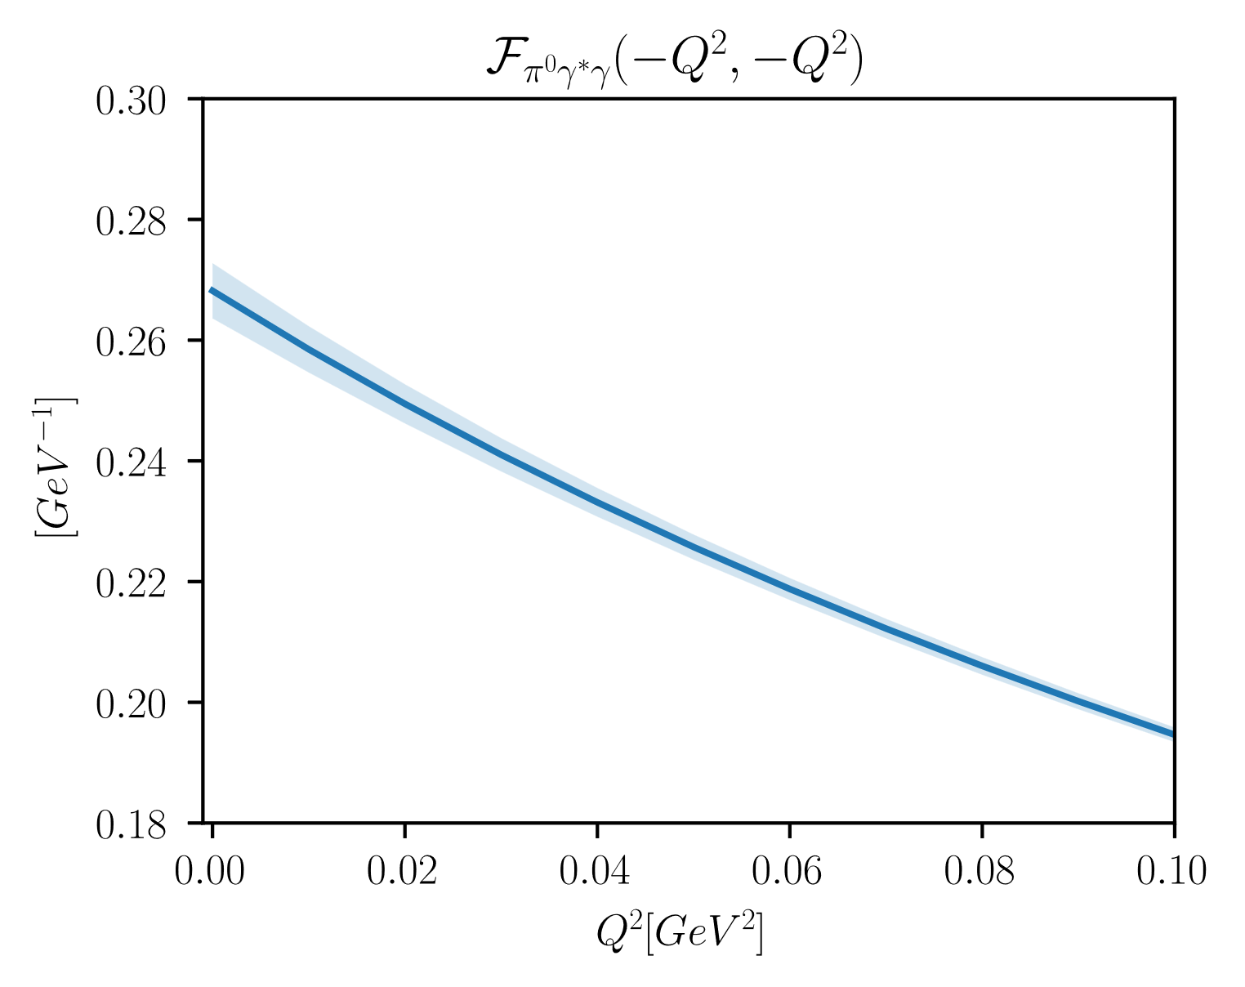
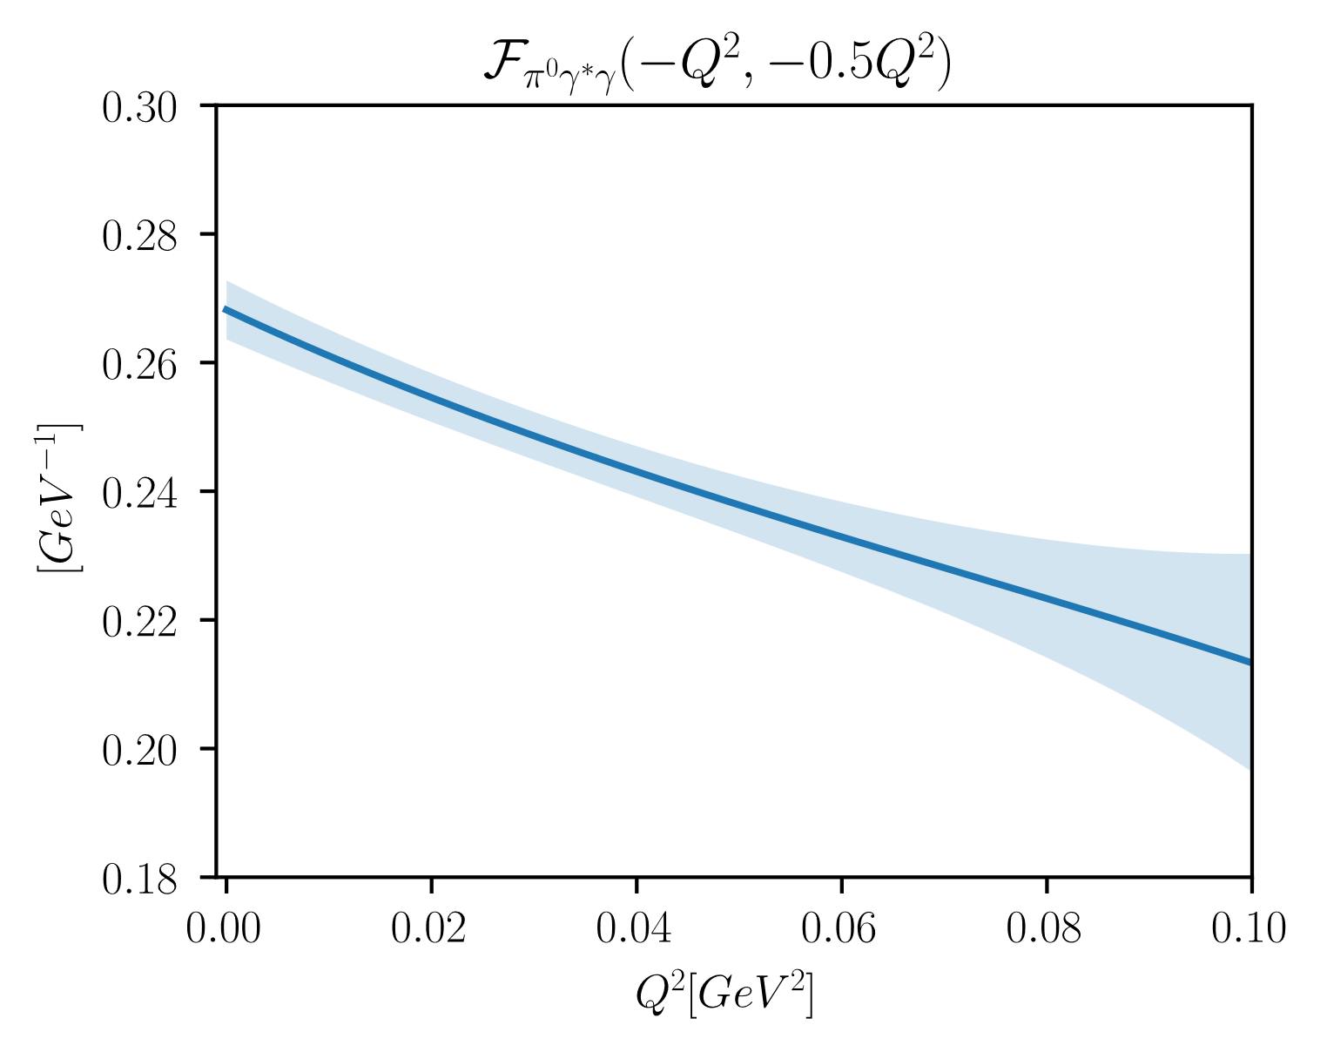
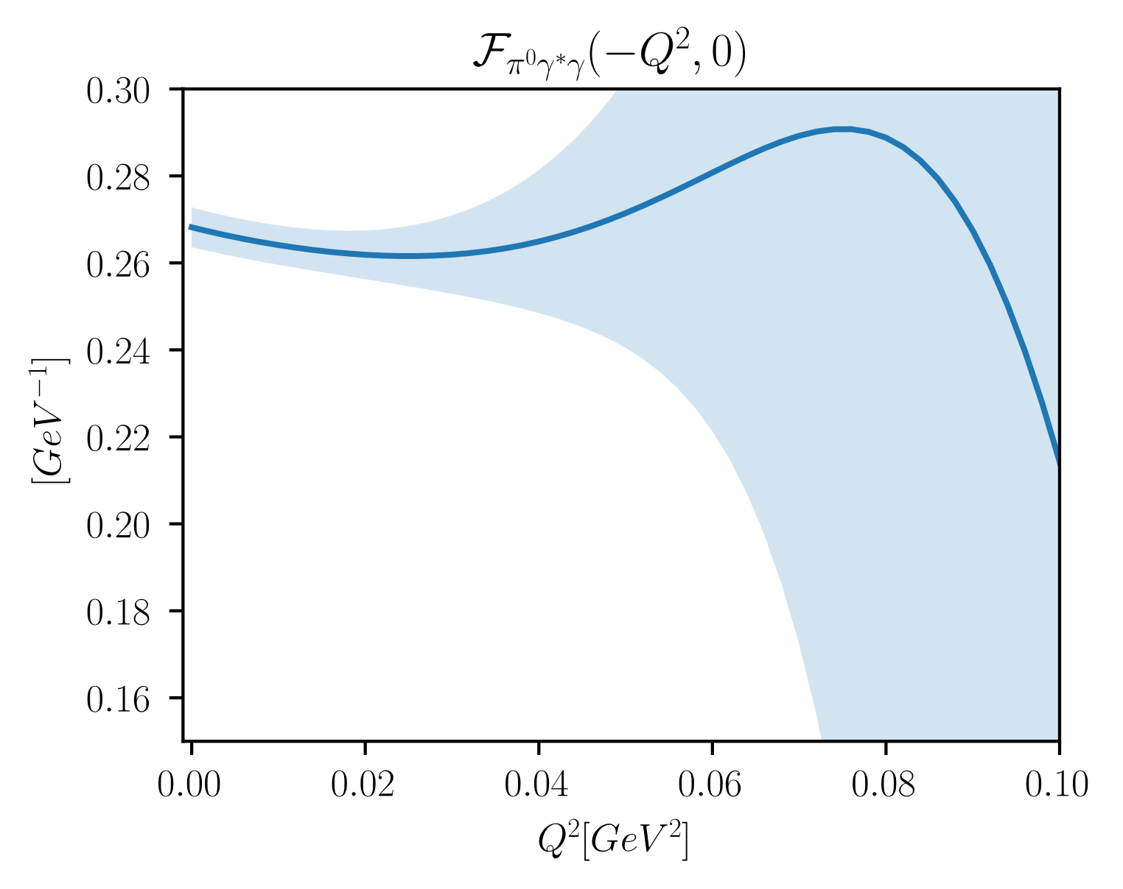
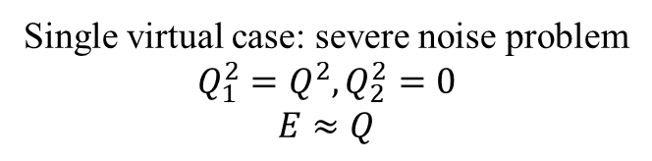
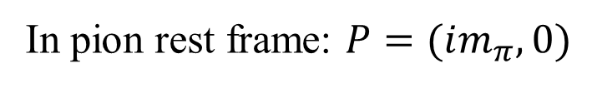
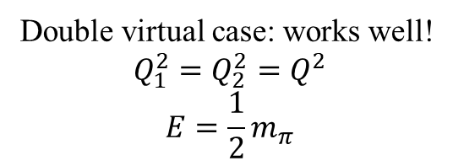
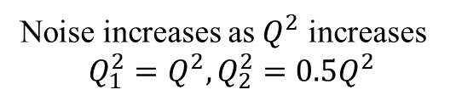
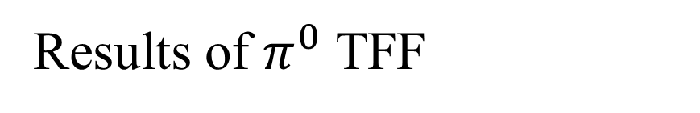
Results of $π^{0}$ TFF
In pion rest frame: $P=(im_{π},0)$
Double virtual case: works well!
$$Q_{1}^{2}=Q_{2}^{2}=Q^{2}$$
$$E=\frac{1}{2}m_{π}$$
Noise increases as $Q^{2}$ increases
$$Q_{1}^{2}=Q^{2},Q_{2}^{2}=0.5Q_{ }^{2}$$
Single virtual case: severe noise problem
$$Q_{1}^{2}=Q^{2},Q_{2}^{2}=0$$
$$E≈Q$$
$$ℱ_{π^{0}γ^{∗}γ^{∗}}\left(−Q_{1}^{2},−Q_{2}^{2}\right)=\frac{1}{2m_{π}}\int{dt }\int{d^{3}x}e^{Et}\frac{{ j}_{1}\left(\left|\vec{q}\right|\left|\vec{x}\right|\right)}{\left|\vec{q}\right|\left|\vec{x}\right|} {ε^{μνα0}x_{α}ℋ}_{μν}\left(x\right)$$
amplify noise if E is large
Due to S/N problem, we can’t obtain $a_{μ}^{π^{0}−pole}$

Slide 6
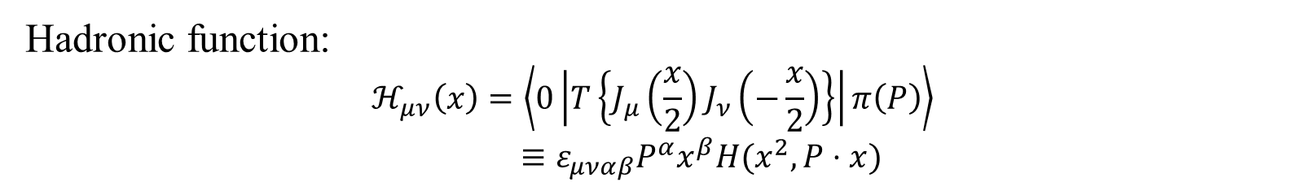
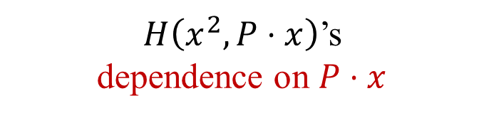


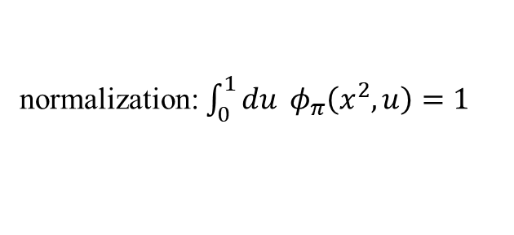
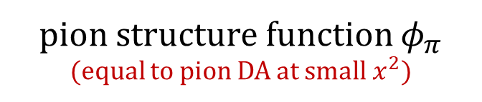
Lorentz structure and symmetry of hadronic function
Hadronic function:
$$ℋ_{μν}\left(x\right)=\left\langle 0\left|T\left\{J_{μ}\left(\frac{x}{2}\right)J_{ν}\left(−\frac{x}{2}\right)\right\}\right|π\left(P\right)\right\rangle$$
$$≡ε_{μναβ}P^{α}x^{β}H(x^{2},P⋅x)$$
$H\left(x^{2},P⋅x\right)$’s
dependence on $P⋅x$
described by
pion structure function $φ_{π}$
(equal to pion DA at small $x^{2}$)
preserve SO(4) symmetry
(Bali et al., 2018)
$$H\left(x^{2},P⋅x\right)=\int_{0}^{1}{du} e^{i\left(u−\frac{1}{2}\right)P⋅x}φ_{π}\left(x^{2},u\right)H(x^{2},0)$$
$φ_{π}\left(x^{2},u\right)=0$ when $u∉[0,1]$
pion structure function
quark-antiquark symmetry: ${ φ}_{π}\left(x^{2}, u\right)=φ_{π}(x^{2},1−u)$
normalization: $\int_{0}^{1}{du} φ_{π}\left(x^{2},u\right)=1$

Slide 7


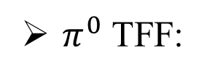
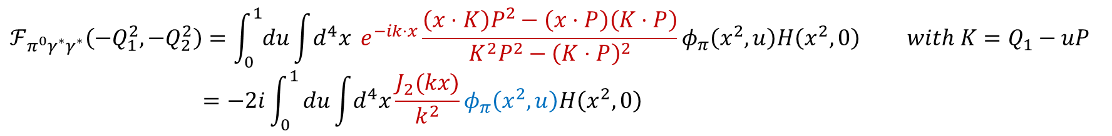
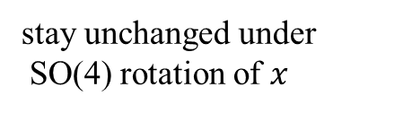

SO(4) average method
Hadronic function:
$$H\left(x^{2},P⋅x\right)=\int_{0}^{1}{du} e^{i\left(u−\frac{1}{2}\right)P⋅x}φ_{π}\left(x^{2},u\right)H(x^{2},0)$$
stay unchanged under
SO(4) rotation of $x$
$π^{0}$ TFF:
$$ℱ_{π^{0}γ^{∗}γ^{∗}}\left(−Q_{1}^{2},−Q_{2}^{2}\right)=\int_{0}^{1}{du}\int{d^{4}x} e^{−ik⋅x}\frac{\left(x⋅K\right)P^{2}−\left(x⋅P\right)\left(K⋅P\right)}{K^{2}P^{2}−{\left(K⋅P\right)}^{2}}φ_{π}\left(x^{2},u\right)H\left(x^{2},0\right) with K=Q_{1}−uP$$
        $$=−2i\int_{0}^{1}{du\int{d^{4}x}\frac{J_{2}(kx)}{k^{2}}}φ_{π}\left(x^{2},u\right)H\left(x^{2},0\right)$$
SO(4) average
Lattice input
Physical pion structure function
no signal to noise problem
introduce unknown structure function

Slide 8
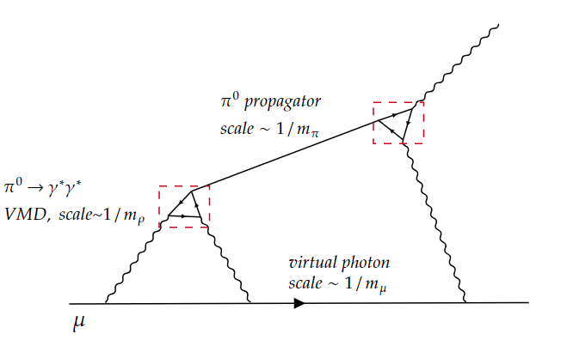
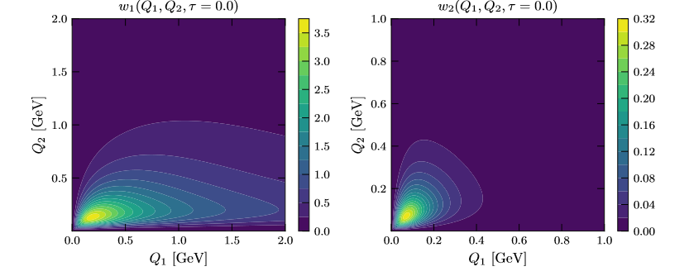

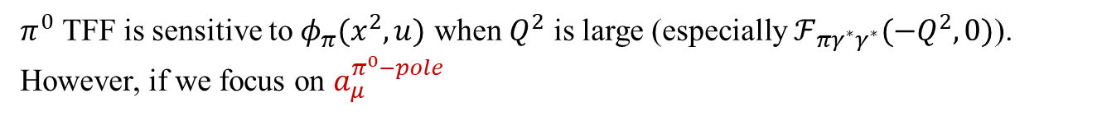
$π^{0}$ pole’s contribution to HLbL
$π^{0}$ TFF is sensitive to $φ_{π}(x^{2},u)$ when $Q^{2}$ is large (especially $ℱ_{πγ^{∗}γ^{∗}}(−Q^{2},0)$).
However, if we focus on $a_{μ}^{π^{0}−pole}$
weight function of $a_{μ}^{π^{0}−pole}$
(C. Alexandrou, et. al 2024)
main contribution comes from low energy region
As $m_{ρ}≫m_{π},m_{μ}$, $a_{μ}^{π^{0}−pole}$ is not sensitive to pion’s SD structure $φ_{π}(x^{2},u)$.

Slide 9


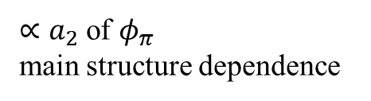

Gegenbauer expansion
lattice input (positive)
$a_{μ}^{π^{0}−pole}$ can be rewritten as:
structure function
known weight function
$$a_{μ}^{π^{0}−pole}=\int{d^{4}x_{1}}d^{4}x_{2}du_{1}du_{2}H\left(x_{1}^{2},0\right)H\left(x_{2}^{2},0\right)φ_{π}\left(x_{1}^{2},u_{1}\right)φ_{π}\left(x_{2}^{2},u_{2}\right)ρ_{sym}(x_{1},x_{2},u_{1},u_{2})$$
Gegenbauer polynomials $C_{2n}^{\frac{3}{2}}(2u−1)$: orthogonal and complete basis on $\left[0,1\right]$.
$$φ_{π}\left(x^{2},u\right)=6u\left(1−u\right)\sum_{n}{a_{2n}\left(x^{2}\right)C_{2n}^{\frac{3}{2}}(2u−1)}$$
Gegenbauer moment
normalization: $a_{0}\left(x^{2}\right)=1$
$$ρ_{sym}\left(x_{1},x_{2},u_{1},u_{2}\right)=\sum_{n,m}{ρ_{2n,2m}(x_{1},x_{2}) C_{2n}^{\frac{3}{2}}(2u_{1}−1)C_{2m}^{\frac{3}{2}}(2u_{2}−1)}$$
suppress as $n,m↑$
$a_{μ}^{π^{0}−pole}$ $≈a_{0,0}^{π^{0}−pole}+a_{0,2}^{π^{0}−pole}+a_{2,0}^{π^{0}−pole}+⋯$
Ignore higher order term
Main contribution
independent of pion’s structure
$∝a_{2}$ of $φ_{π}$
main structure dependence

Slide 10
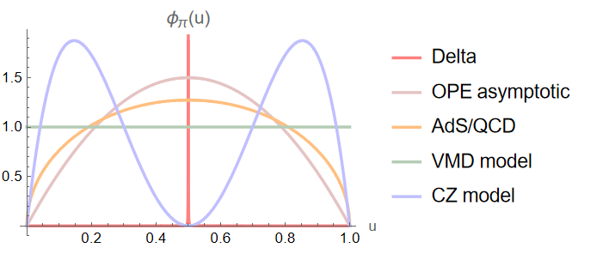


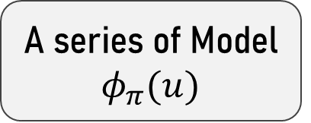

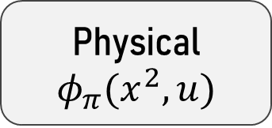


How to determine $φ_{π}(x^{2},u)$?
Thought1: Can we extract pion structure function on lattice?
boost pion with large momentum (signal to noise problem)
inverse problem
a completely new program
In principle we can but…
Thought2: How to evaluate structure dependence
Physical $φ_{π}(x^{2},u)$
A series of Model $φ_{π}(u)$
evaluate model dependence
Delta $φ_{π}(u)=δ(u−\frac{1}{2})$
covering different energy scales
OPE asymptotic :$φ_{π}\left(u\right)=6u(1−u)$
AdS/QCD:$φ_{π}\left(u\right)=\frac{8}{π}\sqrt{u(1−u)}$
VMD model:$φ_{π}\left(u\right)=1$
CZ model: $φ_{π}\left(u\right)=30u\left(1−u\right){\left(1−2u\right)}^{2}$
…
(inspired by pion DA)

Slide 11
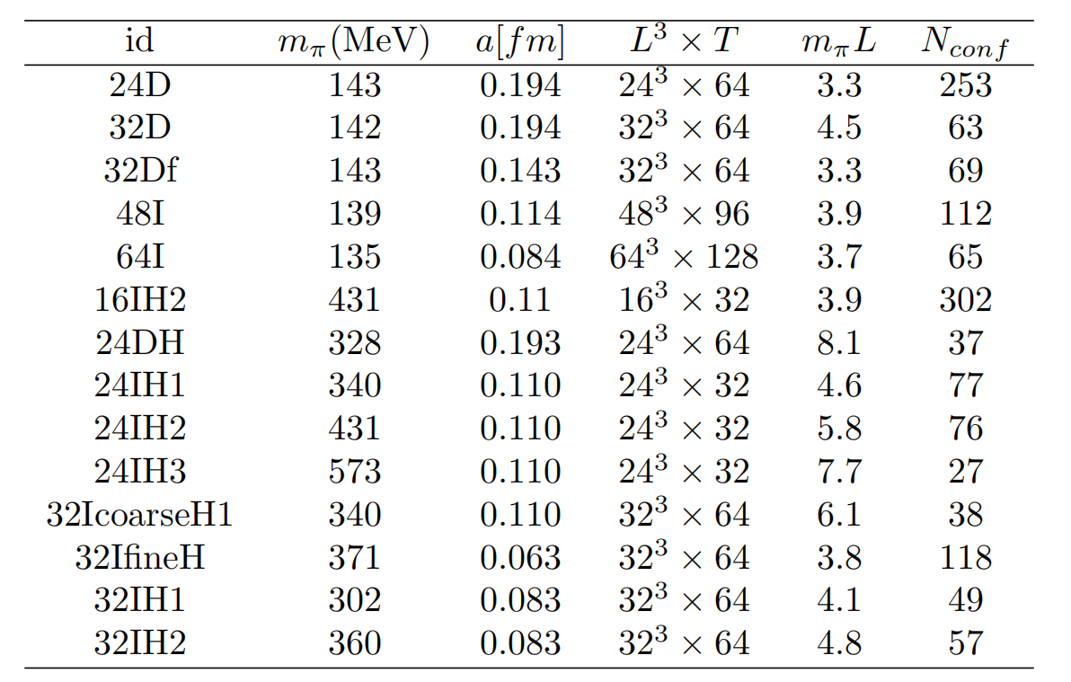
Lattice Ensembles
physical pion mass
Generated by RBC/UKQCD
2+1 Domain wall fermion + Iwasaki gauge action(+DSDR)

Slide 12
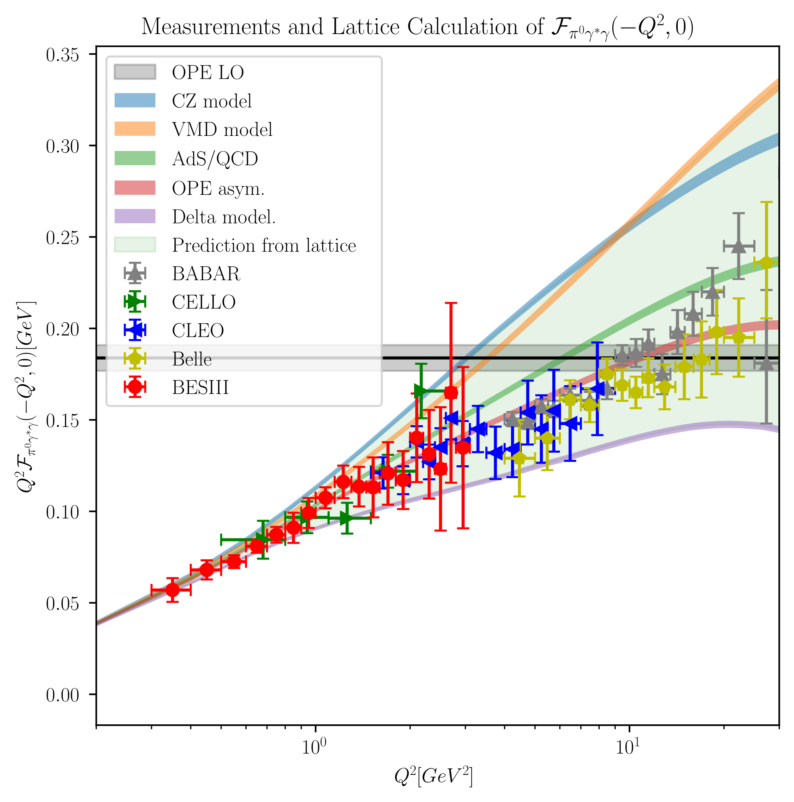


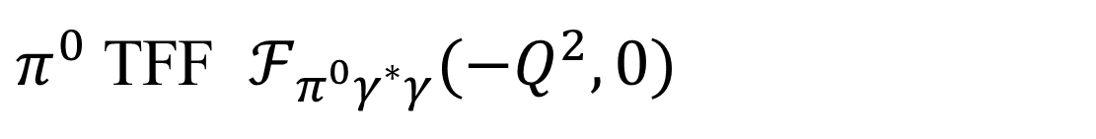
$π^{0}$ TFF $ℱ_{π^{0}γ^{∗}γ}(−Q^{2},0)$
result for a single model
(continuum extrapolations
are performed here)
combine different models:
lattice results
cover all experiment data
experiment data
BABAR, CELLO, CLEO, Belle, BESIII
Choice of models is conservative enough
to evaluate model dependence.

Slide 13
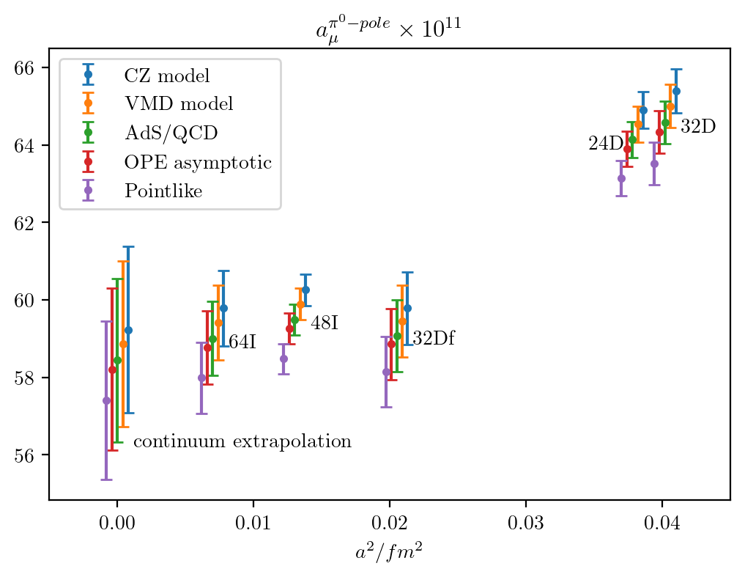
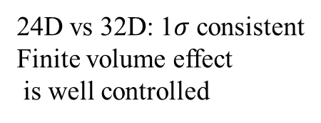
Results of $a_{μ}^{π^{0}−pole}$
24D vs 32D: 1$σ$ consistent
Finite volume effect
is well controlled
different models are consistent in continuum limit
Preliminary result: $a_{μ}^{π^{0}−pole}=58.3{\left(2.1\right)}_{stat}{\left(0.9\right)}_{sys}×{10}^{−11}$
statistical
error
systematic
error
>

Slide 14
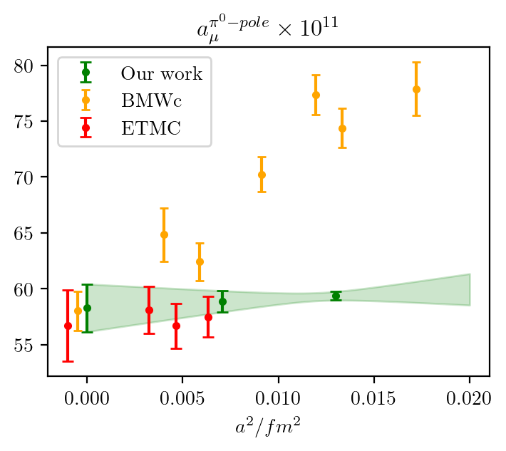
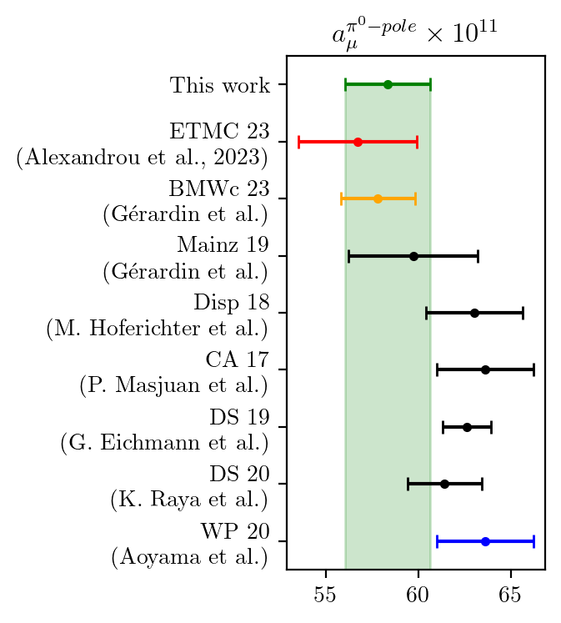
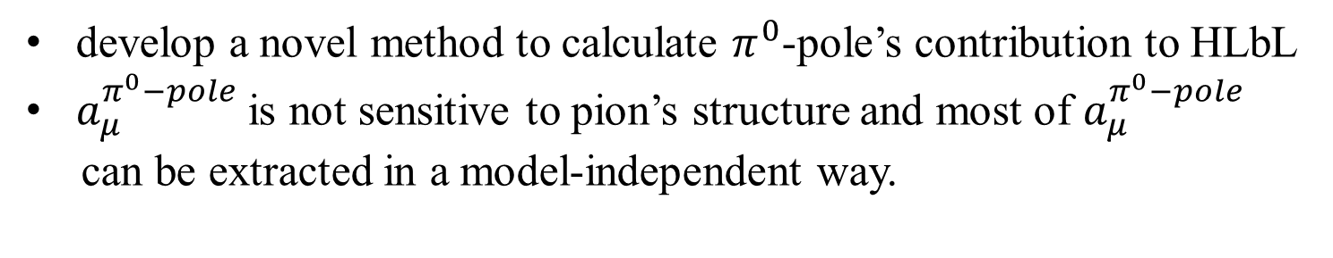
Summary
lattice
dispersive,
model
develop a novel method to calculate $π^{0}$-pole’s contribution to HLbL
$a_{μ}^{π^{0}−pole}$ is not sensitive to pion’s structure and most of $a_{μ}^{π^{0}−pole}$
can be extracted in a model-independent way.

Slide 15
THANK YOU!

