Slide 1
Randomness and Modularity in
2D CFT and Gravity
Eric Perlmutter, IPhT Saclay & IHES
56th IPPP Annual Theory Meeting
December 16 2024

Slide 2
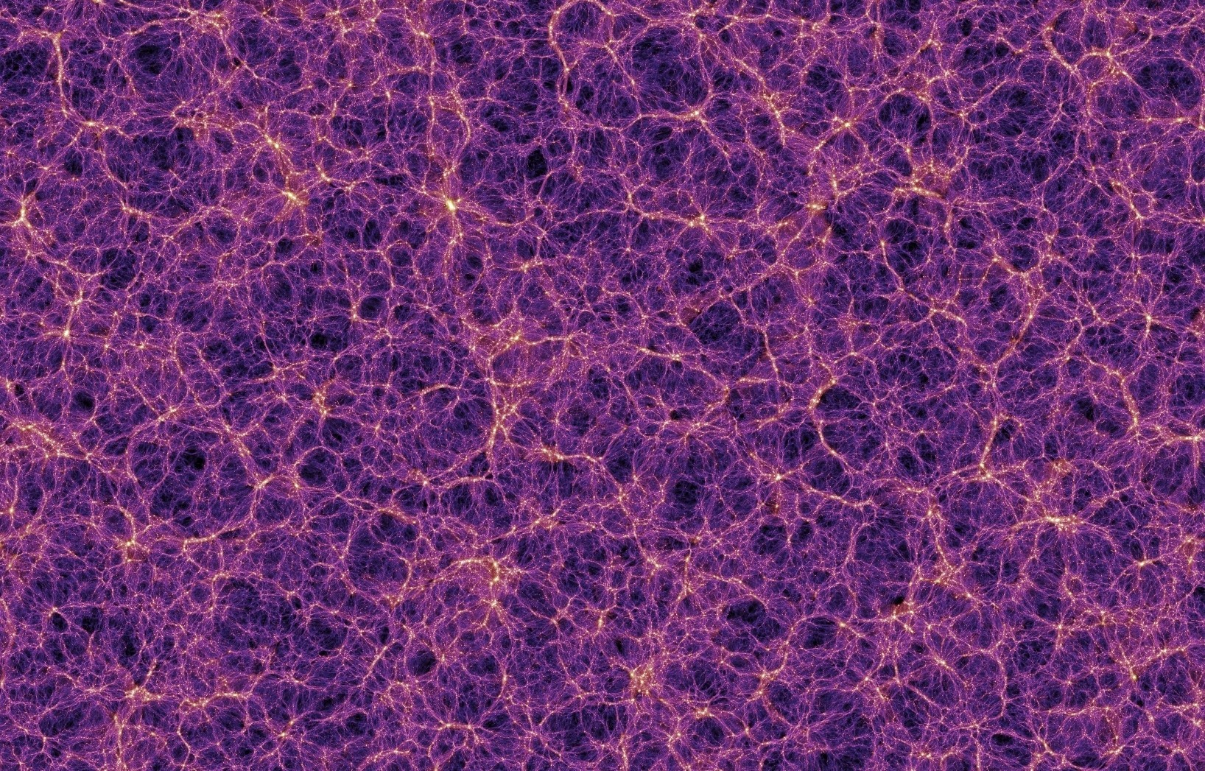

Slide 3
What is the large scale structure of QFT space?

Slide 4
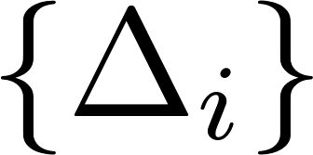
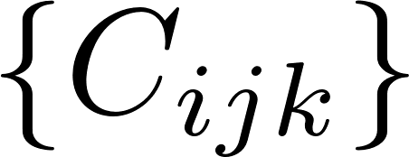
What is the large scale structure of CFT space?
Spectrum
Interactions

Slide 5
What is the large scale structure of CFT space?
Spectrum
What are the properties
of any given conformal field theory?
What are the formal structures that organize/stratify conformal field theories?
Interactions
How are conformal field theory data constrained by fundamental principles?

Slide 6
What is the large scale structure of CFT space?
Spectrum
BOOTSTRAP
What are the properties
of any given conformal field theory?
What are the formal structures that organize/stratify conformal field theories?
Interactions
How are conformal field theory data constrained by fundamental principles?

Slide 7
The state of CFT taxonomy remains somewhat primitive:
There is no explicit example of a generic CFT that is known to exist (much less its data known explicitly).
This is sometimes cited as an embarrassment of modern-day CFT.
What do we mean by generic CFT?
[Yin, TASI’17]

Slide 8
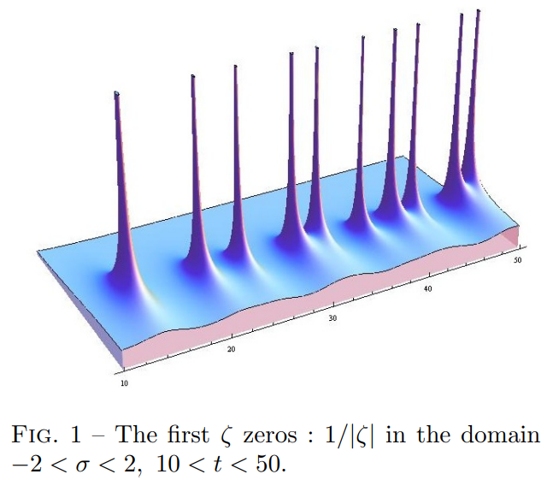
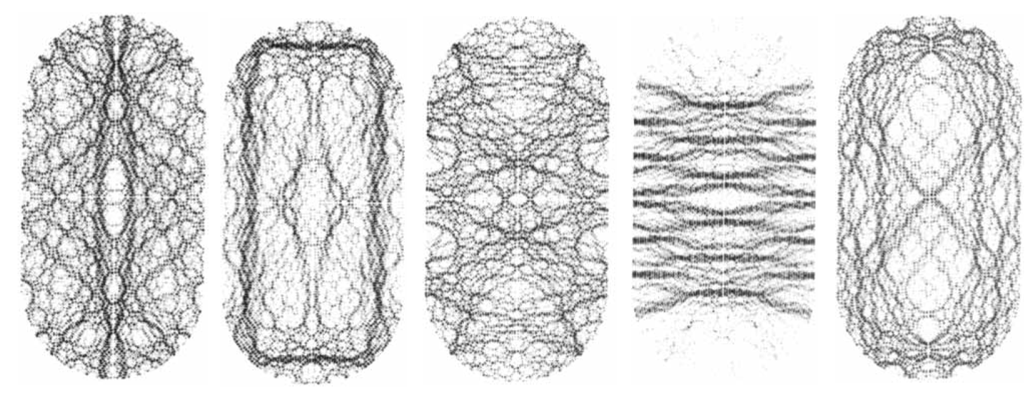
But we shouldn’t be embarrassed: generic CFTs are chaotic.
Chaotic systems are jumpy: high-energy spectra are erratic, with tiny level-spacings.
Spectral statistics of quantum chaotic systems are amazingly well-described by random matrix correlations.
It is too much to ask for exact descriptions!
However, we should ask about existence, universality, and what precisely “CFTs are chaotic” ought to mean.
CFT_{A}
CFT_{B}

Slide 9
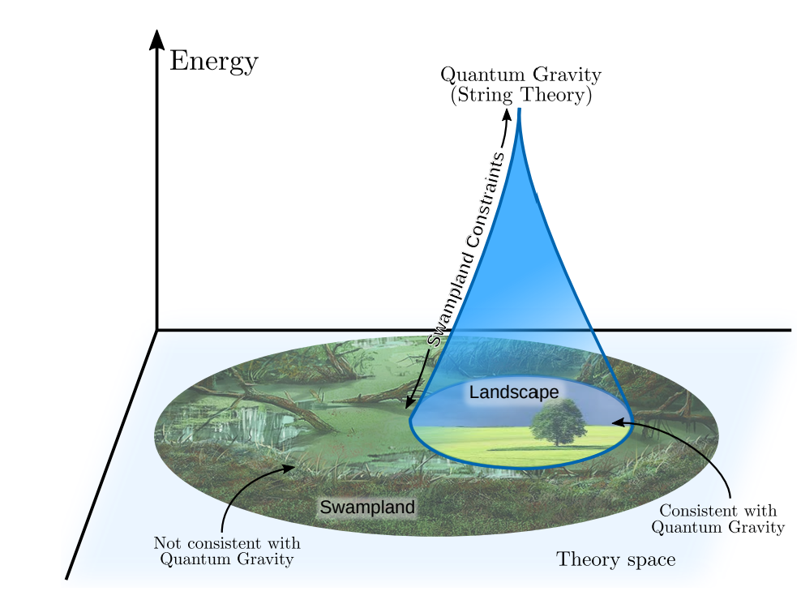
This raises a natural question familiar from effective field theory:
To what extent is the high-energy spectrum fixed by the low-energy spectrum?
UV-IR relations are widespread in quantum field theory and quantum gravity.
In gravity, this is the purview of the Swampland Program.
(e.g. Cardy formula)
(e.g. Bekenstein-Hawking entropy)
[van Beest, Calderon-Infante, Mirfandereski, Valenzuela]

Slide 10
This raises a natural question familiar from effective field theory:
To what extent is the high-energy spectrum fixed by the low-energy spectrum?
UV-IR relations are widespread in quantum field theory and quantum gravity.
In gravity, this is the purview of the Swampland Program.
(e.g. Cardy formula)
(e.g. Bekenstein-Hawking entropy)
[van Beest, Calderon-Infante, Mirfandereski, Valenzuela]

Slide 11
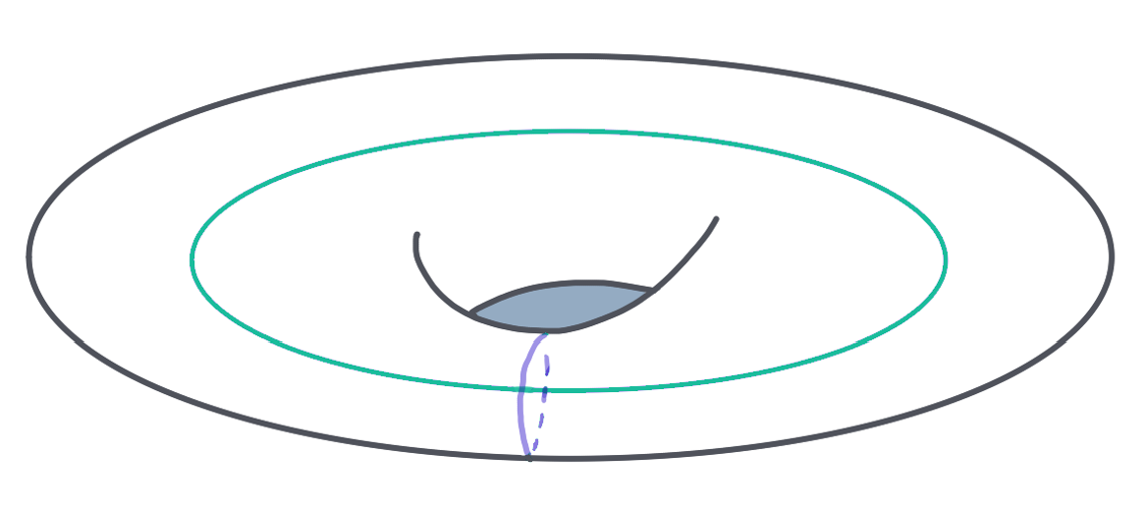
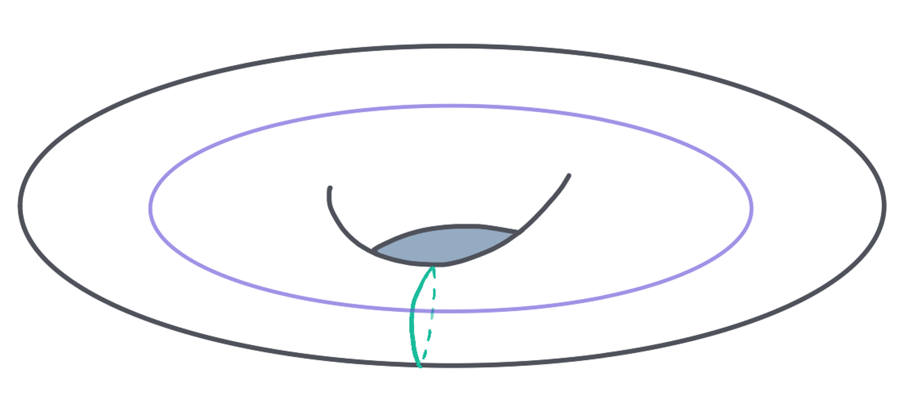
Today: 2d CFTs, and AdS₃ gravity
A consistent CFT₂ exhibits locality and obeys rigid bootstrap and symmetry constraints.
Local conformal symmetry, $SL(2,ℤ)$-covariance of local observables on the torus
Old Q: how does bootstrap constrain the heavy spectrum on average?
New Q: how does bootstrap constrain the heavy spectral correlations?
Cardy
Asymptotic expansions Modular kernels
Chaos
Random matrices

Slide 12
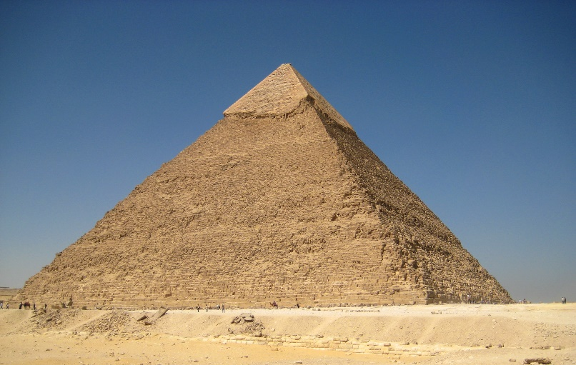
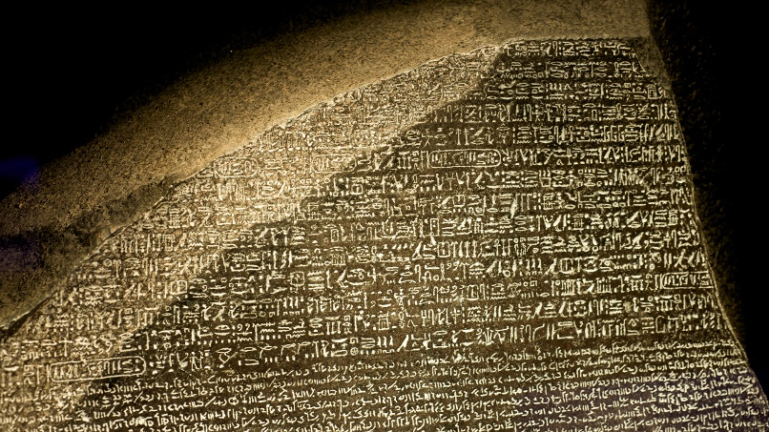
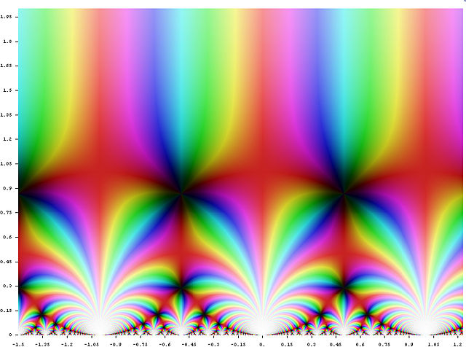
As we will describe in a moment for 2d CFTs, there are different
strata of CFTs which differ in the “complexity” of their characteristic data.
We expect their high-energy spectra to reflect these differences.
But we want a universal language for describing them.
Today we will explore some suggestions coming from number theory.

Slide 13
Outline
1) The Space of 2d CFTs
2) Chaos, Randomness, Modularity
3) Connections to Wormholes in 3d Gravity

Slide 14
The Space of 2d CFTs
Operator dimensions
(~ energies )
A 2d CFT torus partition function may be written as
Known constraints:
Modularity Positivity Discreteness Integrality
Density of states
Characters
(~ sum over Boltzmann factors)

Slide 15
The Space of 2d CFTs
A 2d CFT torus partition function may be written as
Known constraints:
Modularity Positivity Discreteness Integrality

Slide 16
The Space of 2d CFTs
A 2d CFT torus partition function may be written as
Known constraints:
Modularity Positivity Discreteness Integrality

Slide 17
The Space of 2d CFTs
A 2d CFT torus partition function may be written as
Known constraints:
Modularity Positivity Discreteness Integrality

Slide 18
The Space of 2d CFTs
A 2d CFT torus partition function may be written as
Known constraints:
Modularity Positivity Discreteness Integrality

Slide 19
The Space of 2d CFTs
A 2d CFT torus partition function may be written as
Known constraints:
Modularity Positivity Discreteness Integrality
Enforcing Modularity + Positivity = Modular Bootstrap (more later)

Slide 20
The Space of 2d CFTs
A natural way to stratify the space of 2d CFTs: how many “independent” operators (primaries)?

Slide 21
The Space of 2d CFTs
A natural way to stratify the space of 2d CFTs: how many “independent” operators (primaries)?
Modular invariance in turn connects this to number-theoretic properties of the CFT data:

Slide 22
The Space of 2d CFTs
A natural way to stratify the space of 2d CFTs: how many “independent” operators (primaries)?
Modular invariance in turn connects this to number-theoretic properties of the CFT data:
N_{Primaries}
Partition function/Modularity
CFT data/Number theory

Slide 23
The Space of 2d CFTs
A natural way to stratify the space of 2d CFTs: how many “independent” operators (primaries)?
Modular invariance in turn connects this to number-theoretic properties of the CFT data:
N_{Primaries}
Partition function/Modularity
CFT data/Number theory
One
Finite
Infinite

Slide 24
The Space of 2d CFTs
A natural way to stratify the space of 2d CFTs: how many “independent” operators (primaries)?
Modular invariance in turn connects this to number-theoretic properties of the CFT data:
N_{Primaries}
Partition function/Modularity
CFT data/Number theory
One
Chiral CFTs:
Meromorphic modular function
Every operator is a current
Number of
degrees of freedom
Finite
Infinite

Slide 25
The Space of 2d CFTs
A natural way to stratify the space of 2d CFTs: how many “independent” operators (primaries)?
Modular invariance in turn connects this to number-theoretic properties of the CFT data:
N_{Primaries}
Partition function/Modularity
CFT data/Number theory
One
Chiral CFTs:
Meromorphic modular function
Every operator is a current
Finite
Rational CFTs:
Gluing of vector-valued modular functions (vvmf)
c upper-bounded by N_{currents}
Infinite
[Moore, Seiberg]

Slide 26
The Space of 2d CFTs
A natural way to stratify the space of 2d CFTs: how many “independent” operators (primaries)?
Modular invariance in turn connects this to number-theoretic properties of the CFT data:
N_{Primaries}
Partition function/Modularity
CFT data/Number theory
One
Chiral CFTs:
Meromorphic modular function
Every operator is a current
Finite
Rational CFTs:
Gluing of vector-valued modular functions (vvmf)
c upper-bounded by N_{currents}
Infinite
Generic CFTs:
Non-holomorphic modular functions
Unconstrained (…so far!)

Slide 27
To what extent is the high-energy spectrum fixed by the low-energy spectrum?

Slide 28
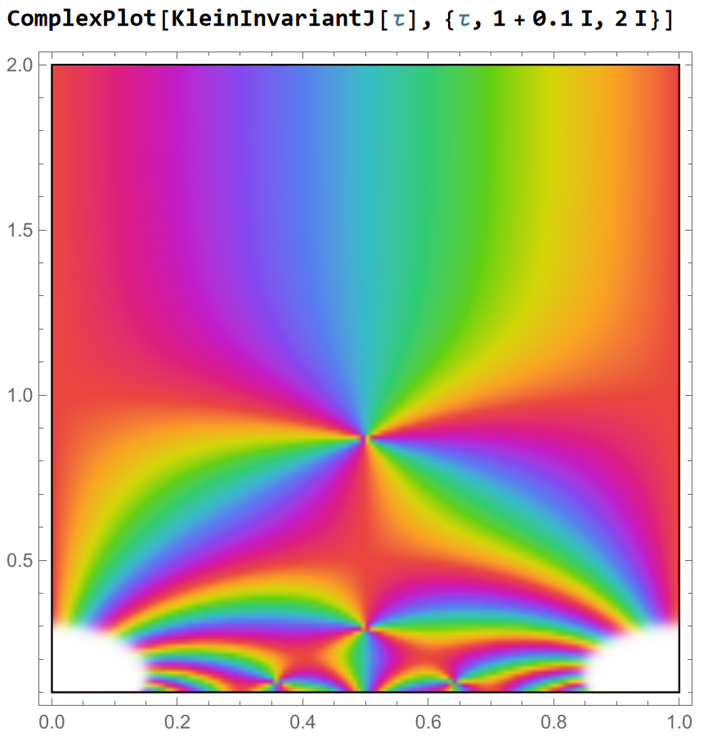
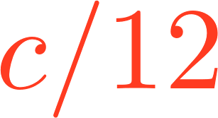
Chiral CFT
In chiral CFTs where $c=24k$ , partition functions are simple:
In this case, meromorphy (cf. Rademacher formula) implies that
the spectrum $h>k$ is fixed by its complement:
We have defined the “twist”
Chiral CFTs obey “twist determinacy”.
KleinInvariantJ[tau] in Mathematica
“Light”
“Heavy”
. . .

Slide 29
Rational CFT
The same turns out to be true of RCFTs.
Take RCFT₁ and RCFT₂ of identical central charge c and current algebra $𝒜$.
If they have identical spectra with $t≤\frac{c}{12},$ then F=0!
In this case, the proof makes use of the integrality of degeneracies – a suggestive step.
Light fixes Heavy (again)
. . .
[Kaidi, EP]

Slide 30
Now we consider what I’ll call generic CFTs:
Only Virasoro symmetry (no extra conserved currents)
A finite number of degrees of freedom (central charge c > 1)
Unitary
Discrete spectrum
We want to probe the high-energy spectrum, which we expect to exhibit some form of quantum chaos.
What does $SL(2,ℤ)$-invariance have in store?

Slide 31
Preliminary note
There is a long history of mining modular invariance.
Most prominent: the Cardy formula for the smoothed high-energy density,

Slide 32
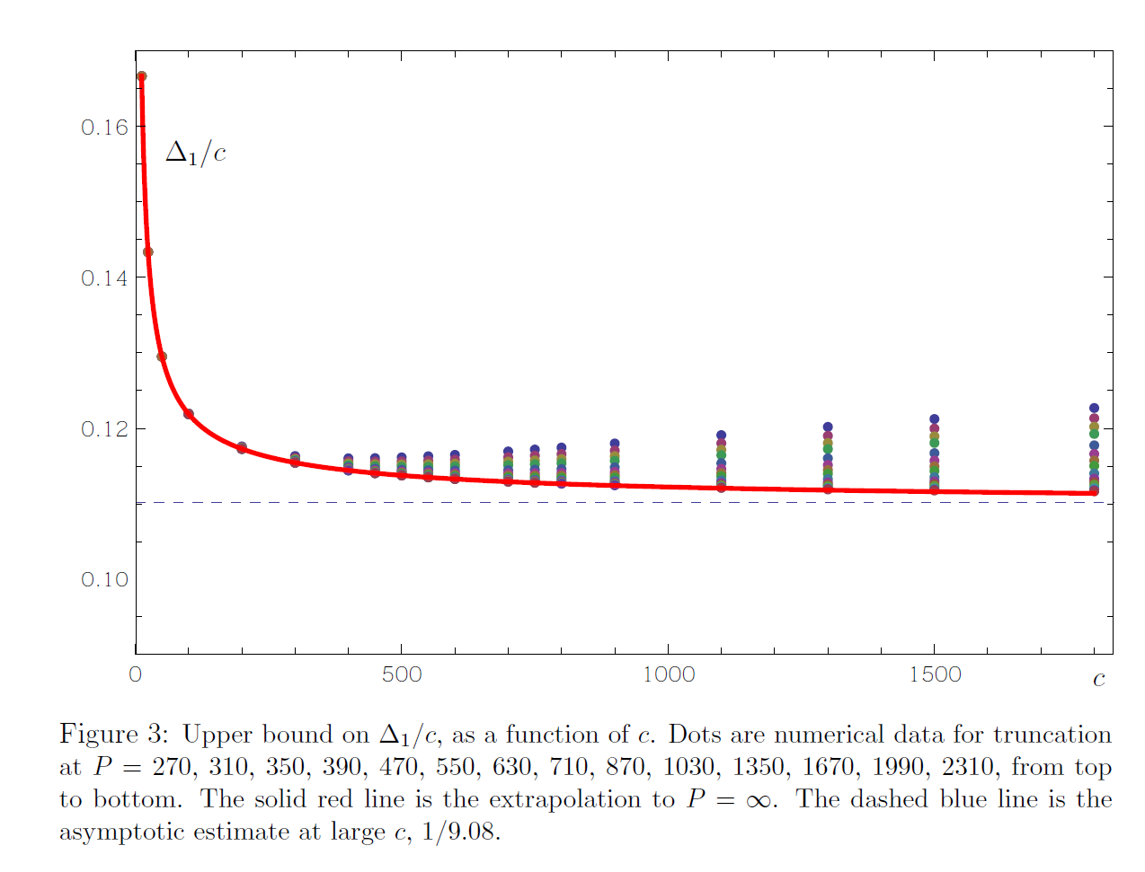
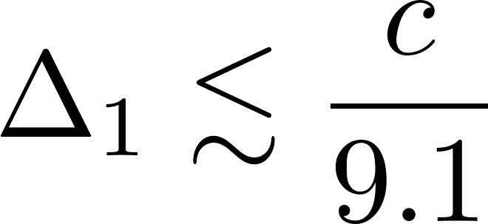
Preliminary note
There is a long history of mining modular invariance.
Most prominent: the Cardy formula for the smoothed high-energy density,
The modular bootstrap enforces modularity and unitarity on
the sum over primary states, using functional methods.
This upper-bounds the lightest non-vacuum operator:
Believed to be sub-optimal (cf. gravity).
[Hellerman; Friedan, Keller; Collier, Lin, Yin; Hartman, Mazac, Rastelli; …]
[Afkhami-Jeddi, Hartman, Tajdini]

Slide 33
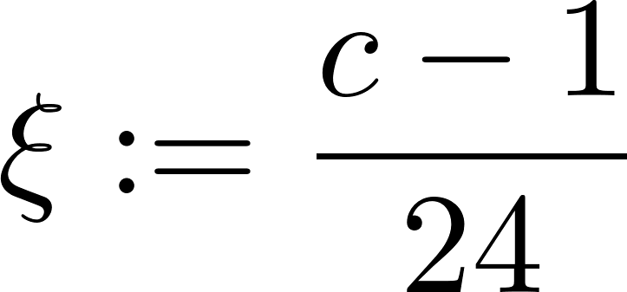
Chaotic Spectrum and $SL(2,ℤ)$
[Benjamin, Collier, Fitzpatrick, Maloney, EP]
The primary partition function of a generic CFT may be split in two:
Definitions:
Both terms are $SL(2,ℤ)$-invariant!
Low-energy + Semiclassical high-energy
“Chaotic” stuff

Slide 34
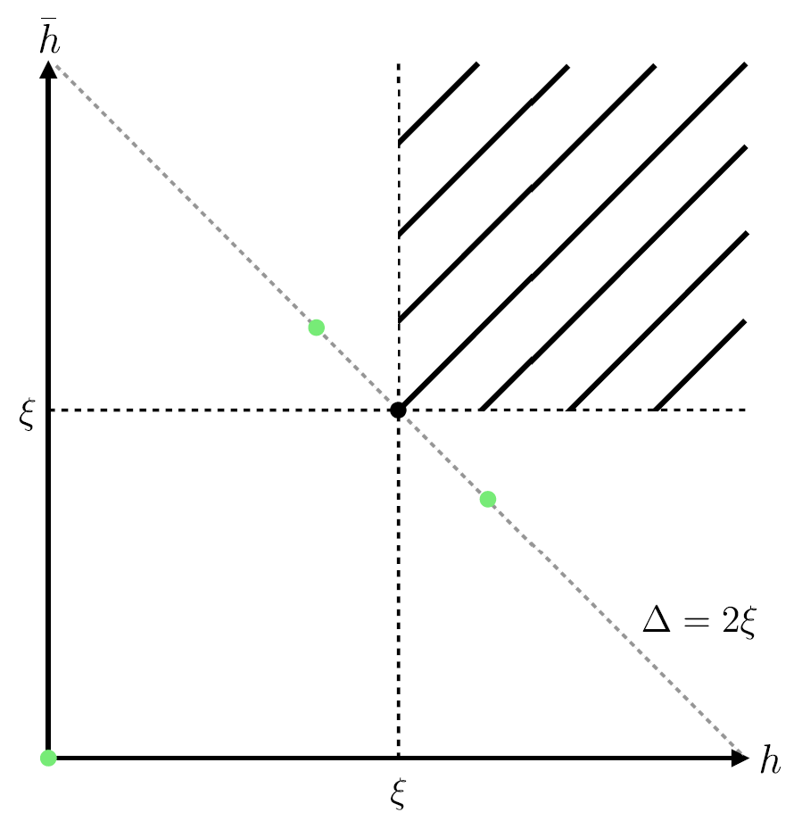
Chaotic Spectrum and $SL(2,ℤ)$
[Benjamin, Collier, Fitzpatrick, Maloney, EP]
The primary partition function of a generic CFT may be split in two:
Definitions:
Both terms are $SL(2,ℤ)$-invariant!
Low-energy + Semiclassical high-energy
“Chaotic” stuff
Support only on $h,\overline{h} ≥ ξ$ states.
The black hole regime in gravity.
Vanishes when averaging over moduli in free boson CFTs.
Vanishes in RCFTs
(Poincare sum)

Slide 35
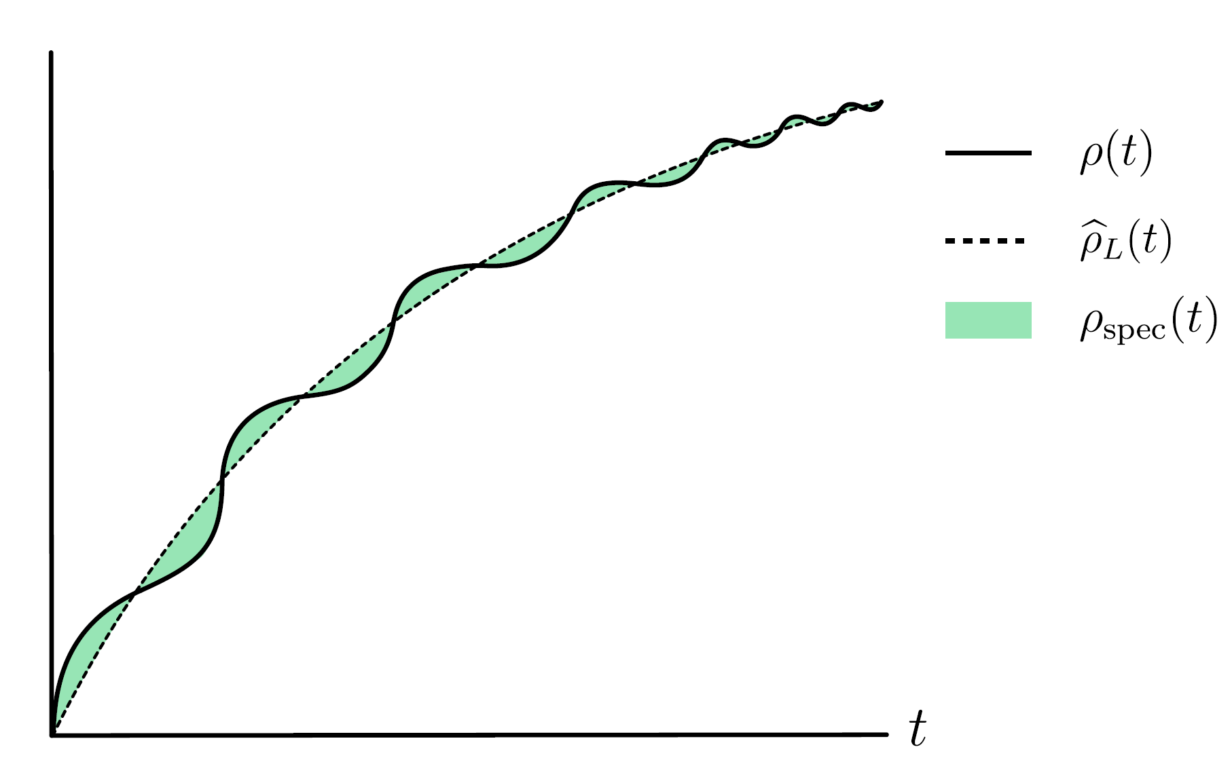
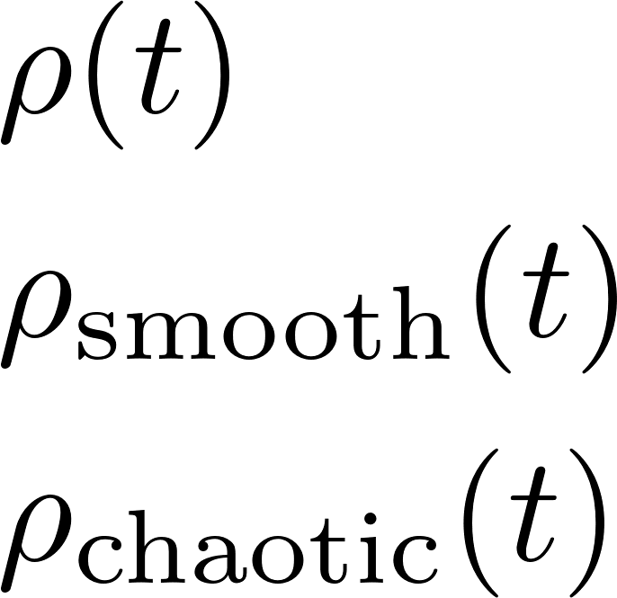
Chaotic Spectrum and $SL(2,ℤ)$
Microcanonically, the density of states splits likewise:
$ρ\left(t\right):$ exact density
(approximated here as smooth curve)
$ρ_{smooth}(t)$: continuous asymptotic
$ρ_{chaotic}\left(t\right)$: oscillates on scales $δt\sim e^{−S_{Cardy}(t)}$

Slide 36
A 2d CFT Trace Formula?
This hints at an analogy with the Gutzwiller trace formula for quantum systems.
Given a spectral density , Gutzwiller expresses the oscillatory term is recast as
a sum over semiclassical periodic orbits:
This presentation helped substantiate an overarching conjecture linking quantum chaos to randomness:
Action
Orbits
“Determinant”
Period
BGS Conjecture:
Energy levels of classically chaotic systems exhibit random matrix statistics.
[Bohigas, Giannoni, Schmit]

Slide 37
A 2d CFT Trace Formula?
This hints at an analogy with the Gutzwiller trace formula for quantum systems.
Given a spectral density , Gutzwiller expresses the oscillatory term is recast as
a sum over semiclassical periodic orbits:
The suggested analogy is
Action
Orbits
“Determinant”
Period

Slide 38
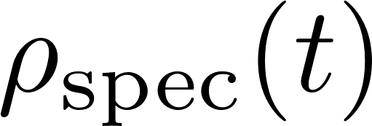
A 2d CFT Trace Formula?
This hints at an analogy with the Gutzwiller trace formula for quantum systems.
Given a spectral density , Gutzwiller expresses the oscillatory term is recast as
a sum over semiclassical periodic orbits:
The suggested analogy is
Action
Orbits
“Determinant”
Period
Remarkably, there is a presentation of which realizes precisely this.

Slide 39
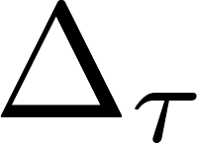
$SL(2,ℤ)$ Spectral Theory
A square-integrable, $SL(2,ℤ)$-invariant function admits a unique decomposition into an $SL(2,ℤ)$-invariant complete eigenbasis of the hyperbolic Laplacian, .

Slide 40
$SL(2,ℤ)$ Spectral Theory
A square-integrable, $SL(2,ℤ)$-invariant function admits a unique decomposition into an $SL(2,ℤ)$-invariant complete eigenbasis of the hyperbolic Laplacian, .
1. Constant: Modular average
2. Continuous: Eisenstein series
3. Discrete: Maass cusp forms
(“critical line”)

Slide 41
$SL(2,ℤ)$ Spectral Theory
by construction, and therefore admits a unique spectral decomposition.
1. Constant: Modular average
2. Continuous: Eisenstein series
3. Discrete: Maass cusp forms
(“critical line”)
[Benjamin, Collier, Fitzpatrick, Maloney, EP; Benjamin, Chang; Paul, EP, Raj; Luo, Wang; Haehl, Reeves, Rozali]

Slide 42
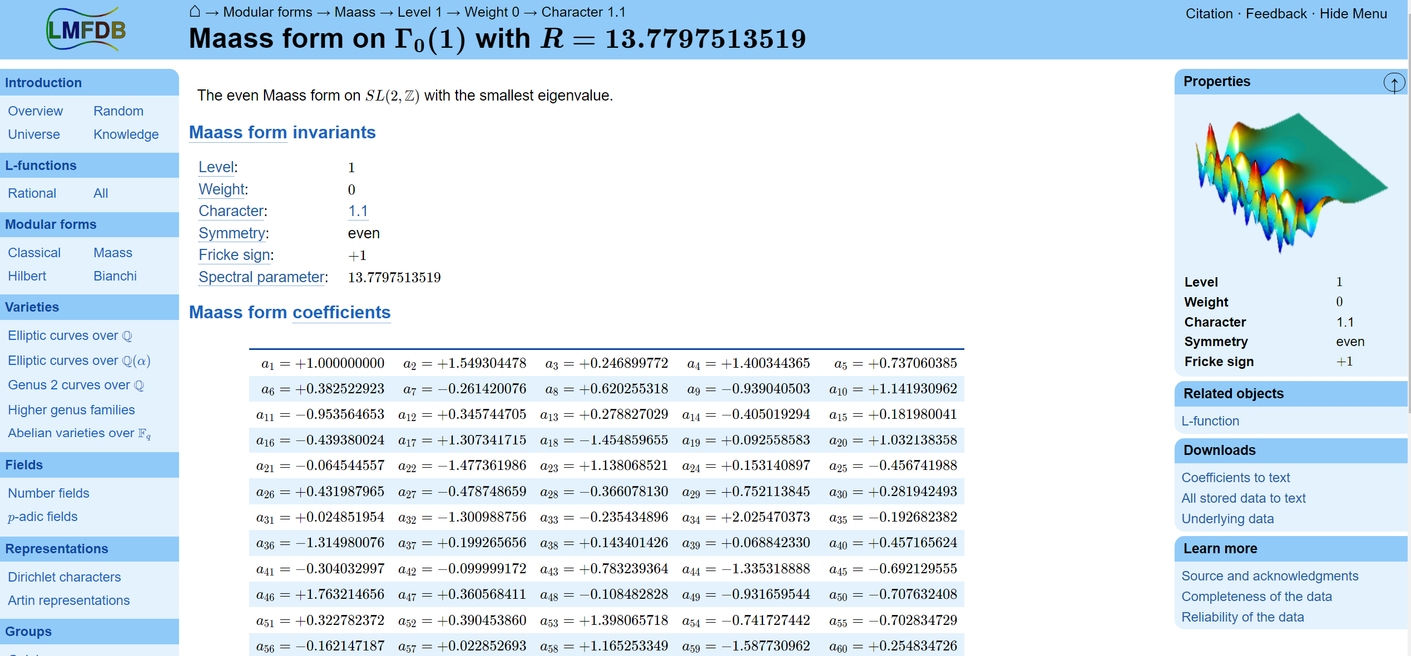

Slide 43
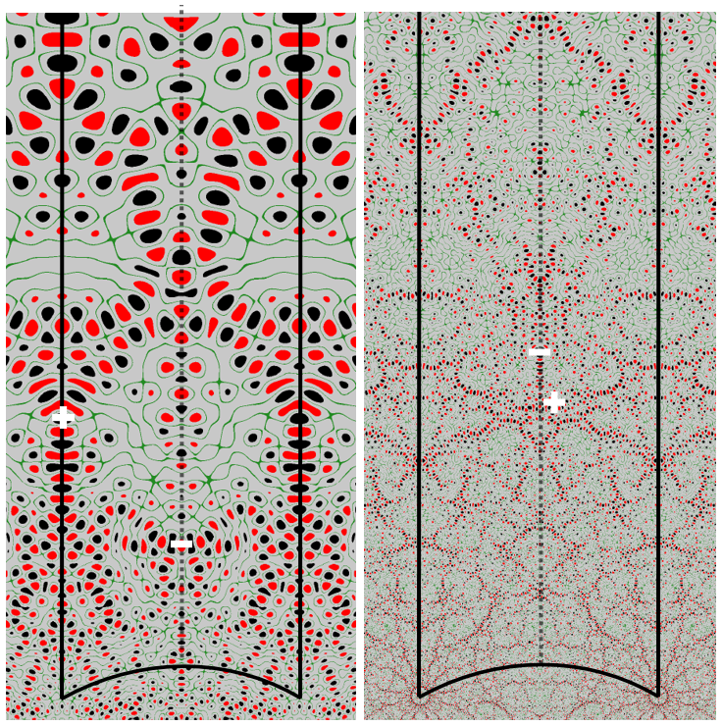
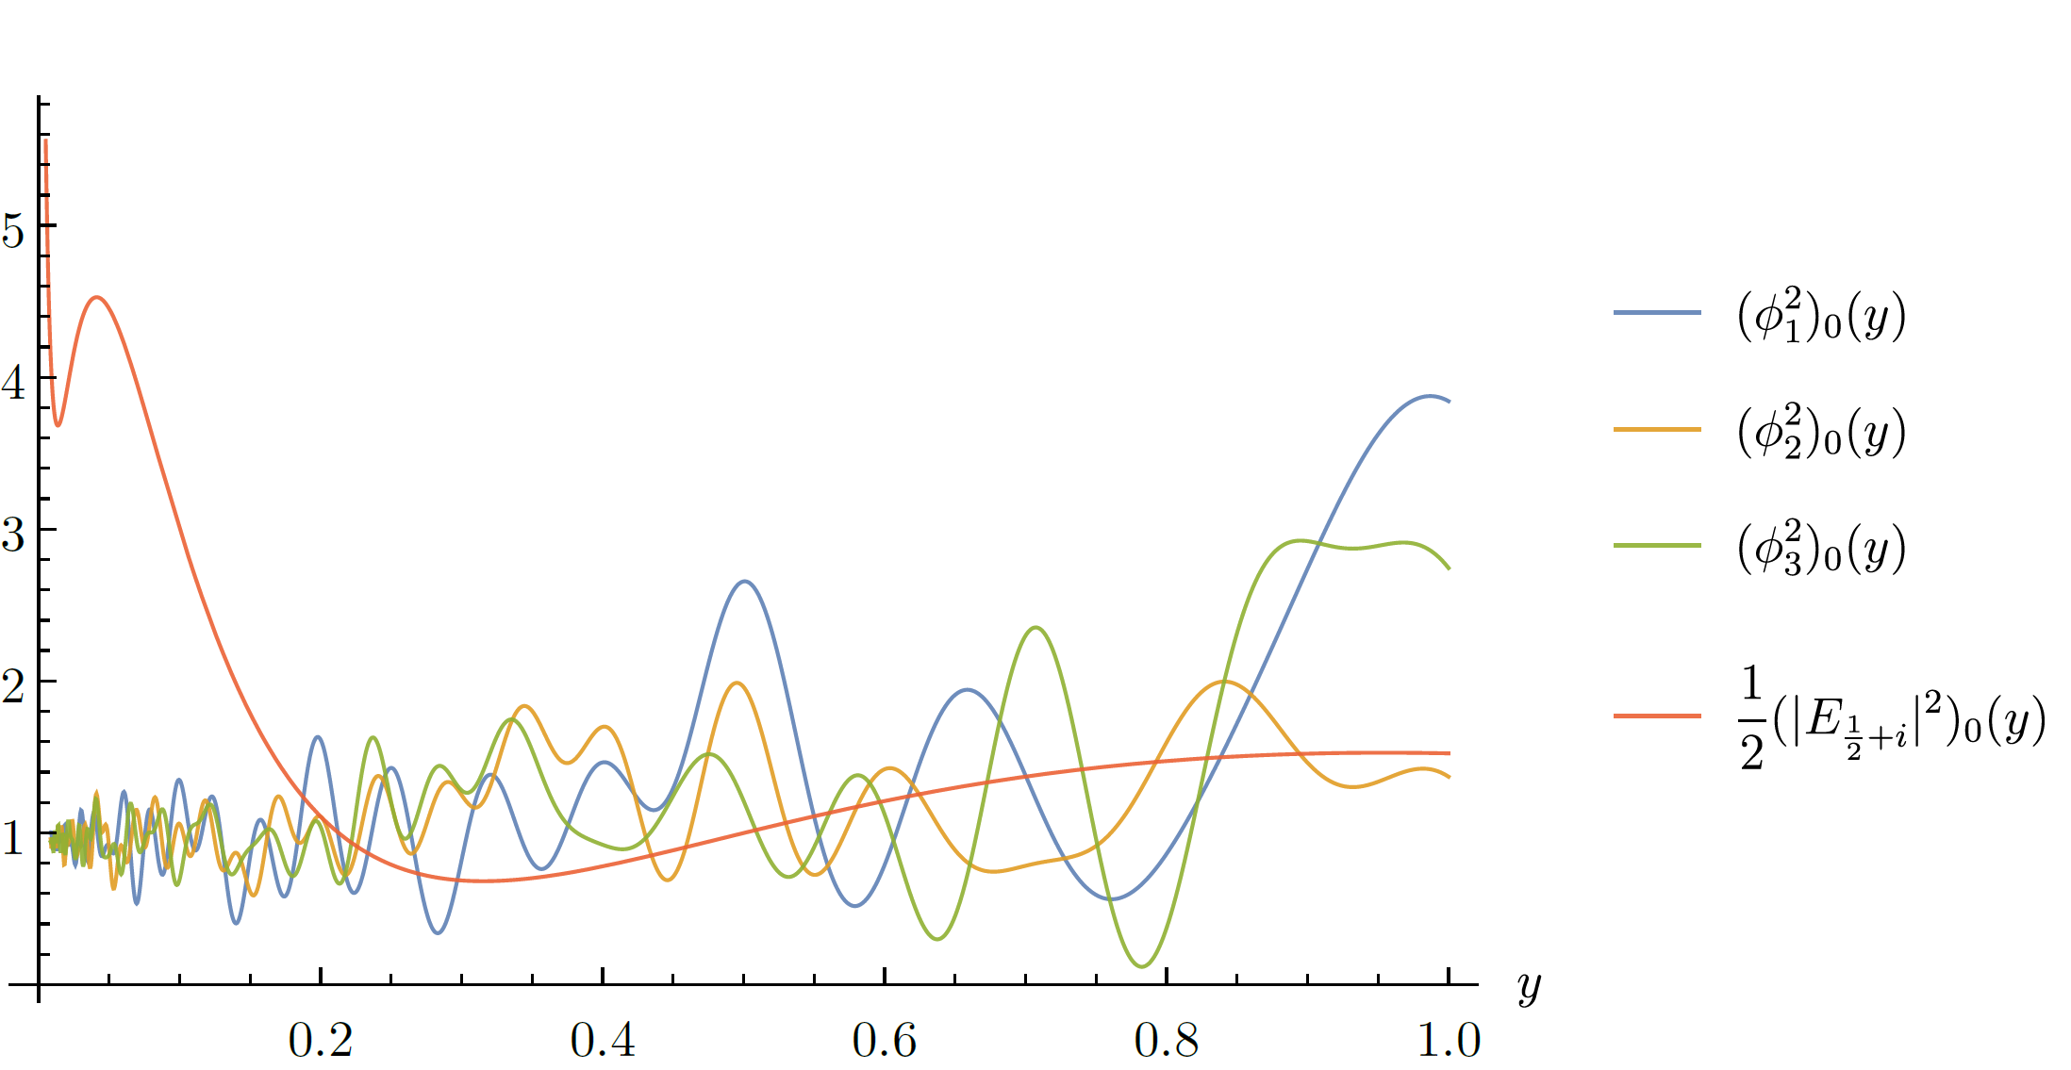
$SL(2,ℤ)$ Spectral Theory
$$ω ≈125.347558$$
$$ω ≈500.283548$$
Maass cusp forms are the subject of modern maths.
Cusp forms are chaotic. (“Arithmetic chaos”)
Leads to sporadic behavior and large n universality.
[Hejhal, Rackner; Then]

Slide 44
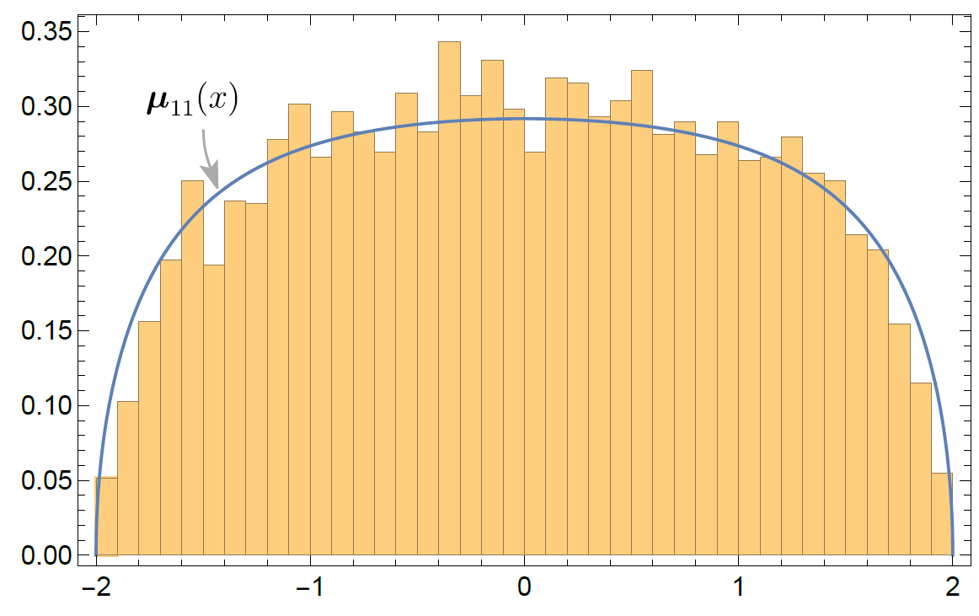
$SL(2,ℤ)$ Spectral Theory
$$ω ≈125.347558$$
$$ω ≈500.283548$$
Maass cusp forms are the subject of modern maths.
Cusp forms are chaotic. (“Arithmetic chaos”)
Leads to sporadic behavior and large n universality.
Random Wave Conjecture
Gaussian Moments Conjecture
Quantum Unique Ergodicity
Ramanujan Conjecture
[Sarnak; Phillips, Sarnak; Lu, Sarnak; Bolte, Steil; Soundararajan; Lindenstrauss; …]
[Haehl, Reeves, Rozali]
[Hejhal, Rackner; Then]

Slide 45
“Nifty detour. What does it have to do with periodic orbits?”

Slide 46
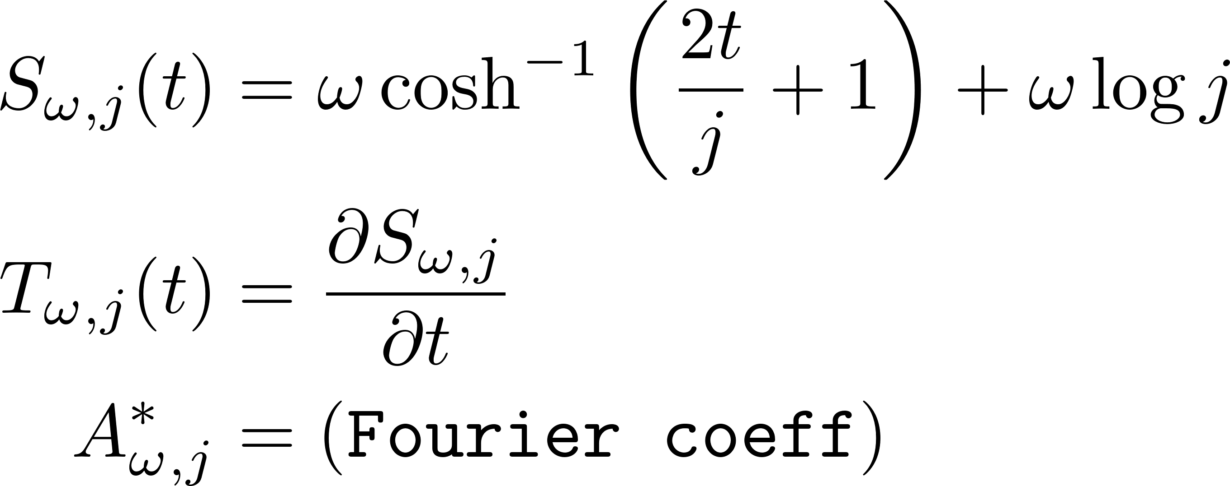
A 2d CFT Trace Formula
The spin-j spectral density likewise decomposes as
That is, they take the form
This furnishes a trace formula for 2d CFTs.
$SL(2,ℤ)$ eigenbasis elements are periodic orbits of 2d CFT.
[Di Ubaldo, EP]

Slide 47
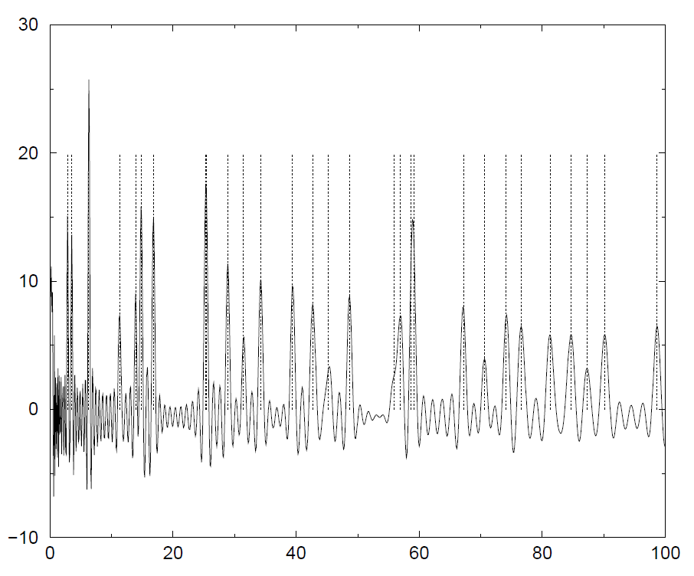
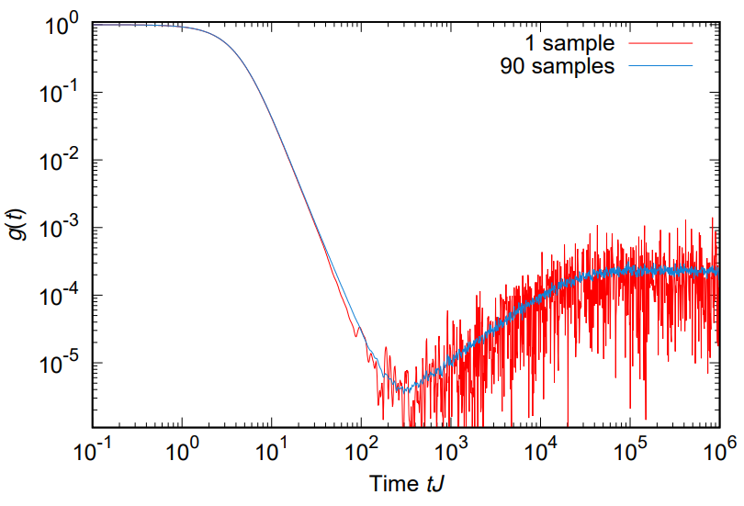
A 2d CFT Trace Formula
[Muller, Heusler, Braun, Haake, Altland]
We can now quantify the chaotic spectral statistics of a CFT.
Random matrix universality = Level repulsion at high energies
This can be approximately derived from a kind of coarse-graining known as Berry’s Diagonal Approximation.
Semiclassical periodic orbit theory establishes the linear late-time growth (“ramp”) of the Spectral Form Factor of chaotic quantum systems
[Cotler et al]

Slide 48
A 2d CFT Trace Formula
[Muller, Heusler, Braun, Haake, Altland]
We can now quantify the chaotic spectral statistics of a CFT.
Random matrix universality = Level repulsion at high energies
This can be approximately derived from a kind of coarse-graining known as Berry’s Diagonal Approximation.
“RMT for CFT”?
Semiclassical periodic orbit theory establishes the linear late-time growth (“ramp”) of the Spectral Form Factor of chaotic quantum systems
[Cotler et al]

Slide 49
A 2d CFT Trace Formula
[Muller, Heusler, Braun, Haake, Altland]
We can now quantify the chaotic spectral statistics of a CFT.
A path to diagnosing random matrix universality in 2d CFTs:
Find CFT analog of Berry’s Diagonal Approximation to spectral form factor,
then extract a condition for the linear ramp.
“RMT for CFT”?
Semiclassical periodic orbit theory establishes the linear late-time growth (“ramp”) of the Spectral Form Factor of chaotic quantum systems
[Cotler et al]

Slide 50
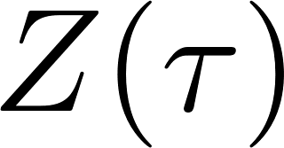
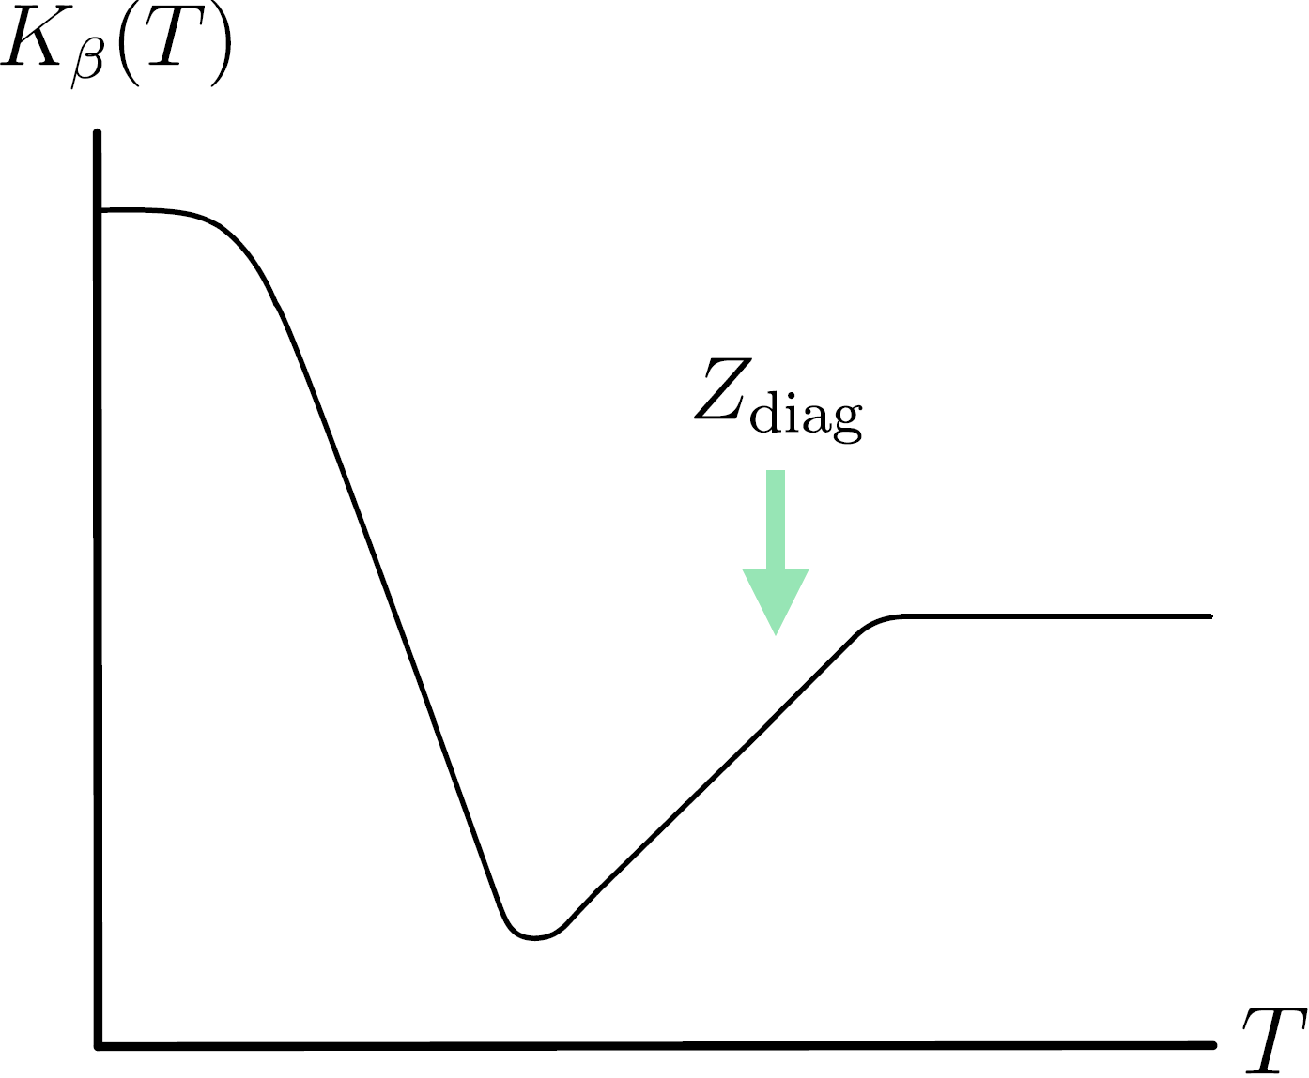
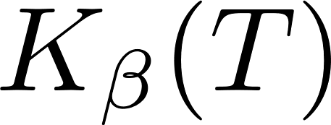
How to find the random matrices in a 2d CFT
Isolate chaotic spectrum, preserve SL(2,ℤ)
Diagonalize two-point correlation
SFF kinematics
Random matrix universality in 2d CFT
[Di Ubaldo, EP]

Slide 51
Summary so far:
Observables in rational CFT, with a finite number of “independent” operators, are built from a simple class of SL(2,ℤ)-invariant functions – whose properties imply a rationality of the CFT data, and an absence of chaos/randomness.

Slide 52
Summary so far:
Observables in rational CFT, with a finite number of “independent” operators, are built from a simple class of SL(2,ℤ)-invariant functions – whose properties imply a rationality of the CFT data, and an absence of chaos/randomness.
Observables in generic CFTs, with an infinite number of “independent” operators, are built from a wider, wilder class of SL(2,ℤ)-invariant functions – whose properties allow for seemingly arbitrary number-theoretic properties of the CFT data, and chaos/randomness.
The surprise is that this chaos becomes manifest in a certain SL(2,ℤ) eigenbasis.

Slide 53
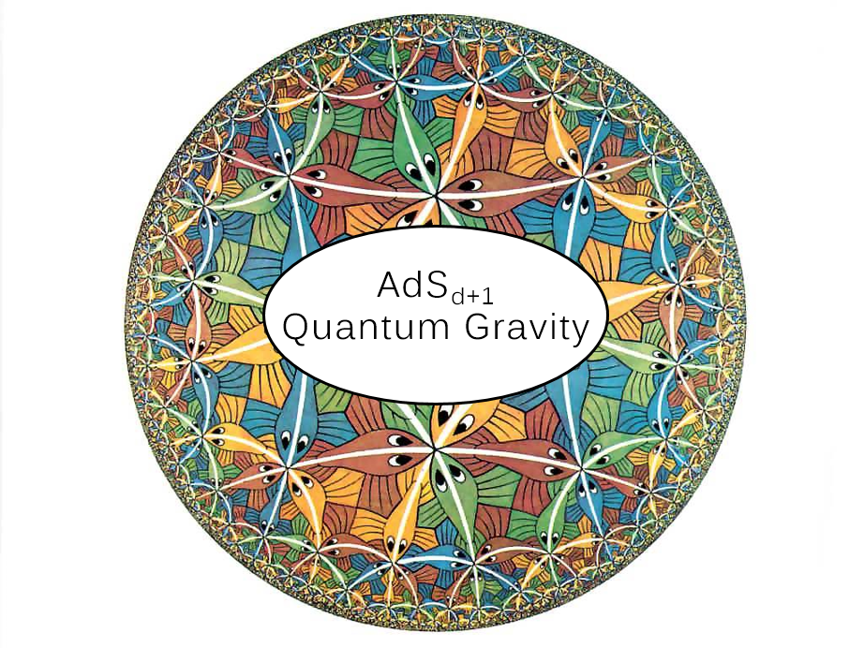
Now we turn to gravity.
The AdS/CFT Correspondence posits an exact equivalence between CFTs and theories of quantum gravity in hyperbolic space (AdS).
High-E CFT states $⟷$Black hole microstates
More subtly (still in development!),
CFT spectral correlations $⟷$ Spacetime wormholes
We can learn some lessons from low dimensions.
CFT_{d}

Slide 54
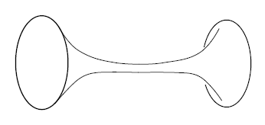
[Saad, Shenker, Stanford; …]
JT Gravity = Random Matrix Ensemble
A scalar-gravity theory in two spacetime dimensions
Double-scaled matrix integral with simple density of states
Impressive all-orders holographic matching of single-boundary
and multi-boundary
partition functions.
What is the AdS₃/CFT₂ avatar of this correspondence? Where are the random matrices there?
Topological expansion of matrix integral

Slide 55
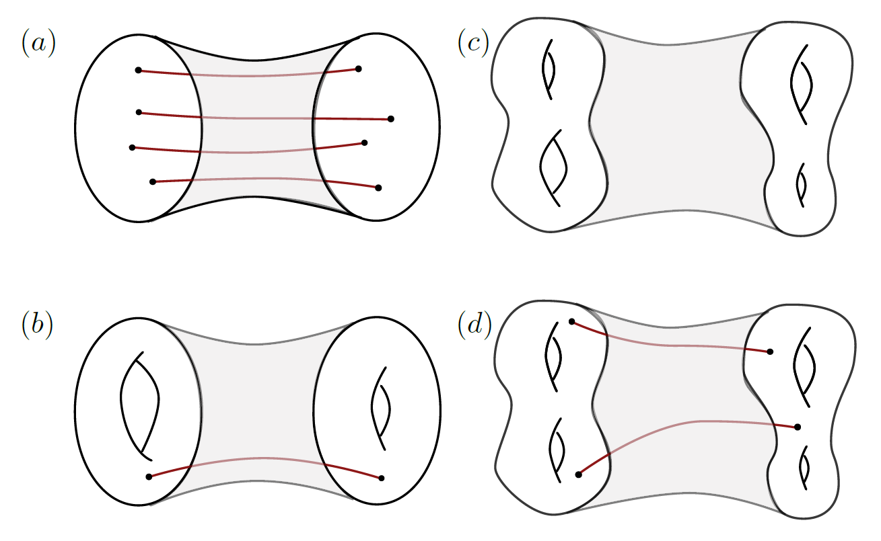
JT Gravity = Random Matrix Ensemble
Recent work in AdS₃ studies wormhole saddles of arbitrary (!) fixed topology:
Z_{saddle} = moment of a “large c ensemble” of CFT data
(Equivalent to a certain topological theory – “Virasoro TQFT” – for hyperbolic 3-manifold observables.)
This ensemble captures universality of asymptotic CFT data, but not randomness/fine structure of
black hole spectrum.
[Belin, de Boer; Chandra, Collier, Hartman, Maloney; Chandra; Yan; Chandra; Collier, Eberhardt, Zhang; Belin, de Boer, Jafferis, Nayak, Sonner; Abajian, Aprile, Myers, Vieira; de Boer, Liska, Post]

Slide 56
JT Gravity = Random Matrix Ensemble
In any CFT_{d} , random matrix dynamics should govern high-E spectrum.
How do we unitarize the naïve semiclassical black hole spectrum?
How are random matrices encoded in the spectral correlations near extremality?
Presumably any understanding of black hole microstates needs to answer this.
$$↔$$
[Maxfield, Turiaci]

Slide 57
An outstanding problem in AdS₃/CFT₂: find the simplest theory of gravity, dual to the sparsest possible CFT.
Call this the AdS₃ Pure Gravity Problem:
Find a consistent semiclassical AdS₃ pure gravity partition function with a single torus boundary.
The MWK density is highly (exponentially) non-unitary.
Is there a solution without adding non-gravitational degrees of freedom (e.g. matter)?
[Maloney, Witten; Keller, Maloney]
Sum over smooth saddles w/ $∂ℳ= T^{2}$ (thermal AdS₃ + BTZ BHs)
?
[Benjamin, Ooguri, Shao, Wang]
[Benjamin, Collier, Maloney; Di Ubaldo, EP; Mertens, Simon, Wong]
[Hellerman; Friedan, Keller; Collier, Lin, Yin; Afkhami-Jeddi, Hartman, Tajdini; Hartman, Mazac, Rastelli]
[Maxfield, Turiaci]

Slide 58
There are several recent threads in 3d gravity – a fascinating subject lately!
Virasoro TQFT
Random matrix tensor model
Max ignorance principle/ensemble
…
[Collier, Eberhardt, Zhang; Belin, de Boer, Jafferis, Nayak, Sonner; de Boer, Liska, Post; Pelliconi, Sonner, Verlinde; …]
[Sonner, IPPP ATM 2023]

Slide 59
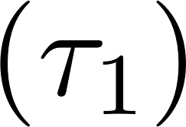
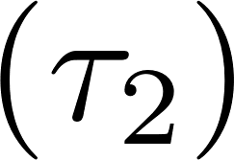
With this motivation, Cotler & Jensen computed the two-boundary torus wormhole of AdS₃ pure gravity.
The computation was non-standard: not a saddle point of the bulk path integral.
Indicates spectral level repulsion $⟶$ “Random CFT”
Microcanonically, something like
$$𝒵$$
$$𝒵$$
what is $𝒵$?
what does this mean??

Slide 60
RMT Wormholes in AdS₃
Well, we have seen that the SL(2,ℤ) spectral basis diagonalizes correlations,
And JT/RMT taught us that spacetime wormholes should geometrize the diagonal approximation.
So: let’s a) compute the amplitude Z_{WH} in spectral space, and b) interpret it microscopically
[Saad, Shenker, Stanford; Penington, Stanford, Shenker, Yang]
“Wormhole Farey Tail”

Slide 61
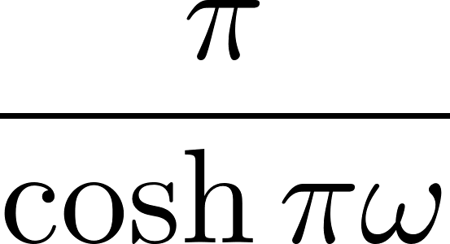
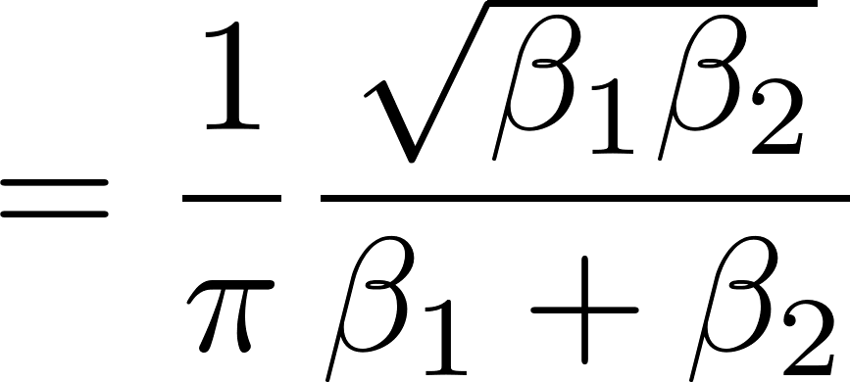
RMT Wormholes in AdS₃
Here is the pure gravity wormhole amplitude in $SL(2,ℤ)$spectral space:
After accounting for 2d CFT symmetries, the remaining function is equal to the double-scaled RMT result:
Exactly the ramp!
(not just asymptotically)
[Di Ubaldo, EP]

Slide 62
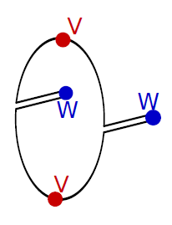
RMT Wormholes in AdS₃
One might call the extremal statistics of AdS₃ pure gravity
Black hole microstate spectrum is “as random as possible”.
Pure gravity is maximally chaotic at both early and late times.
MaxRMT: the maximal realization of random matrix universality consistent with Virasoro symmetry and modular invariance.

Slide 63
CLOSING FORECAST
(NEW YEAR’S RESOLUTION)
Number-theoretic methods will become more central in our understanding of 2d CFTs and 3d gravity.

